Slide 1

Key To The Quality Highway: Course Mapping
7th Annual QM National Conference
San Antonio, TX
November, 2015

Slide 2

A BIG MIL GRACIAS to our survey respondents!

Slide 3

AGENDA
Course Mapping Overview
Survey Sez
Sharing examples
Discussion

Slide 4
How it all began!
“Course mapping is a bunch of busy work! I don’t want to have to work that hard. It’s not something I’m going to use anyway.” (Colleague)
“The faculty, largely retired business people and unseasoned young graduate-school products, struggle with the concept a bit; some actively resent it as busy work.” (Survey participant)

Slide 5
Let’s Talk!
Please raise your hand if you took the Course Mapping Survey!

Slide 6
“You will need to define what course-mapping is…” (Survey participant)
A course map is a visual representation of how the course components are designed to support learners in meeting the intended outcomes.
Re/Design Tool
Variety of formats (table, chart, matrix, concept map, etc.)
Used with variety of course design models

Slide 7
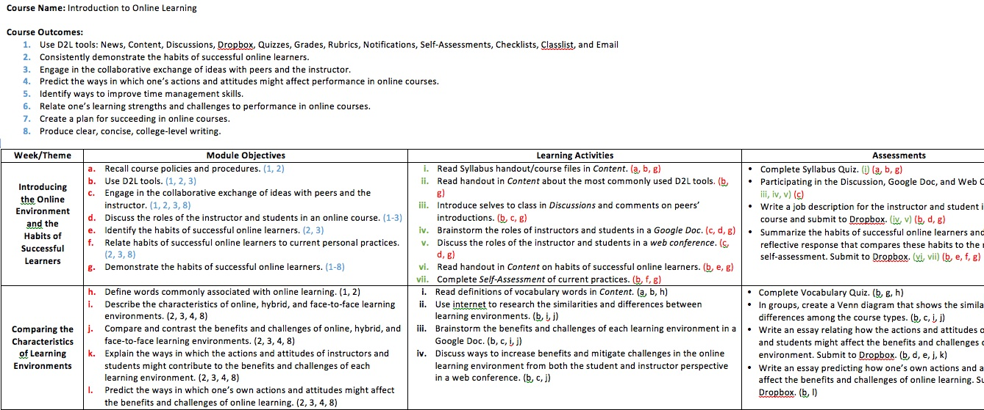
Course Map Example
Thank you Darcy Turner for sharing!
All submissions are available at:
http://PROVIDEDROPBOXLINK

Slide 8
Let’s Talk!
With your elbow partner, discuss the following question:
Why bother with course mapping?
Let’s share!

Slide 9

Why Bother?
Onboarding tool for faculty
See big picture
Help ensure alignment
Increase consistency across course
More efficient
Roadmap for students
Pre-review tool
Accreditation

Slide 10

If for no other reason!
“I believe that course mapping
motivates the students to persevere and succeed.” (Survey participant)

Slide 11
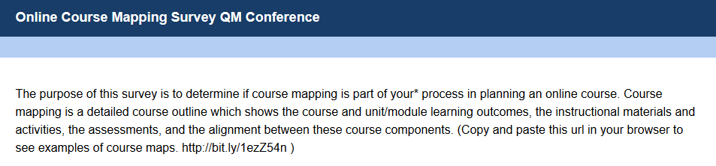
Course Mapping Survey Overview
  113 responses
  July 27 – Sept. 28
  3 multiple choice items, 2 open-ended response items
  1 share course map item
  Results can be found in the Course Map Dropbox

Slide 12
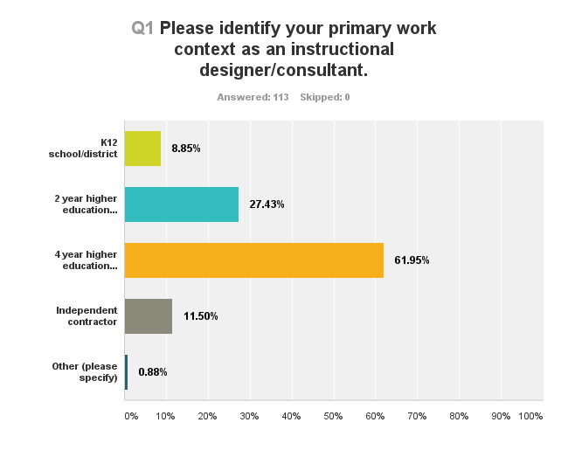
Survey Overview
10
31
70
13
1

Slide 13
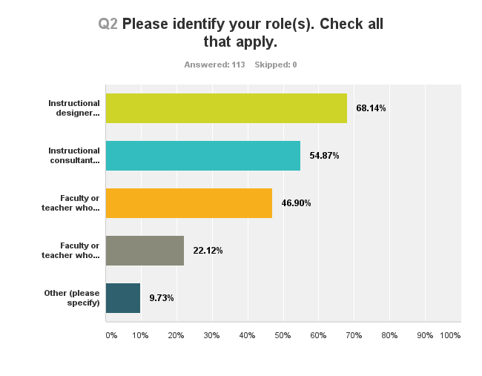
77
62
53
25
11
(Other = administrators (VP, Director, etc.), tech support, course reviewer, GA)

Slide 14
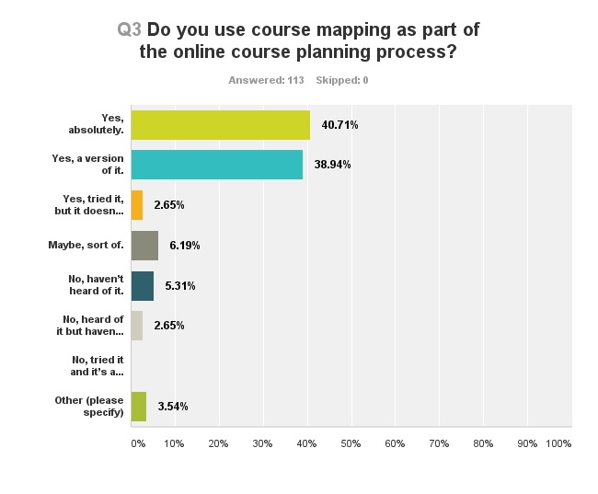
46
44
3
7
6
3
0
3

Slide 15
Q3 Other
I provide students a mind map for each chapter.
I try to get faculty to use the course mapping, but they often view it as an unnecessary step. I, however map all the courses I teach.
I do not use it do design the course but I do use it once I have the course set up to help guide students through the course.
Partially, course and module learning objectives are defined, assessment is based on objectives.

Slide 16
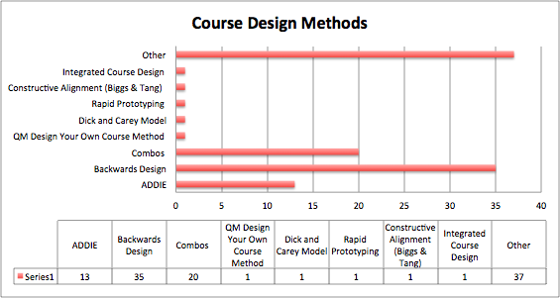
Q4. Please provide a short explanation of what you do to “plan” or “prepare” for online course development before starting to create the course. If appropriate list the major instructional design models you use (i.e., ADDIE, Backwards Design, Instructional Design Model for Online Learning, Rapid prototyping, etc.)

Slide 17
Q4. Combos
Backwards Design and ADDIE
Backwards Design and Rapid Prototyping
ADDIE, Backwards Design, and QM Design Your Own Course Method
Backwards Design and Instructional Design for Online Learning (IDOL)
ADDIE, Backwards Design, and IDOL
Mix or variety of design models

Slide 18
Themes Q4
Start with learning outcomes/objectives at some level
Alignment, Alignment, Alignment
Learning objectives to assessments
QM Standards as part of the course development process (13)
Variation process based - who developing, what audience, what developing

Slide 19

Q5. Resources Q5 If you would like to share your course map or course map template with us, please do! You can upload to the shared folder on DropBox.
Darcy Turner
Robbie Morse
Heather Brown
Robin O’Callaghan
Lisa Kidder
Louise Ochoa
Raj Mohan
Sam Bachert
Sherri Lancton
Miley Grandjean
ML
Sonja Strahl
Steven Crawford

Slide 20
Q6. If you have additional feedback to share, please do so! We would love to hear your comments on course mapping for online course development.
“In the contemporary environment, course mapping is not yet required, but the basic framework will likely be required soon for reporting that accompanies accreditation. We already see this at the program level with program maps that require all courses and course learning objectives to match these larger objectives. We are already required to build tables that link all of our program level material to the larger college and institution level metrics. At the department level we expect that mapping from institution level objectives down to the specific units in the course will be required within in the next 3 - 5 years as part of our annual assessment reports for accreditation.” (Survey participant)

Slide 21
Q6. If you have additional feedback to share, please do so! We would love to hear your comments on course mapping for online course development.
“This has been a very successful tool for course development and has helped our faculty plan and build their online courses to meet QM standards.” (Survey participant)
“I believe a course map helps faculty to see the structure of the course as well as begin to tie in course and module objectives to the course content.” (Survey participant)

Slide 22
That’s so K-12!
“I believe it to be a useful tool in cultures that understand, accept, and adhere to structured learning process as the norm, a goal to strive for.” (Survey participant)
“I try to get faculty to utilize course mapping, but they often view it as an unnecessary step. I, however, map all of the courses I teach.” (Survey participant)

Slide 23
Let’s Talk!
With your elbow partner, discuss the following question:
What do you say to those that oppose course mapping?
Let’s share!

Slide 24
Our Faculty Evaluation Feedback
“Completing the Course Map is 90% of designing a course. Once that’s done, the rest of designing the course falls into place much less stressfully. ”
“The course map provided a great bottom-up approach helping me streamline assignments.”
“It is so essential! Once I got the hang of it, I found that it actually made course design much more efficient.”

Slide 25

Additional Questions
Do you have suggestions on how to encourage college, program, and course alignment of objectives?
Do you have any examples of using the Outcomes tool in the Instructure Canvas LMS?

Slide 26

Sharing Course Maps
Let’s see what’s in the Dropbox!
http://bit.ly/1KCdmvZ
or use the code on your card.

Slide 27
Resources
Getting Results - http://bit.ly/1KkOPp2 - A Professional Development Course for Community College Educators - focuses on planning for learning outcomes
A Self Directed Guide to Designing Courses for Significant Learning http://bit.ly/1kMy8sL
Searching for Open Materials http://bit.ly/1jxFDsg
Typhon -http://www.typhongroup.com/ computer tracking system for Nursing and Health education programs
Worldwide Instructional Design System - WIDS takes care of 50% of the alignment issues within the QM rubric for us.
Map of Course and Module Learning Objectives http://bit.ly/1KkPPcJ
Georgiana Laws Instructional Design Portfolio http://bit.ly/1OP4Slc
ADDIE Videos jclarkgardner http://bit.ly/1NkOmYH

Slide 28

YOU’VE BEEN A GREAT AUDIENCE!
Thank you for attending!

