Slide 1
Leveraging Instructional Design Teams
To Expand the Institutional Value of Quality Matters
Kathi Fjelstul, Instructional Designer
Linda Grant, Instructional Design Supervisor
Capella University
Quality Matters Conference, October 2013

Slide 2
1
Objectives
Strategies for Integrating QM throughout
a centralized course development process
Leveraging the skills and experience
of non-teaching Instructional Designers
Tools for supporting this integration
Using QM principles to inform innovation

Slide 3




Who We Are
1,543
Faculty Members
Capella Faculty Members live in 48 states
and 7 foreign countries or territories
100+
Centrally located
Curriculum and Course Development Staff
1670 +
Number of Courses

Slide 4

2
Course Development Model
115
Rotating Faculty SMEs per year
25+
Centrally located Instructional Designers
360
New and/or Revised Courses per year

Slide 5
4
Expectation
Integrate Quality Matters into
Course Design & Development

Slide 6

5
Groundwork
Presentations & Workshops
Training (QM Course)

Slide 7
6
We Already Do This!
Media
Competency Alignment
Studies
Media
Competency Alignment
5
Studies
1
6
Grading
Grading
Objectives
Assessments
3
2
Objectives
3
Assessments
Scoring Guides
Course Materials
3
Scoring Guides
Cost of Materials
4
Course Materials
Discussions
Workload
5
Discussions
ADA
Introductions
8
ADA
1
Introductions
1
2
3
4
5
6
7
8
Overall
Design
Learning
Objectives
Assessment
Instructional
Methods
Instructional
Activities
Navigational
& Technology
Support
Accessibility

Slide 8
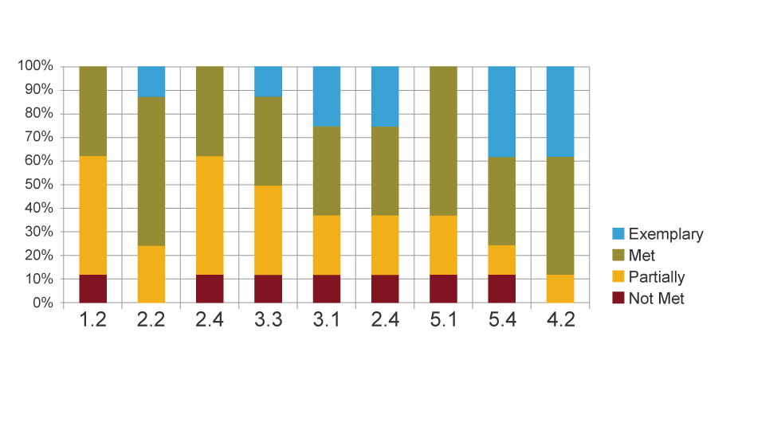
7
Testing Our Assumptions

Slide 9

8
Contextual Framework

Slide 10

9
Design Checklist
Course Design Notes
The Quality Matters rubric has 40 standards. Many of these standards are built into our courses. There are 15 standards that the CD and SME should work together to ensure are met. Please use the following adaptation of the rubric to ensure that the 15 standards are met. For standard 3.5 please identify where this can be found in the course. For all other standards, please indicate “Yes” or “No” as appropriate.
Standard
Pts
1
2.2
The module/unit learning objectives describe outcomes that are measurable and
consistent with the course-level objectives.
3
Yes or No
2
2.3
3
Yes or No
All learning objectives are stated clearly and written from the student’s perspective.
3
2.4
Instructions to students on how to meet the learning objectives are adequate
stated clearly.
3
Yes or No
4
2.5
3
The learning objectives are appropriately designed for the level of the course.
Yes or No
5
The types of assessments selected measure the stated learning objectives and
are consistent with course activities and resources.
3.1
3
Yes or No

Slide 11
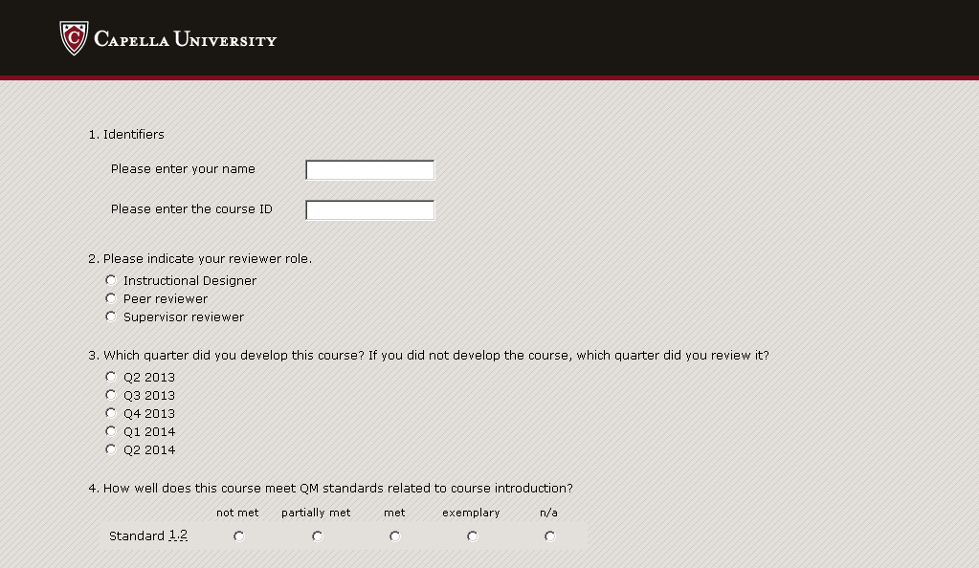
11
Course Quality Survey Tool

Slide 12
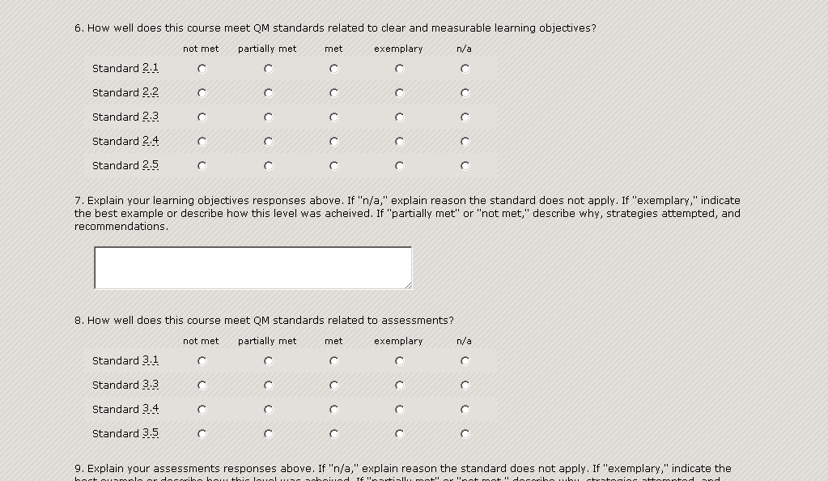
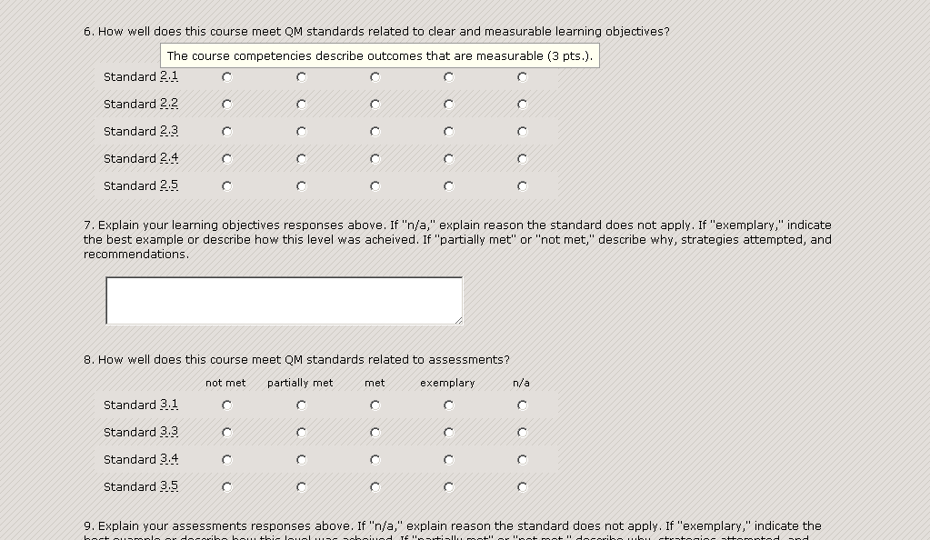
13
Documenting Adherence to Standards

Slide 13
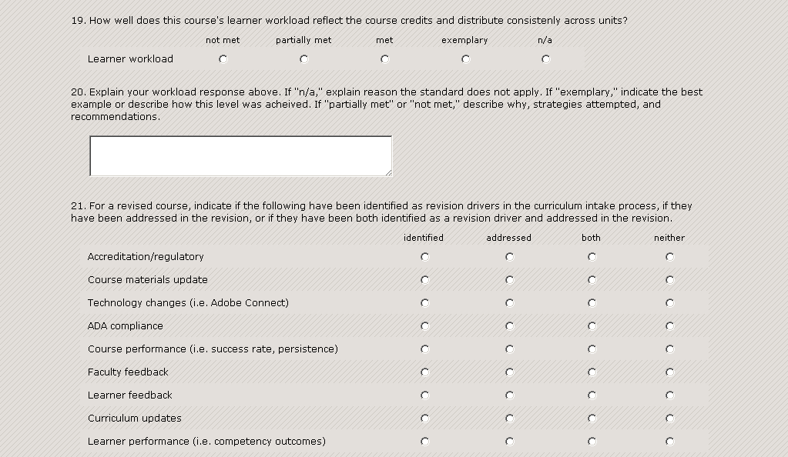
14
Extending the QM Rubric

Slide 14
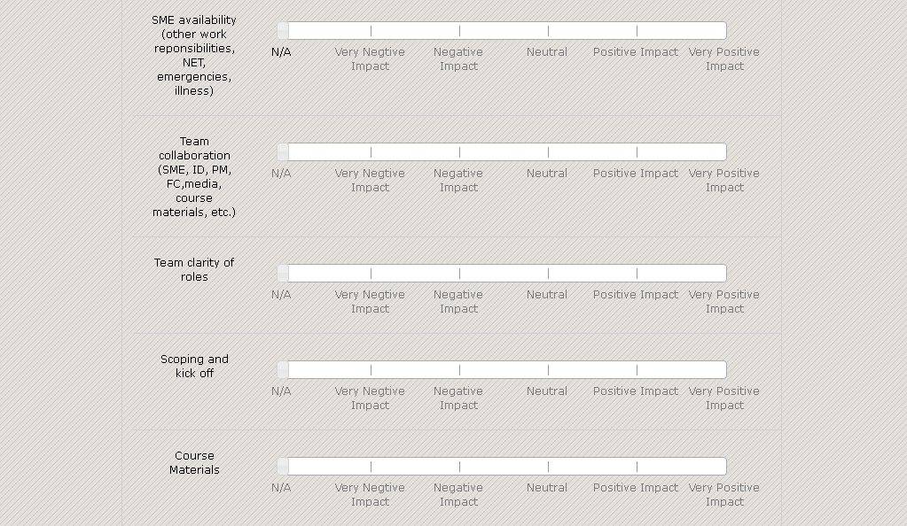
15
Mitigating Factors

Slide 15
16
Triangulating Data
ID – QM Reviewers (informal and formal)
ID – ID (peer reviews)
ID – supervisor (work product feedback)
supervisor – supervisor (organizational consistency)

Slide 16
16
Course Quality Survey Advantages
Reinforces a common language
(for consistent performance).
Keeping QM at the forefront
Integrating QM with Capella Standards
Collecting Data about quality
(to drive continuous improvement)

Slide 17
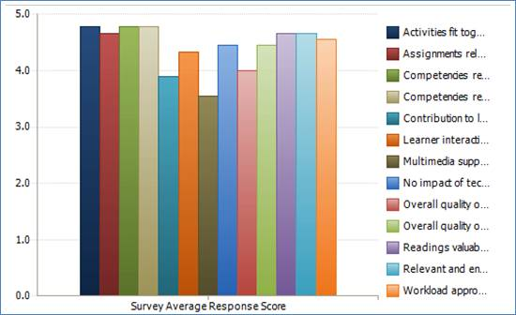
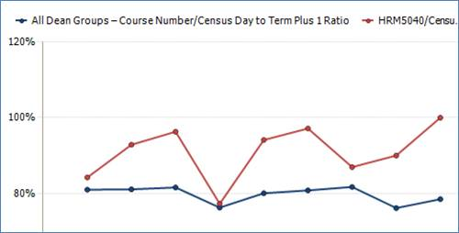
17
Data: Interpreting Feedback
Interpreting feedback from other organizational data sources.

Slide 18



Data:
Informing Innovation
Products and Processes:
    Direct Assessment
    Competency Mapping
    Process Efficiencies
18
Data: Informing Innovation
Products and Processes
Direct Assessment
Competency Mapping
Process Efficiencies

Slide 19

Data:
Informing Innovation
19
18
Data: Continuous Improvement
Training based on the Course Quality Survey

Slide 20
1
Summary
Integrated QM throughout a centralized course development process
Leveraged the skills and experience
of non-teaching Instructional Designers
Created Tools for supporting this integration
Using QM principles & data to inform innovation

Slide 21
Thank You

