Slide 1
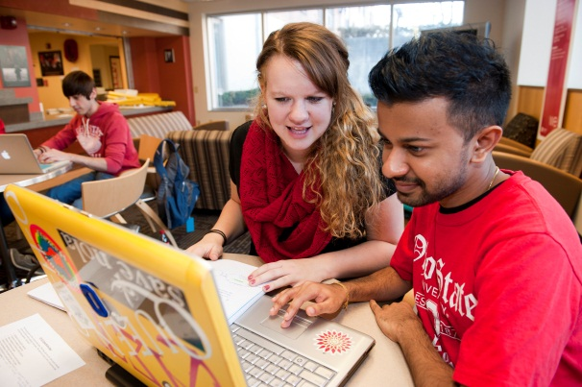

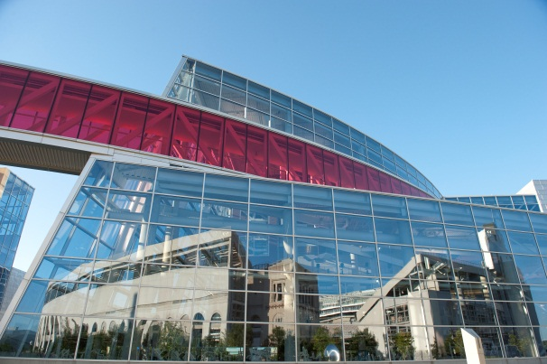

The Ohio State University
College of Education and Human Ecology
Liberty, Learning, and
Living Documents
Sarah Bear-Eberhardt, Ed.D.(c), M.A., M.Ed.
EdTech
Instructional Designer

Slide 2
Permissions
Materials discussed and shared in this presentation are copyrighted by Quality Matters or The Ohio State University (OSU). All rights are reserved.
QM11 was adapted with permission from Quality Matters for use by The Ohio State University. The faculty and staff of OSU developed, modified, and aligned the College of Education and Human Ecology’s Curriculum Committee’s 11 parts of a syllabus and hold the rights to this work.

Slide 3
Overview
3 Learning Objectives
Identify ways in which EHE EdTech’s infusion of QM into PD can be replicated
Decide if EHE EdTech’s approach is appropriate for your institution/college
Adapt EHE EdTech’s approach as necessary
“Liberty without Learning is always in peril and Learning without Liberty is always in vain.”
― John F. Kennedy

Slide 4
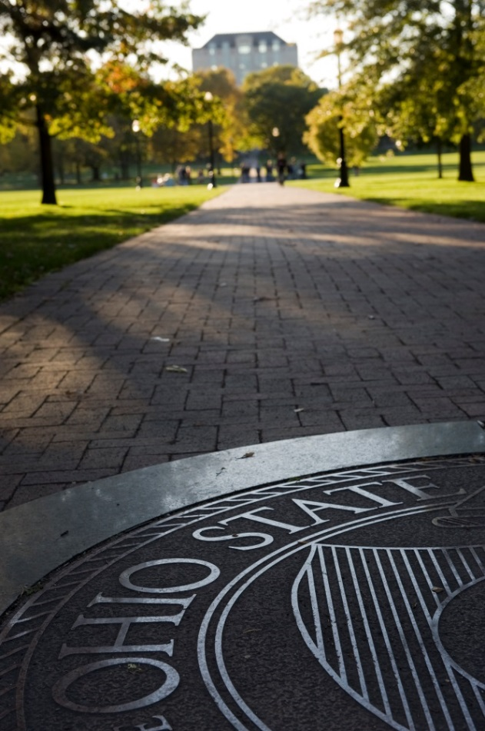
QM @ OSU
The Ohio State University is a subscriber to Quality Matters (QM), a peer-review process designed to ensure quality design and continuous improvement of online and hybrid courses. https://odee.osu.edu/odee-grants/quality-matters-grants
Quality Matters (QM) is an inter-institutional organization that sets baseline research-supported standards to ensure quality design for online and hybrid courses. The QM Rubric is supported on national standards and best practices, research literature, and instructional design principles. http://odee.osu.edu/quality-matters
Quality Matters is a strategic metric and indicator to:
Ensure Ohio State develops a consistent, high quality online education presence that meets or exceeds the current accepted academic rigor and standards.
From the Strategic Planning at The Ohio State University https://odee.osu.edu/sites/default/files/odee-strategicplan.pdf

Slide 5
Background
The 2013-2014 EHE Course Revision Seminar (CRS) professional development
  Assists faculty with moving course from f2f to online
  Started as 7 week, hybrid pd
  Originally focused to teaching faculty the ADDIE process
The 2014-2015 EHE CRS
  6 month revision process
  Focuses on QM Standards
  Initially assumed APPQMR would be part of the CRS
  Realized we needed to answer this question:
    What did we feel the faculty should do to demonstrate their learning?
Notes:
The Ohio State University (OSU) Education and Human Ecology (EHE) EdTech has provided professional development to the faculty of EHE for many, many years. One particular pd session that has been provided for much of this time is called the Course Revision Seminar (CRS). This training provided faculty with the skill set to take a course that had been offered in a face-to-face environment and revise it with a hybrid or online environment in mind. The CRS had always been offered as a hybrid training. In its most recent iteration, it was offered over a 7 week period with a mix of one day per week sessions either in person or on CarmenConnect (AdobeConnect). Over the course of the 7 weeks, the participants were introduced to the ADDIE process, spending the majority of their time on this instructional design approach. Some of what they were asked to consider in their design included QM, Chico, and Illinois quality standards. The quality standards were addressed in the 7th and final module when Evaluation and Implementation were addressed.
The EdTech Instructional Designers took 6 months to not only redesign but to also restructure the CRS, and what resulted was radically different than the CRSs of the past. Since OSU has taken a clearer stance on the implementation of QM centrally, it became apparent that the design needed to focus more on QM. EHE EdTech hired me, a designer whose experience and expertise in QM was extensive, and one of my first tasks was work on the redesign of the CRS. The first change that I made was to shift the focus of the 2014-2015 CRS to Quality Matters rather than on ADDIE. (It should be noted that ADDIE is a process we still use in EHE EdTech to assist faculty with course redesigns, but felt the focus on what the faculty were learning needed to be more about the QM principles.)
Initially, it was proposed that the APPQMR be promoted extensively amongst the faculty and that the CRS serve as a supplemental professional development to address some of the course development aspects that QM does not address as it focuses on design. At that time, the team members brainstormed the various modules that we felt would be needed for the faculty to feel supported and successful. As a result, the modules that were created are the following: Syllabus, Communication, and Assessment. However, the question really became the following: what did we feel the faculty should do to demonstrate their learning? It was determined that the faculty should be able to develop an introductory module/start here module that encompasses the principles advocated in the CRS and QM. Then the faculty would be able to take those skills and apply them to the design of the rest of the course.

Slide 6
Development and Design of the CRS
Faculty resistance to APPQMR
Incorporated the New Mexico State QM 12 Steps
Brainstormed best paths to readiness for online course design
Settled on the most logical starting place: The Syllabus
Notes:
The faculty have been very clear about their resistance to completing the APPQMR in a 2-week online period or in an all-day face-to-face session due to time constraints, so our challenge was to incorporate QM in more creative, less time-consuming ways. Ultimately the feedback prompted us to move the CRS from a hybrid format to an entirely online, self-paced mostly asynchronous training hosted in the institution’s LMS. In this timeframe, I had attended the QM National Conference where I attended the session led by NM State on their 12 Steps. After becoming intrigued by their presentation, I brought the documents and knowledge back to my team members where we have also adapted the documents to meet our needs as they have a Creative Commons licensing on them. This is one way in which we are assisting our faculty with becoming knowledgeable in QM. We are still encouraging them to complete the APPQMR training with the hopes that the QM 12 Step (sounds like a dance) gives them a foundation to move through APPQMR with a strong understanding of QM and in hopes that their time commitment is alleviated a little bit more.
As we brainstormed and talked through the paths to readiness for course design, we arrived at the notion that the syllabus is the foundation of any course design. Thus, born was the first module of the CRS: the Syllabus module. Upon the development of the syllabus module, it became apparent that the faculty would be well served to have an assessment that asked them to revise an existing or create a new syllabus.

Slide 7
Development of the QM11
QM11 document was born from two documents: The Quality Matters Higher Education Rubric, Fifth Edition, 2014 and the College of EHE 11-Parts of the Syllabus
Began by highlighting the Specific Review Standards in QM Rubric that could be found in a syllabus in an effort to revise the EHE 11-Parts document
Many elements were missing from the 11-Parts document that needed to be present if the Curriculum Committee was going to support QM
  Netiquette
  Communication Policies
  Prerequisites
  Late Work
  Technology Requirements and Skills
Notes:
As the components of the syllabus module continued to be developed, I asked myself what would be the most beneficial to assist them to create the most QM compliant syllabus. I started by going through the public version of the QM Rubric and identifying the specific standards that could be found in a syllabus. After highlighting each specific standard that I felt was applicable to the syllabus, I conferred with my colleagues who provided their feedback. Upon the development of this document, it was also decided that we would incorporate a document the EHE Curriculum committee had created in 2005 called the 11 Parts of a Syllabus.
The 11 Parts had some of the typical bits of information like course info, learning objectives, schedule, and major institutional policies (academic integrity and disability services, for example). However, it was missing many aspects that would be necessary for online or hybrid learning environments, such as netiquette. I thoroughly revised this document with QM standards in mind as well. Both documents were taken to the EHE Curriculum Committee for approval, and were enthusiastically approved. This not only improved the relationship between the curriculum committee and the EdTech department, it led to other opportunities for the team to work with faculty on their syllabi.

Slide 8
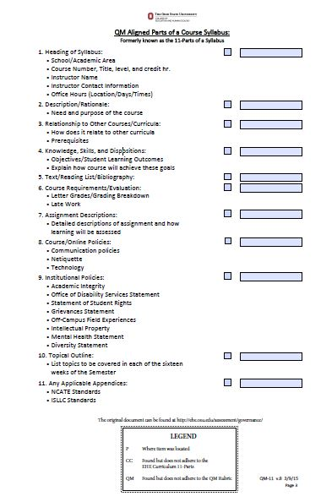
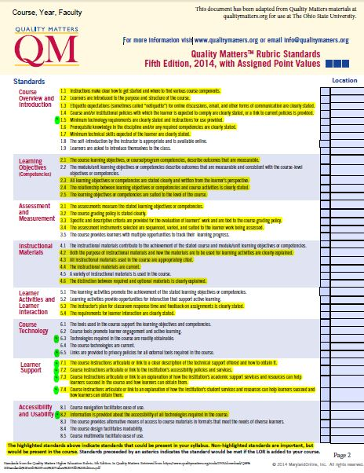
The QM11
Notes:
After reviewing these two documents, it became clear that they needed to be joined as one document and converted into a checklist. The checklist causes the document to be a living document of sorts, and it has been named the QM-11. The checklist came about because we wanted to use it as a quick method to sit with a faculty member and look solely at their syllabus and provide them with a tool to use to make adjustments. The faculty members have the opportunity to enroll in the CRS and the QM 12 Step to obtain more information and knowledge on each aspect. This syllabus checklist was incorporated into the CRS and was supplemented with research reports and publications to assist the faculty in their understanding of the various components. We will continue to gain feedback from the faculty on their experiences with the QM-11 living document, and we will continue to report what we find and make the necessary adjustments as time goes on. The current plan is to make major revisions every time the QM Rubric updates.

Slide 9
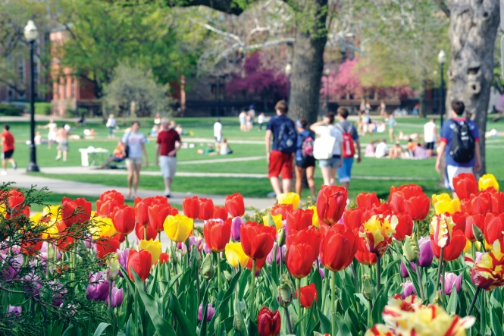
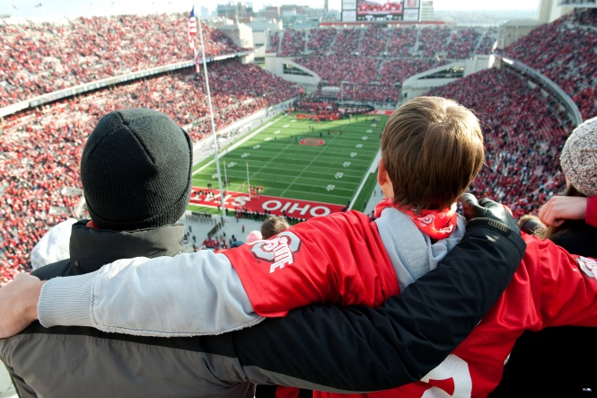
LOR
Learning Object Repository
In D2L, can be developed and added to any course as a module.
EHE EdTech LOR assists faculty in meeting QM standards
  Student/ Academic Resources
  Technology Tools
    Accessibility of Technologies
    Privacy Policies
  Resources for Faculty
  Institutional Policies
Notes:
Revisions to the original QM-11
LOR Added to QM11

Slide 10
Recommendations for Adapting for Your Institution
Find out what documents your Curriculum Committees have for the faculty
Partner with someone on the committee
Identify which parts of the rubric your Curriculum Committee will expect in the syllabi that come across for their approval
Create custom checklists for faculty use
Allow it to be a living document

Slide 11

Sarah Bear-Eberhardt, Ed.D. (c), M.A., M.Ed.
Instructional Designer
The Ohio State University, College of Education and Human Ecology, EdTech
245B Ramseyer Hall, 29 W. Woodruff Ave., Columbus, OH 43210
614-688-1249 Office
bear-eberhardt.1@osu.edu

