Slide 1
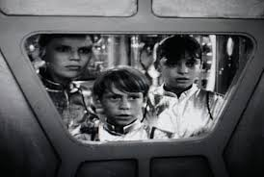
Lost in Space
Not If They Are Engaged
Dr. Cynthia M. Chovich
Colorado Mesa University
Associate Professor
April 25, 2014

Slide 2
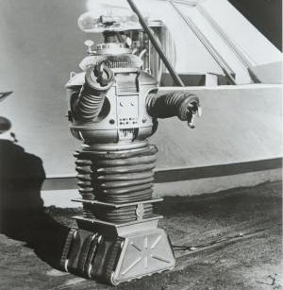
Warning! Warning!
Discussions:
Instructor posts a prompt
Students respond to the prompt
Students respond to peers’ postings
    Typical?
    Engaging?

Slide 3
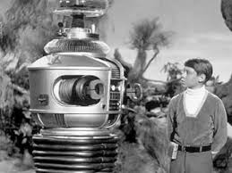
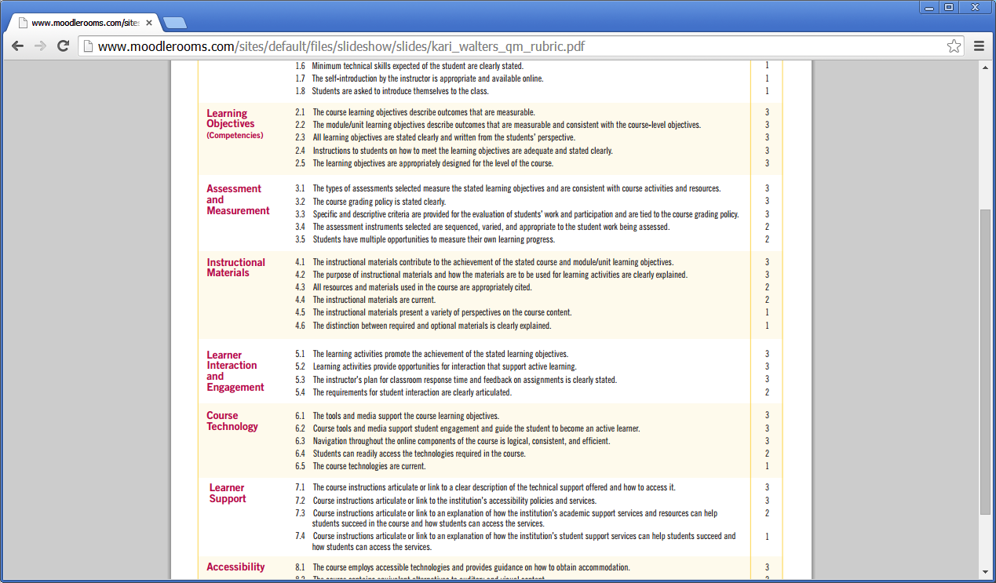
Importance of Discussions
Research indicates students are better prepared to apply content and retain more information if they are actively engaged with course material.
When designed effectively, discussions allow students to talk about, question, restate and interact with course content and the perspectives of other students.
Online discussions are an opportunity to help students become more involved in the course.
The dialogue complements and builds on the lecture and textbook content.

Slide 4
Value of Discussions
Engagement
Critical thinking
Active Learning
Stronger class community
Opportunity for interaction
Cognitive and explanatory learning
Use of research and course readings
Reduced race/ethnicity/gender bias

Slide 5

Redesigning Discussions
Adaptation of classroom strategies
Meet needs of learners
Significant experiences

Slide 6
Save the Last Word for Me
Student posts a section from the reading
(word for word) that resonated with her/him.
NO explanation
Peers respond to the post offering their opinions/ comments.
Student posts after peers explaining why the content was significant to her/him.

Slide 7
Muddiest Point
Instead of writing about what the student understands…
  The student writes about the “most confusing point” in the reading / content
    Peer responses to ‘clarify’ the muddiest point

Slide 8
Let’s Debate
Divide students into three groups
Assign students to groups
Two groups debate the topic
Third group mediates
Repeat

Slide 9
Switch It Up
Student begins writing to the prompt
Student stops (midway / before resolution / result )
Peer writes the conclusion / ending
  Option: Student can reflect after peer how s/he would have finished the posting.

Slide 10
Visually Speaking
Student responds to the discussion prompt with an image
  Peers respond by defining how the image represents / explains / aligns to the prompt
    Option: Student explains her/his thinking about the image AFTER peers have responded. (Explains why the image was chosen and how it aligns to the prompt)

Slide 11
Ten Important Words
Student responds to the instructor’s prompt (written response)
Peer reads student’s post
  Selects ten ‘important’ words from the student’s post which are related to the topic
  Reflects on significance of the ten words as they relate to the instructor’s prompt / content and writes a response to peer using all ten words

Slide 12
Notable Quotes
Student selects one or two significant quotations from the reading (on similar aspect)
  Student reads a peer’s posting.
      Student researches/develops and posts one or two opposing quotations to peer’s posting
Student returns to her/his original posting and either
    Defends the original quotation(s)
    Refutes the peer’s opposing quotation(s)

Slide 13
Found Poem
Option 1:
Use existing text
Refashion
Reorder
Present as a poem
Student writes a reflection to expand on the significance.
Option 2:
Student responds to prompt
Student reads a peer’s post – creates a
‘found poem’
  Refashion
  Reorder
  Present as a poem
  Reflects on significance

Slide 14
Deep Discussions
Assign students to facilitate discussions
  Student(s) can develop the discussion topic
  Multiple discussions can run concurrently
  Instructor participates on student level

Slide 15

Questions?
Save the Last Word for Me
Muddiest Point
Let’s Debate
Switch It Up
Visually Speaking
Ten Important Words
Notable Quotes
Found Poem
Deep Discussions

Slide 16

Idea Sharing
Please share your online discussion practices/strategies currently being used…

Slide 17
Thank you!
Dr. Cynthia M. Chovich
Associate Professor
Colorado Mesa University
cchovich@coloradomesa.edu
(970) 248-1462

