Slide 1
Making Quality Standard
Building a Sustainable Quality Assurance Culture and Establishing a Standard Operating Procedure (SOP)
Notes:
Roger

Slide 2
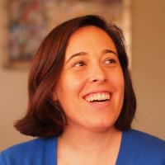
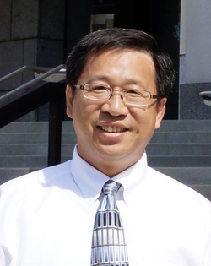

Presenters
Rebecca Farivar
Curriculum Support Specialist
Dr. Roger Wen
Director of the Online Campus
Notes:
Roger

Slide 3
Learning Objectives
Determine best practices in creating and using standard operating procedures for course development
Discuss how to establish standard operating procedures to develop courses according to the QM Rubric
Evaluate the steps used to implement QM Rubric standards during course development
Notes:
Rebecca

Slide 4
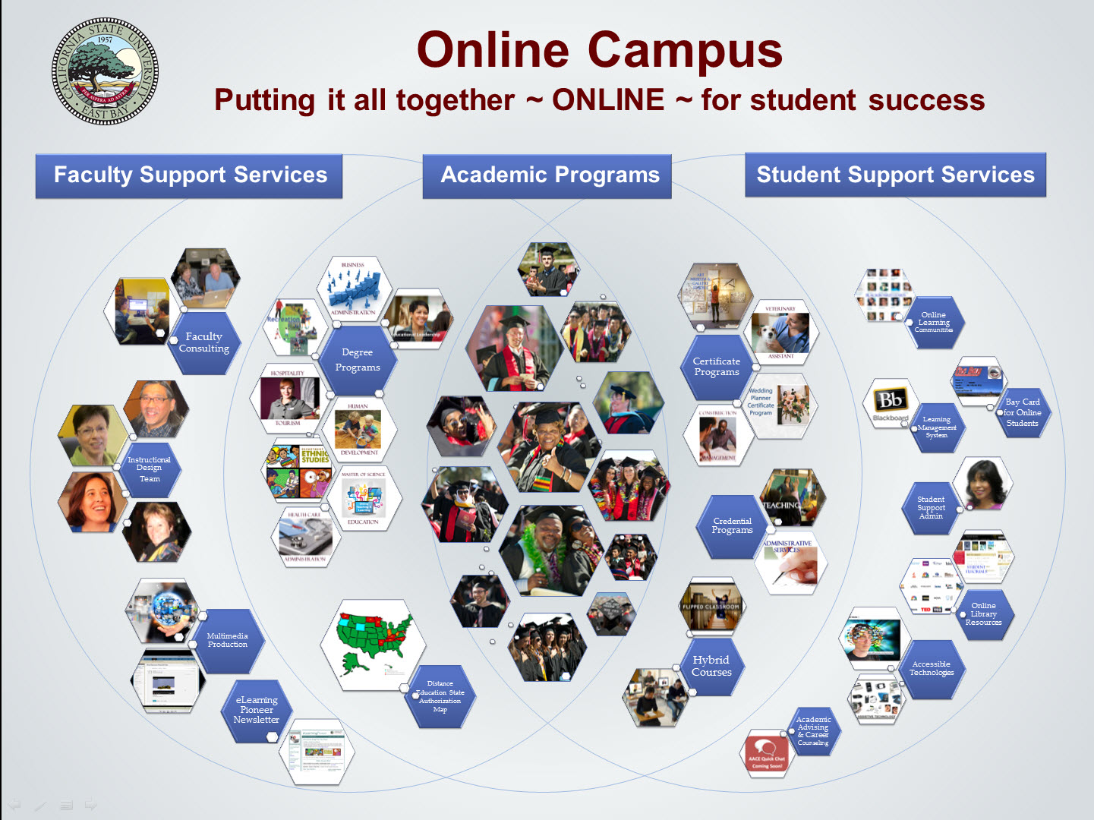
Notes:
Roger
Online Campus is moving away from serving a purely tech function, but rather be more involved and supportive of comprehensive course design.
Promoting and supporting the development of quality materials, not just helping with IT related needs (though we do that too!)
Challenges:
Instructors don’t know what makes an online course “quality” and need training.
Instructors don’t have the time to fully plan and build online courses that meet QM standards.
Instructors aren’t aware of all the tools available in the LMS or don’t feel comfortable using the LMS.

Slide 5
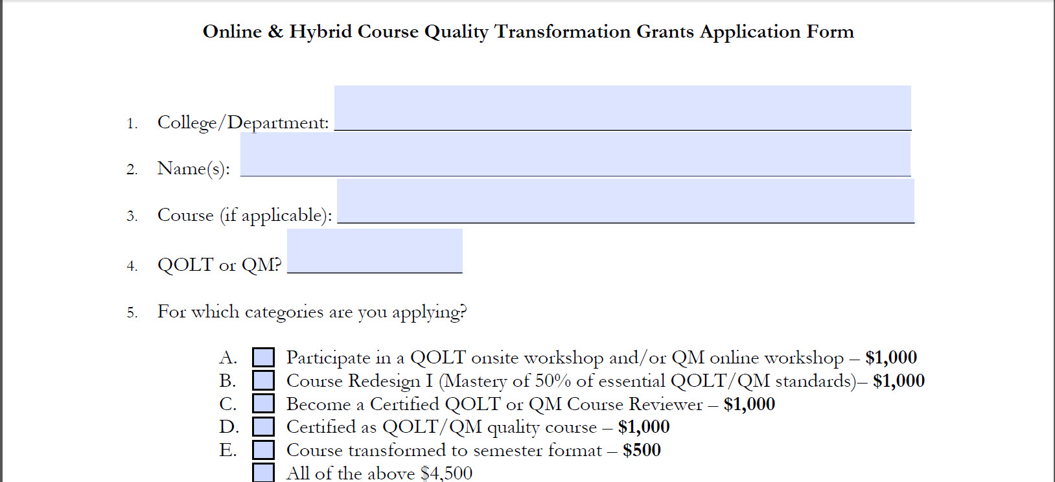
Grant application form
Notes:
Roger
To address these challenges, the Online Campus offered the Online & Hybrid Course Quality Transformation grants.
Five components
Includes QM training; CSU system additionally has an instrument called QOLT, but grantees predominantly choose QM
Includes assistance developing course
Includes incentives to complete QM review process
With the creation of the grants, addressed challenges in getting instructors committed to quality online education by incentivizing it.
Raised a new challenge for the Online Campus:
How do we lead instructors through the grants ensuring that all curriculum support staff is providing instructors with the same guidelines and information?
Answer: Develop a Standard Operating Procedure for all curriculum support staff to follow when working with an instructor.

Slide 6
Need for SOP
Provide OC staff support in serving in this new role
Serve as a way to track progress throughout the course development
Notes:
- Provide OC staff support in serving in this new role focused on developing quality courses and not just fixing bugs and setting up blogs
- Serve as a way to track progress throughout the course development

Slide 7
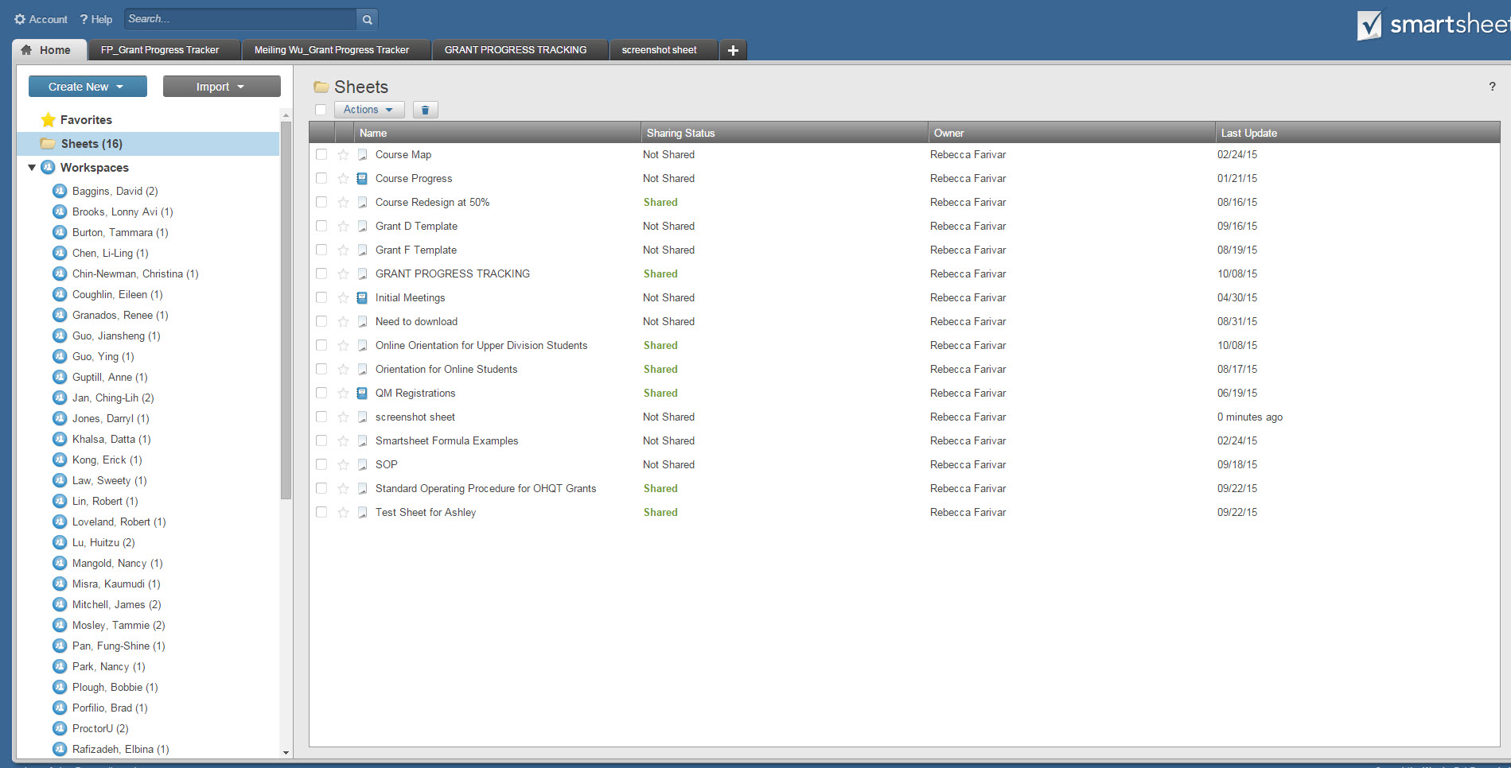
Smartsheet
Notes:
Rebecca (rest of slides)
First step: what tool would we use to track progress and document and share the SOP?
Chose Smartsheet
Allows for easy sharing of progress between OC staff and faculty
Place to easily upload documents
Report feature allows for pulling status of particular components of all grants
Highlights point to revisit: when initially developing the SOP and planning on how to track progress, envisioned as a tool for faculty and OC staff during course development process

Slide 8
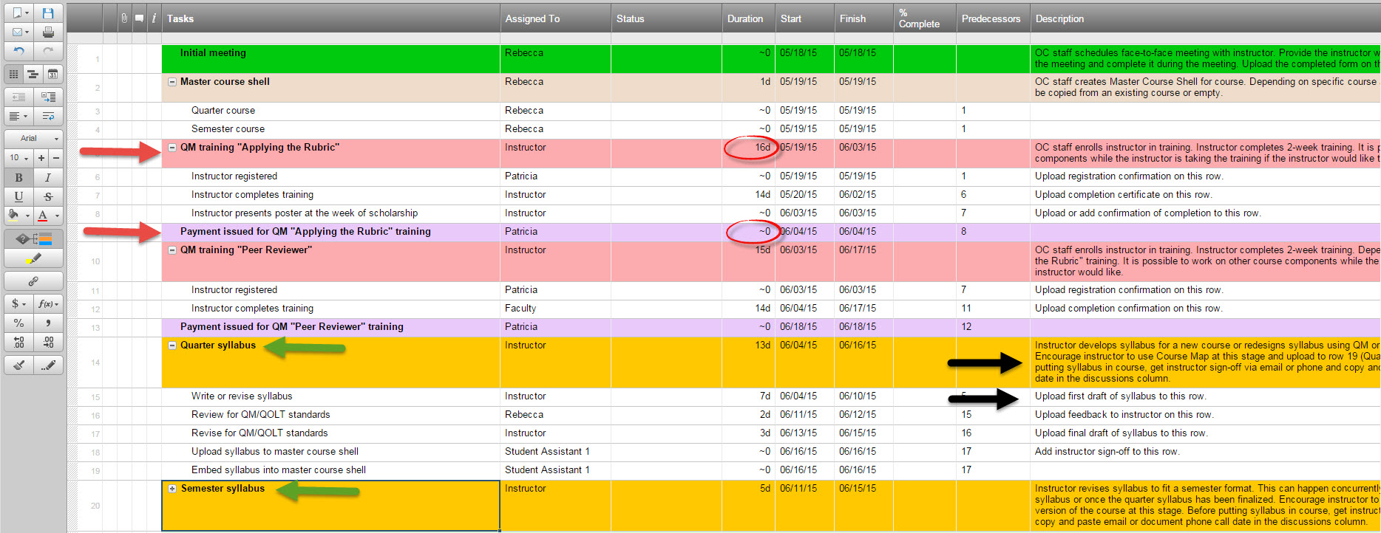
First SOP - Overview
Notes:
This is to give you a sense of what the entire sheet looked like as a whole
Continues on further than this—will look at it in parts

Slide 9
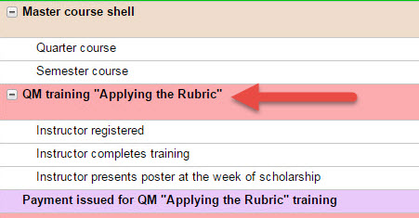
First SOP - categories
Notes:
Organized by main category e.g. QM training
Listed the steps under each category
Steps can be collapsed so you can just see the catetgory

Slide 10
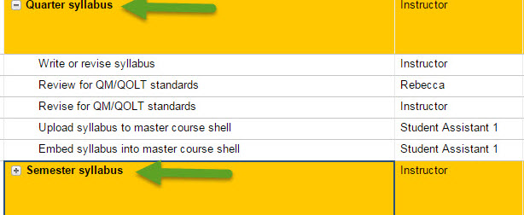
First SOP – quarter and semester
Notes:
Divided out the quarter and semester components each separately

Slide 11
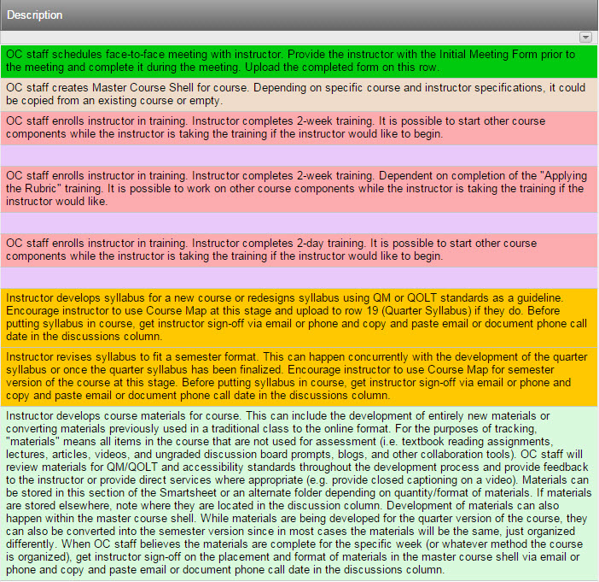
First SOP - descriptions
Notes:
Added descriptions for each main category
Added specifics on files and documents to upload to the Smartsheet as a means of sharing but also documenting completion

Slide 12
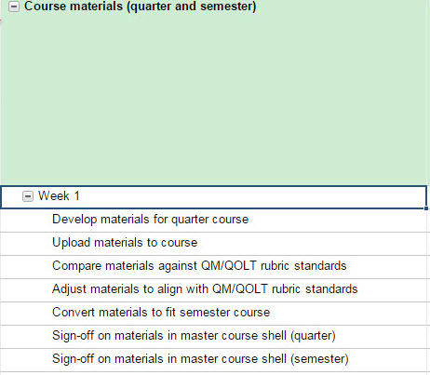
First SOP – course materials
Notes:
Heavily focused on breaking out the course materials development
Aimed at meeting specific standards in General Standard 4 as a core component of the development, so large focus in the SOP
Did it by week since most instructors organize their courses according to the week
Each week had several components documenting the course development from generating the materials to uploading them into Blackboard to reviewing for standards
Assumed instructors were coming to the grant building a course from scratch

Slide 13
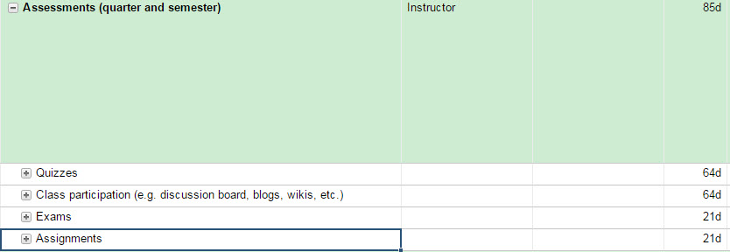
First SOP - assessments
Notes:
Broke out development of the assessments as separate from the course materials again knowing we needed to make sure we we met General Standard 3
Two sections: quizzes and class participation (discussion boards, etc.) as assessments that actually will be developed along with course materials; exams and assignments as summative assessments that will be developed separately and so have their own time frame separate from course materials (red circle)

Slide 14
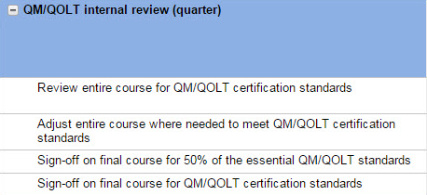
First SOP – internal review
Notes:
Planned to do an internal review of course by Online Campus staff
Within this category, there is the sign off for Grant B (final course meets 50% of the essential standards)
Also sign off that the course meets QM standards as determined by Online Campus staff

Slide 15
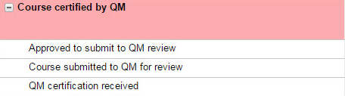
First SOP – QM certification
Notes:
Final component is sending the course to QM certification

Slide 16
What went well?
Separate categories
Detailed breakdown of steps
Descriptions of each categories
Notes:
Having a detailed breakdown of all the “micro” steps to complete an assignment was one of the main reasons for creating the SOP to begin with and that served to be very useful for Online Campus staff to reference as they were working with instructors to complete the grants
In addition to breaking down the micro steps, providing the big picture with the descriptions was useful for Online Campus staff to understand the ultimate goal of the component and what it entailed
Including lines regarding the payment ended up being essential for our office manager who is responsible for making sure the instructors get paid
Including a section for the final technical review was useful as a final check on the course before going to QM review
Including the separate section for the QM review process was also important since that review process happens independent of our own internal review

Slide 17
What needed to improve?
Didn’t specify which QM standards were met
Did not accurately capture collorative element of design
Separate sections for quarter and semester development did not accurately reflect the relationship between the courses
QM certification section was not specific enough
Notes:
Too many steps made the tracking very time consuming for Online Campus staff
Also the need to add percentages and a start and end date made the tracking difficult
Because it was difficult, most staff ended up not actually using the tracking in real time to keep track of the course progress
Course development and assessment sections were planned for someone who was building an online course from scratch, but in fact grantees were coming in having courses in different stages of development
Also, many instructors work on the assessments and course materials together, so separating out those components did not reflect how they wanted to develop the course
Similarly, we found that it made most sense to focus on building the quarter course since that was the main component of the grant and then once that course was set, convert it to semester
This provided a base to work with and then made revising the course for semester much easier to think about, rather than trying to do it in tandem
Milestones for each grant were not specifically indicated, this made it difficult for the office manager to track progress and payment
Left some ambiguity as what is considered the completion of Grant D--would the instructor have to wait until final certification to receive payment?
Also made reporting difficult
Initially thought of QM certification that we send it to QM and wait for feedback, but in fact there are many steps that the office manager needs to take to set up the review and several things OC staff and instructor need to do before the course review is complete

Slide 18
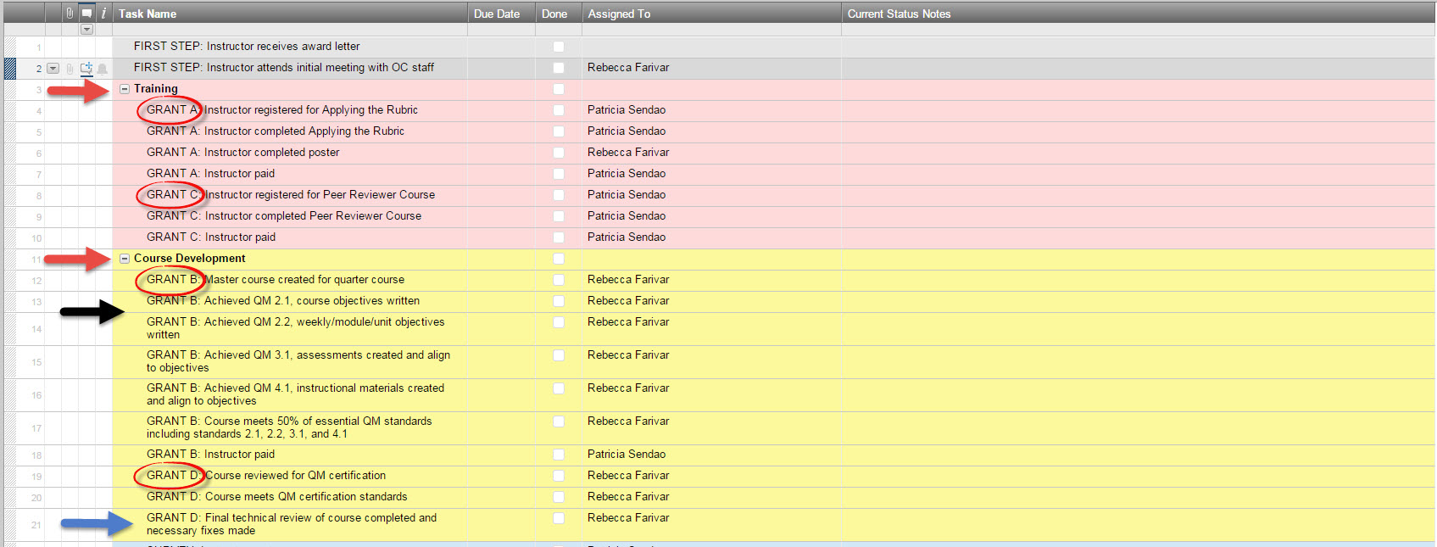
Revised SOP Progress Tracker - Overview
Notes:
Separated out the SOP document that has each specific step and description and the progress tracking function that needs to be used daily by OC staff working with instructors
Removed start/end date and percentages and just made it due date and done/not done with an area for notes

Slide 19
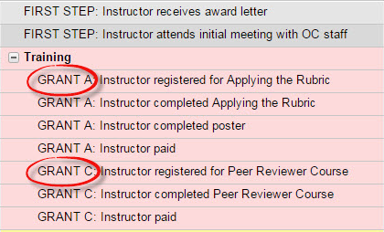
Revised SOP Progress Tracker – steps
Notes:
Still kept overarching categories, but simplified to training, course development, and as you’ll see on next slide QM Review and Semester
Indicated on each step which grant it was part of including payment

Slide 20
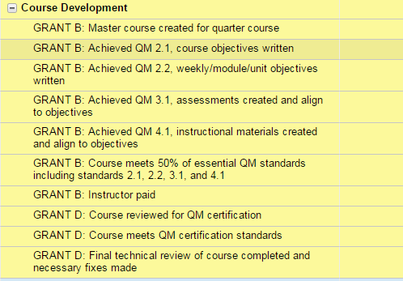
Revised SOP – course development
Notes:
Changed the way we tracked course development: organized by QM standards instead of breaking out assessments and course materials
Made our expectations more specific for Grant B and allows for more flexibility in working with instructors while still accurately tracking progress
Even though Grant D involves the additional step of QM certification, also part of course development, so by indicating which grant a specific step is part of, makes it easier to see the progress through the grants and clearly indicates when one is complete and we’ve moved on to the next

Slide 21
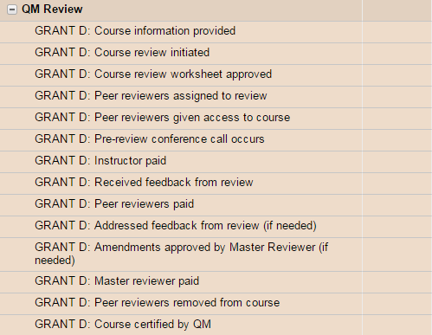
Revised SOP – QM review
Notes:
Major change was adding a lot more details to QM Review section
Realized once we started our first reviews there were a lot of small administrative tasks that needed to be communicated to the office manager, but weren’t accounted for
Added those small tasks to facilitate communication and keep organized on where each course is in the process
One of the major changes in our thinking was that a main component of the progress tracker was really to communicate administrative tasks and steps more than course development, which can involve a lot of back and forth communication with instructor, several drafts, and is generally more collaborative. What needs to be communicated is just if a standard is complete, but not necessarily who is doing what since the process is collaborative and not so well defined. This is not the case with clear cut administrative tasks that are either done or not and assigned to one person.

Slide 22
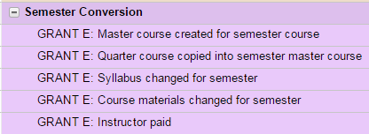
Revised SOP – semester conversion
Notes:
- Separated semester conversion to happen separately from the quarter development once the quarter course is finalized.

Slide 23
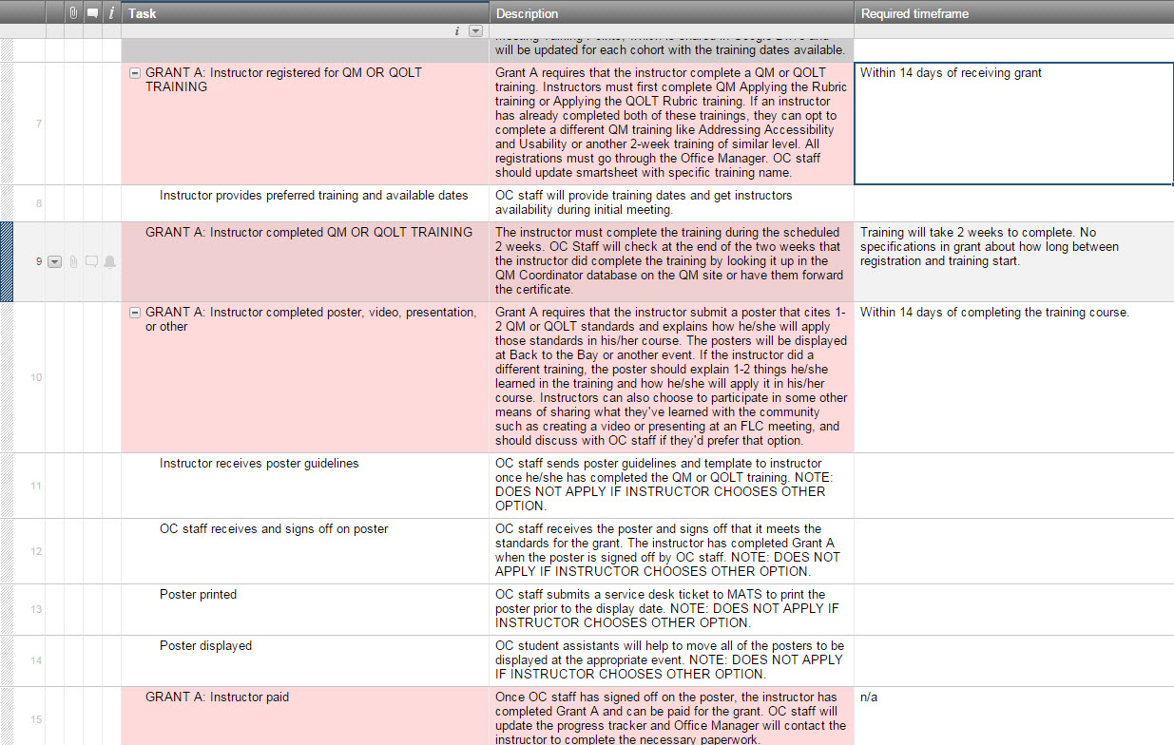
Revised SOP Document - descriptions
Notes:
Kept the step by step, detailed instructions but moved out of progress tracker
This is one section from the SOP which is a massive document
Mirrors progress tracker, but the details of each step are in this document
In cases where there are additional minor steps that would be too cumbersome to add to the progress tracker or conditional steps depending on the individual instructor, categorized under that section within the SOP
Includes required timeframe as specified by the grant -- this is a change from trying to get instructors to complete in 2 quarters, we changed the grant to reflect the time expecations
Only for OC staff--not shared with instructors

Slide 24
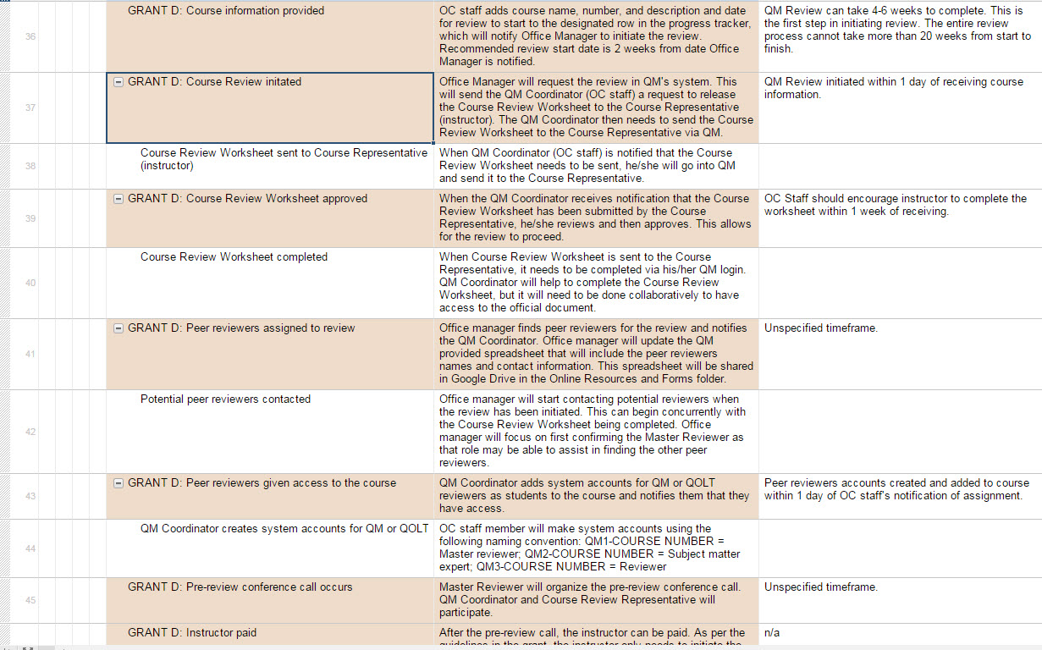
Revised SOP Document - descriptions
Notes:
Same points as previous slide, but can see how it looks for the section of Grant D where we are going through the QM Review
QM Review has many small steps which are documented here

Slide 25
Results
Have an established SOP for course development
2 certified QM courses
9 courses currently in QM review
13 new peer reviewers on campus
36 faculty trained in the Applying the QM Rubric

Slide 26
Takeaways
Align tracking with QM standards or other goals
Allow room for collaboration
Respond to how people are working
Document steps separately from progress tracking

Slide 27
Q&A
What questions do you have about CSUEB’s SOP development?

Slide 28
Contact Information
Rebecca Farivar
Rebecca.farivar@csueastbay.edu
Roger Wen
Roger.wen@csueastbay.edu
Online Campus
(510) 885-2100

