Slide 1

"The Many Shades of MOOC: A Showcase of Approaches"
5th Annual
QM Conference
October 1-4, 2013
Nashville, TN
Moderated by Deb Adair, QM Managing Director and Chief Planning Officer

Slide 2
Presenters
Danielle Budzick, danielle.budzick@tri-c.edu
  District Director, Innovative Learning Design & Quality
  Cuyahoga Community College
Sue Alman, alman.sjsu@gmail.com
  Lecturer, San Jose State University
Linda M. Grisham, Ph.D., lgrisham@massbay.edu
  Director, Center for Teaching, Learning, and Technology Innovation, Massachusetts Bay Community College
Beth Mancini, Ph.D., mancini@uta.edu
  Professor, Associate Dean and Chair, Undergraduate Nursing Programs, University of Texas at Arlington College of Nursing

Slide 3
Learning Objectives
Compare different approaches to MOOCs based on purpose, audience, and design
Generate ideas for developing MOOCs for different audiences
Discuss challenges and successes of MOOCs

Slide 4
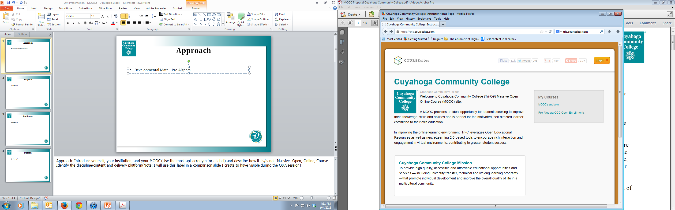
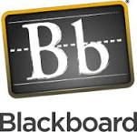
Approach
M
O
O
C
Notes:
Approach: Introduce yourself, your institution, and your MOOC (Use the most apt acronym for a label) and describe how it is/is not Massive, Open, Online, Course. Identify the discipline/content and delivery platform

Slide 5
Purpose
WHY:
Over 90% students place into Dev Ed Math
  FY11 - 3,400 test into Math 0910 – Basic Arithmetic & Pre-Algebra
  Of this, 1,600 test into upper level placement
WHAT:
Bridge gap for students
  Skip 0910 - Go directly to Beginning Algebra
  Increase comfort for placement test
HOW:
  Open Educational Resources
  Gaming Mechanics – Low risk, low failure
Notes:
Purpose: Identify the purpose of your MOOC and how your institution is using it

Slide 6

Audience
WHO?
Multiple audiences
  Bridge students
  Expanded placement prep
  1st Generation
  Returning students
  High school partnerships – PSEOP, Tech Prep, etc.
  Local and regional
  International
The illustrations in this math MOOC are licensed Share and Share Alike under the Creative Commons Attribution 3.0 Unported License. To view a copy of this license, visit http://creativecommons.org/licenses/by/3.0 If you use these illustrations under the Share and Share Alike license, attribute the work to Carl E. Nestor carlnestor.com/copyright
Notes:
Audience: Identify the target audience and anything of particular note about them, including if you provided any special orientation for them.

Slide 7
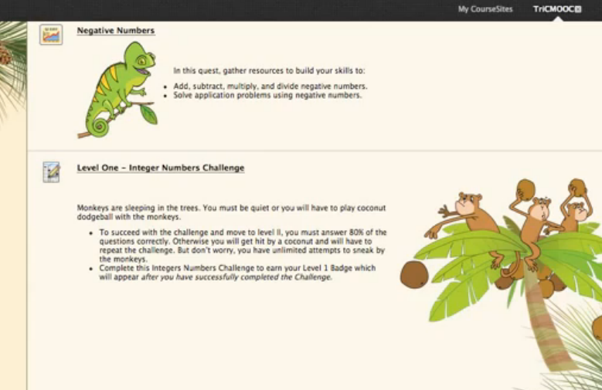
Design
Notes:
Design: Describe the development process and any design highlights

Slide 8
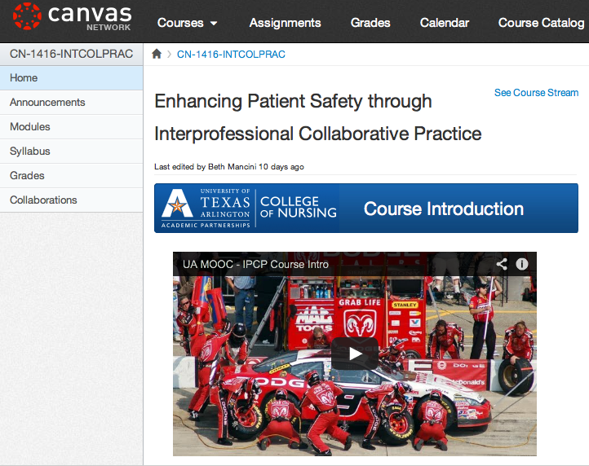

Slide 9

M – Soft launch
O – International response
O – But, of course
C – Multi-purpose
>Degree Credit In UTACON AP RN-to-BSN Program
>Formal Continuing Education Units (CEUs)
>Personal Learning (Ultimately, Badging)

Slide 10
PURPOSE OF OUR MOOC
PROVIDE A “TEST DRIVE” OF THE AP RN-TO-BSN PROGRAM
PROVIDE CONTINUING EDUCATION IN A KEY AREA IN THE FIELD
STUDENT RECRUITMENT

Slide 11
AUDIENCE
PRIMARY: ADN-PREPARED NURSES NEEDING DEGREE COMPLETION PROGRAM
SECONDARY: HEALTHCARE PROVIDERS AND PATIENTS/OTHERS INTERESTED IN PATIENT SAFETY

Slide 12
DESIGN PROCESS
WHO WAS INVOLVED?
WHAT DID THEY DO?
WHAT WHERE THE LESSONS WE LEARNED?

Slide 13
One MOOC Experience at
San José State University
School of Library & Information Science
Presented by
Susan W. Alman
San José State University
School of Library and Information Science

Slide 14

  School of Library & Information Science http://mooc.hyperlib.sjsu.edu/
  Recognized leader in online learning with a cutting edge curriculum
  Professional Development MOOC for 300 LIS professionals

Slide 15


WordPress & BuddyPress
  Open source
  Extremely flexible
  Provides an excellent platform for social interactions and supports constructionist teaching philosophies
  Proven successful: Instructors iteratively building learning environments using it for over 6 years
https://mooc.hyperlib.sjsu.edu/about/technical-design/

Slide 16
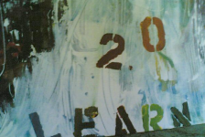
Instructional Design https://mooc.hyperlib.sjsu.edu/about/instructional-design/
  Connected Learning
    Shared Purpose
    Production Centered
    Openly Networked
  Transformative Learning
    Reflection on experience
  Connectivist Learning
    Aggregation
    Relation
    Creation
    Sharing

Slide 17

Unique Features
Very simple, straightforward navigation using verbiage that is common to most students.
Used testing to make navigation intuitive and, where possible, to contextualize pages
Learning community aspects of the course http://mooc.hyperlib.sjsu.edu/community/
e-badges program http://mooc.hyperlib.sjsu.edu/badges/

Slide 18


Slide 19
MOOC Designers & Instructors
Dr. Michael Stephens, Assistant Professor, School of Library and Information Science with research focusing on the use of emerging technologies in libraries and technology learning programs
Kyle Jones, Lecturer, San José State University,School of Library and Information Science and PhD student, University of Wisconsin-Madison, School of Library and Information Studies
The MOOC Team, Members of the SLIS Community
For More Information: http://mooc.hyperlib.sjsu.edu/

Slide 20





Community College-MIT edX Connection x-type SMOOC (blended delivery) of course content
Spring 2013
At
and
Linda M. Grisham, Ph.D.
Director
Center for Teaching, Learning & Technology Innovation
Massachusetts Bay Community College
Wellesley Hills, Boston MA
lgrisham@massbay.edu
5th Annual
QM Conference
October 2013
Nashville TN
Notes:
Project Research Questions
Can Community Colleges (and other credit granting institutions) adopt and use MOOCs to benefit their students?
To what extent do edX courses (and MOOCs in general) need modification for delivery in a community college classroom?
How do different types of students respond to the flipped classroom approach?
How do faculty view the effectiveness of the flipped classroom approach?
How do students perceive their learning in this format compared to their other online and in-class courses?
How does the Community College student experiences (and performance) compare to those students who have completed the same course as a MOOC in the Fall 2012?
What support do the faculty need to use the edX courseware? How are institutions able to support them?

Slide 21

MassBay Community College | Bunker Hill Community College
2-yr. Community College-chartered in 1961 95 Full-time faculty 250 Adjunct faculty Located 10 miles west of Boston in Wellesley Hills Highly diverse urban student body 3,600 full-time students 6,300 part-time students 70 associate degree and certificate programs | 2-yr. Community College- chartered in 1973 143 Full-time faculty 603 Adjunct faculty Located in Charlestown, MA (Boston) Highly diverse urban student body 8,927 full-time students 4,577 part-time students Over 100 associate degree and certificate programs
Research funded by Bill & Melina Gates Foundation
Notes:
Both schools serve urban, highly diverse student populations
(race, income, gender, age, ethnicity, language, etc.).
MassBay students: mostly computer science majors --76% of whom 83% had completed at least one computer programming course.
Bunker Hill students: all IT majors—7% of whom 29% had completed a computer programming course. (BHCC does not offer a computer science program )
Thus there were major differences in comfort with math between the two student populations.
34% of survey respondents had never taken an online course (including hybrid/blended) before.
(33% @ MBCC and 36% @ BHCC)
53% of survey respondents had never completed an online course (including hybrid/blended) before. (56% @ MBCC and 50% @ BHCC)
78% of survey respondents had never completed an online course (including hybrid/blended) in computer sciences/IT before. (83% @ MBCC and 71% @ BHCC )

Slide 22
MITx 6.00x Introduction to Computer Science & Programming “…6.00x is an introduction to using computation to solve real problems. The course is aimed at students with little or no prior programming experience who have a desire (or at least a need) to understand computational approaches to problem solving…”
--from edX course description
MassBay Community College | Bunker Hill Community College
Taught by 1 computer science instructor who created interactive online (bridge) tutorials Most students -computer science majors Full MITx 6.00x materials & platform, plus: Free downloadable O’Reilly text: Think Python Interactive tutorials Course designed to keep pace with MITx semester-long course | Co-taught by 2 IT instructors Students were generally not experienced in programming or computer science Only 7 weeks of original 14 weeks of MITx 6.00x material utilized 85% of student grades were based on edX materials
Prerequisites:
“High school algebra and a reasonable aptitude for mathematics.”
Notes:
MIT’s 6.00 Introduction to Computer Science & Programming is a required course at MIT for students who are NOT computer science majors.
Neither community colleges modified the MITx course content (videos, problem sets, exams, etc.) and each community college used MITx materials identical to that presented in the global Fall 2012 MOOC.

Slide 23
MOOC Matrix
Institution | Platform | Type | Purpose/Course | Audience
Tri-C https://tric.coursesites.com/ | Coursesites/ Blackboard | MOOC | Dev. Ed Math | Multiple
UT Arlington https://learn.canvas.net/courses/83 | Canvas | MOOC | RN-BSN Program test drive, CE | Nurses, Providers
SJSU http://mooc.hyperlib.sjsu.edu/ | Word Press & Buddy Press | SOOC | Professional Development | LIS Professionals
Mass Bay | edX | SMOOC Blend | Intro Computer Programming | CS & IT undergrads

Slide 24
Discussion
Have you MOOC’ed?
  Designed/Developed?
  Taught?
  Taken?
Discuss (2 minutes, be quick!)with a neighbor
  Challenges experienced or observed
  What worked particularly well?

Slide 25
Questions for Presenters?
Specific questions about challenges and/or success?
What are YOUR questions for the presenters?

Slide 26
Results & Next Steps

Slide 27
Results & Next Steps
Course | Enrolled | Completed Survey (started course) | Completed Level 1 | Completed level 2 | Completed Level 3 | Completed Level 4
March 2013 | 138 | 120 | 83 | 33 | 17 | 15
April 2013 | 175 | 108 | 58 | 27 | 21 | 19
May 2013 | 522 | 280 | 152 | 81 | 62 | 55
June 2013 | 537 | 301 | 152 | 93 | 69 | 58
Course | Enrolled | Completed Survey (started course) | Completion rate enrolled | Completion rate Participated
March 2013 | 138 | 120 | 10.87% | 12.5%
April 2013 | 175 | 108 | 10.86 % | 17.59%
May 2013 | 522 | 280 | 10.54 % | 19.64 %
June 2013 | 537 | 301 | 10.81% | 19.27
Notes:
Results and Next Steps

Slide 28
MBCC & BHCC Student Performance
on the MITx 6.00x Mid-term Examination
 | MassBay | Bunker Hill | Community College Totals | Fall 2012 Global MOOC
% of students with scores between 90-100% (A grade) | 39% | 9% | 28% | 37%
% of students with scores between 80-90% (B grade) | 44% | 64% | 52% | 23%
% of students with scores between 90-100% (C grade) | 11% | 9% | 10% | 9%
% of students with scores below-70% | 6% | 18% | 10% | 31%
Overall ‘pass’ mid term rate | 94% | 82% | 90% | 59%
Number of students | 18 | 11 | 29 | 11,645
Notes:
Experience from the Fall 2012 MITx MOOC: Approximately 5,000 earned the MITx certificate. A large majority of those who were award the MITx certificate had BA/BS degrees (or higher) and were computer science/ IT professionals.

Slide 29
MBCC / BHCC Course Enrollment & Retention Rates
 | MassBay | Bunker Hill | Total
# of students at course start | 21 | 19 | 40
# of students sitting for mid-term | 18 | 11 | 29
Mid-course retention rate | 86% | 58% | 73%
# of students completing the course | 18 | 10 | 26
Final retention rate | 86% | 53% | 65%
Notes:
Projects Examined the Perspectives of:
Community College students enrolled in course
pre and post course surveys
focus groups
analysis of student participation in on-site and off-site course activities
assessment results
class observations
big data
Community College Instructors
pre and post course surveys
interviews
class observations
Community Colleges and other accrediting institutions
edX and other providers

Slide 30
Next Steps
At
and
Course will be reconstructed on edX platform (free to download)
Will run again in Spring 2014 and managed at MassBay
How much of the edX content will be used? TBD
Notes:
Project Research Questions
Can Community Colleges (and other credit granting institutions) adopt and use MOOCs to benefit their students?
To what extent do edX courses (and MOOCs in general) need modification for delivery in a community college classroom?
How do different types of students respond to the flipped classroom approach?
How do faculty view the effectiveness of the flipped classroom approach?
How do students perceive their learning in this format compared to their other online and in-class courses?
How does the Community College student experiences (and performance) compare to those students who have completed the same course as a MOOC in the Fall 2012?
What support do the faculty need to use the edX courseware? How are institutions able to support them?

Slide 31
Final Questions?

Slide 32
Contact Information
Danielle Budzick, danielle.budzick@tri-c.edu
  District Director, Innovative Learning Design & Quality
  Cuyahoga Community College
Sue Alman, alman.sjsu@gmail.com
  Lecturer, San Jose State University
Linda M. Grisham, Ph.D., lgrisham@massbay.edu
  Director, Center for Teaching, Learning, and Technology Innovation, Massachusetts Bay Community College
Beth Mancini, Ph.D., mancini@uta.edu
  Professor, Associate Dean and Chair, Undergraduate Nursing Programs, University of Texas at Arlington College of Nursing

