Slide 1

Quality Matters Research Initiative in Minnesota

Slide 2
Presenters
Susan Engelmann
University of Minnesota
Elizabeth McMahon
Minnesota Online Quality Initiative/ Northland Community & Technical College
Deb Adair
Managing Director & Chief Planning Officer
The Quality Matters Program
Statewide Lead QM Coordinator
Center for Education Innovation, eLearning Team
Office of the Senior Vice President and Provost

Slide 3
Agenda
Discuss the merits of conducting QM research that addresses the research questions as a part of a larger national QM framework (QM Impact Infrastructure: Changing the Culture of Teaching a Learning Through Continuous Improvement).
Discuss Possible Research Agenda Questions.
Get perspective from other universities about value and need for a QM research/evaluation component.

Slide 4

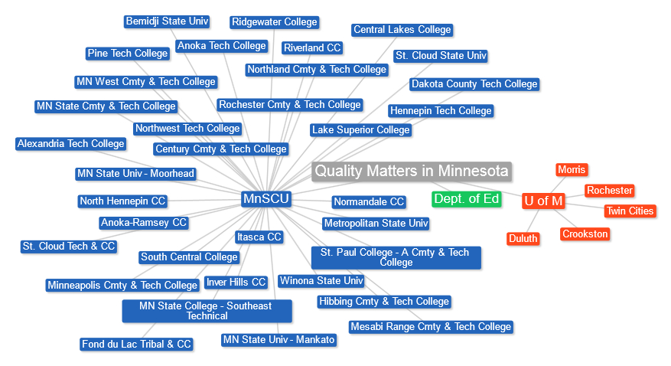

Affiliate Institutions in Minnesota
Notes:
Current as of 9/25/13

Slide 5
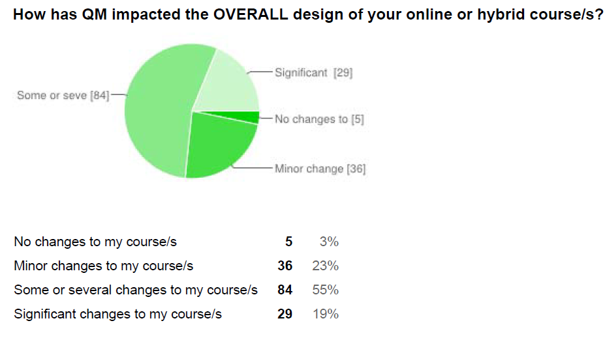
What We Know
Spring 2014 Survey Results – MnSCU institutions

Slide 6
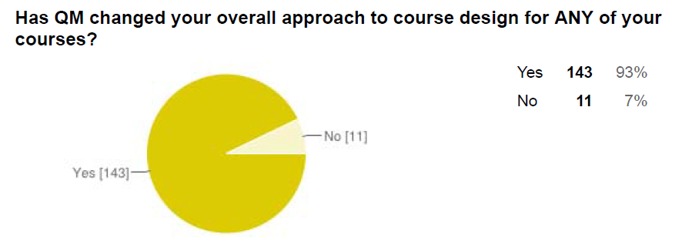
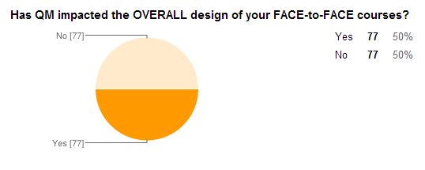
What we know

Slide 7
What are the merits of conducting QM research that addresses the research questions as a part of a larger national QM Framework?
(QM Impact Infrastructure: Changing the Culture of Teaching and Learning Through Continuous Improvement)

Slide 8
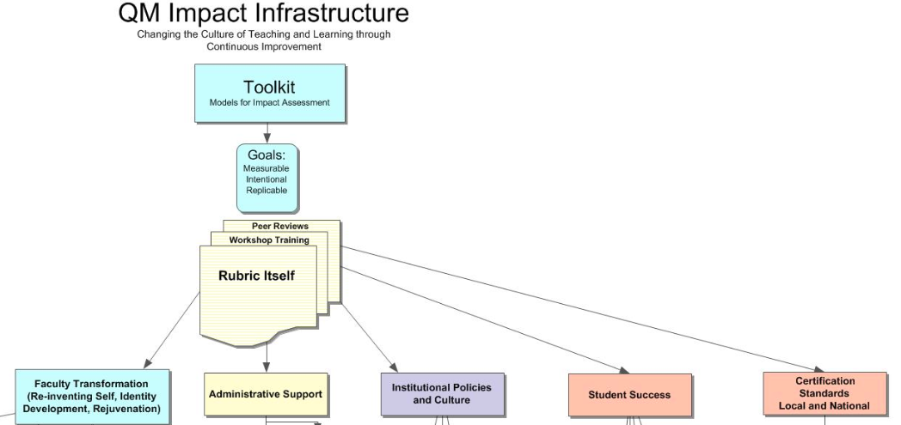
QM Impact Infrastructure
Demonstrating
WHAT
To
WHOM

Slide 9
Possible Research Questions?
How applying QM to course design impacts student success?
How QM has improved faculty approach to course design?
How has QM implementation at department or collegiate level impacted quality of the curriculum?

Slide 10
Value of Research
What is your perspective about the value or need for a QM research/ evaluation component?
Other considerations?
Questions?

