Slide 1
Dissecting a MOOC with the QM Rubric:
Implications for MOOCs Design and Delivery
Li Wang, Ph.D., Ashford University
Wendi Shen, A.B.D., University of Illinois-Urbana Champaign
Talin Saroukhanian, Ph.D., CSU-Northridge

Slide 2

What’s your vote?
Yes
No
Image source: http://campustechnology.com/articles/2013/08/07/moocs-eat-stanford-harvard-closes.aspx
Notes:
Study Background:
MOOC’s heat
Experience of taking a MOOC
Noticeable issues in MOOC

Slide 3
Agenda
Course Overview & Summary
Assessment
Materials
Community Building
Teaching & Facilitation
Course Technology
Learner Support & Resources
Accessibility

Slide 4
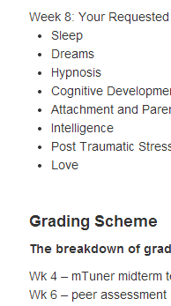
Course Overview & Summary
Clear message
Nice and short video(59 sec) to spark and sustain interest
Syllabus not quite clear
Jargon used
Instructor role unclear

Slide 5
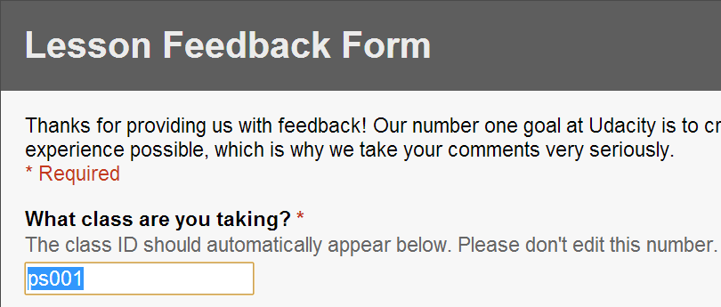
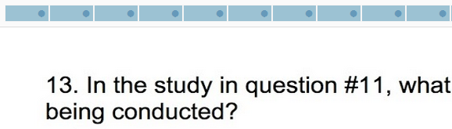
Assessment
SLOs Measurable
PLOS and CLOs listed
Peer Coaching
Multiple Choice
Proctored exams
Too many objectives tangled into one
Too long , wordy and jargon
Assessment-CLOs-PLOs alignment not clear
Lack of other assessment types
Open ended question
A
B
Notes:
A: Good practice of soliciting feedback per lesson
B: Better to repeat the context / content of study.

Slide 6
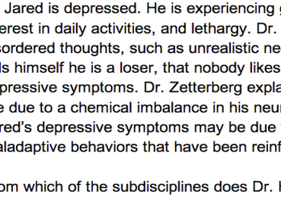
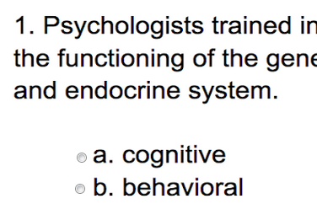
Assessment Cont.-MCQ
A
B
Notes:
A: Showing three times but asking different questions.
B: Question is not written in a learner friendly format.

Slide 7
Assessment Cont.
One Objective Example:
Identify and analyze the social dimension of society as a context for human life, the processes of social change and social continuity, the role of human agency in those processes, and the forces that engender social cohesion and fragmentation.
Revised Objective Example:
Identify and analyze the… | Example
social dimension of society as a context for human life | Why do we form friendship?
processes of social change and social continuity | What effects did Hurricane Katrina have on the residents of New Orleans?
role of human agency in those processes | Why would a change in management lead to employees quitting their jobs?
forces that engender social cohesion and fragmentation | How does Facebook create community?

Slide 8
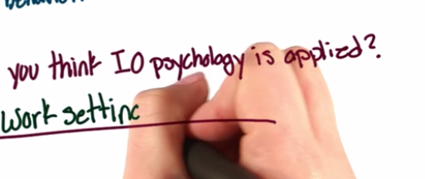
Materials
Use of videos
Some videos might be too long (18 minutes average in one course, 9-38 range)
Cognitive overload
A
Duration Recommendation: <=2 minutes
Over 2-minute treatment: 1) chunk 2) emphasize the beginning
Notes:
A: distracting treatment of video with overlaid scenes causing cognitive overload
Research on Video Length:
The data is quite clear, shorter videos are more engaging than longer videos. For videos 2 minutes and under, you should strive to make your content as short and punchy as possible to guarantee the highest engagement. If your video is 30 seconds or under, it's very likely that most people will watch it all the way through.
If your message is more complex, be comfortable taking the time to explain it, but understand that half of your audience won't make it to the end of the video. With this in mind, you would be well served to front-load your video with the most important parts of your message. http://wistia.com/blog/does-length-matter-it-does-for-video

Slide 9
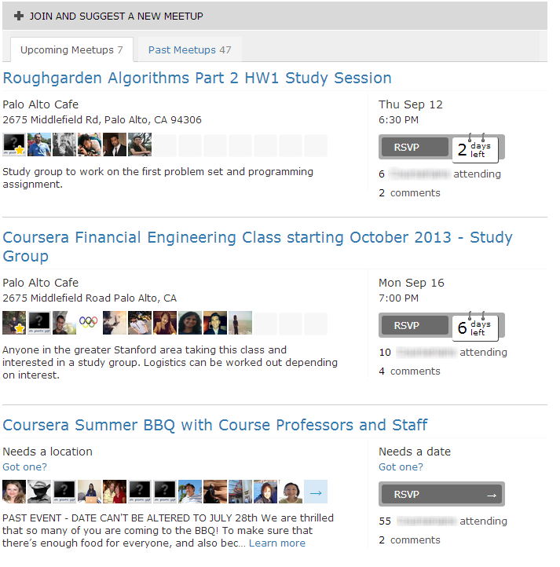
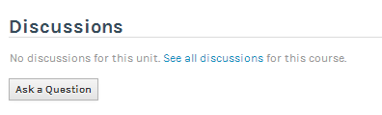
Community Building
Highly motivated individuals respond and connect with others
Lack of community building after the course is inactive

Slide 10
Teaching & Facilitation
Frequent communications (47 messages sent by the instructor
Instructor fails to keep promise

Slide 11
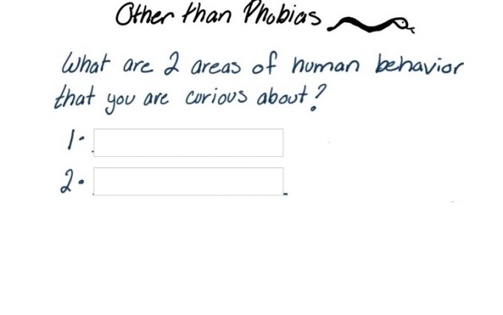
Course Technology
Quiz question embedded in video
Google hangout and alternative meeting space
Lack of Technology support
“Video not loading in Firefox. Not expected…”

Slide 12
Learner Support & Resources
FAQs
Video on taking class in a particular environment
APA mentioned but no reference provided or resource suggested
Help resources need updating based on these discussions

Slide 13
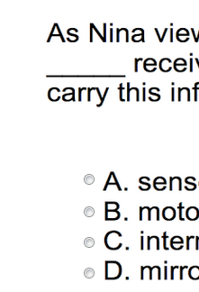
Accessibility
Video captioned
Multiple ways of access (download)
Alternative virtual meeting space for google hangout
Problem Set after the video prevents key tapping through

Slide 14
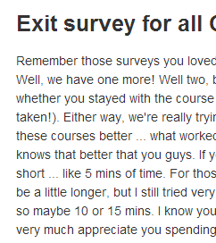
Course Summary & Wrap-up
Instructor’s extra resources to keep students motivated
Seeking feedback for improvement
Lack of summary/wrap-up and connecting the dots, typical house cleaning

Slide 15
Possible Solutions
Designer
Facilitator
Students
Use standard font
Provide study guide
Have a plan
Ensure clarity of content
Teach Metacognition
Connect with others
Include technology readiness checklist
Be clear and comprehensive.
Explore inside and outside (Wikipedia)
Help connect the dots throughout and at the end (concept mapping)
Ask questions. Be critical.
Make use of instructor notes area
Summarize messages /discussions into Q&A or FAQ

Slide 16
MOOC’s Future?
Student teaching/facilitating MOOCs
Not replacing faculty
Not replacing traditional education
Going blended/flipped classroom
xMooc in session with cMooc post session(MapQuest, Activity Guide)
Active Model
Post Class
Instructor led
Multiple assessments
Weekly Summary
Discussion summary
FAQs: content
Prior to start
Technology checklist
Grouping students
Readiness questions
Self Study Mode
Summary
Webquest/Team Teaching
Study guide
Weekly summary
Rubric
Work samples

Slide 17
Disclaimer
All screenshots unless specified are all taken from the two courses from Udacity and Coursera. Please do not distribute.

Slide 18
Contact
Contact Author: Li Wang, Ph.D.
Li.Wang@faculty.ashford.edu

