Slide 1

No Instructional Designer!
Now What?
Dr. Karen Castagno
Dr. Leslie Sevey
Dr. Susan Zoll

Slide 2
Objectives of Session
Overview of Project
Course > program: Using QM as a framework
Addressing Quality Matter Standards
  QM Standard 1 – Course Overview and Introduction
  QM Standard 8 – Accessibility and Usability

Slide 3

Race to the Top – Early Learning Challenge
Rhode Island College
RI Department of Education
Notes:
Opportunities that were provided by the grant to develop a fully hybrid delivered program.
The genesis for this program was partnership with the RI Department of Education as part of the Race to Top, Early Learning Challenge Grant.
This option for a bachelor’s degree using an alternative delivery was designed specifically to meet the needs and different context of early childhood professionals working full-time in early care and education programs.

Slide 4
“Innovative Program”
Online
F2F
Notes:
Because we were designing a program for individuals who worked full-time we had to develop an Innovative Delivery System for the coursework to meet their needs.
RIC has defined hybrid as: A course in which half of the instruction is online and the rest in person..
The actual percentage of face-to-face (f2f) and online may vary, depending on course content and format (lecture vs. practicum), student needs or other criteria.
This meant that we were creating new courses and these were developed in a hybrid format while other courses that currently existed needed to be modified from a fully F2F to a hybrid model.
For example: Wellness Course and ECED 302 Child Development
Whether the courses are F2F or Hybrid the QM Standards provided a framework for “Best Practice” in teaching.
We didn’t have an instructional designer and so the QM Standards provided the guidance for us in the design of courses in place of an instructional designer.
We made the decision to deliver all of the content/coursework using the 50-50 model of hybrid and f2f. Candidates would take two courses each semester and only come to campus one night a week.

Slide 5

Notes:
In order to support students that were in many cases returning to school after a hiatus, were working full time, and not always confident in their academic skills we needed to find ways to make the online courses as user friendly as possible.
The QM Standards heped us to keep the student in mind – How could they best access the information and internalize the content.

Slide 6

Quality Online Instruction
Notes:
We then needed to decide how we were going to ensure the quality of the online delivery.
The College had been simultaneously searching for a way to ensure the quality of online teaching and learning and determined that Quality Matters would best meet the needs of the college.
Through the grant we had an opportunity to bring in a QM Training open to any faculty member across the college who wanted to participate. The Applying the QM Rubric training was held and was coordinated through the college’s FCTL.
We had faculty from the Nursing, ELED, SPED, ECED, PSYC, and HPE participate in the training.

Slide 7
QM Standard 8
Blackboard Course Template
Homepage
Announcements
General Course Information
My Instructor
Syllabus
Course Materials
My Grades
Course Content
Units of Instruction
Assignments
Additional Course Resources
Course Communication
Class Discussion or Blogs
Email
College Resources
Notes:
The QM Standards helped us to make decisions such as the decision to utilize a course template so that each course in the program would have the same look when a student entered their Blackboard course. F2F or Hybrid.
We found that course instructors often used a variety of language to label course materials or portals. We decided that it was important that each course have the same look and information for continuity and ease of use.

Slide 8
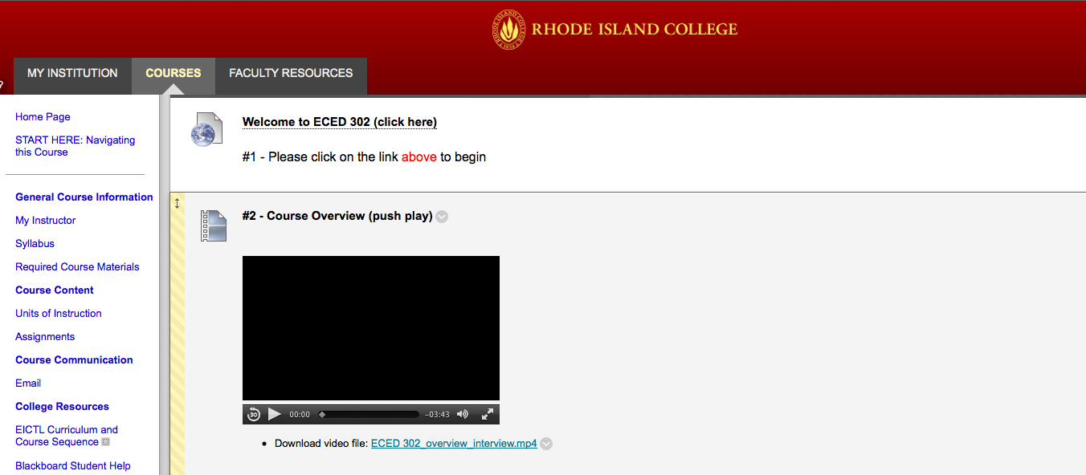
ECED 302 Child Development, Birth-8
QM Standard 1
The overall design of the course is made clear to the learner at the beginning of the course
Notes:
Here’s what the Blackboard site looks like for one of our courses, ECED 302 a child development course in our early childhood program. This course is delivered both in F2F and Hybrid.
Standard 1 looks for navigation of the course to be consistent and logical. And as a program we’ve made the decision to keep the navigation consistent across all program courses – again helping students by creating an efficient way to access course materials that looks the same regardless of the course they are taking in our program. Content of course changes, but how to identify where the content is located: the syllabus, the assignments, the individual units of instruction – all remain the same

Slide 9
QM Standard 1
The overall design of the course is made clear to the learner at the beginning of the course
Camtasia
Notes:
One way the instructor has addressed Standard 1 is by creating a Camtasia video, allowing the professor to narrate a powerpoint that describes the structure of the course and where materials can be found on the Blackboard course shell.

Slide 10
QM Standard 1
The overall design of the course is made clear to the learner at the beginning of the course.
Notes:
In addition to a predictable framework for their hybrid instruction, students begin their course with a welcome message from their instructor. As soon as the site is available to students, they will have a welcome message that includes a few important items, such as: the name of the course, days and time course will meet, who the instructor is, and how to contact her.

Slide 11
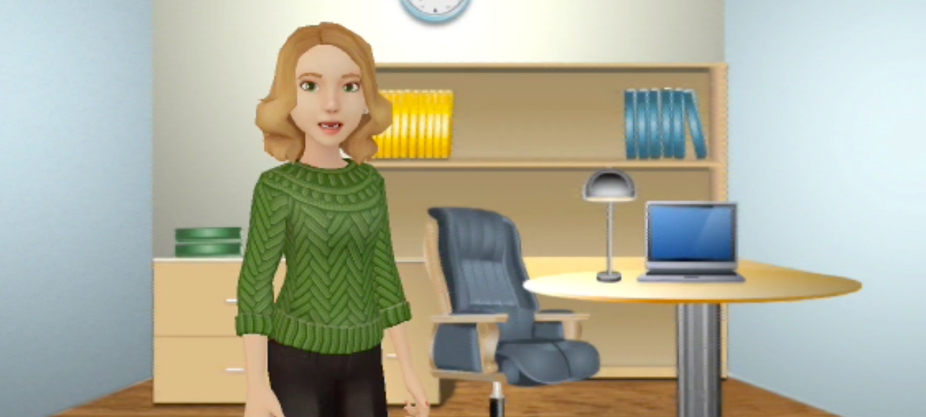
Tellagami
https://tellagami.com/gami/KBSYV4/embed/
Notes:
[Play Introduction/Tellagami link, via Bb]
For this course, the instructor used Tellagami. We have a handout that provides a step-by-step process for you to develop your own avatar and introduction. You can download the app and we’ll walk you through your own online introduction at the conclusion of this session if you’d like to try!

Slide 12
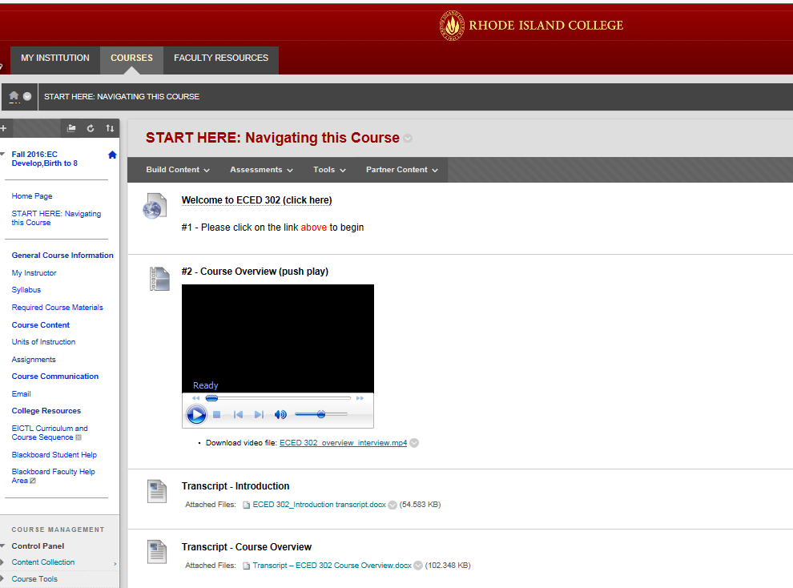
QM Standard 8
The course design reflects a commitment to accessibility and usability for all learners
Notes:
In addition to Standard 1, the instructor was also able to address Standard 8 by using both videos to address diverse learners needs, as well as by uploading the transcripts for both the course introduction and course overview videos. This allows for an “equivalent textual representation” – again meeting the needs of all learners.

Slide 13

Our belief…
Quality Matters is good teaching practice.
Whether designing a new program, a new course, or even down to individual teaching sessions – the standards help faculty improve content delivery to meet the needs of all students.

Slide 14
Synopsis
Begin with the standard to inform your course design
Take part in QM professional development / training
Find like-minded colleagues along the way
Build on your own areas of strength and address a new area to grow in each time you teach your course

Slide 15
Connecting with Colleagues
To continue the conversation you can contact us at:
Karen Castagno Kcastagno@ric.edu
Leslie Sevey Lsevey@ric.edu
Susan Zoll Szoll@ric.edu

