Slide 1
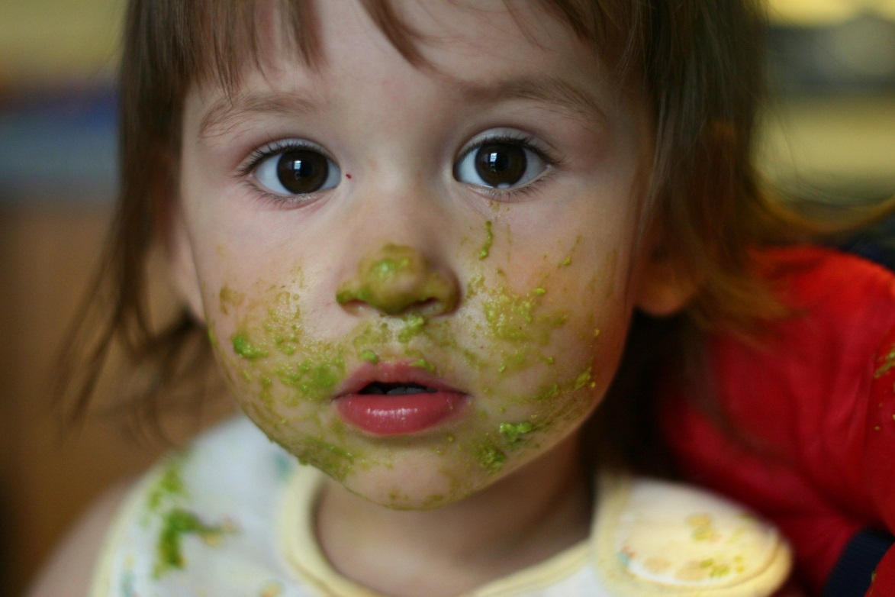

No Muss!
CC Image courtesy of moominmolly on Flickr
No Fuss!
CC Image "Crying Yuri - At Home" courtesy of Emran Kassim on Flickr

Slide 2
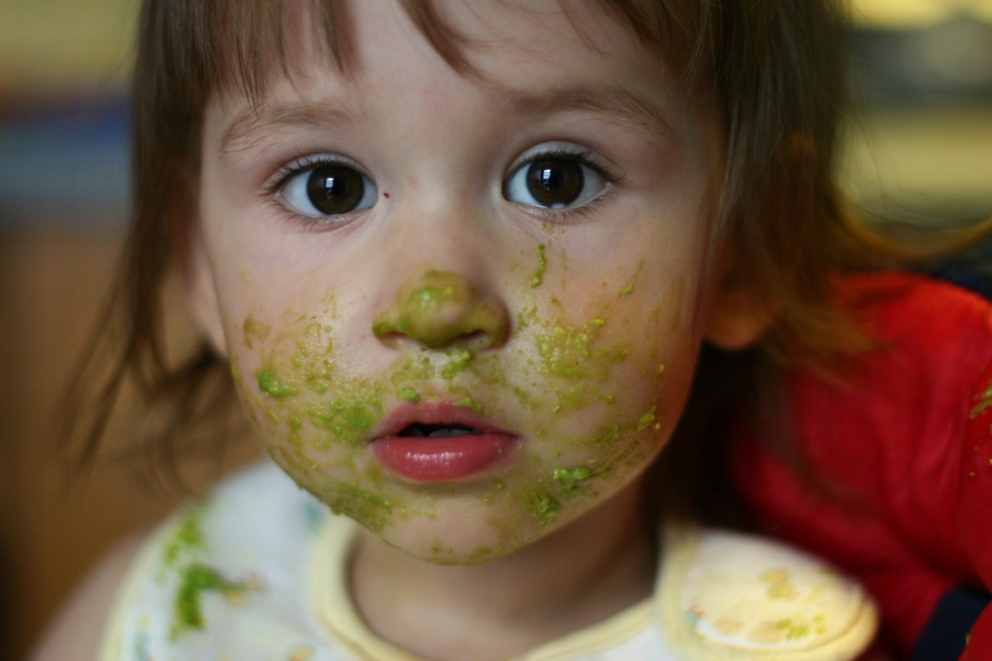
No Muss! No Fuss!
HOW TO BECOME AN
ONLINE . . .
CC Image courtesy of moominmolly on Flickr

Slide 3
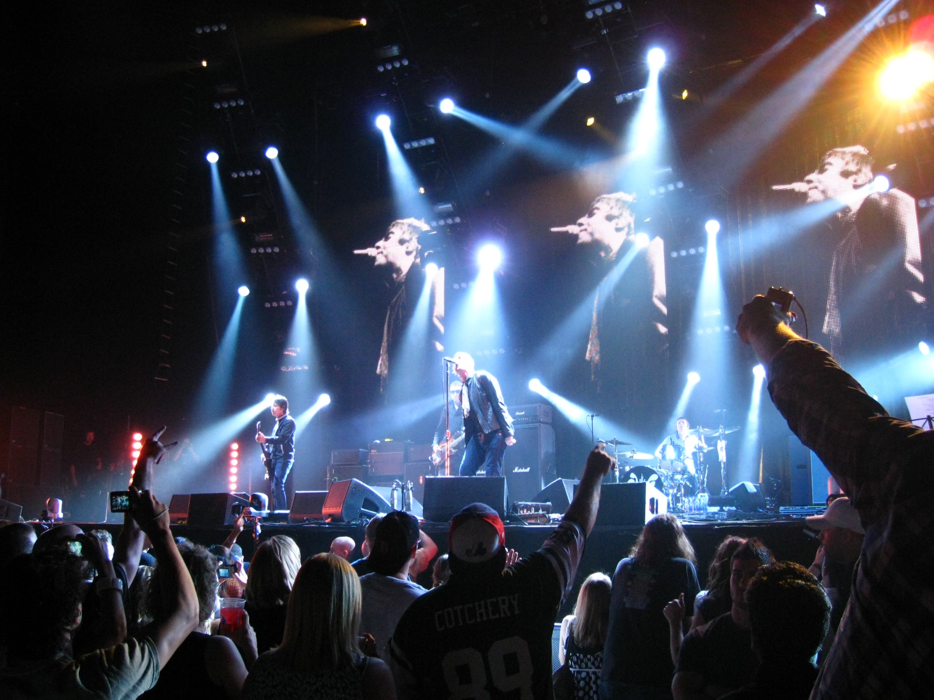
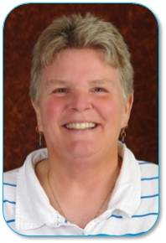

STAR
CC Image courtesy of Anirudh Koul on Flickr

Slide 4
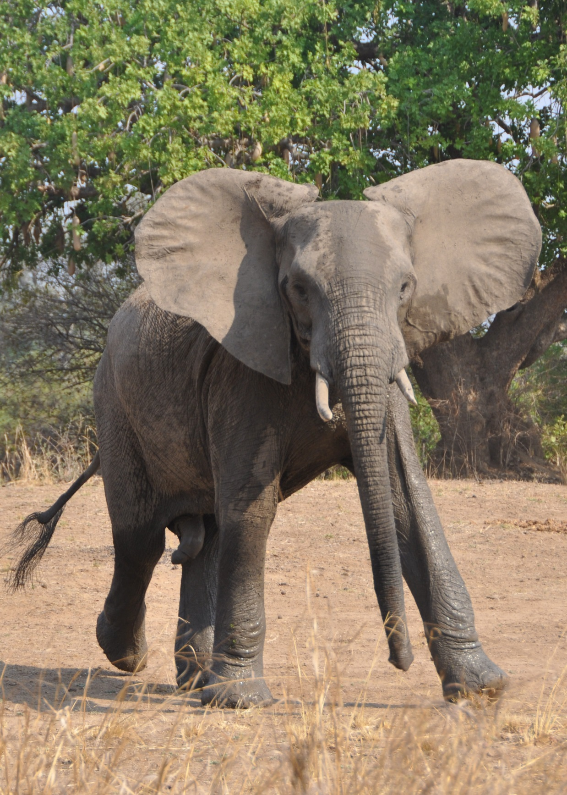
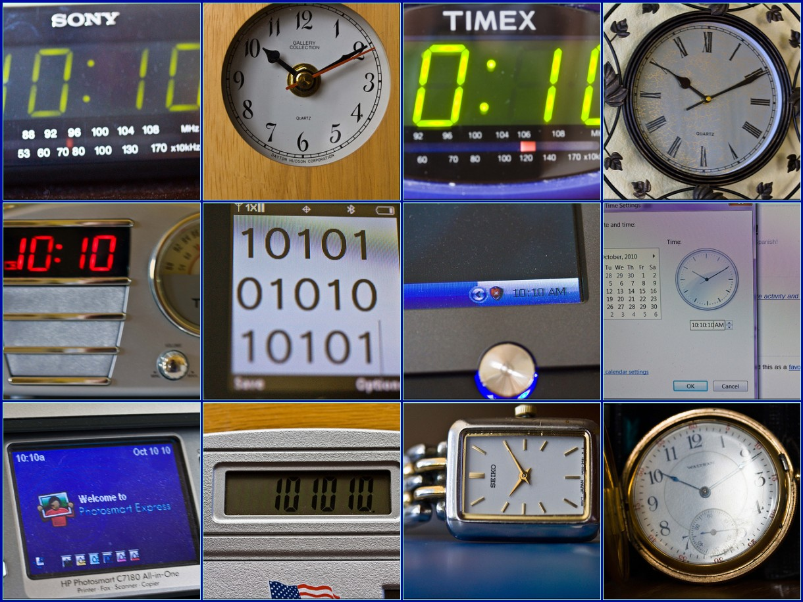
CC Image courtesy of Jill Clardy on Flickr
CC Image courtesy of Laura Kay on Flickr

Slide 5



Slide 6


Slide 7
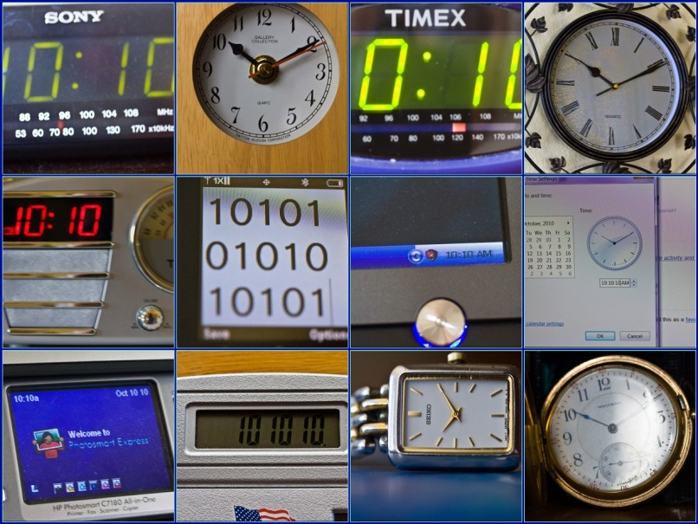
CC Image courtesy of Jill Clardy on Flickr

Slide 8

TIME, TIME and MORE TIME . . .
CC Image courtesy of s3aphotography on Flickr

Slide 9
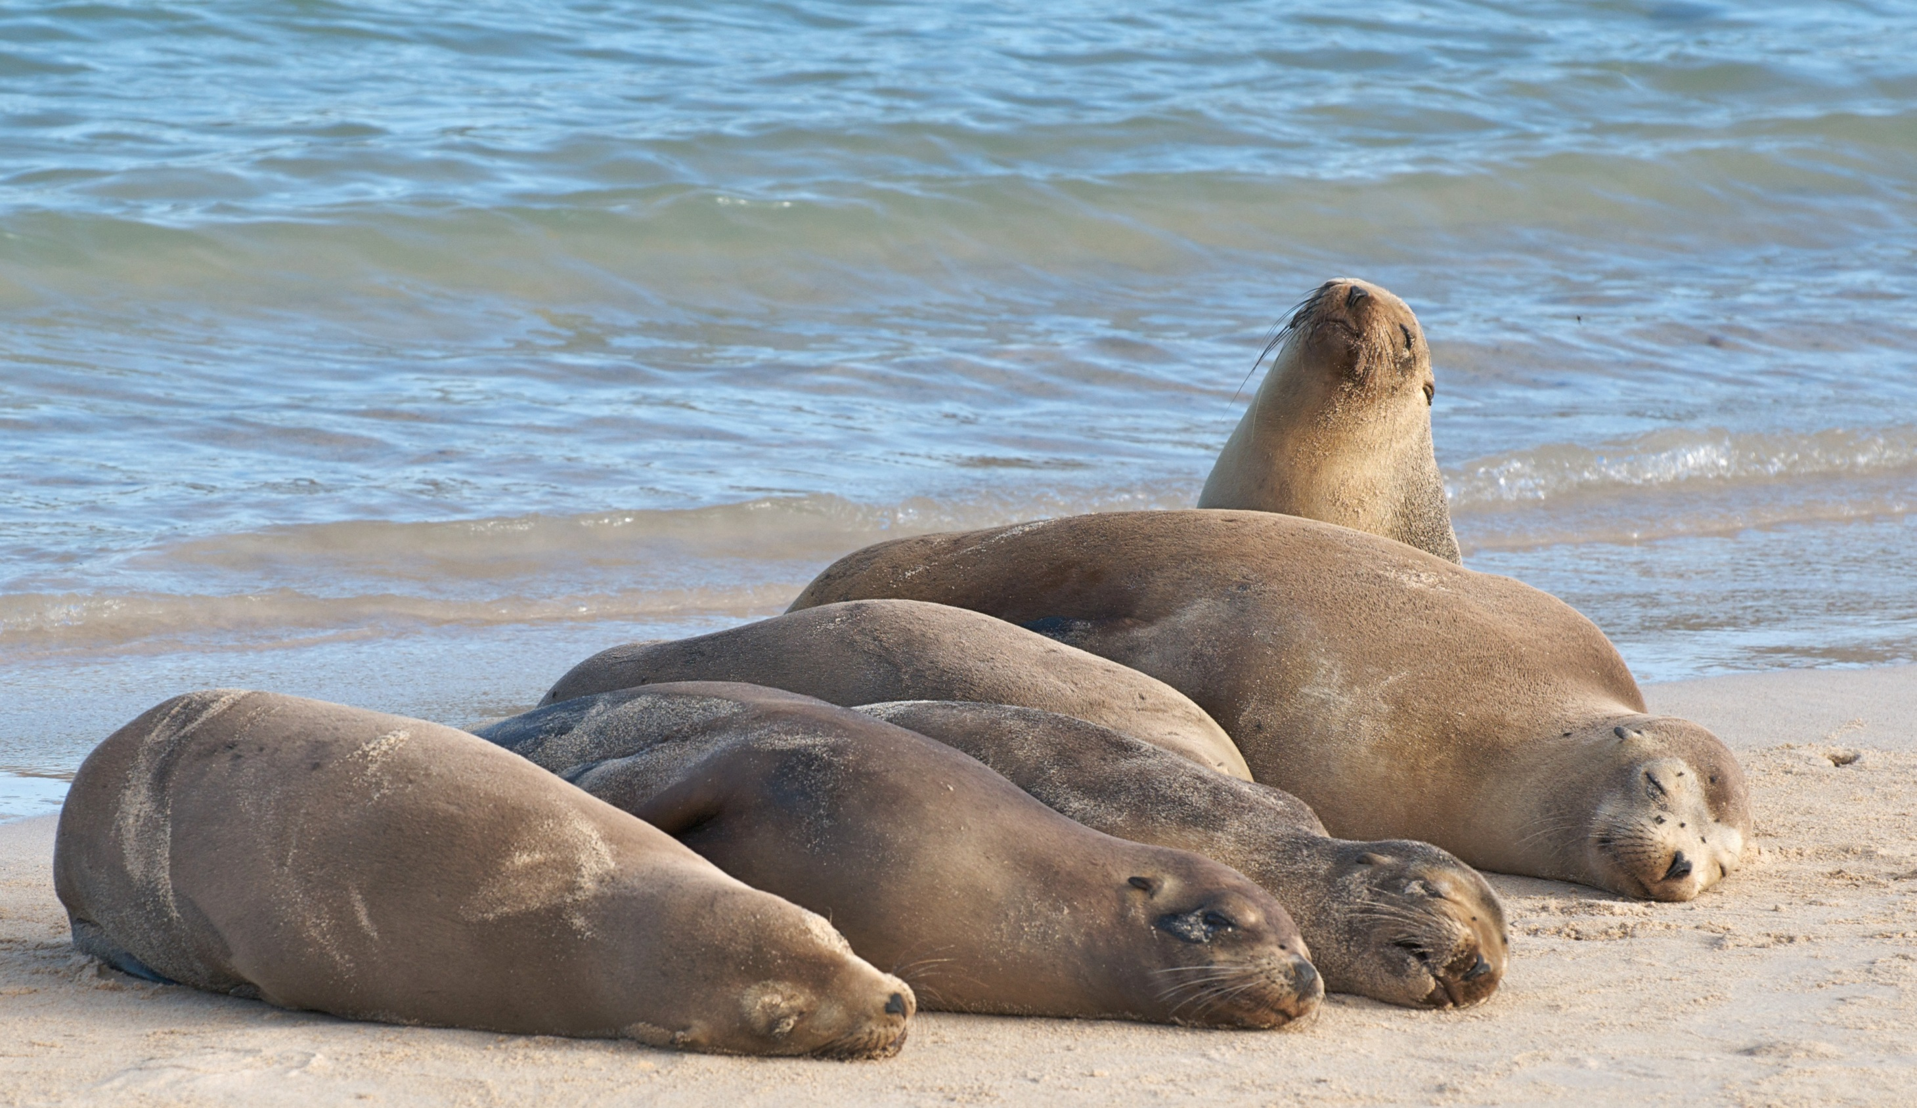
CC Image courtesy of A. Davey on Flickr

Slide 10


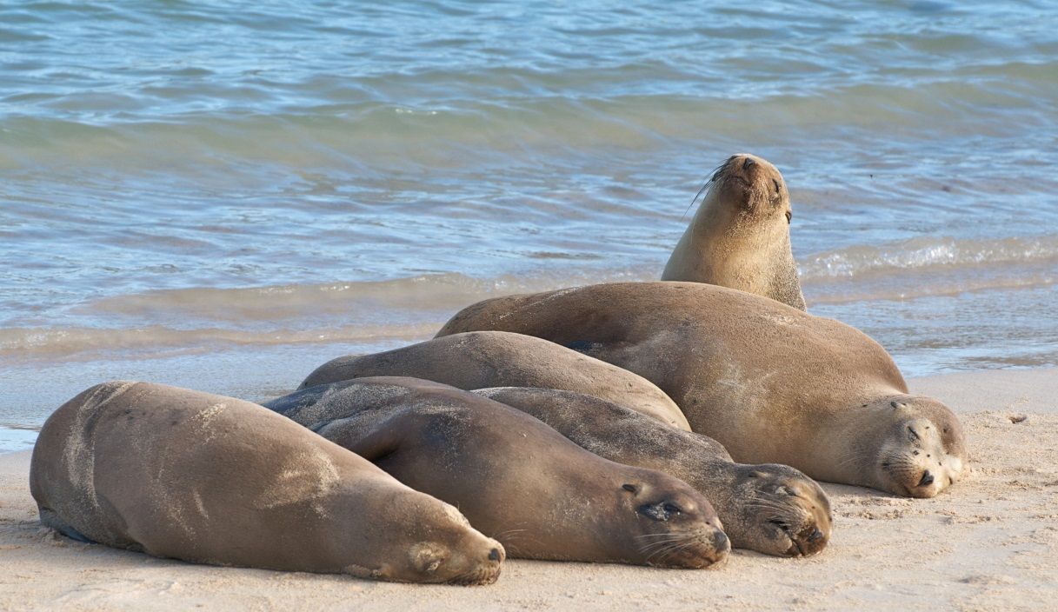
CC Image courtesy of Marjan Lazarevski on Flickr
CC Image courtesy of s3aphotography on Flickr
CC Image courtesy of A. Davey on Flickr

Slide 13
HANDS OFF SAVES TIME

Slide 14

Courtesy of www.clipartbest.com

Slide 15
THE SYLLABUS

Slide 16
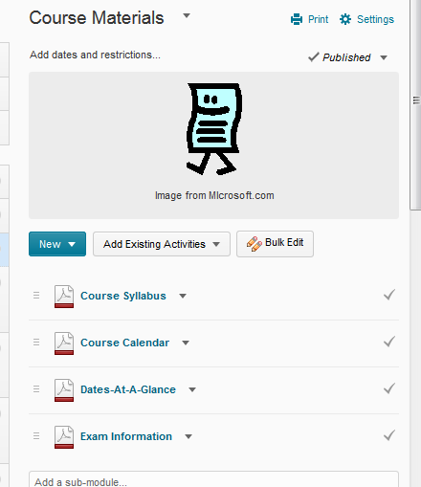

Slide 17
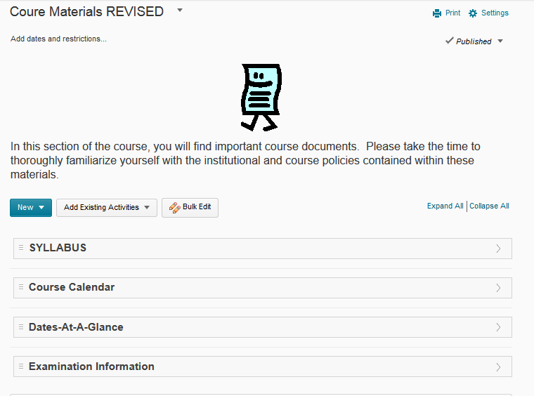

Slide 18
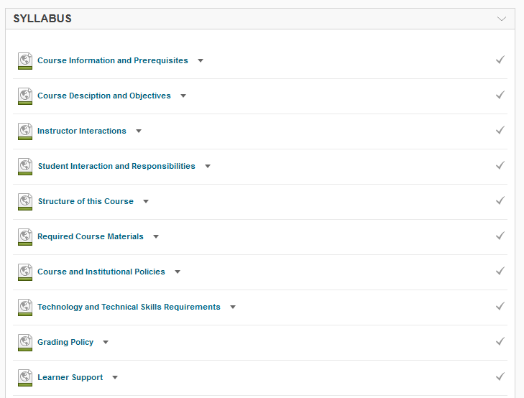
1.66
2.1, 2.36
5.36
5.46
1.26
4.66
1.3, 1.46
1.5, 1.76
3.26
7.1, 7.2, 7.3, 7.46

Slide 19
19 of 43 Specific Standards
40 of 95 points

Slide 20
42%

Slide 21
CC Image courtesy of Jill Clardy on Flickr

Slide 22
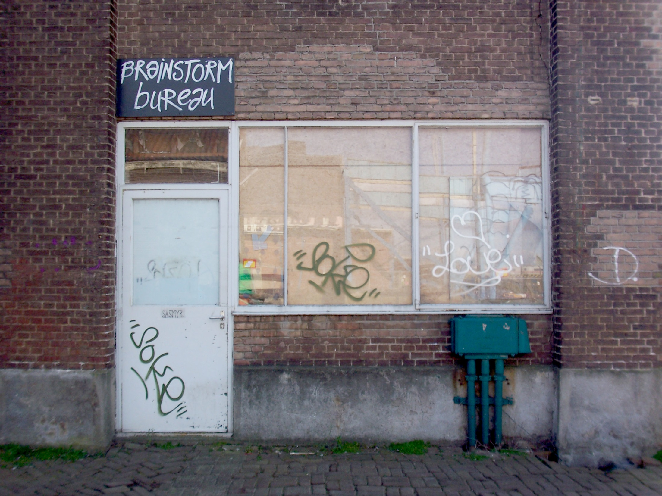
SYLLABUS
CC Image courtesy of screenpunk on Flickr

Slide 23
CC Image courtesy of Jill Clardy on Flickr

Slide 24
USE PATTERNS

Slide 25
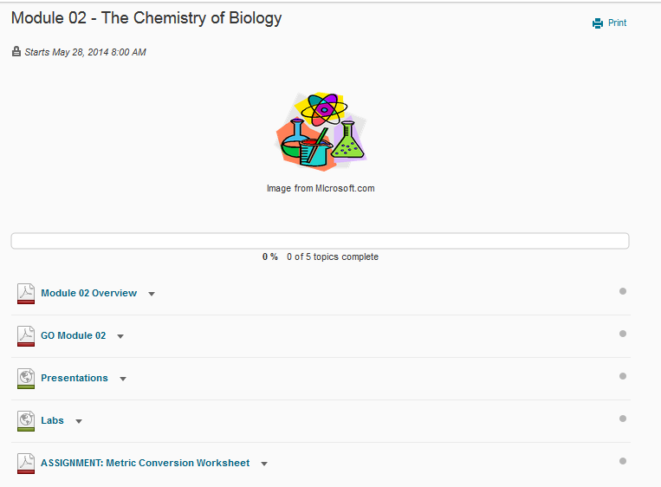

Slide 26
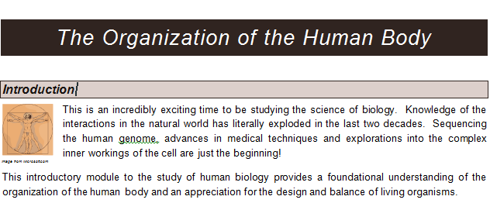

Slide 27
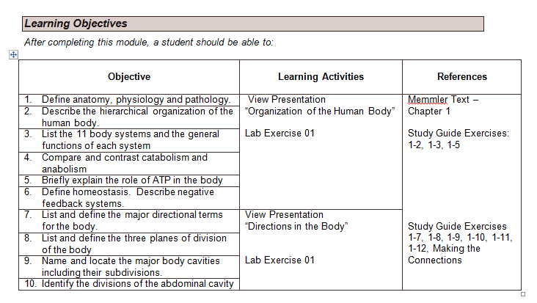

Slide 28
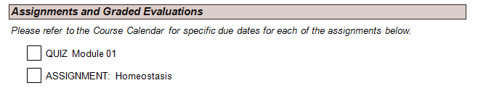
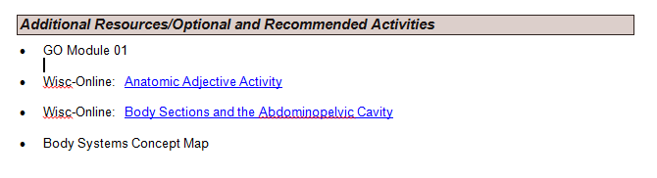

Slide 29
PATTERNS
CC Image courtesy of screenpunk on Flickr

Slide 30
DATES

Slide 31
Assignments

Slide 32
This ASSIGNMENT is worth a maximum of 10 points and is due in the D2L Dropbox “Cellular Disease” by the due date listed in your course calendar. Files submitted after the posted due date and time will receive a grade of “zero”.

Slide 33
Dropboxes

Slide 34
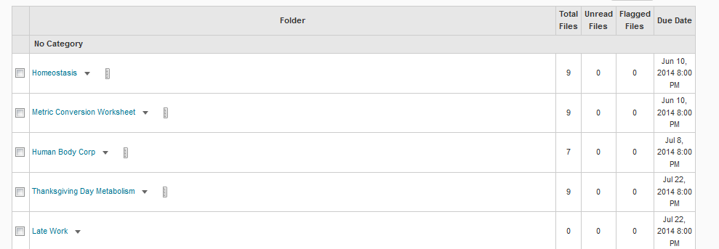

Slide 35
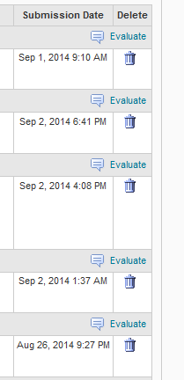

Slide 36
You can do the same thing with Discussions!

Slide 37
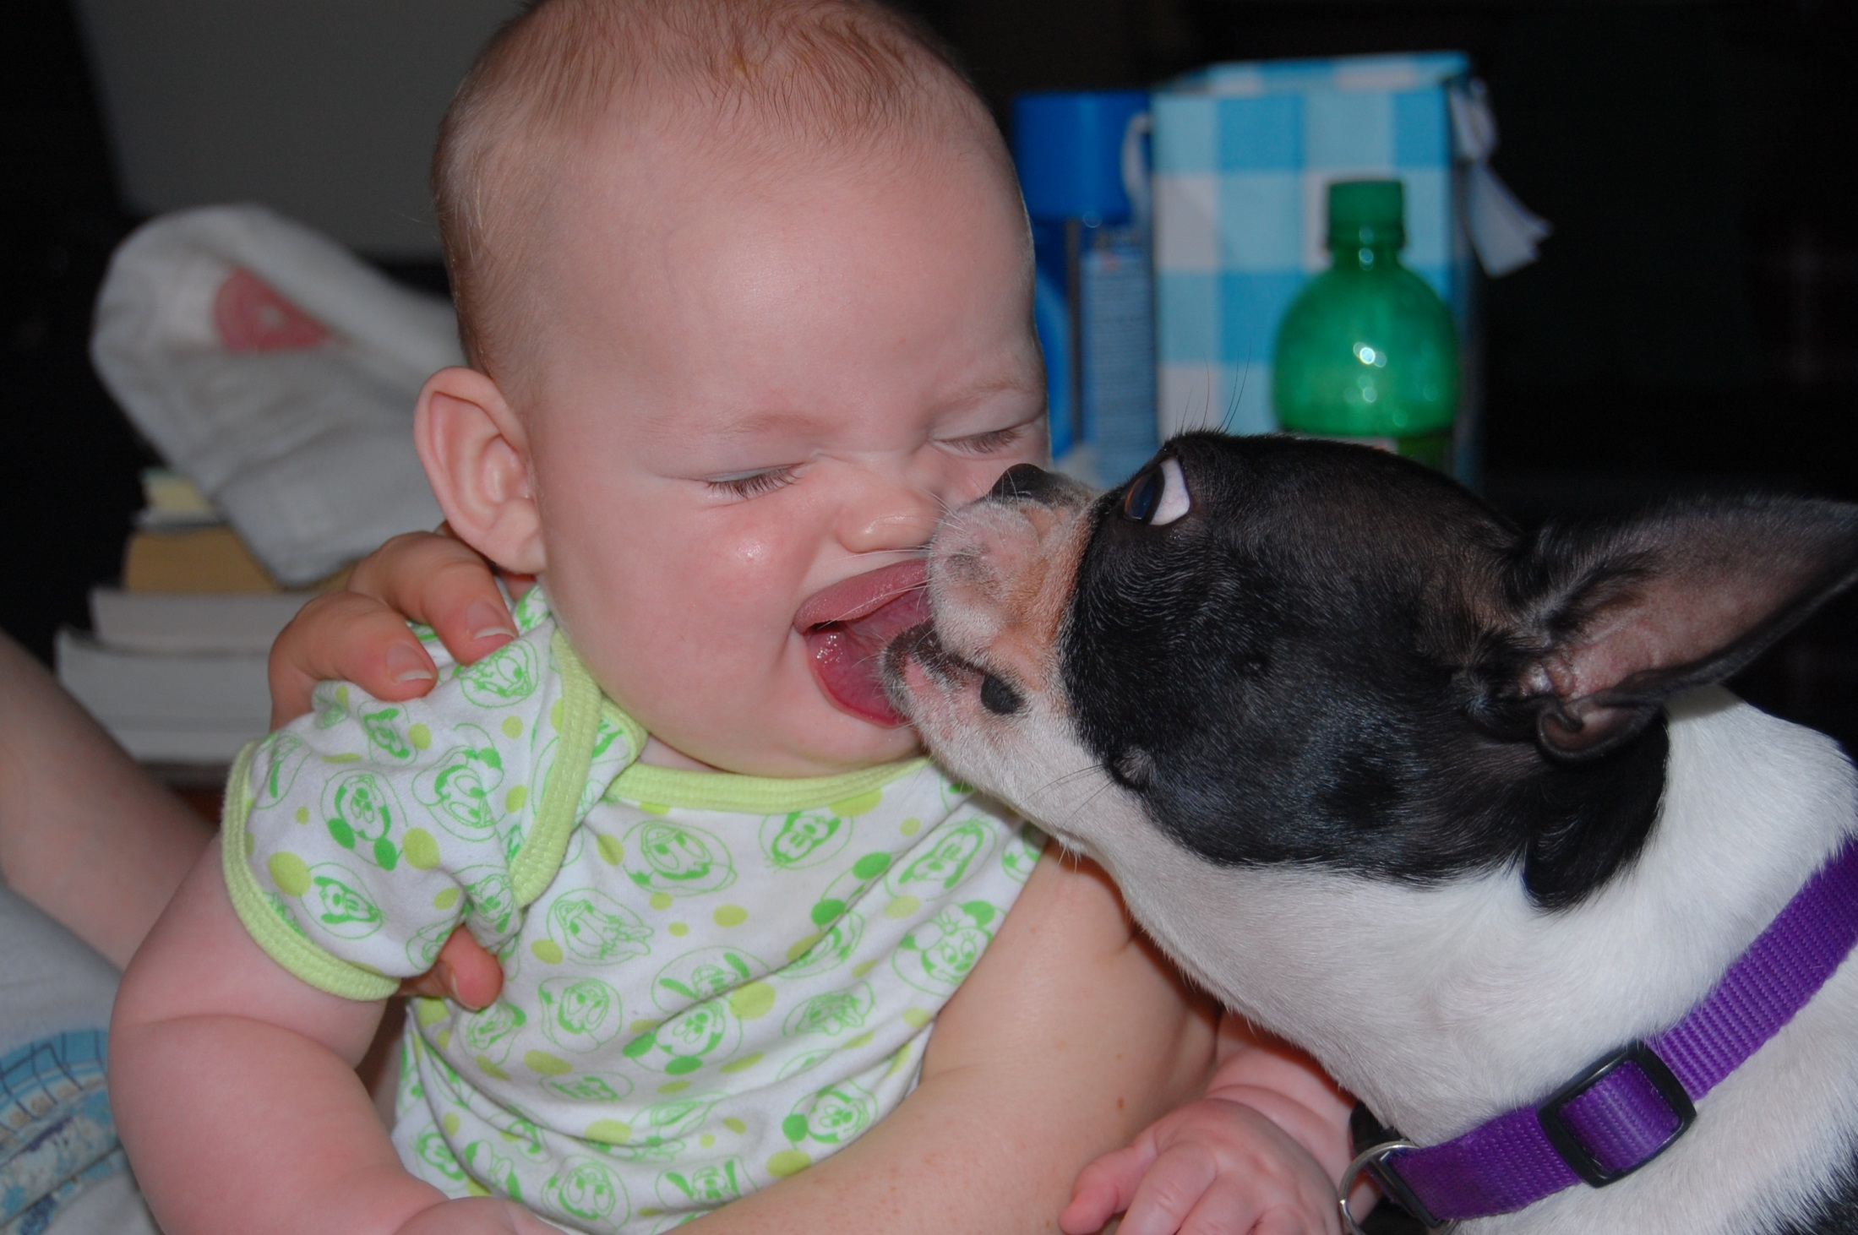
CC Image courtesy of Jay Malone

Slide 38
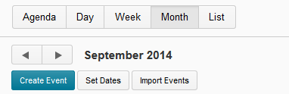
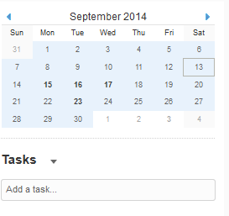

Slide 39
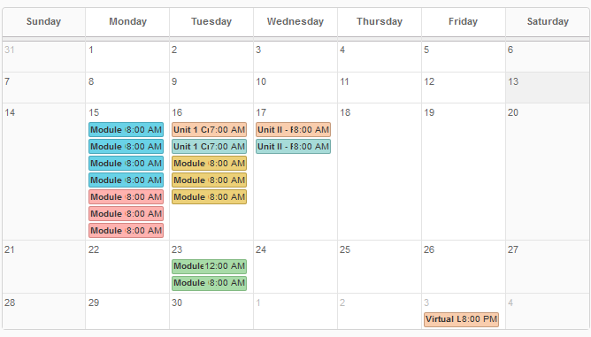

Slide 40
HANDS OFF SAVES TIME

Slide 41
DATES
CC Image courtesy of screenpunk on Flickr

Slide 42
FUN TOOLS

Slide 43
Links

Slide 44
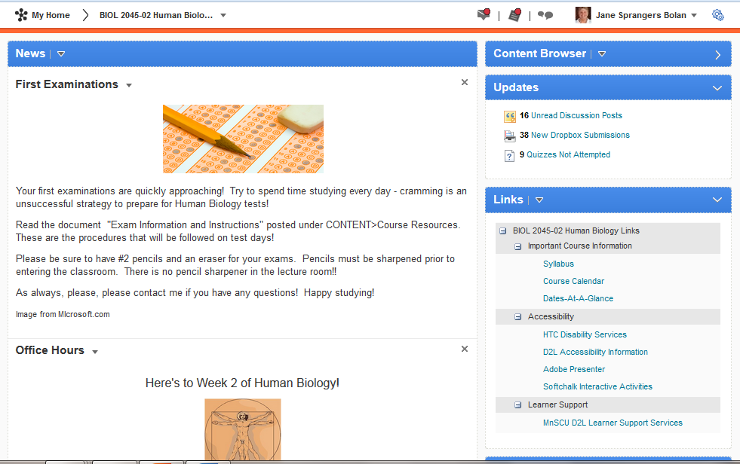

Slide 45
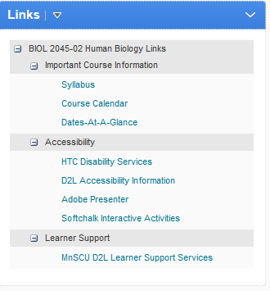
8.2
Standard 7

Slide 46
Checklists

Slide 47
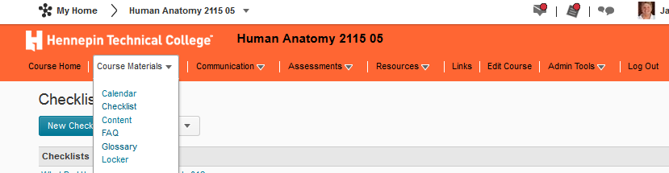

Slide 48
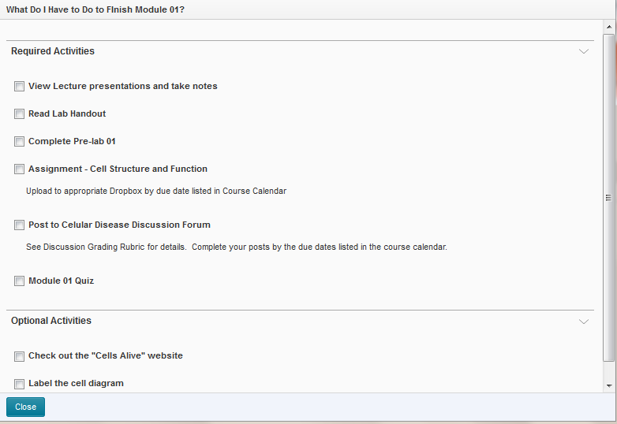

Slide 49
FAQs

Slide 50
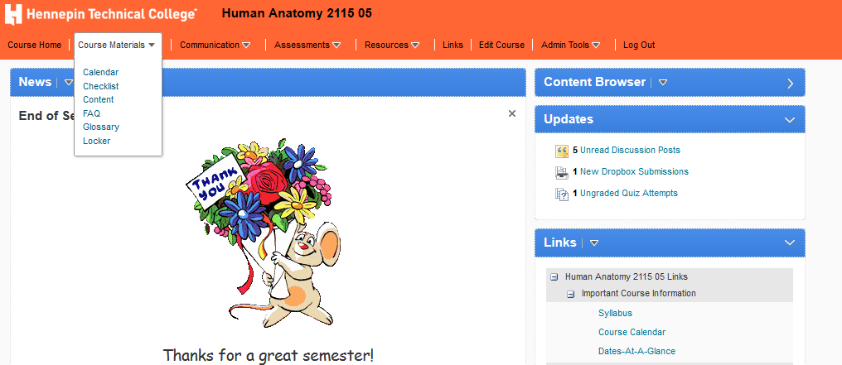

Slide 51
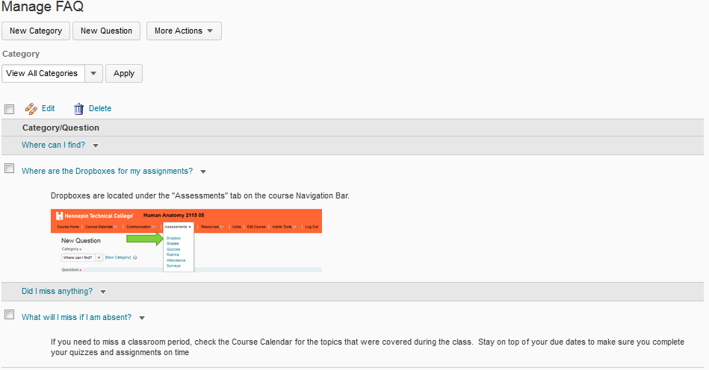

Slide 52
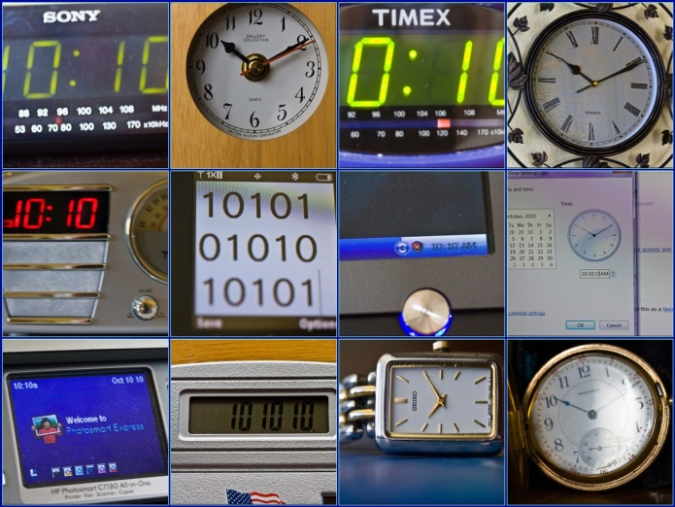
CC Image courtesy of Jill Clardy on Flickr
HANDS OFF SAVES TIME

Slide 53
MY ACTION PLAN
CC Image courtesy of screenpunk on Flickr

Slide 54

jsprangers@hennepintech.edu

Slide 55


Slide 56

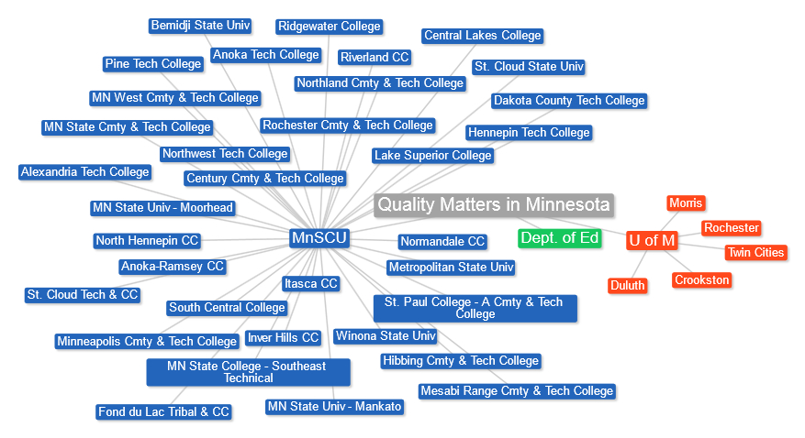

Affiliate Institutions
Notes:
Current as of 9/25/13

Slide 57
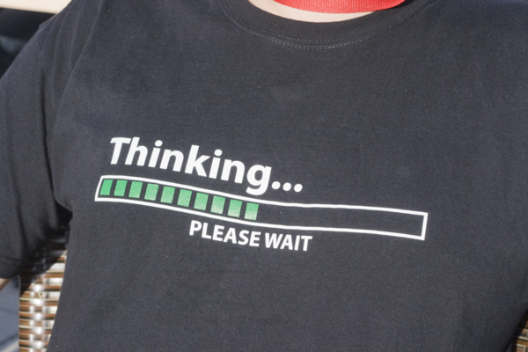
CC Image courtesy of Karola Riegler on FLickr

Slide 58
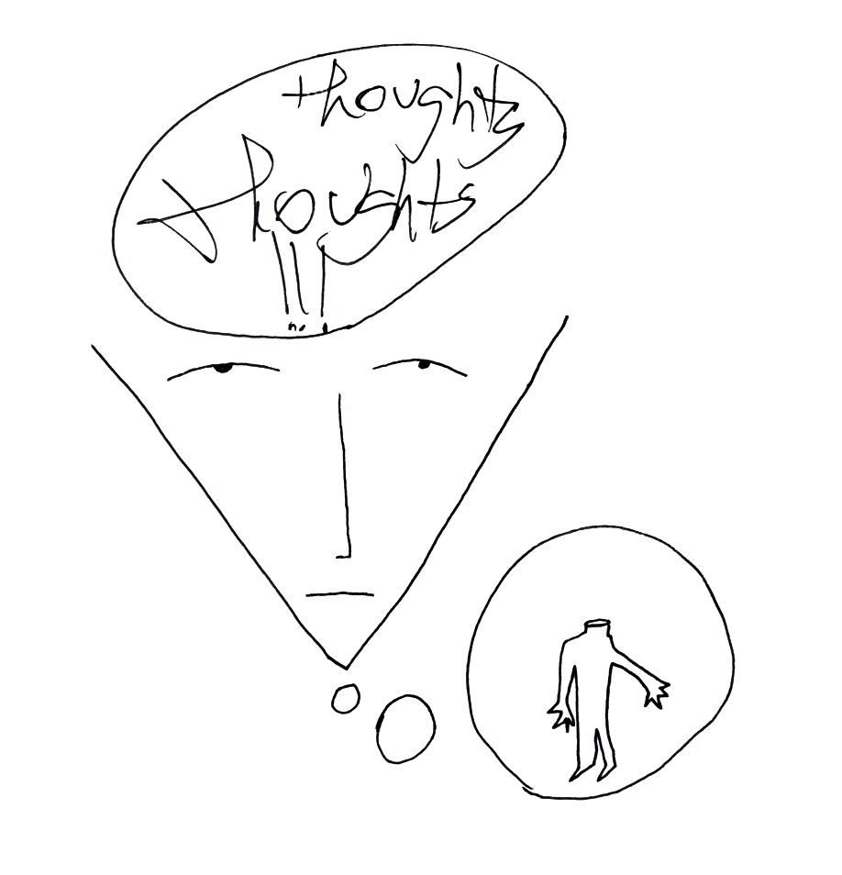
CC Image courtesy of Dan Allison on Flickr

Slide 59
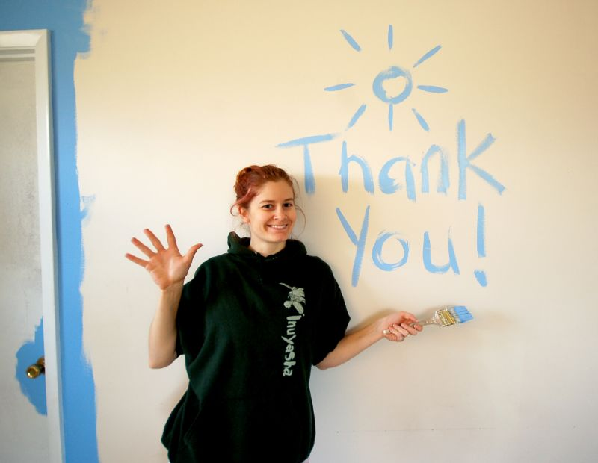
CC Image courtesy of Jaybird on Flickr

