Slide 1
Not So Lone Stars
Connecting the Global #QMmunity Using Social Media
#QMmunityConnect

Slide 2

GET SOCIAL
#QMmunityConnect
Tweet Tweet!

Slide 3

Timothy Lombardo
ABOUT YOUR PRESENTERS
Instructional Designer in the Office of Distance Education and eLearning
University Quality Matters Coordinator
Communications manager for the Ohio QM Consortium
#QMmunityConnect

Slide 4
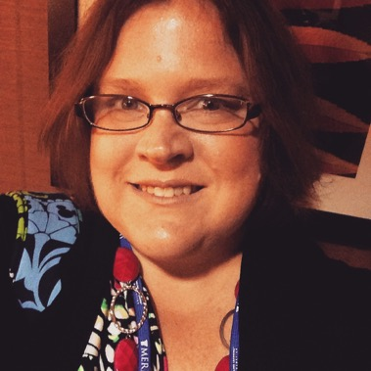
Julie Henn
ABOUT YOUR PRESENTERS
Director of Technology & CIO, Quality Matters
MyQM, CRMS, MyCR Application Development
Technical Support for QM Community
BI / Reporting Tools
#QMmunityConnect

Slide 5
By the end of this session, you will:
LEARNING OBJECTIVES
Identify a variety of social media tools and their potential to help promote Quality Matters
Describe tools and resources available through Quality Matters to engage with your institution as well as the global QM community
Illustrate how to implement these social media resources by looking at examples from other institutions/organizations at the local, state and national levels
Develop a social media plan
#QMmunityConnect

Slide 6
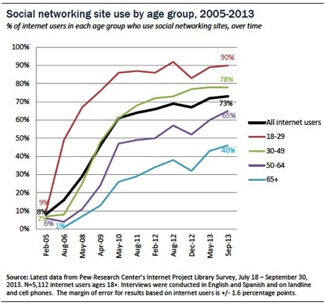
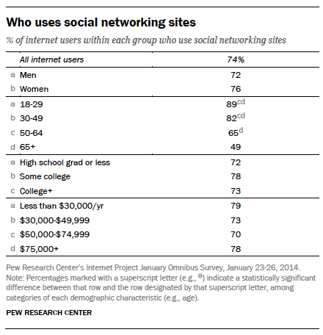
OBLIGATORY STATISTICS
#QMmunityConnect

Slide 7
THE ‘QMMUNITY’: WHO’S USING QUALITY MATTERS?
1,000+ Subscribing Institutions /Organizations
64,526 Individuals have MyQM Accounts
15,000+ Actively Engaged in Current Year
MyQM account holders in all 50 United States
800 individuals outside the United States
73% of MyQM Account Holders = Faculty
80% of QM Coordinators = “Administrator” or “Staff”
95% of All MyQM Account Holders Currently Receive QM Communications
Programs Offered via Distance Ed by QM Subscribers: 7,120 (14%)
Student Population of Subscribing Institutions: 7,483,990
#QMmunityConnect
Notes:
Over 150 institutions have subscribed for 8 years – growing percentage of QM veterans – with experience to share
# of individuals: (More than can fit in Dodger Stadium – 56,000)
Growing international presence
73% faculty - How are we reaching faculty? Social media is one tool / opportunity.
80% of QM Coordinators are Administrators or Staff – not faculty.
95% opt-inb - Very engaged / receptive community
Subscribing institutions serve close to 8 million students – offering 7,120 programs via distance education. Nationally, 14% of all distance ed programs are offered by QM subscribers. (Data: IPEDS)
How many more are using QM or QM-related materials without subscription? # is much higher

Slide 8
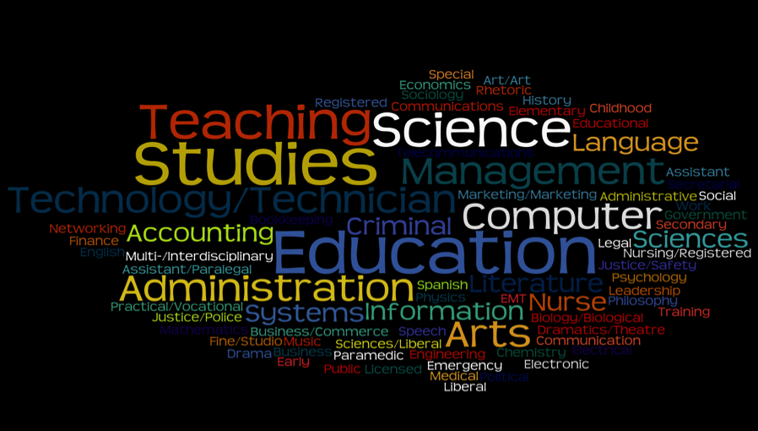
THE ‘QMMUNITY’: WHO’S USING QUALITY MATTERS?
#QMmunityConnect

Slide 9


SOCIAL MEDIA
Blogging
Facebook
Flickr
Instagram
LinkedIn
Twitter
Yammer
YouTube
#QMmunityConnect

Slide 10
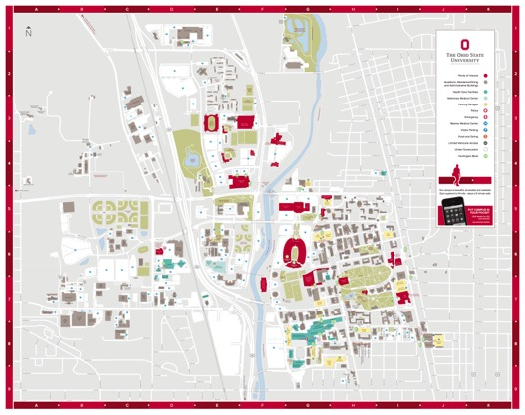
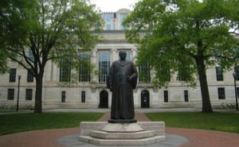
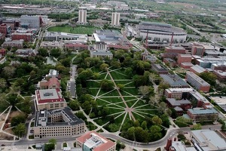
THE CHALLENGE: OUTREACH AND PROMOTION
#QMmunityConnect

Slide 11
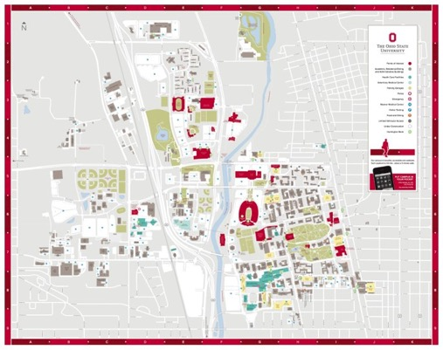
The Ohio State University
THE SOLUTIONS: OUTREACH AND PROMOTION
Blogging
Social Media
Websites
Videos
Webinars

Slide 12
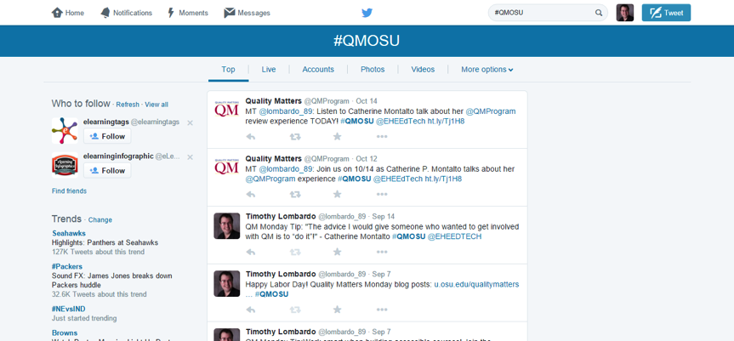
Twitter Hashtag
THE SOLUTIONS: TWITTER HASHTAG

Slide 13
THE SOLUTIONS: OUTREACH AND PROMOTION
The Ohio State University
Page Views: 2014
Visits: 981
Unique Visitors: 809
Blogging
Viewers in:
Italy
Bulgaria
Canada
Germany
United States
Japan
Malaysia
Saudi Arabia
Social Media

Slide 14
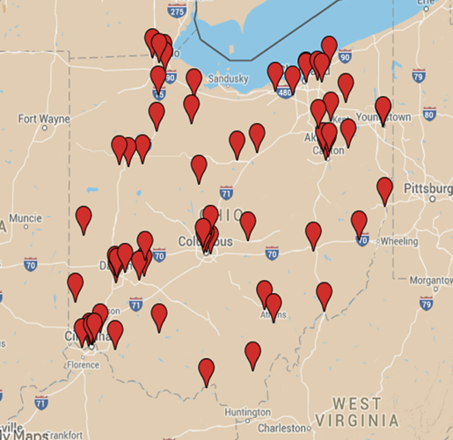
THE SOLUTIONS: OUTREACH AND PROMOTION

Slide 15

The Ohio QM Consortium
THE SOLUTIONS: OUTREACH AND PROMOTION
Blogging
Social Media
Websites
Flickr
YouTube

Slide 16
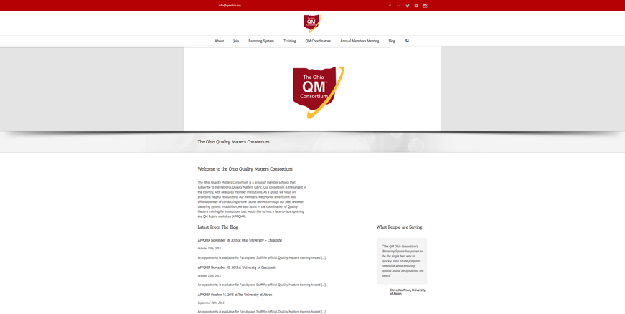
THE SOLUTIONS: OUTREACH AND PROMOTION

Slide 17
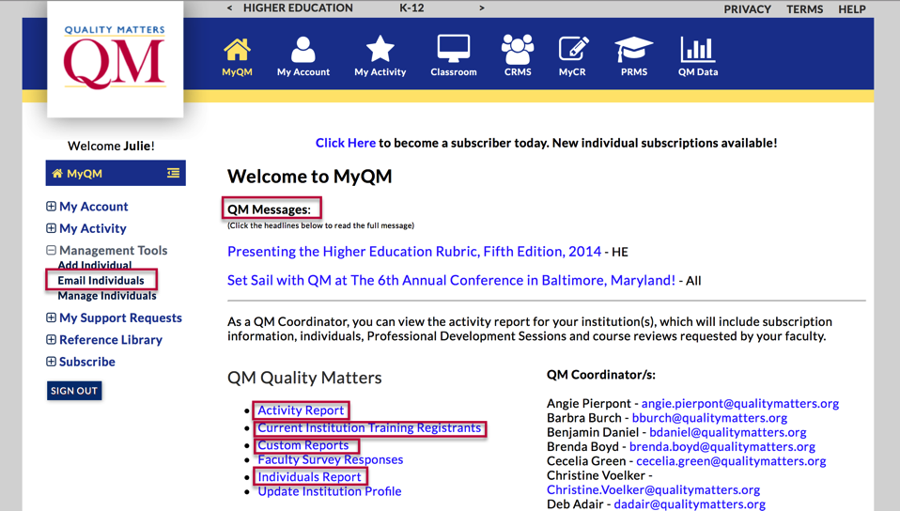
Quality Matters Tools
QM TOOLS FOR ENGAGEMENT
Notes:
Some QM tools are available only to QMCs – if you’re not the QMC, ask for information / access.
QM Messages area contains headline news items. Most important QM news – content for sharing
Email Individuals based on QM Role, Training, or Institution (for Statewide Systems).
Activity Report

Slide 18
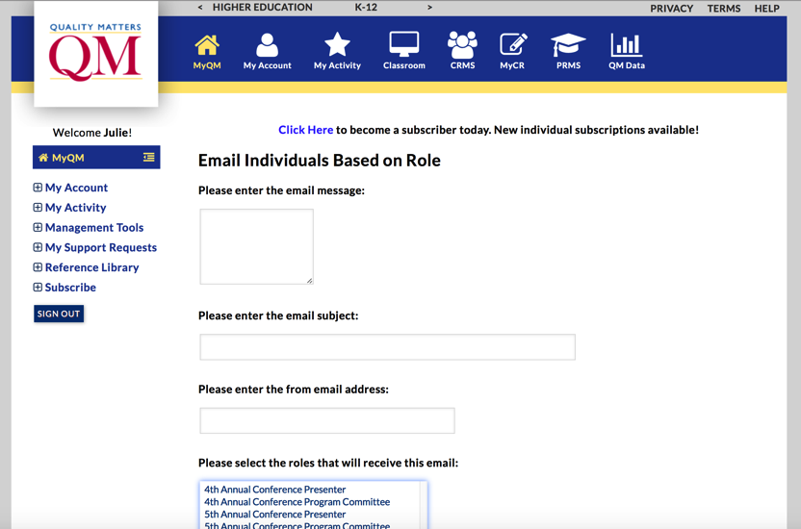
Quality Matters Tools
QM TOOLS FOR ENGAGEMENT
Notes:
Email Individuals at your Institution / Within your System Based on Role – All Peer Reviewers, Master Reviewers, etc.

Slide 19
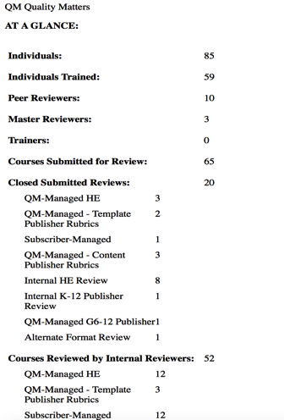
QM TOOLS FOR ENGAGEMENT – ACTIVITY REPORT / CUSTOM REPORTS
Statistics on QM implementation
Available in MyQM
Export to Excel
Export to PDF
Uses: Promotion, Progress Reporting, Financial Justification
Coming Soon to MyQM Dashboard
#QMmunityConnect

Slide 20
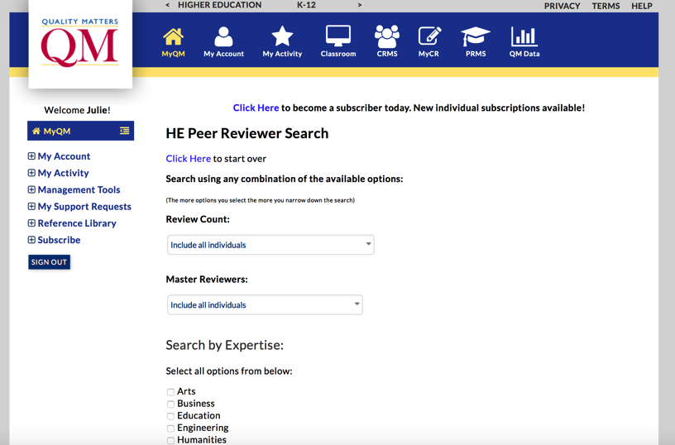
Quality Matters Tools
QM TOOLS FOR ENGAGEMENT
Notes:
Locate peer reviewers at your institution or within your system by expertise / discipline area. Helpful for targeting particular groups to help with outreach / promotion.

Slide 21
QM TOOLS FOR ENGAGEMENT – COMING SOON: MILESTONE SHARING
MyQM Social Media Integration
Course Recognition
Professional Development Completion
Professional Development Referral Tool
Individual Certifications – PR, MR, Facilitator
User Defined / Implementation Plan Milestone Achievements
Membership Anniversaries
Group Professional Development Completed
Conference Attendance
#QMmunityConnect

Slide 22
How can QM help you capture and promote your institutional QM efforts?
QM TOOLS FOR ENGAGEMENT – COMING SOON: MILESTONE SHARING

Slide 23





Social Media Tools
TOOLS FOR THE SOCIAL MEDIA PLAN
#QMmunityConnect

Slide 24
Social Media Plan should include:
CREATING A SOCIAL MEDIA PLAN
What are your measurable objectives for using social media?
What tools am I going to use?
  Ex. Blog, Twitter, Hootsuite
When am I going to consistently have announcements?
Can people participate in discussions?
  If yes, how long before I reply?
#QMmunityConnect

Slide 25
Social Media Plan should include:
CREATING A SOCIAL MEDIA PLAN
Gathering statistics and data
  Google Analytics
    How long are your followers reading?
    Where are your readers?
A plan to celebrate wins and milestones!
#QMmunityConnect

Slide 26
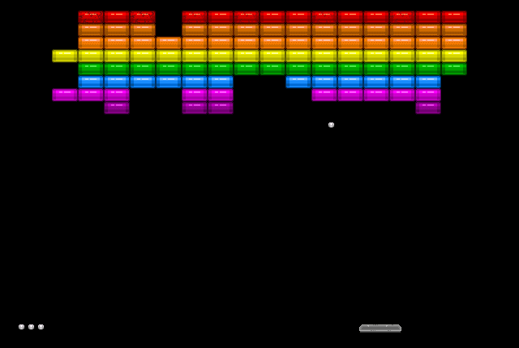
Create a Social Media Plan
BREAKOUT TIME!

Slide 27

Create a Social Media Plan
BREAKOUT TIME!
Get into a small group
Discuss the following:
  What days are you planning to post?
  What are you going to post?
  What tools are you going to use?
    Blog + Tweet?
  When are you going to respond to questions or other communications?
Report back in 5 minutes
Reminds you of standard 5.3?
END
Notes:
This bar timer, will start when anywhere on the slide is clicked. The bar will move from left to right and the word ‘End’ will appear at the end, accompanied by a ‘Deep Gong’ sound. It is possible to change the duration of this timer to any time, by entering the animation settings, and changing the timing for ‘rectangle 3’. Note the time has to be entered as a number of seconds – so if you want 2mins & 30secs – this is entered as 150 (60X2 + 30 = 150).

Slide 28
Why?
THE BIG QUESTION
The Big Question:

Slide 29
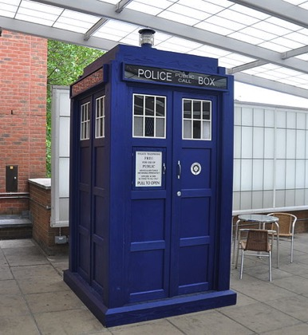
The answer to, Why?
THE BIG QUESTION
Unless you have one of these, you won’t be able to get to every person at the same time.

Slide 30
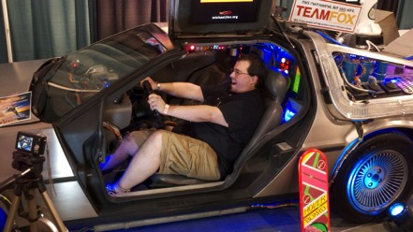
The answer to, Why?
THE BIG QUESTION
Unless you have one of these, you won’t be able to see every presentation.

Slide 31

The answer to, Why?
THE BIG QUESTION
All it really costs is time

Slide 32
Great Resources to follow on Social Media
WHO TO FOLLOW
Quality Matters Program
QMProgram
QMQualityMatters
@QMProgram
@QMTechnology
quality-matters-program
http://www.qualitymatters.org

Slide 33
Great Resources to follow on Social Media
WHO TO FOLLOW
Quality Matters Instructional Designers Association
IDA.Network
@IDA_Network
http://ida.qualitymatters.org

Slide 34
For More Information
CONTACT INFO
Timothy Lombardo, M.S.
Instructional Designer
University Quality Matters Coordinator
614.688.2085
@lombardo_89
lombardo.89@osu.edu
#QMOSU
go.osu.edu/qm
u.osu.edu/qualitymatters

Slide 35
For More Information
CONTACT INFO
Julie Henn, MBA
Director of Technology & Chief Information Officer
Quality Matters
410.497.8035
@juliehenn
jhenn@qualitymatters.org
@QMTechnology

Slide 36
THANK YOU
Questions?
Timothy Lombardo, M.S.
Instructional Designer
University Quality Matters Coordinator
Office of Distance Education and eLearning
(614) 292-8860
www.osu.edu
Julie Henn, MBA
Director of Technology & CIO
Quality Matters
(410) 497-8035
www.qualitymatters.org

Slide 37
Presentation References
Presentation References
Center, P. R. (2013, 2013-12-27). Social Networking Fact Sheet. Retrieved from http://www.pewinternet.org/fact-sheets/social-networking-fact-sheet/
Cheng, F. (2015). Atari 2600 home version of Breakout (from Wikipedia). Retrieved from https://www.flickr.com/photos/gloomcheng/4956907364/
Consortium, T.O. Q. M. (2015). The Ohio Quality Matters Consortium. Retrieved from http://qmohio.org/
Google. (2015). Google Analytics Developer
Branding Guidelines & Policies. Retrieved from https://developers.google.com/analytics/terms/branding-policy /

Slide 38
Presentation References
Presentation References
Google. (2015). Google Analytics Developer Branding Guidelines & Policies. Retrieved from https://developers.google.com/analytics/terms/branding-policy /
Inc., H. M. (2015). Media Kit. Retrieved from https://hootsuite.com/about/media-kit
Lombardo, T. (2015). OH QM Consortium Members Google Maps. Retrieved from https://www.google.com/maps/

Slide 39
Presentation References
Presentation References
Lombardo, T. (October 14, 2015Time: 11:30am â 12:30pmLocation: Campbell Hall 252Registration: No Registration Required). Quality Matters Program at OSU | Quality Matters through the Office of Distance Education and eLearning. Retrieved from https://u.osu.edu/qualitymatters/
OpenClipartVectors. (2015). Free Image on Pixabay - Twitter, Tweet, Bird, Funny, Cute. Retrieved from https://pixabay.com/en/twitter-tweet-bird-funny-cute-117595/

Slide 40
Presentation References
Presentation References
Periscope. (2015). Periscope - Press Assets. Retrieved from https://www.periscope.tv/presssonywiz. (2015).
Free Image on Pixabay - The Tardis, Doctor Who, Television. Retrieved from https://pixabay.com/en/the-tardis-doctor-who-television-263153/
Twitter. (2015). Twitter | #QMOSU. Retrieved from https://twitter.com/search?q=%23QMOSU

Slide 41
Presentation References
Presentation References
University, T. O. S. (2015). Map_2015-16_4C_pathed_150629 - map.pdf. Retrieved from https://www.osu.edu/map/pdf/map.pdfUniversity
W. F. (2015). Icons | Web Style Guide | Wake Forest University. Retrieved from http://styleguide.web.wfu.edu/icon/

