Slide 1

Determining an Internal Course Review Process
Panel Discussion

Slide 2
Panelists
Sue Schou, PhD
    College of Business
Gary Storie, EdD
    College of Education
Mary Whitaker, AuD
    Division of Health Sciences
Lisa Kidder, MA
    Instructional Technology Resource Center
Jeff Brocket
    Division of Health Sciences
Notes:
Here are our panelists for today. Unfortunately Jeff and Lisa were unable to join us.

Slide 3
Overview
Provide some background
Describe the process used to determine an internal review process
Present the 3 models we evaluated
Discuss experiences with the process
Examine the recommendations
Notes:
This is an overview of the presentation today.

Slide 4
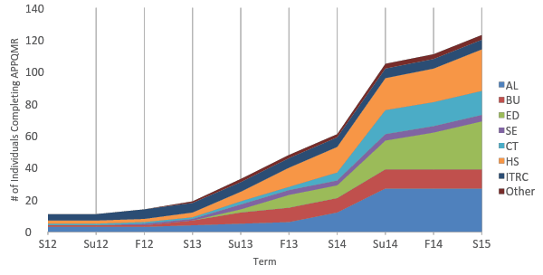
QM Workshop by College / Division
Notes:
To provide you with some background, we began our adoption of QM in 2012 with a committee of 10 faculty. We have taken a slow implementation path and have been focusing on preparing faculty through professional development. This is a chart of how many faculty across the university have successfully completed the Applying the QM Rubric Workshop.
As you can see we have experienced a large growth rate this past year, with several departments and colleges requiring their faculty to participate.
Overall this is approximately 14.7% of the faculty – both full time and adjunct, with some others from the ITRC, the Library, and the Student Success Center.

Slide 5
Original QM Committee Recommendations
Online Student Experience
Objectives & Alignment
Manageable Pieces
Recommended Professional Development (APPQMR)
Additional Professional Development
ISU Internal Review Process
Actual Student Perspective
QM Official Reviews
Incentives
Examples
Notes:
From the initial QM Committee in 2012, there were 10 recommendations. This past summer we worked on #6.

Slide 6
Peer Review Project
The Project included
  14 Faculty as Reviewers/Mentors
  2 Instructional Technologists
  6 Course Developers
Complete a course review following one of 3 models
Recommend an Internal Peer Review Process
Notes:
In order to develop an internal peer review process we wanted to include faculty form across the campus.

Slide 7
The 3 Internal Review Models
Mentor Model
ID Model
QM Model
Gary Storie
Mentor
Mary Whitaker
Course Representative
Sue Schou
Master Reviewer
Mary Whitaker
Peer Reviewer
Notes:
The panelists today each took part in one of more of the models and will be talking about their experiences, and then we will be presenting the recommendations.

Slide 8
Mentor Model
1 Mentor
  Confirm Evidence
  Support & Recommend Improvements
Course Developer
  Self-Review
  Alignment Matrix
  Respond to Feedback
Notes:
Gary

Slide 9
Mentor Model
The 3 R’s
Review
  developer
Recommend
  mentor
Respond
  developer
Notes:
Gary

Slide 10
Mentor Model: Responsibilities
Course Developer
Confirm evidence
Support & recommend improvements
Self-Review
Complete Alignment Matrix
Mentor
Respond to Feedback
Notes:
Gary
May also include a Review Coordinator: This person will coordinate the reviews, form the review teams, and provide assistance during and after reviews.

Slide 11
Mentor Model: Requirements
Supportive Behavior
Positive Interaction
Good Communication
Notes:
Gary

Slide 12
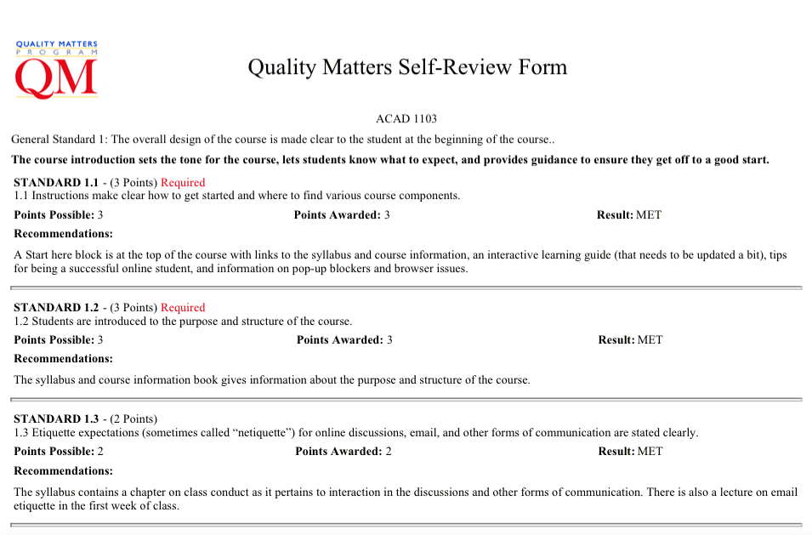
Mentor Model - Self Review
Developer
  … as if they were doing the QM review
Review format
  … already established
Notes:
Gary

Slide 13

Mentor Model - Recommend
Mentor
  Easy to find information
  Live collaboration increases efficiency
  Opportunity for learning on both sides
  Single reviewer – less stressful for
  developer
Notes:
Gary

Slide 14

Mentor Model - Respond
Developer
  Focus on specific recommendations
  Many are quick link fixes or clarifications
Show quick (early) progress
Easy to set goal for completion
Notes:
Gary

Slide 15
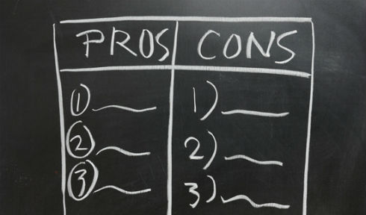
Mentor Model
Personality
Low oversight
Active Learning
Interactive
Efficient
? SME
Notes:
Gary

Slide 16

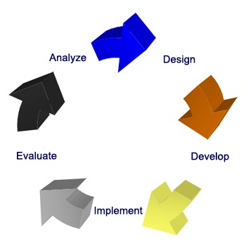
ID Model
3 Reviewers
  Outside College
  Instructional Designer
  Team Chair
Followed the QM Process
Notes:
Mary – participating as a course representative

Slide 17
QM Model
3 Reviewers
  1 SME
  Outside College
  Team Chair
Followed the QM Process
Notes:
Sue & Mary as peer reviewers

Slide 18
The 3 Internal Review Models
Mentor Model
ID Model
QM Model
1 Mentor
  Confirm evidence
  Support & Recommend improvements
Course Developer
  Self-Review
  Alignment Matrix
  Respond to Feedback
3 Reviewers
  1 Outside College
  1 Instructional Designer
  Team Chair
Followed the QM Process
3 Reviewers
  1 SME
  Outside College
  Team Chair
Followed the QM Process
Notes:
Here is an overview of all three models, identifying the people involved, their roles, and some of the details from the process.

Slide 19
Instructional Designer / Technologist
Alignment Matrix
Self-Review
3 Reviewers w/
1 Outside of College
ISU Internal Review Process
Notes:
In the end it was recommended to incorporate pieces from each model to create the internal course review process for Idaho State.
From the Mentor Model, as part of the preparation and application for course review, course representatives will complete an alignment matrix and provide evidence of a self-review.
From the ID Model, the review team will include an instructional designer/technologist.
From the QM Model, there will be 3 reviewers with one outside the college.

Slide 20
Internal Review Recommendations
Combination of the ID / Mentor Models
Course Review application to include
  Course Alignment Map
  Evidence of Self-Review
3 Reviewers
  1 from the College/Division
  1 outside the College/Division
  1 Instructional Technologist
Midpoint Check in with the Course Review Manager
Notes:
In addition, the group recommended an additional Midpoint Check-in meeting with the Course Review Manager.
At this point in time the recommendations have been presented to the eISU committee (oversees online courses) and will be presented to the Dean’s Council at the end of this month.

Slide 21
Questions?

Slide 22
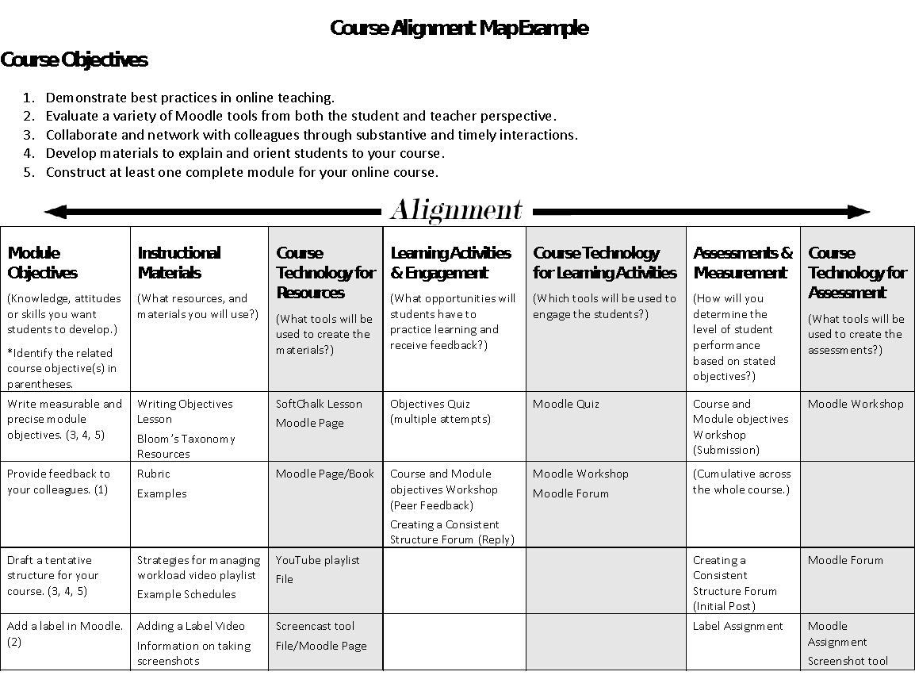
tinyurl.com/alignmentmap
Notes:
This is an example alignment matrix.
You can go to the tinyurl address to pull up a copy you are able to see and explore.

