Slide 1

Once Upon a Time there was a small college in Westchester County, NY
They believed that Quality did Matter – and still does
This is their journey…
Poster by Paula Cancro, pcancro@cw.edu
The College of Westchester, White Plains NY

Slide 2
2010
The Online Division began – with quality in the mission,
but not a lot of knowledge of QM as a program
A Dean went back to school -online and took a LOT of classes

Slide 3
2011 – What is this QM?
Quality Matters is introduced to a few interested faculty

Slide 4
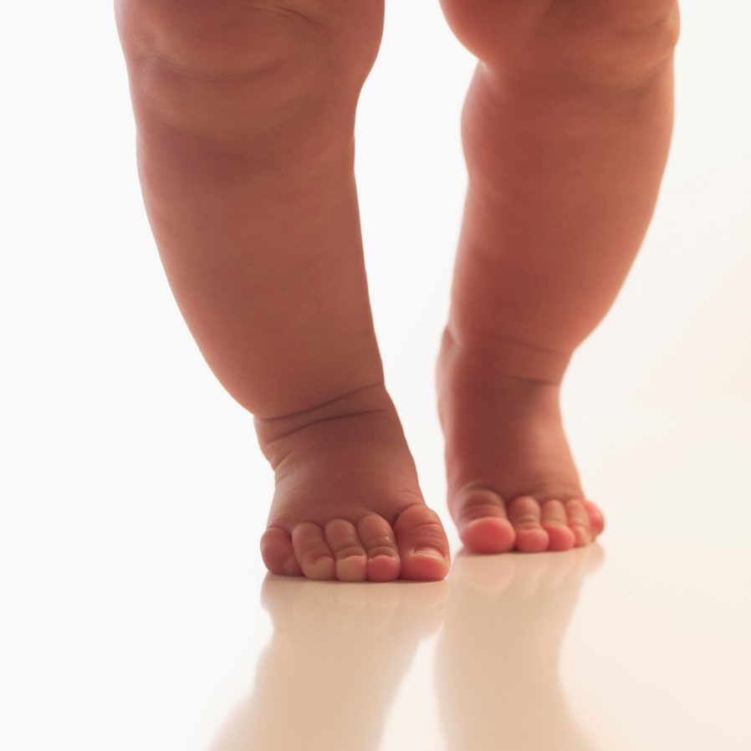
2011
The word of QM begins to spread
And a small group of faculty begin to learn again - online

Slide 5

2011➔????
What’s next? We want more

Slide 6
2011
APPQR
2012
Publisher Rubric
CPE Rubric
Peer Reviewer
Accessibility
Teaching online
Accessible Word Documents
2013
Discussion Board Rubric
Improve your course
2014
2014 Rubric Update

Slide 7
APPQR and Peer Reviewer Certifications

Slide 8
Various QM Courses
Discussion Board Rubric
Accessible Word Docs
IR Tools Webinar
Improve Your Online Course
CPE Reviewer for HE
Publisher Accelerated Reviewer
Teaching Online – An Intro
Improve your Online Course

Slide 9

2011 - Three CW Participants Certified:
Applying the QM Rubric
Peer Reviewer 
Today
12+ certified in APPQR
8 Peer Reviewers
1 Master Reviewer
1 Certified Face-to-Face Facilitator
1+ Certified Online APPQR Facilitators

Slide 10

Current Activities
Online Faculty Development Course
Course Design Revisions
Partnership – IDs and SMEs
Continuing Education opportunities - full-time & adjunct

Slide 11

Going Forward
In-house Faculty Development
Full-time and adjunct faculty
Face-to-Face and Online
**In-house Face-to-Face and Online APPQMR Workshop Facilitators

Slide 12
Let’s continue the conversation

Slide 13
Post any contact info, questions, comments – Let’s continue the conversation
Paula Cancro, Assistant Professor pcancro@cw.edu
The College of Westchester, White Plains NY

