Slide 1

Activities for Building Community Online
Sarah Barnhardt, Associate Professor, ESOL
Chester Gates, Adjunct Professor, Reading/ESOL/ACLT
Quality Matters Conference 2015

Slide 2




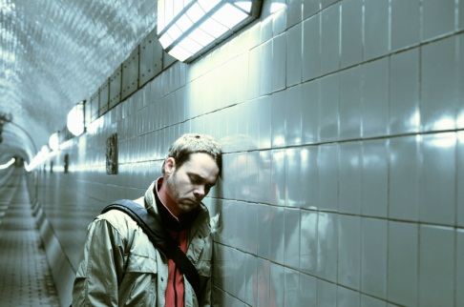
What’s the challenge?
Isolation
The online environment can create a sense of isolation for learners.

Slide 3
Building Community
Creates a class identity
Builds a support system
Personalizes learning
Provides students with motivation and encouragement to complete the class successfully
Supports retention

Slide 4
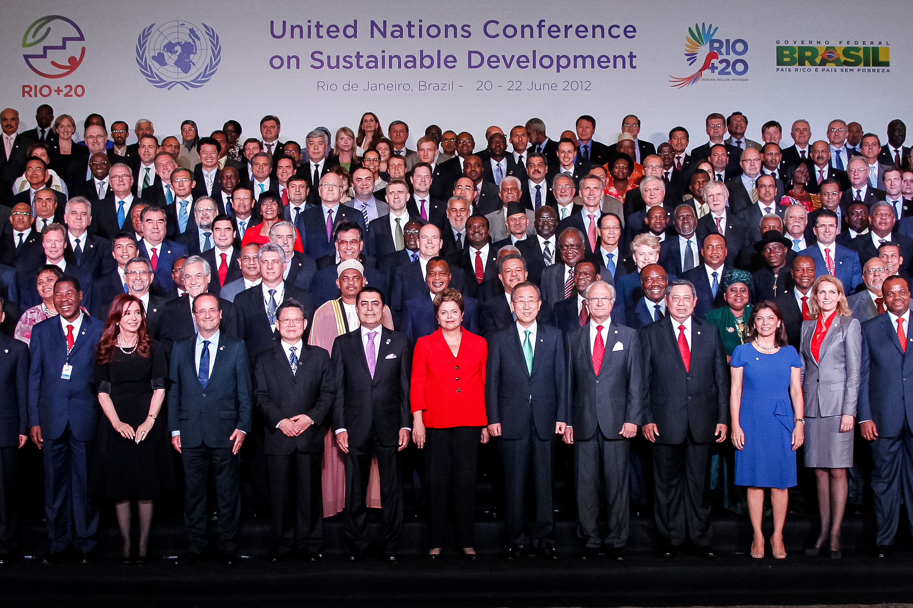
Building Community
Promotes a sense of belonging
Notes:
By Blog do Planalto (Flickr: Quarta-feira, 20 de junho) [<a href="http://creativecommons.org/licenses/by-sa/2.0">CC BY-SA 2.0</a>], <a href="https://commons.wikimedia.org/wiki/File%3AWorld_Leaders_at_the_United_Nations_Conference_on_Sustainable_Development.jpg">via Wikimedia Commons</a>

Slide 5
Quality Matters Standards Related to Community
Standard 1: Course Overview and Introduction
Standard 5: Course Activities and Learner Interaction
Standard 6: Course Technology

Slide 6
Building Community and Quality Matters
Activities and materials must support the course and module learning objectives.
Technology must be user-friendly and have the necessary supports.
Technology must be accessible.
Privacy issues should be considered.

Slide 7
Holmberg’s Empathy Approach
Teacher models empathetic communication
Uses proper forms of address: Dear, Hi, Hello, Thank you, Kind Regards, Cheers
Uses simple language
Uses pictures and emoticons
Encourages questions
Responds within a set time frame
Notes:
Communication
Holmberg’s Empathy Approach
“personal, friendly interaction and conversation-like presentations of subject matter”
facilitates learning by reducing students’ anxiety
more likely to have students feel free to contribute their ideas

Slide 8
A Framework for Building Community
Garrison’s Community of Inquiry
Social
Cognitive
Educational Experience
Teaching
Notes:
Garrison, R. (2007, April). Online community of inquiry review: Social, cognitive, and teaching presence issues. Journal of Asynchronous Learning Networks, 11(1), 61-72. Retrieved from http://jaln.sloanconsortium.org/index.php/jaln
Social Presence: “the ability to project one’s self and establish personal and purposeful relationships”
Cognitive Presence: “exploration, construction and confirmation of understanding through collaboration and reflection in a community”
Teaching Presence: “ design, facilitation and direct instruction” “It is a significant determinate of student satisfaction, perceived learning, and sense of community.”

Slide 9
Ideas for Building Community
Ice Breakers /Introductions

Slide 10
Ice Breakers
A Collage
Students find pictures (online and their own sources) to answer the questions. Using the pictures, students create a collage of who they are.
Students decide how they want to be represented.
Students see each other differently than just physical appearance.

Slide 11
Ideas for Building Community
Ice Breakers
Community Maps

Slide 12
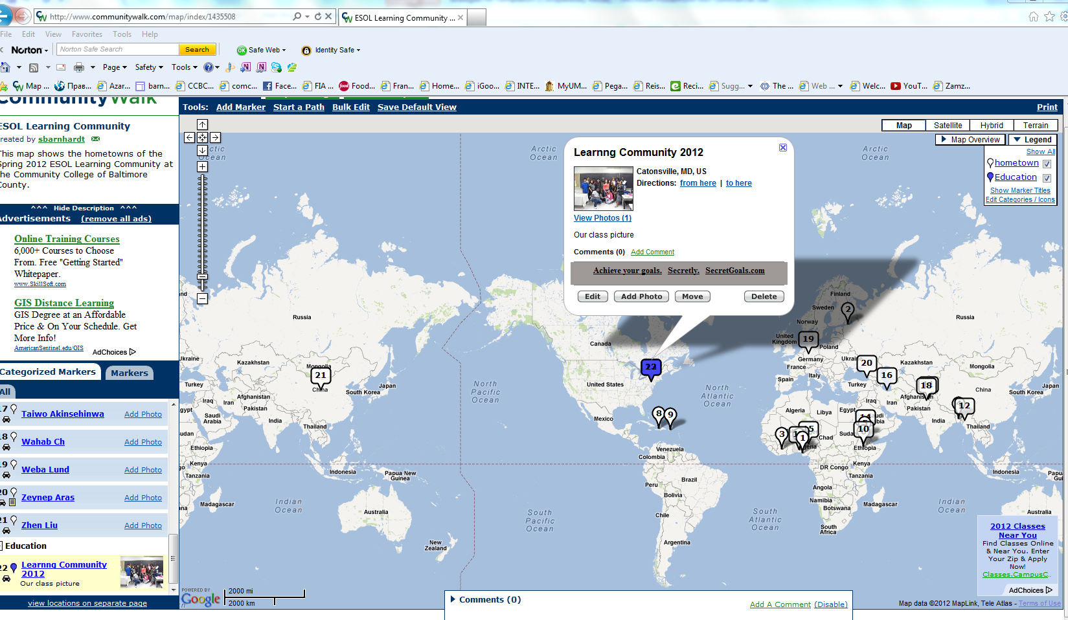
Community Maps

Slide 13
Ideas for Building Community
Ice Breakers
Community Maps
Reciprocal Teaching

Slide 14
Ideas for Building Community
Ice Breakers
Community Maps
Reciprocal Teaching
Student Teaching

Slide 15
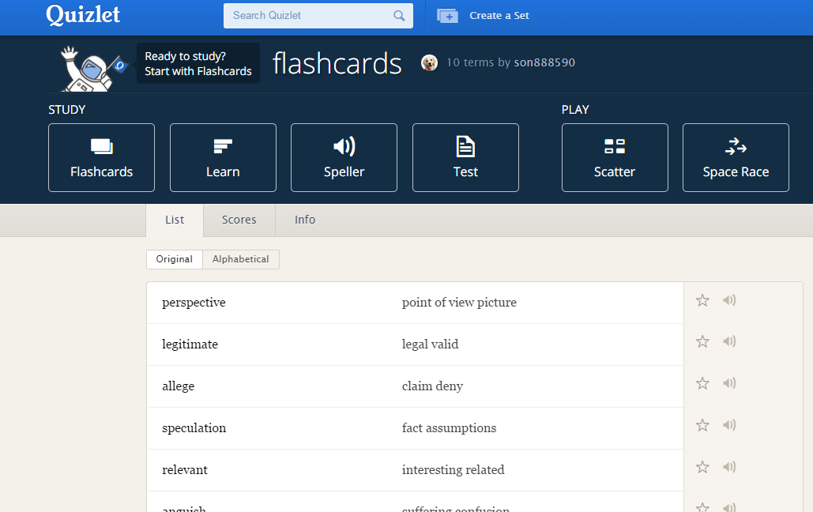
Student Created Online Quizzes
Have students create online quizzes either individually or in teams.
Example: Quizlet

Slide 16
Ideas for Building Community
Ice Breakers
Community Maps
Reciprocal Teaching
Student Teaching
Digital Multimedia

Slide 17
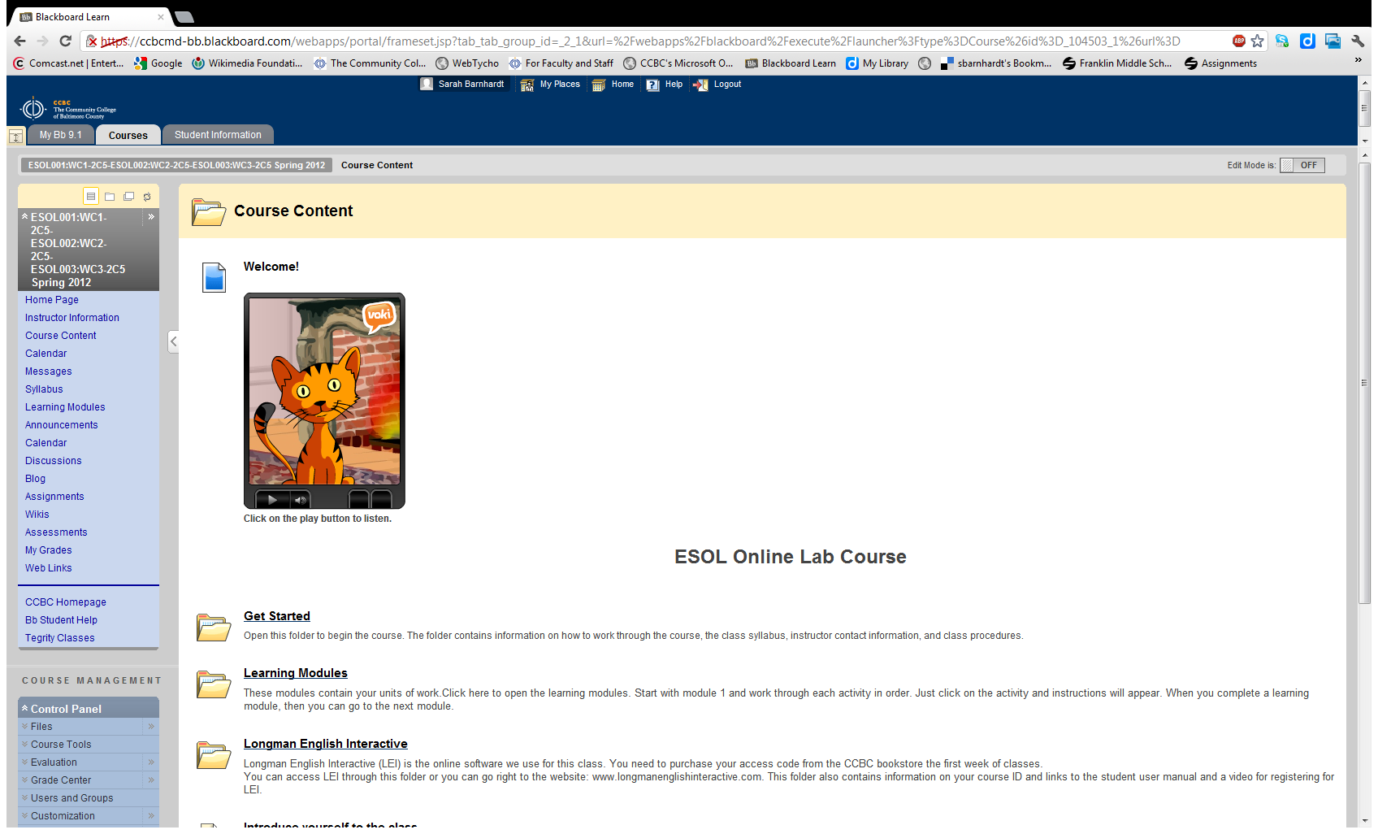
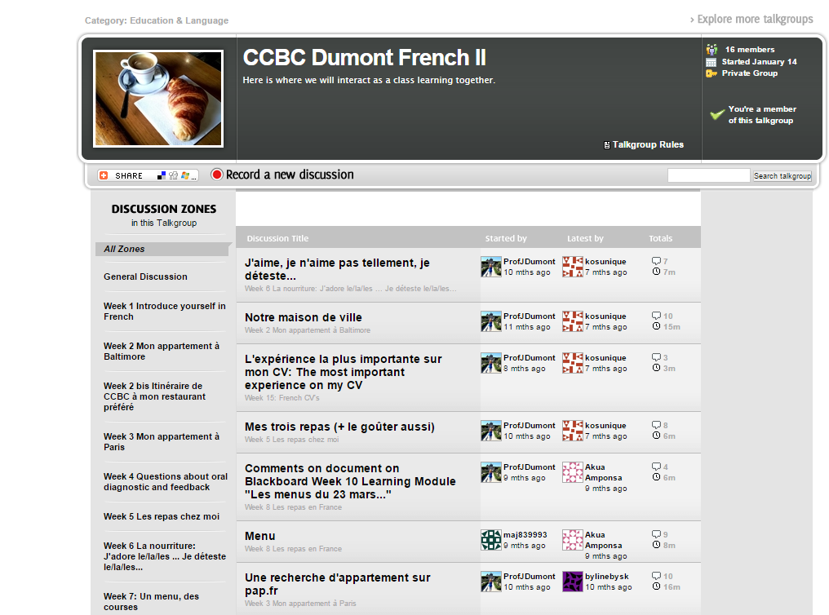
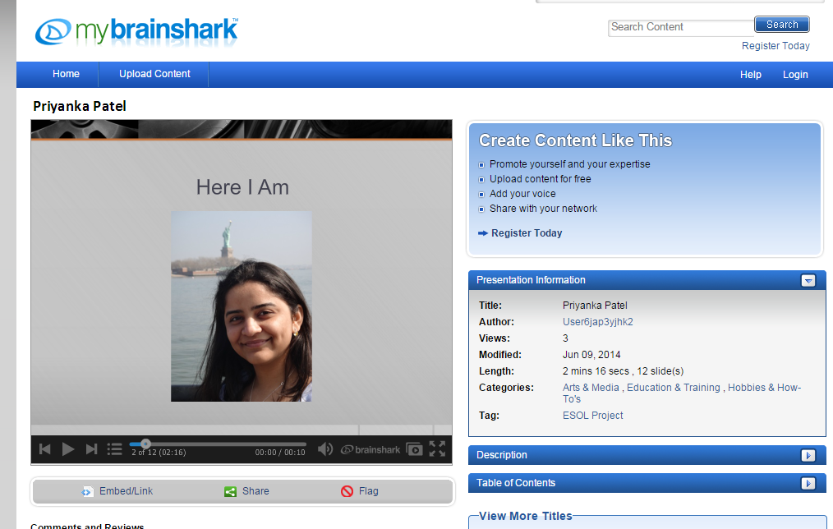

Digital Multimedia
Vokis
Voxopop
Brainshark
Voice Thread

Slide 18
Ideas for Building Community
Ice Breakers
Community Maps
Reciprocal Teaching
Student Teaching
Digital Multimedia
Discussions

Slide 19
Ideas for Building Community
Ice Breakers
Community Maps
Reciprocal Teaching
Student Teaching
Digital Multimedia
Discussions
Group Wiki Projects

Slide 20
Ideas for Building Community
Ice Breakers
Community Maps
Reciprocal Teaching
Student Teaching
Digital Multimedia
Discussions
Group Wiki Projects
Personalization

Slide 21
Ideas for Building Community
Ice Breakers
Community Maps
Reciprocal Teaching
Student Teaching
Digital Multimedia
Discussions
Group Wiki Projects
Personalization
Study Groups

Slide 22
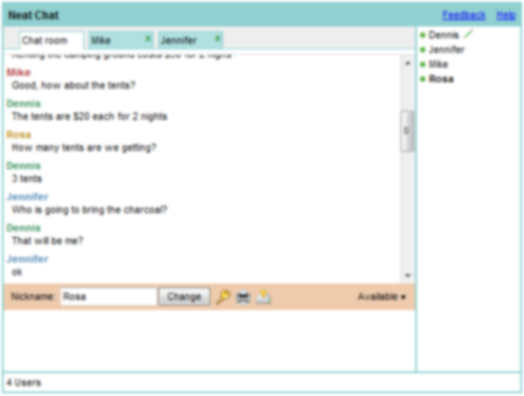
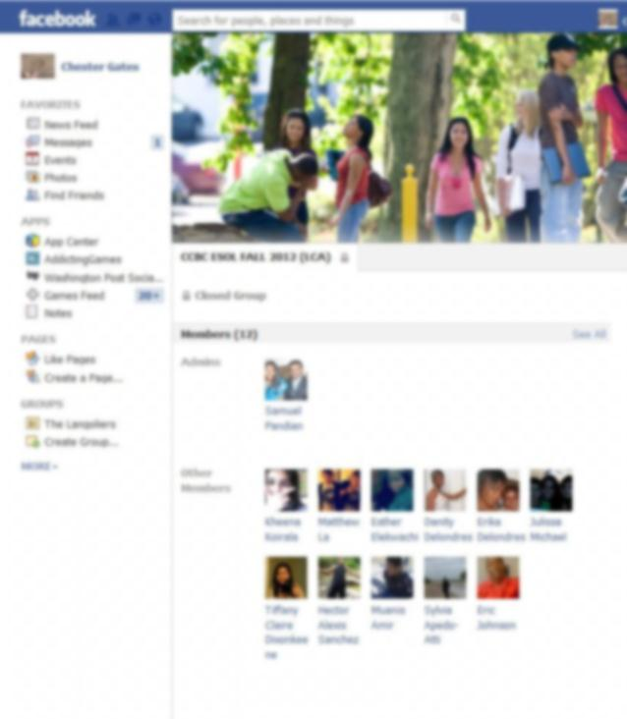
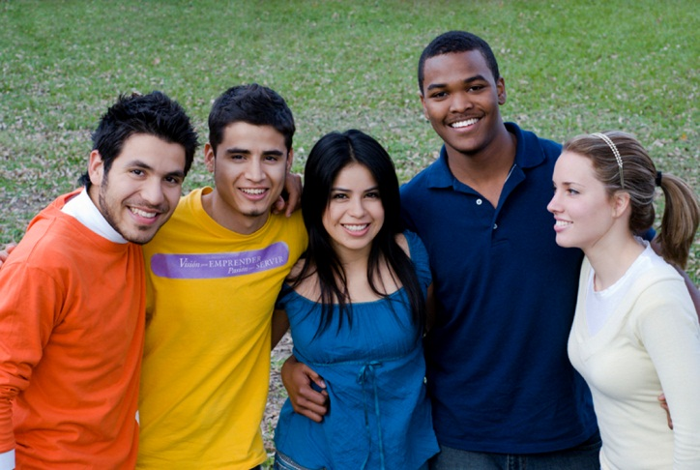
Study Groups
Online Chat
Social Media
Face-to-Face Meetings

Slide 23
Ideas for Building Community
Ice Breakers
Community Maps
Reciprocal Teaching
Student Teaching
Digital Multimedia
Discussions
Group Wiki Projects
Personalization
Study Groups
Assignments Tied to College Student Life

Slide 24
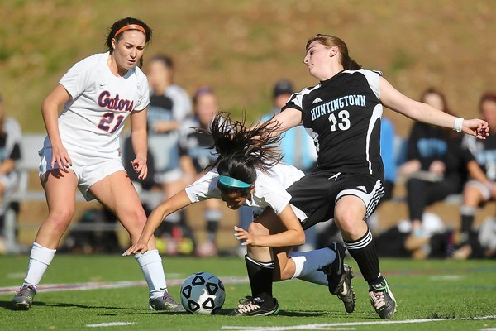
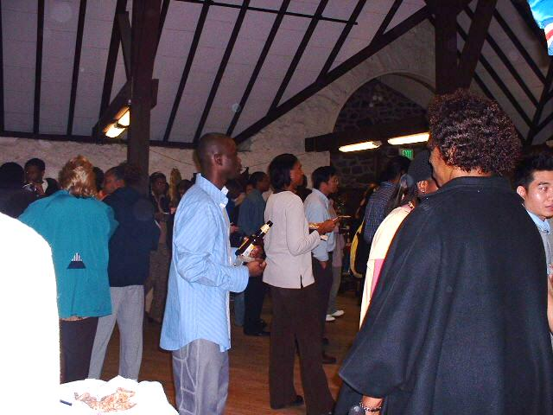
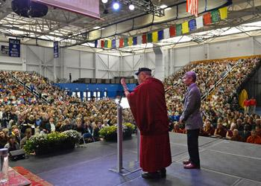
Activities Tied to College Student Life
Sporting Events
Festivals
Guest Speakers

Slide 25
Ideas for Building Community
Ice Breakers
Community Maps
Reciprocal Teaching
Student Teaching
Digital Multimedia
Discussions
Group Wiki Projects
Personalization
Study Groups
Assignments Tied To College Student Life
Formative Assessments

Slide 26
Ideas for Building Community
Ice Breakers
Community Maps
Reciprocal Teaching
Student Teaching
Digital Multimedia
Discussions
Group Wiki Projects
Personalization
Study Groups
Assignments Tied To College Student Life
Formative Assessments
Collaborative Games

Slide 27
Ideas for Building Community
Ice Breakers
Community Maps
Reciprocal Teaching
Student Teaching
Digital Multimedia
Discussions
Group Wiki Projects
Personalization
Study Groups
Assignments Tied To College Student Life
Formative Assessments
Collaborative Games
Blogs

Slide 28
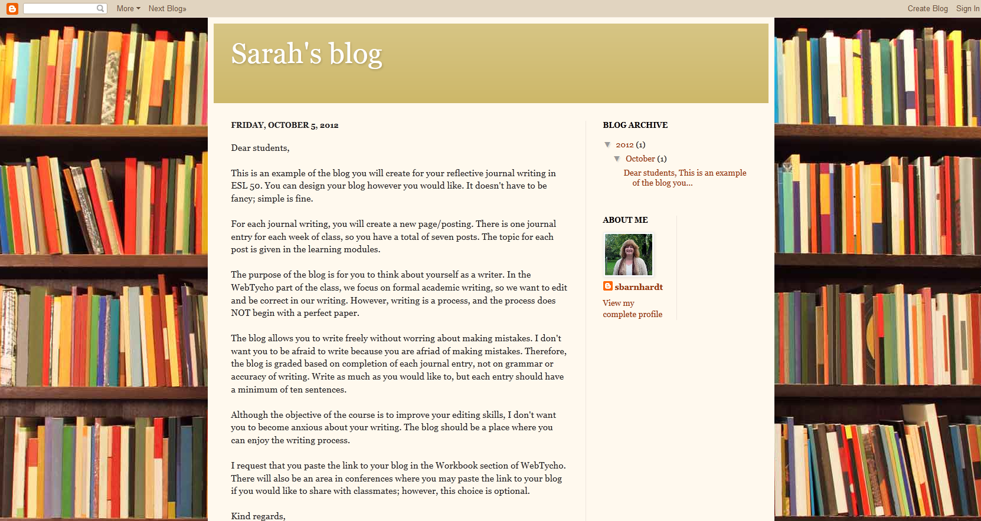
Blogs
Blogs: A safe place for students to keep reflective journals. They may choose to share them with the teacher and/or classmates.

Slide 29
Ideas for Building Community
Ice Breakers
Community Maps
Reciprocal Teaching
Student Teaching
Digital Multimedia
Discussions
Group Wiki Projects
Personalization
Study Groups
Assignments Tied To College Student Life
Formative Assessments
Collaborative Games
Blogs

Slide 30
Learning to Let Go
Be a facilitator (not “the sage on the stage”).
Create community building opportunities, but allow the students to create the community.
Allow the community to create knowledge and learning opportunities.
Notes:
Nancy’s slide for wrap-up

Slide 31

Questions?
Thank you.
Sarah Barnhardt sbarnhardt@ccbcmd.edu
Chester Gates cgates@ccbcmd.edu

