Slide 1
How Online Teaching Enhances the Face-to-Face Classroom
Eric Matte, Associate Professor of Communication
Melissa Wetherby, Lead Educational Technologist, Adjunct Faculty
Quality State of Mind, March 2016
Notes:
Polling Question-
Session Objectives:
Explain the mission of LMC and the LMC teaching philosophy
Demonstrate what an Eric class looked like in 2012
Demonstrate what and Eric class looks like today
Discuss and document the benefits of learning online standards for the F2F classroom

Slide 2



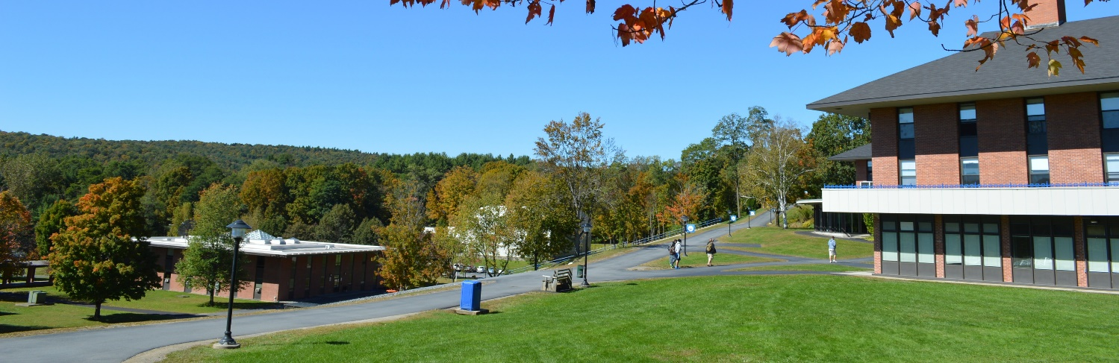
Landmark College
Notes:
Polling Question on Metacognition
Landmark, at risk pop, transfers with a context of failure
Me, My teaching philosophy , metacognition is to empower students by teaching them how to learn.

Slide 3
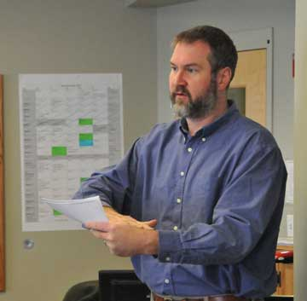
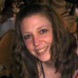
Who we are…
Notes:
Polling Question- Sage on the Stage
Teaching Philosophy- Always to empower the learner with the proper academic tools to learn.
Constant Improvement

Slide 4
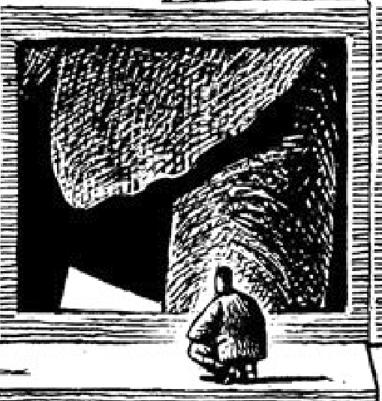
What are we looking at?

Slide 5
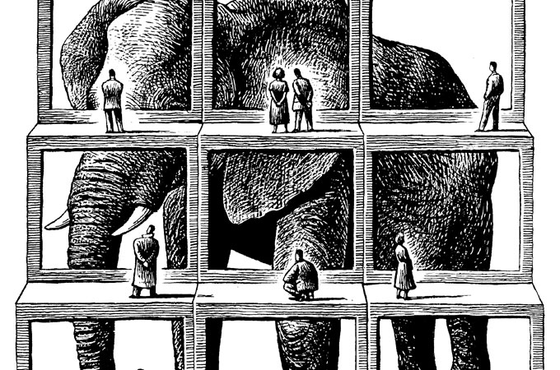
Big Picture – Small Chunks

Slide 6
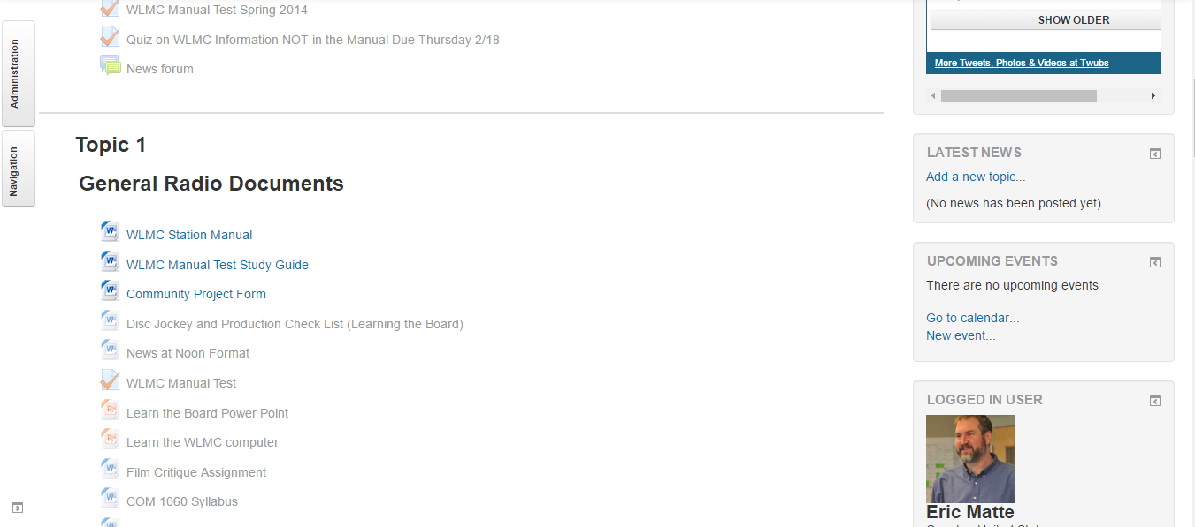
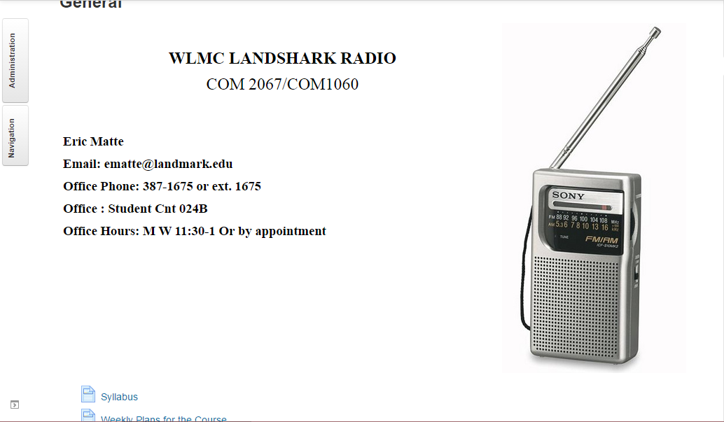
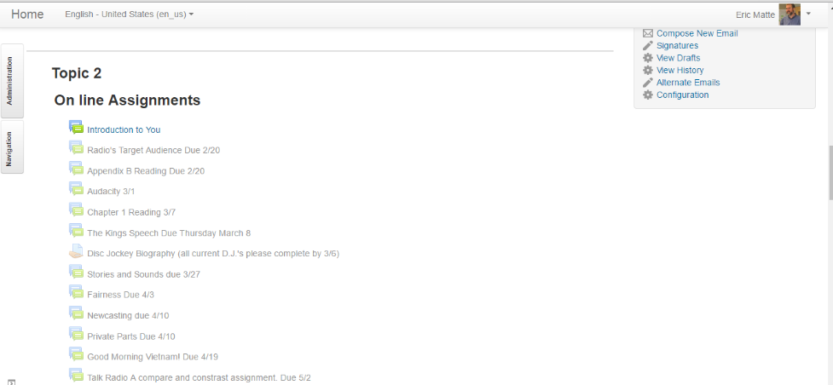
The Beginning
Notes:
I was never comfortable with lecture. My conflict with my sage on stage… How to effectively teach but not lecture…
Primitive site, not connected to grade book, a house for documents, scroll of death

Slide 7
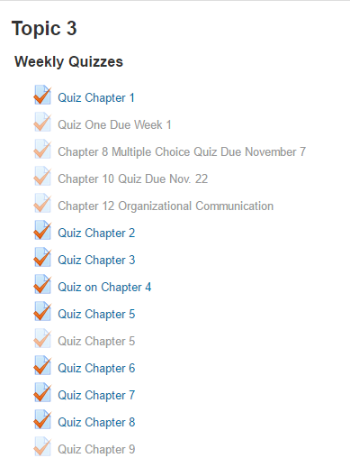
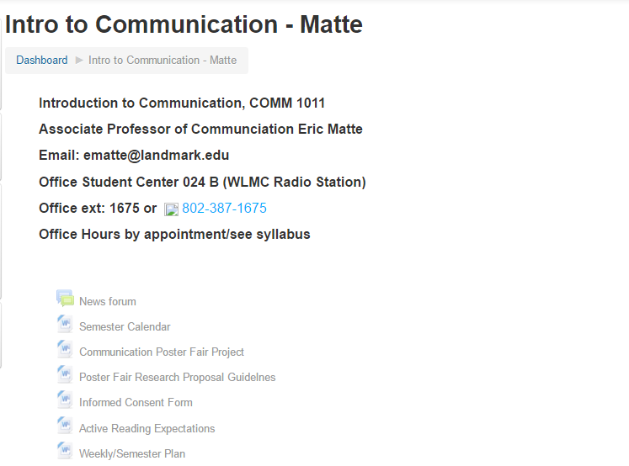
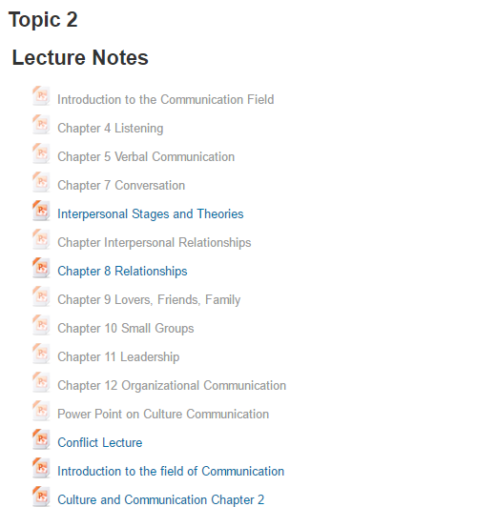
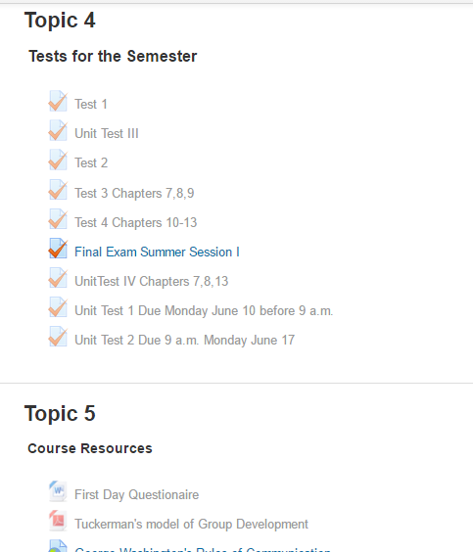
Before the Beginning
Notes:
An earlier class example. Arranged by topics. Zoom in.

Slide 8
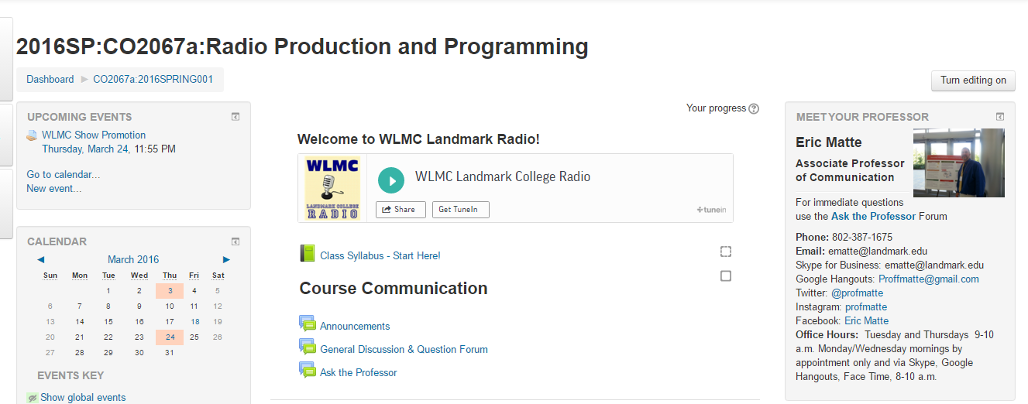
Today
Notes:
How I brought clarity to my courses! Using QM standards, 6 months as a member!
Start Here playing the radio at the start of every class
Your seeing alignment…. Course Unit Objectives
No more email because of the communication tool,
Better discussions better feedback, gradebook grades etc housed in one place
Constant improvement… What’s not perfect… A lot… Goals Objectives continued work, creative assignments and activitys

Slide 9
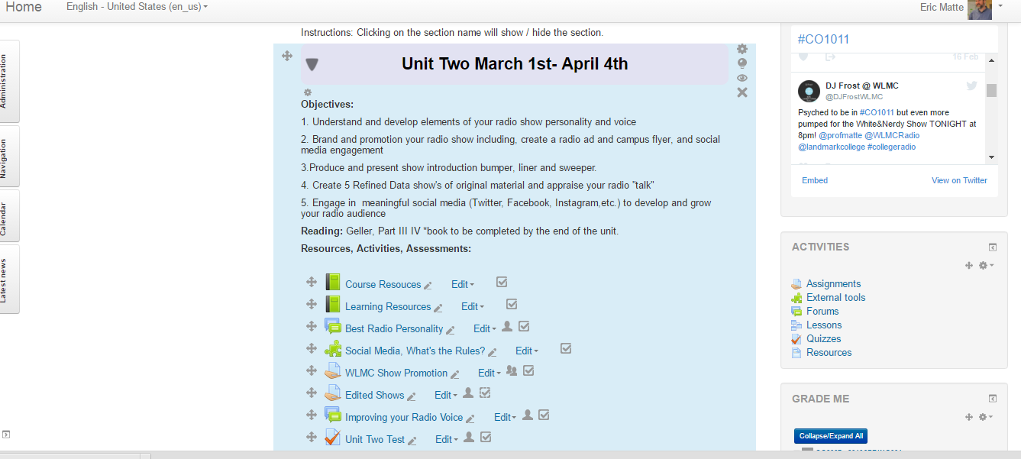
Today
Notes:
How I brought clarity to my courses! Using QM standards, 6 months as a member!
Start Here playing the radio at the start of every class
Your seeing alignment…. Course Unit Objectives
No more email because of the communication tool,
Better discussions better feedback, gradebook grades etc housed in one place
Constant improvement… What’s not perfect… A lot… Goals Objectives continued work, creative assignments and activitys

Slide 10
Backwards Design
Define Learning Goals
Decide on Assessments
Design Instruction

Slide 11
Benefits of Applying Online Standards to the F2F Class
Your Thoughts
Notes:
Better In class discussions because students are prepared. Better clarity to the class. Everything in one place! Communication, grades, feedback, etc.
Constant Improvement-

Slide 12
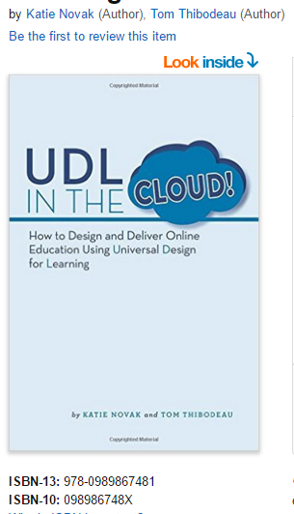
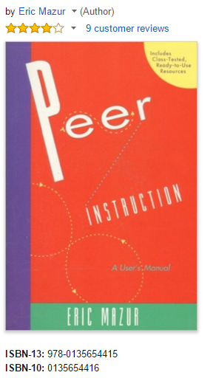

Credits
Eric Matte
ematte@landmark.edu
@profmatte
Melissa Wetherby
melissawetherby@landmark.edu
@defiantdyslexic

