Slide 1

Online, But Skeptical
1
Results of Inside Higher Ed/Gallup 2013 Survey
of Faculty Attitudes on Technology
Quality Matters Conference, Nashville, Tenn.
Oct. 3, 2013

Slide 2
Presenters
2
Doug Lederman, co-editor,
Inside Higher Ed
Gerard L. Hanley, senior director for academic technology services, California State University; executive director, (MERLOT)
Sheryl Hansen, director for academic quality assurance, Ohio Board of Regents

Slide 3
Methodology
3
Surveys conducted by Gallup in June/July 2013
Responses from 2,251 college faculty members and 248 academic technology administrators
Gallup estimates 95% confidence level of margin of error of 2.1 percentage points on overall faculty results; higher margins for subsets of faculty population and administrative sample.
Responses coded to enable analysis by sector, faculty status (full-time/part-time), age, etc.
Complete anonymity for individuals and institutions

Slide 4
Key Findings
4
Only 1 in 5 professors agree that online courses can achieve learning outcomes equivalent to those of in-person courses.
Majorities consider online learning to be of lower quality than in-person courses on several key measures (but not in terms of delivering content to meet learning objectives).
Most professors are skeptical of MOOCs -- and want to be sure that campus faculties control decision-making over how courses are used and that accreditors review quality.
BUT: 30% of faculty members had taught at least one course online (up from 25% in 2012); they are far likelier than peers who have not to believe online courses can produce equivalent learning outcomes (but even they are evenly divided).
Instructors with online experience likelier than not to believe that online courses can deliver equivalent outcomes at their institutions (47% agree, 28% don’t) and in the classes they teach (56% vs. 29%).

Slide 5
The Quality Gap
7% of professors strongly agree and 14% agree that "online courses can achieve student learning outcomes … at least equivalent to those of in-person courses." (48% disagree.)
For administrators, numbers are 60% and 13%.
Skepticism grows closer to home:
% Who Disagree Outcomes Can Be Equivalent …
At any institution | 48%
At my institution | 50%
In my department/discipline | 60%
In classes I teach | 62%

Slide 6
The Quality Gap (cont’d)
Professors say online courses are same quality as or better than face-to-face classes in terms of (1) grading and communicating about grading, and (2) communicating with college about logistical and other issues.
Faculty split 50/50 (the same/better vs. lower quality) on online courses' "ability to deliver the necessary content to meet learning objectives."
Online courses perceived as of lower quality on four other course elements: (1) interaction with students during class (85%), (2) ability to reach “at risk” students (78%), ability to answer students’ questions (67%), and interaction with students outside of class (62%).

Slide 7
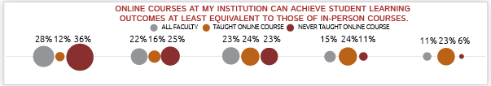
Familiarity ≠ Contempt
7
The more exposure professors have to online instruction, the more comfortable they become with it.

Slide 8
Familiarity ≠ Contempt
Aspect of Course Delivery | Have Taught Online | Haven’t Taught Online
Ability to delivery necessary content to meet learning objectives | 64% | 43%
Ability to answer student questions | 55 | 24
Interaction with students during class | 29 | 8
Interaction with students outside class | 48 | 34
Grading/communicating about grading | 79 | 59
Communication with the college about logistics and other issues | 68 | 51
Ability to reach “at risk” students | 33 | 17

Slide 9
Indicators of Quality?
Asked to identify “very important” markers of quality online education …
Faculty most likely to say “offered by an accredited institution” (73%), course “certified for quality” (66%), and offered “by institution that also offers in-person instruction” 59%).
Administrators: “accredited institution” (83%), “leads to academic credit” (64%), and “offered as part of degree/certificate program” (52%).

Slide 10


The Year of MOOCs
10
What’s changed?
Hype
Growth
MOOCs or MOOC-like substances?
Presidential shoutout

Slide 11


MOOCs: How Do You Feel?
11
Response to: “MOOCS make me excited about the future of academe.”
 | Faculty | Technology Administrators
Strongly agree | 4% | 7%
Agree | 9% | 20%
Neutral | 20% | 30%
Disagree | 20% | 22%
Strongly disagree | 46% | 22%

Slide 12
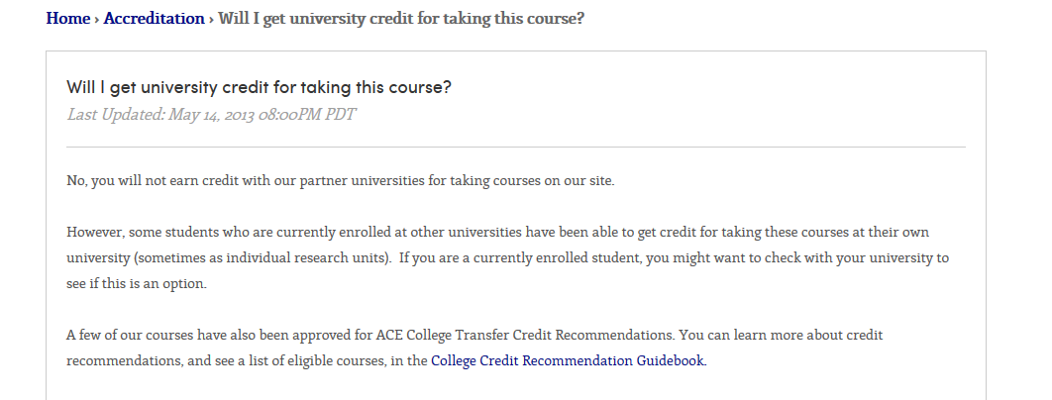
MOOC Oversight and Fairness
12
Why accreditation matters to many faculty members (but not so much to MOOC providers).
If you offer MOOCs, should you grant credit at your own institution?

Slide 13
MOOC Effectiveness
13
Statement | Agree / Strongly Agree | Disagree / Strongly Disagree
MOOCS can help with capacity at public colleges. | 40% | 31%
MOOCs can serve students at all ability levels. | 19% | 62%
Course completion rates of 5-10% are acceptable | 10% | 74%
MOOCs could lower costs for students | 48% | 25%

Slide 14
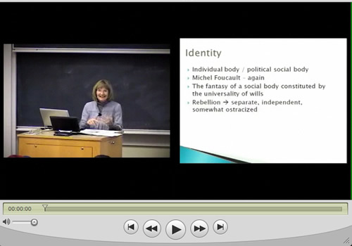
Other Teaching Technologies
14
Lecture capture
Adaptive learning

Slide 15
More Information
Read the survey article: http://www.insidehighered.com/news/survey/survey-faculty-attitudes-technology
Download the survey report: http://www.insidehighered.com/download/form.php?width=500&height=550&iframe=true=true&title=Survey%20of%20Faculty%20Attitudes%20on%20Technology&file=IHE_FacultySurvey-final.pdf
Scott Jaschik: scott.jaschik@insidehighered.com
Doug Lederman: doug.lederman@insidehighered.com

Slide 16




With Thanks to Advertisers

