Slide 1


Prepare to Hit the Trail
Successful QM Implementation Strategies
Heidi Schroeder Instructional Designer
E-Learning Services

Slide 2
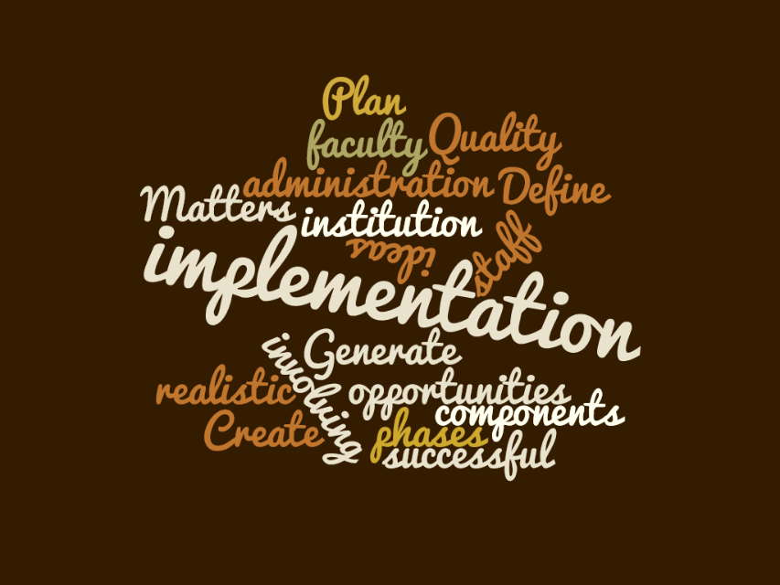
Session Objectives
Define Components
Create Benchmarks
Generate Ideas

Slide 3
QM Implementation Plan Proposal Components
Internal
QM Managed
Course Reviews
APPQMR
PRC
MRC
IYOC
DYOC
SPECIALIZED
Professional Development
%
#
Benchmarks

Slide 4
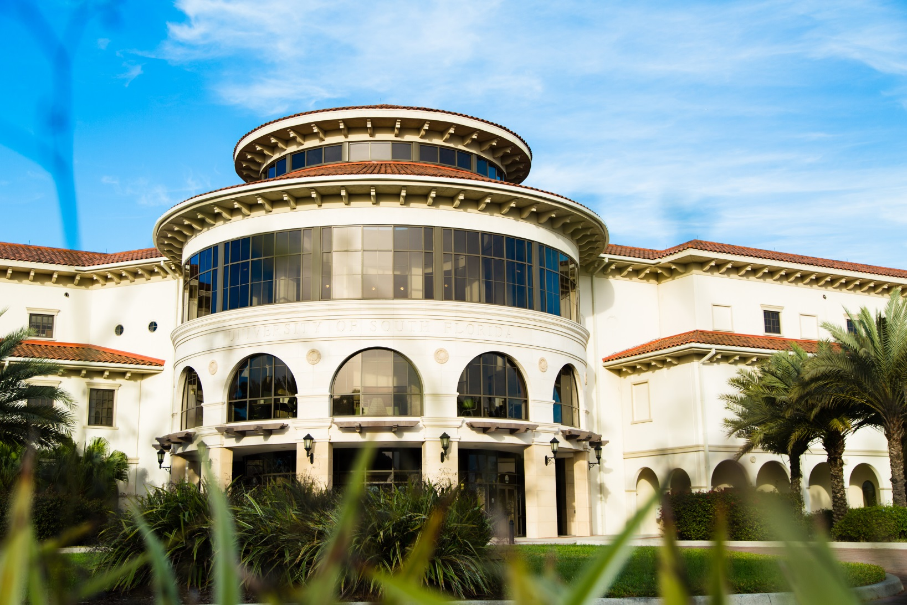
Back Story
University of South Florida, Sarasota-Manatee
2000 students
Re-designed
E-Learning Services
90
full-time faculty
Tasked with creating or finding online course
standards
40% – 60%
Online Courses
Quality Matters
Pilot

Slide 5
USFSM QM Implementation Plan
Phase 1: Awareness
Phase 2: Professional Development
Phase 3: Course Reviews
Phase 4: Community of Practice

Slide 6
Phase 1: Awareness
Information Sessions
1 Hour
Faculty Administrators Staff
Course Certification Process
Quality Matters Overview

Slide 7
Phase 2: Professional Development
Applying the Quality Matters Rubric Workshop
Peer Reviewer Course
Improving Your Online Course Workshop

Slide 8
Phase 3: Course Reviews
Internal Review
Identify Eligible Courses
Internal Review Teams
QM Managed Review
Successful Internal Review
Faculty partner with Instructional Designer

Slide 9
Phase 4: Community of Practice
Community of Practice
Awareness
Professional Development
Course Reviews

Slide 10
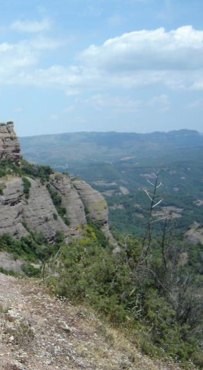
Which of the following are components of a QM Implementation plan?
Anticipated QM-Managed Course Reviews
Number of anticipated enrollees in QM Professional Development Sessions
Anticipated Internal Course Reviews
All of the above
Fact Check
Anticipated QM-Managed Course Reviews
Anticipated Internal Course Reviews
Number of anticipated enrollees in QM Professional Development Sessions
All of the above
Image Credit: Jordan Kalich

Slide 11
True or False
TRUE!
A Quality Matters Implementation Plan can be implemented in phases to allow an institution to systematically build and evaluate courses based on the QM Standards
Fact Check
Image Credit: Jordan Kalich

Slide 12
QM Implementation Plan Proposal Components
Internal
External
Course Reviews
APPQMR
PRC
MRC
IYOC
DYOC
SPECIALIZED
Professional Development
%
#
Benchmarks

Slide 13
USFSM Benchmarks
Professional Development: Anticipated Participants
Semester | QM Information Sessions | Applying the QM Rubric (APPQMR) | Peer Review Course (PRC)
Spring 2015 | 10-15 | 5 | 0
Summer 2015 | 10-15 | 5 | 2
Fall 2015 | 10-15 | 5 | 2
Spring 2016 | 10-15 | 5 | 2

Slide 14
USFSM Benchmarks
Course Review: Anticipated Reviews
Semester | Internal Reviews | QM Managed Reviews
Spring 2015 | 0 | 0
Summer 2015 | 1 | 0
Fall 2015 | 1 | 1
Spring 2016 | 1 | 1

Slide 15
Professional Development: Results
Semester | QM Information Sessions Anticipated | QM Information Sessions Actual | Applying the QM Rubric (APPQMR) Anticipated | Applying the QM Rubric (APPQMR) Actual | Peer Review Course (PRC) Anticipated | Peer Review Course (PRC) Actual
Spring 2015 | 10-15 | 34 (6 sessions) | 5 | 9 | 0 | 1
Summer 2015 | 10-15 |  | 5 | 8 | 2 | 0
Fall 2015 | 10-15 |  | 5 | 8 | 2 | 4
Spring 2016 | 10-15 |  | 5 | 9 | 2 | 0

Slide 16
Course Review: Results
Semester | Internal Reviews Anticipated | Internal Reviews Actual | QM Managed Reviews Anticipated | QM Managed Reviews Actual
Spring 2015 | 0 | 0 | 0 | 0
Summer 2015 | 1 | 0 | 0 | 0
Fall 2015 | 1 | 0 | 1 | 0
Spring 2016 | 1 | 1 | 1 | 0

Slide 17
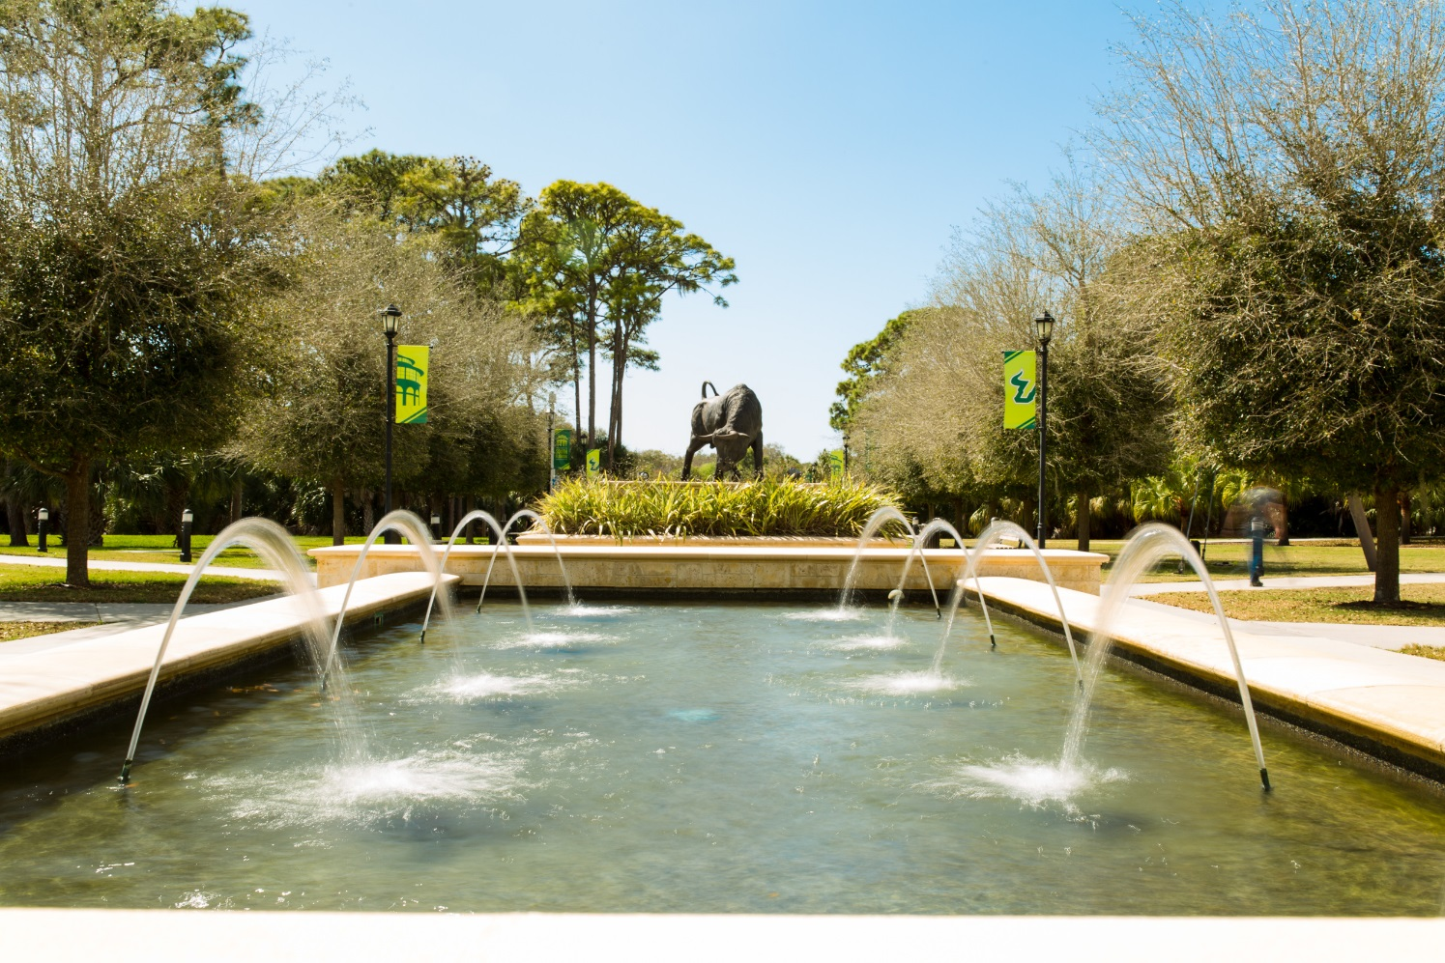
USFSM Beyond the Pilot
APPQMR
48
Approved by Faculty Senate as Standard for Online Learning
PRC
7
Internal Course Reviews
3
IYOC
6
QM Managed Course Review
1

Slide 18
Quality Matters Implementation Plan
Benchmark
Activity
Identify Benchmarks for your institution:
QM Reviews
QM Professional Development
Image Credit: Jordan Kalich

Slide 19
Implementation Strategies
Overlapping Phased Approach
Professional Development
Focus
Course Review
Focus
True
Phased Approach

Slide 20
Group
Discussion
In Small Groups,
share the Implementation Strategy
that could work well for your institution.
Image Credit: Jordan Kalich

Slide 21
You’re prepared to
HIT THE TRAIL!
Heidi Schroeder
Instructional Designer, E-Learning Services
University of South Florida, Sarasota-Manatee
schroederh@sar.usf.edu
(941) 359-4229
Thank you!
Image Credit: Jordan Kalich

