Slide 1
Accessible Online Courses:
They Can Have a Good Personality and Be Good-Looking
Quality Matters Regional Conference on Quality Assurance in Online Learning
“Quality State of Mind”
March 17-18, 2016
Tiffany Hoefer, M.Ed, CPhT
Instructional Designer
Office of Virtual Education
South Carolina State Department of Education

Slide 2
Learning Objectives
Explain best practices for promoting functional accessibility
Discuss how Universal Design for Learning (UDL) benefits online accessibility and improves accessibility
Apply covered information to course design, specifically as it relates to Standard 8

Slide 3
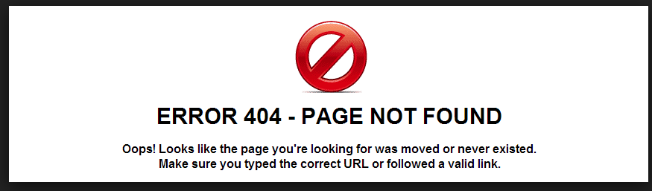
Functional Accessibility
Best Practices
Why standards?
Notes:
We’re all familiar with standards – the rubrics are full of standards that we’re trying to meet. Industries from insurance to banking are regulated by standards. A standard is something that has gained acceptance and been organized for others to follow. As standards relate to functional accessibility, the internet simply wouldn’t work without them. Web addresses follow a standardized protocol for passing messages between my browser, a web server and then back again to my browser. If the protocol didn’t rigorously follow a standard, the chances of my receiving any response, much less the one I want, are greatly reduced.

Slide 4
Functional Accessibility
Best Practices
Why standards?
WCAG
508
Notes:
The two guidelines and standards that always come up in discussion of web accessibility are WCAG and 508.

Slide 5
Web Content Accessibility Guidelines
WCAG
W3C
December 2008
Complex
  60 rules
  4 broad categories
Conformance
Notes:
Just know that the Web Content Accessibility Guidelines (WCAG), version 2.0 was published in December, 2008 and became an official recommendation of the World Wide Web Consortium (W3C), the leading international group providing web standards. It is a complex document that provides a set of around 60 rules divided into four broad categories and supported by an extensive glossary of definitions. The document is further staged into levels of "conformance." If you follow in lock step all the guidelines through all levels of conformance (good luck with that), you will produce content that is accessible across devices.

Slide 6
“508 Standards”
Section 508
1998
US Federal Rehabilitation Act
  Subsection 1194.22
  Amended in 1998
Accessible technology for those with disabilities
16 standards
Notes:
When web accessibility proponents mention "508 standards" they are typically referring to this subsection (POINT TO 1194.22) of Section 508 of the U.S. Federal Rehabilitation Act, which was amended in 1998. The Section 508 law requires Federal agencies to make their electronic and information technology accessible to people with disabilities. The 16 standards comprising subsection 1194.22 refer specifically to content and applications delivered via the web. This section is primarily oriented as a set of standards that dictates procurement and contracting of development for web resources and applications used and promoted by Federal agencies for internal and public consumption.

Slide 7
What this can REALLY mean
Complete WCAG conformance = accessible content
Satisfying rules in Section 508 = accessible content
(necessarily)
Notes:
Meeting the very high bar of complete and total WCAG conformance will guarantee accessible content. However, it is wholly possible to satisfy the basic rules of Section 508 and still have content that is plagued by accessibility problems.

Slide 8
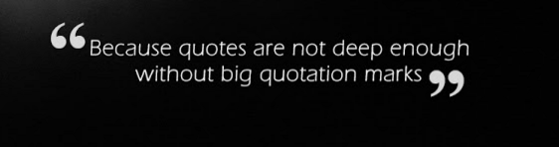
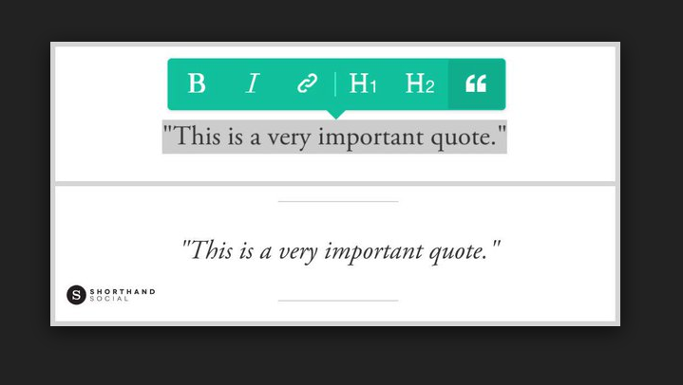
Real world problem
Notes:
To take a key example, Section 508 states that all non-text elements need to have text equivalents—this is the aptly named "alt text" standard. The problem is that this standard says absolutely nothing about the quality of the alternative text, only that it be "equivalent" to the non-text element. But let's take a common example of web content and apply the rule. Say we have a pull quote on our web page that is set off from the rest of the text by using an image of enlarged quotation marks. What is the "text equivalent" of this image? If we give the image alternative text of "image of quotation marks," then a screen reader user will hear that text read aloud before he/she hears the pull quote. In reality, the large quotations image is simply decorative and is something that the screen reader should not voice at all. So, it is entirely possible to follow the Section 508 standard and still have web content that has minimal or very poor accessibility.

Slide 9
Goal of Best Practices
Relatively simple set of techniques
Functionality for users regardless of ability
Practical advice geared for educational content
Easily deployable
Notes:
In organizing and composing Best Practices, the goal is to provide a relatively simple set of techniques and approaches to composition and organization of content that results in increased functional accessibility. I don’t want to minimize the importance of standards and guidelines, but I believe the crucial end goal is: functionality for users regardless of ability, which is the primary purpose of the Universal Design principles.
I also hope to provide practical advice geared specifically to providing educational content and could be implemented by instructors and course designers who are familiar with UD principles. So, practical techniques that can be deployed easily.

Slide 10

Fast Talking Disclaimer
HTML
Universal Design
Access issues
Notes:
While it is not necessary to have a full understanding of HTML markup in order to implement Best Practices, familiarity with HTML will ease understanding and facilitate implementation. I strongly recommend that instructional designers for the web learn HTML. Your ability to understand and use these Best Practices will be greatly enhanced if you understand HTML, principles of Universal Design, and access issues in general.

Slide 11
Course Organization & Navigation
Page structure
Color combinations/font sizes
Page titles and links
Navigation bar/list of links
  Unordered lists
  Introduce with a heading
Notes:
We’re going to discuss course navigation and organization next.

Slide 12
LMS/No LMS
LMS
No LMS
Navigation is typically handled by the LMS
As a designer you have no control over navigation
There are still things you can do
You drive the navigation
You have tons of control
Lots you can do
Way more responsibility
Notes:
For the most part, if you are using an LMS, navigation between course materials is typically handled by the system. This means that as a designer or developer that you probably have no control over this navigation and students ability to navigate around depends on the quality of the implementation of the LMS itself. Despite this restriction, there are things you need to do to ensure decent navigation for students. Whether you use an LMS or work outside of an LMS, certain rules of page and navigation apply universally.

Slide 13
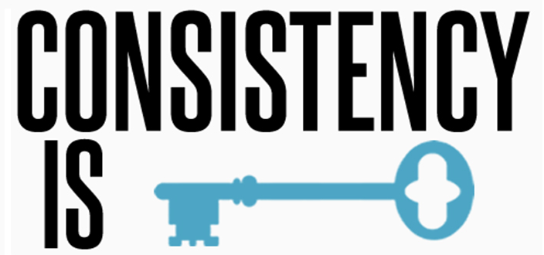
Page Structure
Similar and consistent across all pages
Notes:
Consistency breeds familiarity and increased confidence, not contempt. However, structure should not only be consistent but be similar. In other words, use highly similar language on all content pages. For example, you have a section for assessments. In Unit 1, you call it Quizzes and it’s introduced using an H4 heading. In Unit 2, we would not want to call it Tests and introduce it with an H3 heading. Choose the clearest and most descriptive heading titles that you can. Keep the use of heading levels consistent and make the language choices echo throughout the course.

Slide 14
Color Combinations/Font Sizes
Should be consistent across all pages
Doesn’t have to be limiting
Can create a more professional look and feel
Notes:
While the color combinations and font sizes should be similar across all pages, this doesn’t have to be restrictive. Consistent appearance can create a more professional look and feel. It may be proper to color-code certain areas of content. For instance, you might interrupt text with important information in a specially styled box with more padding and a yellow background because you need to bring attention to a key point or you might want the content for each decade of the 20th century to be in a different color. Just make sure that that all of the key points get the same style and color and that all of the subpages for the 1970s are stylistically consistent. This is not the same as using color to convey meaning (which is a no-no). This is one of the areas that people confuse. Giving visual relief is different than using color to convey meaning, which we’ll discuss later.

Slide 15
Page titles and links
Need to make sense out of context
Screen readers
Consistent styling
Some Judgment Calls
Notes:
Links can be read by screen readers apart from the words that surround them on the page. Even when tabbing through a web page, a sighted student's ability to decide if a particular link is something they are interested in following is improved if the link is styled differently from surrounding text and appears somewhat independent and provides a clear indication of what it points to.
Same goes for titles. Except a title should convey not only the page content but also where that content is, structurally, within the course. Use your best judgment on how much context you need to provide. But, imagine that you are given only the page title from which to determine the page's content and location in a particular course. Which is better: "Module 1" or "Module 1: Environmental Factors – Theories of Evolution – Biology 650." There is no consensus on what character to use to separate the parts of a title. I prefer a dash or a colon with a space on both sides. But that is a personal preference. We could also argue about the order of the parts. Do you work from page content out to course number or title or from course title to page content? If you start with the page, it makes skimming with a screen reader easier because the user has less to read before getting to the meat. But starting with the course number or name allows for bookmarks in the browser to be alphabetized so that titles from the same course follow one another. Whichever way you go, just be consistent across the content as a whole.

Slide 16
Navigation
Multi-page navigation: bar or list of links consistent across pages
Notes:
Time is restricting how much I can go into designing outside of an LMS. Since so many people use an LMS, I’m focusing on this group, but if you want more information on content structure outside of an LMS, let me know. So, I’m skipping the bulk of navigation for time sake.
SKIP BELOW
========================================================================================================================================
I wanted to address issues for everyone whether you use an LMS or not, but I had to cut a lot of that out for time sake. But, some things are important for depth of knowledge. So, some non-LMS items will sneak in. So, surprise!, this applies more to those who work outside of an LMS.
If you get to design your own content structure, you have complete control over page to page navigation. In these cases, the key for usability in course navigation is keep it consistent across pages. It doesn’t matter if the navigation is a list of links or an actual navigation bar, consistent navigation allows for screen reader users to have a familiar set of references that are always identical. I can’t really stress how important this is. It makes all the difference in the world to someone using a screen reader or who can only navigate using a keyboard. It increases the page to page navigation but it helps students feel confident that they know where to find content. For students with cognitive disabilities, consistent navigation reduces cognitive load by providing a familiar reference. So, the student doesn’t have to worry about or be distracted trying to figure out navigation.

Slide 17
Navigation
Multi-page navigation: bar or list of links consistent across pages
Text Link Back to Home
Notes:
However, this is something that you might run up against when using a WYSIWIG editor in your LMS. A text link back to the course "home" page is preferable to the all-too-common practice of creating a clickable course logo or some other non-text anchor back to the home page. You can still have the clickable course logo or similar item, but you should incorporate a text link back to home too.

Slide 18
Navigation
Multi-page navigation: bar or list of links consistent across pages
Text Link Back to Home
Implement bars/menus as unordered lists
Notes:
SKIP
======================================================================================================================================
I’ve had faculty and staff say to me, “Well, we’re not supposed to use nested lists…” This is not true. Use nested lists if they are needed. However, it is best to nest deeper than 3 levels deep. I’ll discuss the reasons fully later. Use CSS to manipulate appearance if necessary. Screen readers can browse the contents of lists with simple keystrokes. In addition, most screen readers announce the number of items in a list before they begin reading it. For these reasons and because of the semantic appropriateness and styling possibilities of lists, use of unordered lists for grouping navigation links has become a web convention. Virtually all modern web sites organize their navigation bars and menus using unordered lists. This may not be obvious to visual users of the web because often these navigation elements get sophisticated styles that make them appear similar to the menus of desktop applications. But if you disable the style sheets or look at the code, you will see unordered lists are the rule for site navigation schemes.

Slide 19
Navigation
Multi-page navigation: bar or list of links consistent across pages
Text Link Back to Home
Implement bars/menus as unordered lists
Introduce bars/menus with a heading
Notes:
SKIP
======================================================================================================================================
As mentioned, screen readers can navigate by heading. Browsing a page's headings is one of the first things a screen reader user will do when entering a page. Introducing the site navigation with an H3 heading (or other level as appropriate to page structure) such as "Course Navigation Bar" provides an easily discoverable landing spot or coordinates for blind students. Such headings may be hidden from visual users using the "off-left" technique, if you feel the page design is adversely affected by having the heading visible.

Slide 20
Content Layout and Styling
Text is primary method for delivering information
  Color and iconography are second
Test color contrast
White space
Text sizes need to be adequate
Sans-serif over serif font styles
Notes:
A lot of content creators think that we have to jeopardize the nice and elegant styling of their content in order to make them accessible. Not so! I encourage keeping the elegant or interesting design of your content and not jeopardize the styling because of accessibility. But, I encourage youto separate structure of the content from presentation.
I’m going to provide you with some Best Practices that can ensure the accessibility of your content without jeopardizing the styling effects.

Slide 21
Content Layout and Styling (cont.)
Large enough default text size/scalability
Use CSS for all text styling, including size, face, line-height, spacing, color, etc.
“Elastic” over fixed-width
Notes:
I’ll discuss scalability and briefly touch on some of the more intimating things like CSS and elastic designs

Slide 22

Color/Iconography
Text is primary
These are secondary
Accompany with visual textual equivalent
Can use
Notes:
Icons and colors can be useful for signifying functionality. However, without textual content, a screen reader user will be unable to comprehend the information. The textual content can be in the text that is adjacent to the icon or color or, in the case of icons that are HTML images, use "alt" tags. The problem is more complicated than this. Color blind students may be unable to distinguish between certain colors and testing is necessary to determine the effectiveness of the color choice. Later, I’ll provide some of my favorite tools for testing contrast or other accessibility issues.
There are very few universally understood icons for computers—maybe the "save" computer disk icon or the "clipboard" copy icon are recognizable. But, students with cognitive disabilities may not be able to understand even relatively "universal" iconography. The overriding lesson is that, if you use color or iconography to deliver content or indicate functionality, accompany the color or icon with a visible textual equivalent. You can certainly have color and pretty pictures. Just be thoughtful.

Slide 23
Text-Color Contrast
Test color for sufficient foreground-background contrast
Distinguish between colors for color blindness
Notes:
Students grouped under the category of "low vision," may have severe difficulties if there is not sufficient contrast between text and background colors. The W3C recommends a minimum color contrast ratio of 3:1. Students with one of the varieties of color blindness may be affected both by low color contrast and color differences that are indistinguishable. Rather than guessing if you are achieving proper foreground-background contrast or if your color choices are recognizable by students with color blindness, use a tool to test the page. I’ll give you a list of some that I find helpful later.

Slide 24
White Space
The dreaded white space – SMEs either love it or hate it
But, cramped text is a bummer
No set in stone rules
Notes:
White space – whether you love it or hate it -- Cramped text is difficult for anyone to read. The stakes are heightened for a student with a cognitive or reading disability. There are no hard and fast rules for margins or line height. And, it may be the case that your LMS determines margins and line height. However, if you have the ability to control it, ensure that margins are simultaneously tall enough for the eye to easily distinguish between paragraphs yet still be able to clearly discern that related paragraphs are sequential rather than wholly separate elements and that neighboring paragraphs "feel" related. There should be right and left margins ample enough to clearly distinguish paragraphs in the main body of the text from elements in the sidebar. Line height of text should between 130% and 150% of the base font size.

Slide 25
Text Sizes
Heading styles
  Level changes need to be visually apparent
Indentation and spatial relationships
Notes:
Heading styles should differ enough that level changes are visually apparent—and meaningful and that an H3 "feels" subordinate to an H2, and so on. This can be achieved not only through size differences but also through changes in indentation and the spatial relationships between the heading and the surrounding elements.

Slide 26

Font Styles
Sans-serif preferred over Serif
  Trebuchet MS, Verdana, Helvetica and Lucida Sans
  Arial as default -
    Run together
      rn versus m
    Similar characters
      b and d
Notes:
Anecdotal evidence suggests that sans-serif fonts are easier to read than serif fonts for students with dyslexia and other reading disabilities. Although Arial is the default sans-serif font for many web browsers, Trebuchet MS, Verdana, Helvetica, or Lucida Sans are probably preferable because similar-appearing characters—"b" and "d"—and characters that visually run together— "rn" can look like "m"—are more easily distinguished than in Arial.
As I said, the evidence is anecdotal at this time. So, just keep this information in mind as you design.

Slide 27

Default text size
Make default text large enough
  16 pixels typically
  Seems large but avoid smaller
“Zoom” test your pages
  View>Zoom
  Ctrl ++
Notes:
Though the default font-size in most browsers seem big (it is typically 16 pixels), try to avoid using a smaller font for main page content. If there is a need for a smaller default font, make sure that students can increase text size using standard browser commands, such as View > Zoom or Ctrl + + to increase the font size.

Slide 28
Use CSS
For all styling
  Font size
  Font face
  Line height
  Color
  Spacing
Notes:
Course designers will have the easiest time maintaining uniformity of style across the course web site if they put all presentational styles inside an external style sheet. Modifications to styles then affect all of the pages/courses that use the style sheet. LMSs have the CSS built in, but it can usually be modified by an administrator.

Slide 29
“Elastic” to fixed-width
For those who create outside of an LMS
Most common screen resolution 1024x768
Houses a 900 pixel wide page fine
How do we know what size screen they have
  We can’t
Sweet spot between completely flexible and fixed - Elastic
Notes:
This is really only applicable if you are building your own pages outside of an LMS. Again. Just know that if you build outside of an LMS, elastic is best.

Slide 30
Content Markup/Organization (HTML)
Headings
Lists
Links
Notes:
HTML was created as a language that provides basic containers to organize and make sense of content. Without going into excruciating detail, these containers focus on the meaning of the content by organizing and structuring the content.
Often times we forget or ignore the meaning and worry only about the appearance. For those using screen readers and other assistive technologies, the semantics are crucial. A screen reader doesn’t recognize a 72 point bold line of text as a heading. But, if that text is marked up as a heading, the screen reader can share that information with the end user.
It is a best practice to rely on semantic markup to presentational markup for organizing course page and content. A lot of this section will sound like it only applies if you are creating content outside of an LMS, but it is important to understand the concepts for those areas within an LMS where you are touching the HTML. If you are using a WYSIWYG editor in your LMS, you are affecting the HTML. It’s just that the LMS is doing the heavy lifting for you.

Slide 31
Hierarchical HTML structure
H1-main heading of the page
  Should reference the content of the page
H2-major subsections
H3-subsections and so on
Nest headings hierarchically
  Do not skip heading levels
Heading text – unique and meaningful
Notes:
Headings are one of the primary means for navigating a web page in a screen reader. All commonly used screen readers allow a user to pull up a list of headings and move between headings via simple keystrokes.
The main page content should be introduced with an H1 heading, and subordinate content sections should get H2, H3, and on down the line. The order of headings should always proceed by single increments: H1, H2, H3, H4, etc. Do not skip heading levels. Following a logical order helps screen reader users surf a page by heading and heading level while providing an unambiguous structure for users with cognitive disabilities.

Slide 32
Group related content via lists
Use lists liberally
Types
  Ordered
  Unordered
  Definition
Notes:
Use lists liberally. I know that in good ole non-web delivered writing, stringing together concepts using commas and conjunctions is appropriate, but writing for the web should be simplified and maximize scannability. Using lists is a key method for making web writing easily scannable and to improve reader comprehension.
There are three types of lists available in HTML—ordered, unordered, and definition lists.
Ordered lists should be used when sequence is important to convey meaning. For example, when listing instructions thatt be followed in order. If sequence is not important, use an unordered list.
Definition lists should be used sparingly. Definition lists are two part structures. Each item has a term and a definition. An ideal application for definition lists is a glossary of terms, in which a term is introduced and a definition is provided.

Slide 33
Introduce lists with a heading
Screen readers
  Some can navigate between lists on a page
  All major ones can navigate by heading
Notes:
Some screen readers can navigate between lists on a page, making discovering lists easier. But all major screen readers can navigate by heading. So having a heading precede a list is very helpful for orienting a student who is using a screen reader. It also makes a page more easily scannable (both for visual and screen reader students).

Slide 34
Limit nested lists to 3 deep
Nesting of lists is announced
HTML only has 3 default bullets
  Asterisk
  Circle
  Square
Styles can be used to affect numbering
Notes:
Screen readers announce the nesting of lists. However, it becomes increasingly difficult for the screen reader user to remember their place within the list structure the deeper they goes. For users with cognitive or reading disabilities it may decrease comprehension if a list has more than three levels of nesting.
Another minor factor to keep in mind is that with unordered lists, HTML has only three default bullet types: asterisk, circle, and square—which is only enough to represent three levels. (This can be worked around using CSS, but let’s keep this simple.)
For ordered lists, it is also possible to use styles to affect the numbering. You can use decimals, roman numerals, or alphabetical characters in both upper and lower case, providing a visual distinction between levels of nesting. However, a screen reader will not announce the case. Screen readers also differ on how they announce the level of nesting. Some only indicate that a list has ended and not the level of nesting, which makes orientation within a list structure more difficult.

Slide 35
Down and Dirty List (the etceteraS)
HTML, not breaks or divs, to create paragraphs
Semantic em(phasis) or strong and presentational i or bold are different
Do not use font tag/deprecated markup
Each page needs a unique descriptive title
Declare a default language for each page
Notes:
I don’t want to bog you down in a bunch of stuff that you will really only be applying if you are building your own pages, altering your LMS’s CSS or other equally weighty projects. But, there are few things that I need to just mention because I would feel like I wasn’t giving you all the scoop if I didn’t. If you have specific or detailed questions about these areas, you are welcome to grab me later today or contact me after the conference.
Use the paragraph element to denote paragraphs not breaks or divs. Your WYSIWYG editor probably does this for you. Just as emphasis and italic are not the same thing, bold and strong are not the same thing. One is presentational only and one is semantic. Each page needs a unique and descriptive title that orients the page within the site. My LMS does this based on what I name an activity, a test, or a subpage. The first thing a screen reader announces when a page loads is the title that we see at the top of our browser.

Slide 36
Down and Dirty List (the etceteraS)
Part Two
Links need to be descriptive outside of context
Denote links to non-HTML resources (PDF, PPT, etc.) appropriately
  Ex. Review Tuesday’s lecture notes (PPT; 43KB)
Notes:
As I’ve mentioned before, links should be descriptive outside of their context within the page. This makes it clear what resources they link to. It is assumed that links take a user to an html page. If it directs to another type of resource like a PDF document or Powerpoint presentation, the user needs to be told that. It can be disorienting when the browser launches an external application to provide content. So, include the name of the type of resource (PDF, PPT) or an icon with alt text and title attributes in the link itself. This one applies to LMS users as well. If you are linking out to something other than an HTML page, this is helpful.

Slide 37
Images, Charts, Other Graphics
Alt tag, null
Images as links
Charts need text caption
Chart reference (identifier not location)
Long data descriptions vs. data tables
How to convey complex chart information
Long description attribute
Notes:
Images are an important part of instructional content, and are often one of the biggest challenges when trying to make content accessible.

Slide 38
“alt” attribute/”longdesc” attribute
All content conveying images must have an “alt” attribute
The “alt” attribute conveys the content of the image
  without it: img src="http://scde.mrooms.org/draftfile.php/317003/user/draft/812428971/google%20cloud%20platform%20%281%29.png”
“longdesc” – optional attribute best avoided
Notes:
If you leave out the "alt" attribute in an image tag, screen readers and other user agents that read web pages aloud will typically read the "src" (source) attribute of the image, which is normally just a path to the image. This information will be confusing to students.
Read out the SRC url on the screen.
The “alt” text value functions as a replacement of the image. For anyone who can’t see the image, the “alt” text value is all they know about the image. It is important to remember that images are typically viewed within the context of the surrounding text that surrounds them. So, we need to be aware of the literal visual content of the image and what the image’s function is within the page.
HTML image tags have an optional attribute that was implemented to provide a link to an alternate page that explains the image or chart. The "longdesc" attribute was for those cases where the description of the image was too complex to be packed into an "alt" value. The "longdesc" attribute will only take a URL as a value.
Because screen readers handle it differently, try to avoid using the “longdesc”.

Slide 39

Example of Context
A bunch of text that describes the model and all of its attributes. Lots and lots of text. Really important stuff. Can’t emphasize how important…..
Notes:
For example, in a discussion of audio headsets, we may mention a number of models that are appropriate to use for speech-to-text usage. The details of the models might be given in the body of the text. So, when we provide images of the headsets, it will not be necessary to say more than, for example, “Generic Headset Model XYZ."

Slide 40
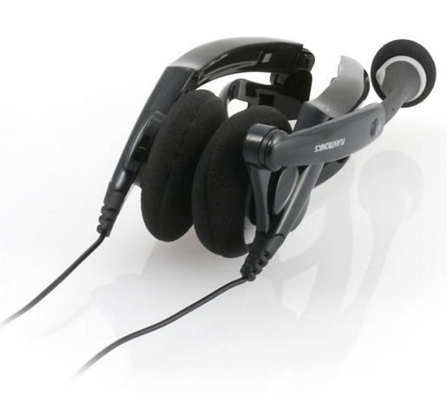
Example of Context
Notes:
If, on the other hand, we were discussing specific functionality of the headset—that it was highly portable because it folded up—we might want to say, “Generic headset Model ABC, shown in collapsed position."

Slide 41

Example of Context
Introductory text about headsets in general. Based on the context, any picture of
any headset would do.
Notes:
Finally, if the image is introducing a section discussing headsets in general and the particular model displayed is not relevant to the discussion, an appropriate "alt" text value might be, "stereo headset with microphone.” or it might even be appropriate to use “null”.

Slide 42
“null” attribute
All content conveying images must have an “alt” attribute
The “alt” attribute conveys the content of the image
The “null”attribute actually has a purpose besides getting around using the “alt” attribute
Notes:
Which brings us to “null” alt text. If an image is used as decoration only—a cartoon of a person talking excitedly and used to jazz up the "comments" section of a blog page—then we do not need to provide any "alt" text value for the image. The image is just decoration or visual relief. It does not contribute anything significant to the understanding of the content of the page. The null tag tells the screen reader to ignore the image. The student will not hear anything at all about the image.

Slide 43
Images as links
Links should identify the resource linked to so that it makes sense out of context
Images as links are no different
Except link goes in the “alt” value
Notes:
As already discussed, link text should identify the resource linked to, so that the link can be read out of context of the surrounding text.
The same goes for images used as links, except the link text goes in the "alt" value.

Slide 44



Images as links – example
“alt” text = home page
“alt” text = small house
Notes:
For example, a graphical icon of a small house used to link to the course home page should get the "alt" value "course home page," not "icon of a small house." By indicating "home page" we are telling the user the function of the image—it is a link to the course home page. We do not need to say "link to course home page," since all user agents will identify that the image is a link. Hearing it again is repetitive and tedious for the user.

Slide 45
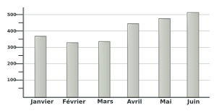
Charts
Charts need a unique identifier
Refer to the chart by the identifier not location on the page
Figure: 1-5: First half earnings
Notes:
Instructional designers should place a text caption above or below the chart graphic which uniquely identifies the chart. In some cases, images should have a caption. But often an "alt" text value is all that you need.
For charts or images that are crucial to understanding the content, however, the stakes are different. There needs to be a way to search in a document for these charts or images and have those search results be accurate enough so that a student can easily locate the rich data in the chart or image and not confuse it with some other chart or image.
The most straightforward means for such identification to give the chart or image a unique number or label.
For non-visual web users, it is always more difficult and in some instances impossible to determine visual spatial references, such as "to the right," "on the left side of," "above," etc., because a screen reading program reads the page in code order, rather than spatially.
Because of this, it is preferable to refer to charts by the unique number or label in their text caption. The label can be searched for easily. Another good strategy is not only to refer to the label but also to provide an in-page hyperlink or "anchor" that will scroll the student's browser window to the chart when clicked.

Slide 46
Charts descriptions
Long descriptions – use a data table
Simple chart – provide a short description via the “alt” attribute
Complex chart
  How do we best explain the information?
Notes:
Most charts in instructional materials are graphical representations of tabular data. It benefits all students, especially students with disabilities, to supply an accessible HTML table of the data graphically represented in the chart.
For simple charts or for charts that are merely graphical representations of table data already provided on the page, an "alt" value is enough to identify the chart. Something like "a chart representing the data in table 4.5" might be used as the "alt" value.
This Best Practice builds on the previous two. It is usually best to use the main body text of the lesson, article, or discussion to elaborate the data in the chart. However, it may not always be feasible to do this. For greatest clarity, it may be necessary to provide both a link that takes the student to a page containing the tabular representation of the data along with further explanatory text. Place the link adjacent to the image/chart and clearly identify in the link text that it is a "long description". For example, the link text might read, "long description and table equivalent of chart 4.5."

Slide 47
Data Tables
Summary attribute
Caption element
Table header element
Row and column scope (simple tables)
“id” attributes (complex tables)
“axis” attributes
Avoid large tables when feasible

Slide 48
Summary Attribute
Provides a sense of the “what” is being presented
Provides information about table organization
Orients students by giving a preview of the table
Notes:
When a sighted student first scans a table, they immediately get a sense of the information that is being presented, how it relates to columns and rows and a general idea of the what the point of the table is. The summary attribute tries to do the same thing for someone who either can’t see the table or has a literacy or reading disability.
It provides information about how the table is organized – in other words, how its rows and columns relate and what the content of the table is in respect to what the data table provides. Think of it like an “alt” tag for the table’s organization. The summary orients the student before they even encounter the data by giving them a kind of preview of what they’re getting in the table.

Slide 49
Caption element
First element
Title and/or brief description
Position
Notes:
The first element in a data table is the caption. It should contain the title and/or a very brief description of the table.
Using CSS, it is possible in most browsers to position the caption visually either at the top or bottom of a data table and that choice is up to you. But a screen reader will read the caption to the student upon entering the table. The student can also use specialized keystrokes in their screen reading program to call up the caption at any point in browsing a table.

Slide 50
Table header element
Columns and rows
Semantically correct
Screen reader interaction
Notes:
Like in an Excel spreadsheet, an HTML table has columns and row header cells that provide descriptive categories for the data that line up in each column and row. Not only is it semantically correct to mark up headers using the table header (“th”) tag, but doing so also has special meaning for access technologies, such as screen readers. When an access technology reads the content of a table data cell, it also can read the table header associated with that cell, which helps the student better understand the significance of the data content.

Slide 51
Simple vs. Complex Data Tables
For simple tables, “scope” attributes for columns and rows help eliminate misinterpretation from guesswork
For complex tables, “id” attributes for columns and rows and “headers” attributes to define the relationship
Notes:
This is a causality of the time constraints, but see me if you need more data table information.
SKIP=================================================================================================================================
How do access technologies know which table header helps describe any given data cell? In the case of very simple tables, the access technology can just “figure it out.” But as we know, the goal is not to leave it up the (potentially “dumb”) access technology. Our task as content authors and designers is to take away ambiguity and present information in a way that ensures maximum clarity for the student.
The “scope” attribute of a table header tells the access technology that the header applies to the data in the either the row or the column, and thereby helps minimize the chance that the student will misinterpret the data.
In the case of tables where we have multiple headers on columns and rows, it is necessary to provide extra information so that access technologies, especially screen readers, can make sense of the data in the cells.
We can assign “id's” to all of the table headers and then use the “headers” attribute in each data cell to tie the data to one or more table header cells. A modern screen reader will then read the contents of the associated header cells when it reads the current cell contents.
If we do this, modern screen readers will have no problem figuring out what header belongs with what data cell and can relay that information back to the student.

Slide 52
“axis” attribute
Extra information about the category of things to which a cell belongs
Infrequent use
Extra help
Notes:
SKIP=========================================================================================================================
This is a more complex and frankly, infrequently used, attribute. For particularly complex tables with lots of numbers or raw figures, this can be helpful. If you have questions about this or want some examples of code, talk to me after.

Slide 53
Divide large tables
When appropriate, break large and complex tables into smaller tables
Improves clarity for all
Notes:
As tables get very large and complex, however, it may make sense to break large and complex tables into smaller, individual tables.
It can be difficult to determine when to make the decision to break up large and complex tables. Try to decide if the relations between the data you are presenting might be broken up into multiple separate instances of correlations. Always be cognizant of ways you might present your data more simply. All students, not only those with disabilities, will benefit from the increased clarity.

Slide 54
Non-HTML Content
Video and Audio
Non-HTML Documents (Word, PDF, PPT)
Notes:
We all tend to use the tools that we have available at our immediate disposal – Microsoft, Adobe, Photoshop, Camtasia, and so on. We don’t get much formal training (if any) so we teach ourselves. Unfortunately, most common content creation tools don’t create accessible co.ntent by default

Slide 55

For me????
Notes:
And, when new stuff comes along, we want to try it and sometimes the powers that be will actually buy it for us. Oftentimes new technology is embraced without being evaluated for its accessibility – so students with disabilities continue to struggle with a lot of inaccessible content.
I’m going to highlight the most critical issues faced with non-HTML content.

Slide 56



Video and Audio
Notes:
Multimedia is important. Teachers and students want it and expect it. So, we need to be aware of some of the potential barriers (and benefits) of multimedia. So much multimedia is inaccessible, but with some extra effort, we can minimize the problems, satisfy the mission of universal usability and enrich the educational experience of students with no identified disability.

Slide 57
Significant issues
Inadequate delivery formats
Lack of text transcription for audio
Lack of synchronized captioning for video
Lack of audio description for video
Notes:
There are four significant accessibility issues commonly associated with multimedia delivery:
Inadequate delivery formats
Lack of text transcription for audio
Lack of synchronized captioning for video
Lack of audio description for video

Slide 58
General Requirements
Basic goal is universal play-ability
Base on IT staff recommendations/LMS specs
Go agnostic if you can
Notes:
The basic goal for web-delivered multimedia is universal play-ability. You want the video and audio to be easily viewed and heard. We don’t want students to have to jump through a bunch of hoops to access content.
So, how do you decide? The choice will likely be based on IT staff recommendations or the capability of your LMS. For instance, there is a subscription based service, Kaltura, that integrates with Moodle, Blackboard, D2L and Sakai. It’s player is device agnostic. But, there are costs associated with that, so, if that isn’t an option, just keep in mind that mp3 works best for audio playback, and generally Flash works best for videos that do not have to be downloaded or have interactive content. But, Flash can be a beast when we are dealing with Flash-based content in web pages. You will need to test your Flash-based media players in multiple browsers and operating system combinations. This is by no means a comprehensive overview products or file types.

Slide 59
Text Transcriptions of Audio
Makes course accessible
Provides benefit for others
Makes audio content searchable
Not gonna lie – expensive, time-consuming
Notes:
Provide full and accurate text transcriptions of all audio-only content. Either the transcription can be provided on the same page as the media player or a link can be provided. Links should be contextual—that is, "link to transcript" is not as good as "transcript of July 4, 2009’s Chemistry 101 lecutre."
Audio content that doesn’t have easily accessible transcription has no value for deaf students. But audio transcripts aren’t only valuable for students that are deaf. They make it easier for non-native speakers and students with cognitive disabilities by providing multiple modes of presentation.
A real bonus is that they make the content of the audio searchable. Raw audio is nearly impossible to search accurately – it’s expensive and requires tons of computer resources. But, text, is super easy.
I am not going to sugar coat this, transcription is time consuming, exhausting, and expensive. It stretches labor and budget resources, but it’s necessary. So, keep this in mind when making decisions about your multimedia choices and needs.

Slide 60
Video Captioning
Time-synchronized captioning
Videos in stand-alone players
  Keyboard
  Screen reader
Notes:
All video must have time-synchronized captioning that is either enabled by default or easily turned on and that has good background-foreground contrast and is properly "chunked" for easy reading. Web-page embedded and downloaded video which plays in a stand-alone player need to be keyboard and screen reader navigable.
I was going to go into a great deal of detail about what players do what well, but it really goes beyond the scope of this discussion. Frankly, you will have to do some research and make decisions based on your institution, LMS and budget. I am happy to discuss this in depth later if anyone has questions.

Slide 61
Basic Steps
“Chunk” the transcript
Add audio cues/sound effects and speaker change indications
Synchronize captions with video to create a timed-text file
Associate that timed-text with the video for playback
Notes:
Chunking is the breaking of the transcript into 1 to 3 line segments between 32 and 42 characters per line. Chunks appear in the video alone during the time the information is spoken. This is called “pop-on” captioning and is what you are used to seeing. There are conventions for chunking but no set standards. You want the chunks to make sense and be relatively understandable out of context and they should be easy to read. Use proper grammar. Follow your intuition on where to break lines and chunks.
Once you’ve chunked the text, it’s good to add indications of speaker changes, audio cues and sound effects. Conventions vary somewhat. Again, use your judgment. Most off all be consistent. It makes everyone happy.
Next, we have to synchronize the captions with audio track. There are several software options – some are free some aren’t. They all have some learning curve and they all require time investment.
Once all that is done, the text file is associated with the video.

Slide 62
Audio Description
Audio-only track that runs synchronously with main video’s audio
Describes key visual content
Very uncommon
Very difficult
Can be argued as undue burden
Notes:
Provide audio description of important visual content. Audio description should be able to be easily turned on and off.
An audio description is an audio-only track that runs synchronously with the main video's audio and describes key visual content. Audio descriptions provide necessary context for understanding what is going on in the video for students who cannot see the video, and they provide extra context to aid comprehension for students with cognitive disabilities.
There is no question that there is very little audio-described video on the web, whether in or outside of educational institutions. Instructors and content designers see creation of it as an undue burden. However, if your goal is universal design that provides access to everyone, regardless of ability, then audio description is a necessity.
You should audio describe:
Opening titles and on-screen text (when it is not spoken)
Crucial scene changes, on-screen events, actions, and gestures
Character appearance and observable emotional states, when essential to comprehension of the video
It is probably easiest to scrub through the video and record the audio description as separate clips. Any good audio recording software will allow you to insert silence of arbitrary length into a clip and merge clips together. So if you have money and time it does not take much effort to produce a video-length audio description track. I do understand that most of have neither time nor money.

Slide 63
Non-HTML Documents
Word
PDF
PowerPoint
Notes:
In general, it is best to have your content formatted as HTML, but this isn’t always practical. People will always upload and link out to documents. So, remember to include the document type as part of the text link.

Slide 64
Word
Adequate accessibility when properly formatted
Use styles for text formatting
“alt” text for images
Table of Contents/Table of Figures
Tables are tricky
Avoid exporting to HTML from Word
Notes:
Use styles for all text formatting. Large, bold text is not the same as text that looks the same but has a heading style applied.
Even in Word, images need “alt” text. Use the reference menus to add a table of contents (when appropriate) and/or a table of figures for graphic-rich documents.
Tables are never great because Word has no provision to differentiate between a header cell and a data cell. You have more control over table markup in PDF than Word, but just be aware.
Even in the latest versions of Word, HTML exported from Word is bloated, doesn’t validate, and is very difficult to edit after the fact.
If you are running Word on a PC and not a Mac, you have an accessibility checker built right in.

Slide 65
Adobe PDF
Accessible format
Creating PDF from Word
PDF forms, ensure proper tab order
Editing other’s PDFs
Securing PDF via password protection
Notes:
PDFs can be pretty accessible, but HTML is still the better choice. But, sometimes you need to use a PDF document. To be accessible, PDF must be tagged. This is similar to marking up in HTML. This can be done manually or generated from heading structure if exporting from Word. When creating from Word, use the Acrobat “Create PDF” option because, printing to PDF loses structure. If you need step by step directions, see me after. Editing other people’s PDFs is a pain and usually frustrating. If you can get the Word document, almost any amount of time you spend hunting that down will be worth it. If you want to check someone else’s document for accessibility, there are a number of things you need to do. I am happy to discuss this after.
When securing PDFs via password protection, make sure the “Enable text access for screen reader devices for the visually impaired” option is checked. This option is in the same dialogue box where you password protect the document.
Adobe Pro also have an accessibility checker built in. If you only have the Reader, you would have to upgrade to Pro to get this option.

Slide 66
PowerPoint
Most widely used presentation format
HTML is still a better option
Choose standard and simple layouts
Descriptive titles for every slide
Minimum length and number of bullet points
Use speaker notes to elaborate graphics
Notes:
Even though HTML is still better, thoughtfully produced PowerPoint can be accessible. A number of these recommendations are similar to what you hear about making good PowerPoint slides in general. So, a lot of it won’t be a surprise. Use the Slide layout pane for creating new slides and keep layouts standard and simple. Use clear descriptive titles for every slide. Slides should have no more than 6 points per slide at a default font size. Ideally, each point would have only line of text. Two tops. Use the Speaker’s Notes pane to elaborate graphics such as diagrams, charts or complex tables. A student using a screen reader can hit a special set of keystrokes to listen to the contents of the Speaker’s Notes pane.

Slide 67
PowerPoint
Clean, uncluttered pages
Standard, non-decorative fonts
Font foreground-background high
Concise, non-figurative language
Images need “alt” text
Embedded multi-media needs captions
Notes:
Pages should be clean and uncluttered. Fonts should be standard and non-decorative. Like we discussed earlier, sans-serif is preferred, with the most preferred being Verdana, Trebuchet MS, Lucida Sans, Helvetica and Arial.
Keep font foreground-background contrast high. Use concise, non-figurative language. We have to provide “alt” text for non-decorative images or no “alt text” for decorative images.
Embedded multimedia needs captions. Unless something has changed, only QuickTime and Flash can embed captioning that will play back in PowerPoint. If there is no other option, the Speaker’s Notes can be used to include a transcription of verbal content of movies. However, synchronized captions are preferable.

Slide 68
PowerPoint
Yes, you can use slide transitions
You can also use text effects
Avoid using shapes with text boxes inside of them
Use the Outline pane to visually check screen reader accessibility of text
Notes:
Yes, you can use slide transitions - they are ignored by screen readers. You can use them, but they can cause cognitive overload for students with certain cognitive disabilities, like ADHD. Text effects, like fly-in bullet points, can be used as well. Because of the way screen readers hear the new bullet points, if you use text effects, it is even more important that you properly title your slides. Avoid using shapes with text boxes inside of them. Modern screen readers will read the text in the textboxes if you do this, but not in the visual order they appear on the screen. They will read text boxes last.
Use the Outline Pane to visually check screen reader accessibility of text. If text is missing from the outline, then the content may not be visible to screen reader users. For example, graphical text is not readable for these users. PowerPoint has an accessibility checker built in as well.

Slide 69
Universal Design for the Web
Designing for inclusive environments
Helps eliminate “doing it again” to accommodate a special need
Relates to spatial environments, product designs, and communications media – not just the web
Notes:
Universal design emerged from the general approach of designing inclusive environments, typically called barrier-free. Most of us have seen the curb-cut video. If not, and you’re interested, I can get that to you. Universal design can be applied to all types of environments, designs and media. It helps eliminate the process of creating something once and then having to do it over for a special need. So, it’s not only the right thing to do, but it can save time and money in the end.

Slide 70
Universal Design for Learning
Set of principles for curriculum development
Blueprint for creating instruction that can work for everyone
Notes:
Universal Design for Learning
is a set of principles for curriculum development that give all individuals equal opportunities to learn.
UDL provides a blueprint for creating instructional goals, methods, materials, and assessments that work for everyone--not a single, one-size-fits-all solution but rather flexible approaches that can be customized and adjusted for individual needs.

Slide 71
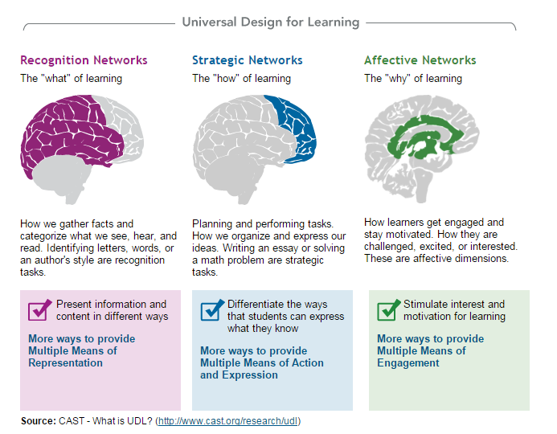

Why is UDL necessary?
Notes:
I know most of have seen this, but just a reminder that individuals bring a huge variety of skills, needs, and interests to learning. Neuroscience reveals that these differences are as varied and unique as our DNA or fingerprints.
UDL helps address learner variability by suggesting flexible goals, methods, materials, and assessments that empower educators to meet these varied needs. Curricula that is created using UDL is designed from the outset to meet the needs of all learners, making costly, time-consuming, and after-the-fact changes unnecessary. The UDL framework encourages creating flexible designs from the start that have customizable options, which allow all learners to progress from where they are and not where we would have imagined them to be. The options for accomplishing this are varied and robust enough to provide effective instruction to all learners.

Slide 72
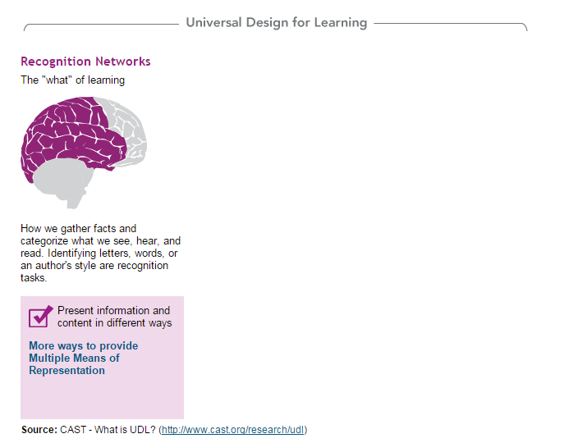
Recognition Networks
Notes:
The "what" of learning - How we gather facts and categorize what we see, hear, and read. Identifying letters, words, or an author's style are recognition tasks.
Provide multiple means of representation.
Provide options for language, symbols and text. A graph may make perfect sense to you but be confusing to someone else. Remember when we talked about providing chart descriptions.
Learners differ in the ways that they perceive and comprehend information that is presented to them. For example, those with sensory disabilities (e.g., blindness or deafness); learning disabilities (e.g., dyslexia); language or cultural differences, and so forth may all require different ways of approaching content. Others may simply grasp information quicker or more efficiently through visual or auditory means rather than printed text. Also learning, and transfer of learning, occurs when multiple representations are used, because it allows students to make connections within, as well as between, concepts. In short, there is not one means of representation that will be optimal for all learners; providing options for representation is essential.

Slide 73
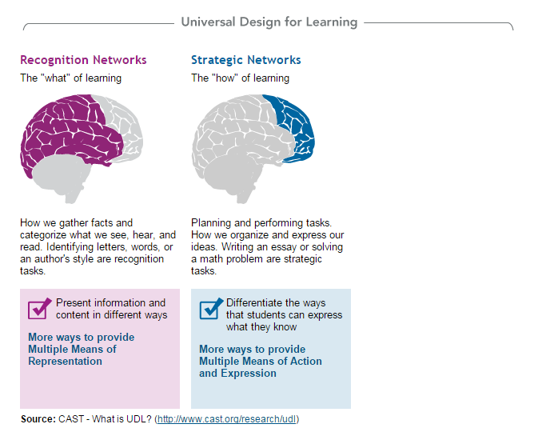
Recognition Networks
Notes:
The "how" of learning
Planning and performing tasks. How we organize and express our ideas. Writing an essay or solving a math problem are strategic tasks.
Differentiate the ways that students can express what they know
Vary methods of response and navigation. We talked about being able to navigate using the keyboard and not just the mouse.
Let students have a choice on how they show their comprehension – report writing may work great for some whereas a video report is better for someone else.
Help with goal setting, planning and managing information and resources.
Learners differ in the ways that they can navigate a learning environment and express what they know. For example, individuals with significant movement impairments (e.g., cerebral palsy), those who struggle with strategic and organizational abilities (executive function disorders), those who have language barriers, and so forth approach learning tasks very differently. Some may be able to express themselves well in written text but not speech, and vice versa. It should also be recognized that action and expression require a great deal of strategy, practice, and organization, and this is another area in which learners can differ. In reality, there is not one means of action and expression that will be optimal for all learners; providing options for action and expression is essential.

Slide 74
Recognition Networks
Notes:
The "why" of learning
How learners get engaged and stay motivated. How they are challenged, excited, or interested.These are affective dimensions.
Stimulate interest and motivation for learning by offering options and autonomy. Minimize distractions and threats to learning. Accessibility again – students with cognitive disabilities are easily distracted and this can inhibit learning. Vary demands for a challenge and a change of
Affect represents a crucial element to learning, and learners differ markedly in the ways in which they can be engaged or motivated to learn. There are a variety of sources that can influence individual variation in affect including neurology, culture, personal relevance, subjectivity, and background knowledge, along with a variety of other factors presented in these guidelines. Some learners are highly engaged by spontaneity and novelty while other are disengaged, even frightened, by those aspects, preferring strict routine. Some learners might like to work alone, while others prefer to work with their peers. In reality, there is not one means of engagement that will be optimal for all learners in all contexts; providing multiple options for engagement is essential. pace. Foster collaboration and communication. Facilitate personal coping skills, develop self-assessment and reflection.

Slide 75
UDL Benefits to Educational Content
Improved academic experience for all students
Content is compatible with wider range of technologies
Full access to content
Notes:
By adopting the universal design principles in creating websites and course materials for our online teaching environments, we improve the academic experience of all of our students including students with disabilities; this makes the learning environment and instructional materials more accessible and usable.
By following the universal design principles for creating course materials we ensure that our content is accessible for a wide range of students with different abilities and learning styles. For example, this will allow any student to learn at their own comfortable pace and time.
Universal design principles will also make our content compatible with a wider range of technologies and allow everyone to view and interact with the content in the most comfortable environment. For example, students can use low or high resolution monitors, PDAs, cell phones, text browsers, refreshable Braille displays, and screen reader programs to view and interact with the content.
Additionally, by providing alternative text for charts and informational graphics, all students including blind students will learn about the message of the chart or graphic. By providing transcript and/or caption for an audio/video clip, you not only make your audio/video clips accessible to deaf students and those with language barriers, but you also make your audio/video clip searchable.
The point is that regardless how students access the information and what their abilities are, they have full access to the content and can interact with it.

Slide 76
Standard 8
The course demonstrates a commitment to accessibility for all students
The accessibility standard incorporates the principles of Universal Design for Learning (UDL) and is consistent with Web Content Accessibility Guidelines (WCAG 2.0)

Slide 77
8.1 – Information, Guidance, Support
Link or statement certifying LMS accessibility
Documentation stating degree of accessibility of materials
Link or statement (and instructions) stating who to contact with problems
Notes:
Honestly, I think this one is pretty easy to meet. Most LMSs provide you with the link certifying their accessibility. Just make sure to put this in your worksheet. Document the degree to which your content, tools and software are accessible. To meet this, you don’t have to be perfect. You have to tell what you have done, where you are going (if you need to improve), and you have to document it in your worksheet. Make sure that you let everyone know what to do if they need an accommodation, can’t access materials, or are having some other problem. You are not being judged on the degree of help that is provided (in other words, you don’t have to have a 24/7, 365 day a year support team on staff). But, you do need to have some plan in place, you need to make sure it’s clear what that is and how students can take advantage of it.

Slide 78
8.2 – Equivalent Alternatives
Alternative means of access to course information is provided for all students
  “alt” text
  Captions/transcripts
  Forms
  Etc.
Notes:
Okay. This one is harder. You have to actually do the stuff. But, remember, we all want an “A” but you meet if you get a solid “B”. So, do what you can, make a real effort to do these things. Sure, some things take more time, effort and money than others. So, make sure you do the easy stuff. “alt” text should be a no brainer. Just do it. If you can’t do captions right now, make transcripts. I can only speak for how I conduct a review, but if you transcripts, I give you a met. You will get a suggestion for improvement, but you also get a met.
Do your best on forms, documents, and all the other stuff we discussed. If you make it clear in your course worksheet what you have done and/or are doing to regarding these things, it will take you a long way.

Slide 79
8.3 – Screen readability/Distractions
Colors
Fonts
Spacing
Graphics
Formatting
Color Coding
Notes:
Okay. You got this one. We discussed it to ad nauseum earlier. Color alone cannot convey meaning. Contrast between background colors and font colors needs to be sufficient. Text size is consistent with typical View, Text and Size settings. Formatting and color coding are used to serve specific instructional purposes – we talked about this regarding emphasizing relationships or communicating key points.

Slide 80
8.4 – Design accommodates assistive technologies
No “click here” or “more”
“alt” text
Tables used appropriately
Accessible documents
Skip navigation
CSS
Notes:
Again, you go this one. You know not to use “click here” or “more”. Link and descriptors make sense out of context. “alt” text again. So, if you did it to meet 8.2, you’ve already done it for 8.4. Make sure you use tables and lists appropriately. Documents – do the best you can here. If you create them in Word, you can run the accessibility checker and if you save them as PDFs, you they maintain their accessibility. If you have someone else’s document, you can check it using the accessibility checker in Adobe Reader and Pro. These are the little things that you can do, that don’t take much time, and don’t cost you extra money that will help you get a met.
Skip nav and CSS are probably handled by your LMS or IT person, but keep them in mind.

Slide 81

When I sit on a review….
Notes:
Yes, I actually run your course through the checkers. I look for transcripts, captions and alt text. But, I look at these things as a whole. And, if real effort is displayed throughout your course, you get a “meets” from me

Slide 82
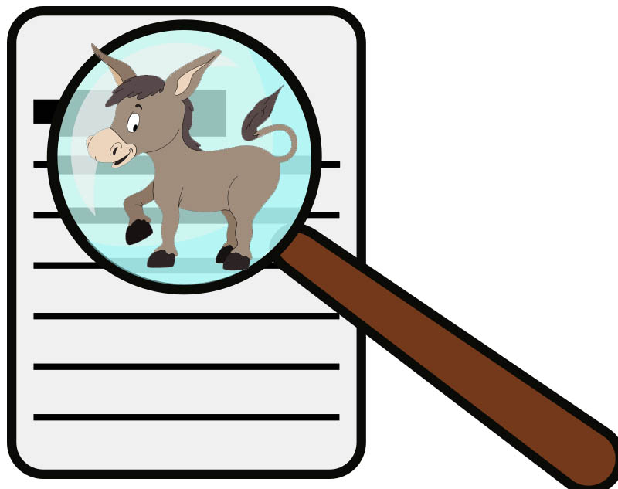
When I sit on a review….
Notes:
But if you kind of, well, half-donkey it, then you won’t get a “meets” from me. I have seen courses where the first unit or two has captions, alt text, image credits, on and on. Then all of the sudden, nothing for the remaining 8 units. Really? You are not getting a “meets.” But, if you consistently provide these things and your worksheet lets me know what you are doing in the area of accessibility, you are probably going to be just fine. You will probably always get feedback comments – there is usually something that could use a little tweaking, but I will also give you props for the good work that you do.

Slide 83
Access to code/links
https://coursesthatcaptivate.moodlecloud.com
Login Information:
User name: teststudent
Password: teststudent

