Slide 1

Infusing Quality Matters into a Clinical Nursing Course
Meredith Troutman-Jordan PhD, RN, PMHCNS-BC
Associate Professor
College of Health and Human Services-School of Nursing

Slide 2

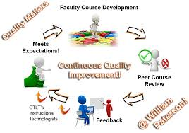
NUnu5rs 4420
Objectives:
Describe the process of revising a clinical nursing course with hybrid online delivery to meet Quality Matters standards.
Source: http://www.wpunj.edu/irt/ctlt/qm/index.dot
Notes:
Careful editing and review from the QM certification process has resulted in consistent, organized, clear, and logically related course
objectives, weekly learning aims, self-assessments, and learning activities, dramatically reducing confusion or the
need for questions. Historically, students have asked me "what we are supposed to do" in this course; a clinical
course in psychiatric mental health nursing, students practice interpersonal relationship skills and therapeutic
communication with patients, psychiatric assessment, and various therapeutic interventions, rather than more
tangible actions, such as giving injections or dressing changes. With the QM revision of the course, students now
complete weekly self-assessments to ascertain their mastery of content. These self-assessments are aligned with
weekly learning aims, which are designed to meet specific course objectives. Therefore, students are regularly
apprised of what they are learning (and doing) and why. Currently, we are in the first semester of this course being
taught since the QM revision and already I have observed striking differences; students are hardly using the
instructor Q&A forum. During our clinical time together, when I have asked about this, they state that they have
no questions and need no clarification of online material. This is unlike previous semesters when I would get a fair
amount of questions or students seeking clarification. Students have submitted high quality assignments and
verbalized a positive, meaningful learning experience this semester.
Brief description for publication (may include names): This presentation includes an overview and discussion
of one instructor's experience revising a clinical nursing course to be QM certified. Originally the course included
weekly discussion boards, accessed via the university learning management system. Upon QM revision, the
course was expanded to include consistent, organized, clear, and logically related course objectives, weekly
learning aims, self-assessments, and learning activities. Course clinical experiences and learning were integrated
with the QM objectives and teaching strategies, resulting in positive student feedback and higher quality
coursework submitted by students, as compared to previous semesters.

Slide 3
NUnu5rs 4420
NURS 4420-Development of competencies necessary for the practice of psychiatric mental health nursing. Emphasis is on the use of self in relationships, psychiatric nursing assessment, nursing interventions with clients and working as a member of the health care team. A variety of clinical settings are used.
Originally the course was comprised of eight hours spent in a clinical setting and online discussion boards.
Each week- 8 hours clinical time, discussion board reflection, times 14 weeks.
Strengths and limitations
  Considerable clinical exposure
  Disconnect between hands on clinical activities and learning
Notes:
Full description - no names:.. Careful editing and
review from the QM certification process has resulted in consistent, organized, clear, and logically related course
objectives, weekly learning aims, self-assessments, and learning activities, dramatically reducing confusion or the
need for questions. Historically, students have asked me "what we are supposed to do" in this course; a clinical
course in psychiatric mental health nursing, students practice interpersonal relationship skills and therapeutic
communication with patients, psychiatric assessment, and various therapeutic interventions, rather than more
tangible actions, such as giving injections or dressing changes.

Slide 4
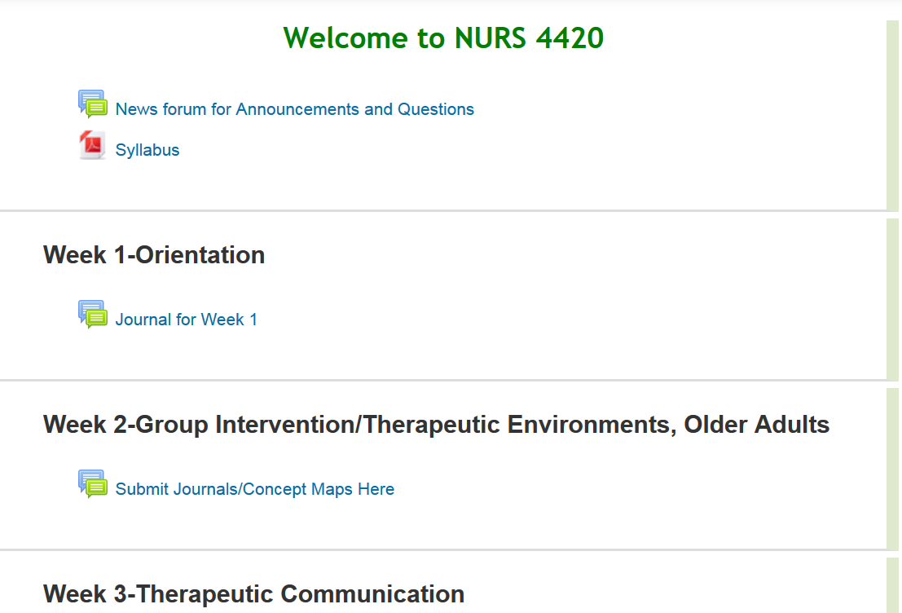
Notes:
Weekly discussion forums and drop boxes for submissions at appropriate places/times

Slide 5
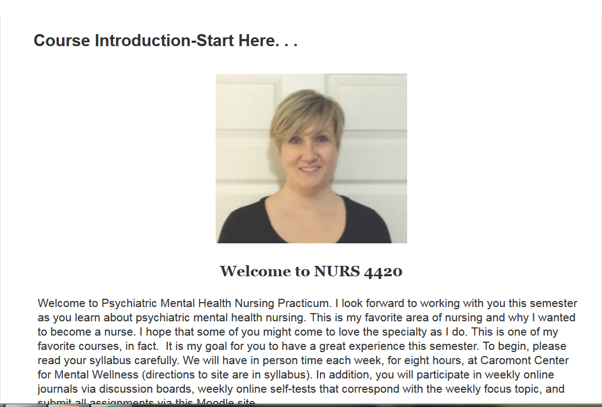

Slide 6
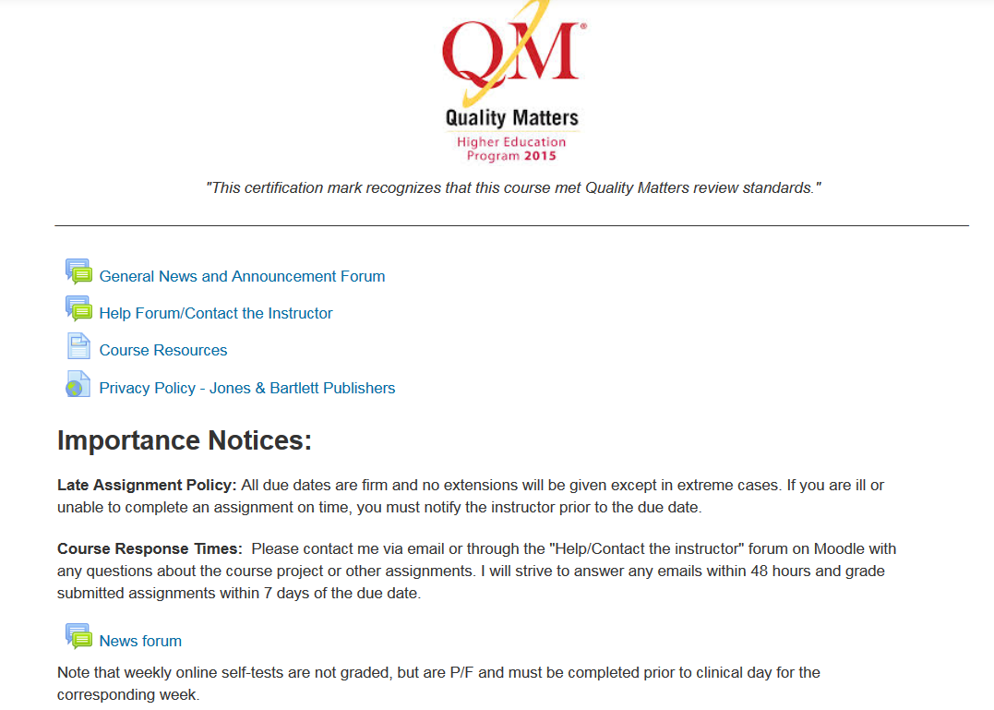

Slide 7
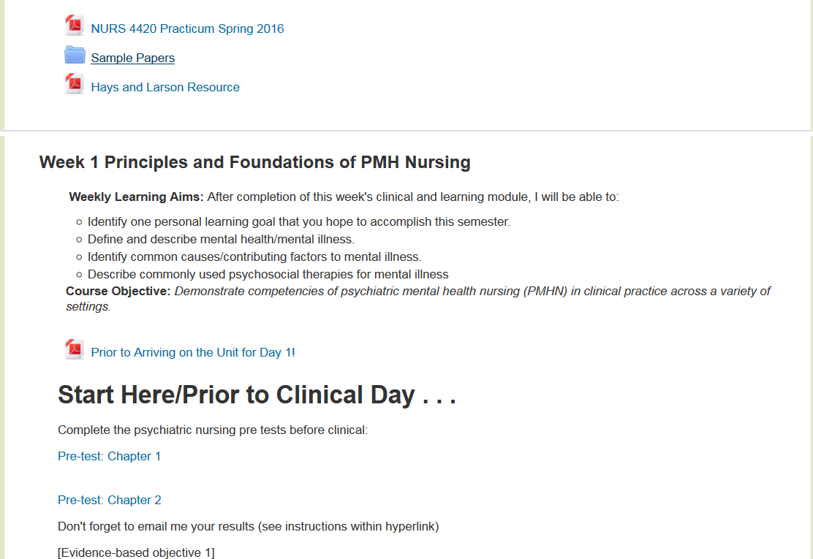
Notes:
weekly self-assessments to ascertain their mastery of content. These self-assessments are aligned with
weekly learning aims, which are designed to meet specific course objectives. Therefore, students are regularly
apprised of what they are learning (and doing) and why.

Slide 8


Increased interaction between student and teacher
Reinforce clinical and didactic learning
Helped identify further areas of exploration/consideration:
The course would have been more effective had the
course coordinator assigned a specific topic (maybe something that was not covered in depth in class) for the instructor to teach a short lesson on. I would have also liked to have been verbally quizzed on my client's medication in order to help me make connections from class.
I learned a lot in this class and was able to
really refine my communication skills, which I am very grateful for.

Slide 9

Questions?
Thank you
Meredith Troutman-Jordan PhD, RN, PMHCNS-BC
Associate professor, School of Nursing
UNC Charlotte
MeredithTroutman@uncc.edu

