Slide 1
Creating an Interactive One-Stop Online Quality Assurance Shop Using Adobe Captivate
Jun Yang
University of Maryland
Oct, 2016

Slide 2
Our Goals
Provide faculty with a self-assessment instrument.
Provide faculty with a one-shop quality shop.
Aid faculty in their efforts in developing an online course.
Provide faculty with a framework that promotes best practices for online learning.
Create a culture of quality for online teaching at UMD.

Slide 3
Things we have heard from faculty
Their schedule does not align with the our schedule.
They want more timely and on-demand support.
They are overwhelmed with requirements containing a long list of bullets__Time and workload
They want a simple, streamlined approach.
They do not know where to get started.

Slide 4
Our Approach
Focusing on the key competencies
Creating a multi-media based interactive online course quality system that encompasses a QM checklist, design templates, and design tutorials to answer “How To” questions
Creating the checklist also in survey format to track user input

Slide 5
Quality Frameworks
Quality Matters (www.qualitymatters.org)
Online Learning Consortium (http://onlinelearningconsortium.org)
Blackboard Exemplary Course Evaluation Rubric
(http://www.blackboard.com/resources/catalyst-awards/bbexemplarycourserubric_rebrand_july2015.pdf)
Quality Online Learning and Teaching (QOLT) at Chico State

Slide 6
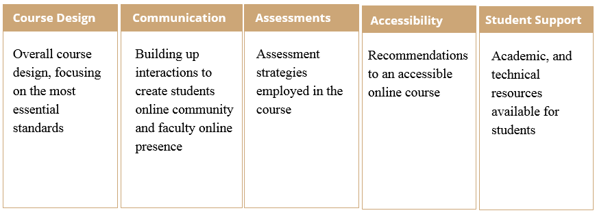
5 Key Components
Course Design
Communication
Overall course design, focusing on the most essential standards

Slide 7
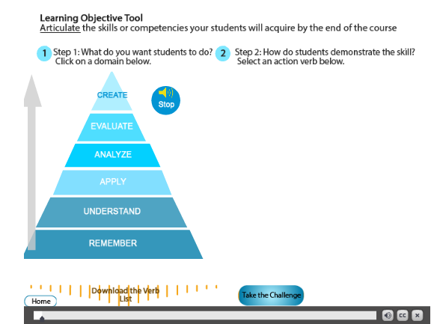
Examples

Slide 8
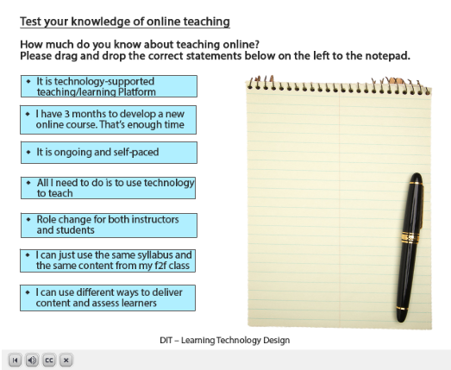
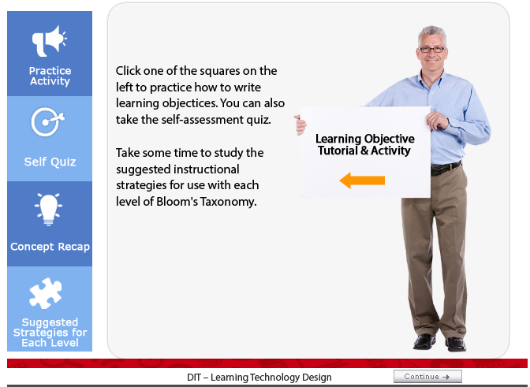
Examples
Interactive Tutorial Examples

Slide 9
Demo of the checklist
Demonstration of the checklist and the interactive tutorials

Slide 10
Challenges
Making tutorials engaging__ time commitment and learning curve with Adobe Captivate
Accessibility issues of Adobe Captivate tutorials
Collecting and following up the survey data
Marketing on the wider adaption of this checklist
  Faculty buy in and review
  Faculty focus group

Slide 11
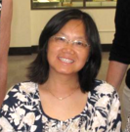
Thank You and Questions?
Jun Yang
Instructional Designer
Quality Assurance
University of Maryland
Instructional Designer
Quality Assurance
University of Maryland
Email: junyang8@umd.edu

