Slide 1
Creating a Pathway to Quality Design For Online and Blended Courses
5th Annual QM Conference
Nashville, TN
October 3, 2013
Tammy Macek, Susan Paul, Mary Jo DiGiandomenico,
Janis Thompson, and Aimee Dickinson
Lorain County Community College

Slide 2
Introduction of LCCC to
Quality Matters

Slide 3
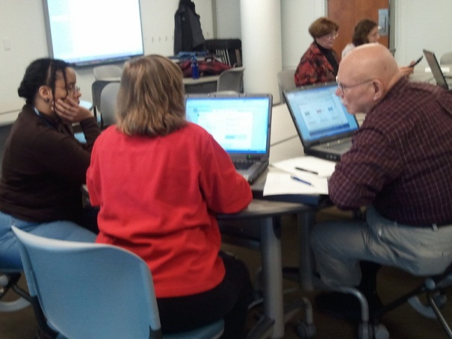
QM Implementation - 2010-2011
2010 - 2011
May: LCCC joined Quality Matters and the Ohio QM Consortium.
May: LCCC hosted the Applying the Quality Matters Rubric (APPQMR) workshop.
Fall: Quality Matters Pilot Project with 12 faculty participants.
  APPQMR training
  Informal peer reviews
Internal Communications.
Progress
Presentations:
  QM pilot project participants to Spring faculty workshop.
  Internal LCCC Committees
  June QM Regional Conference
10 faculty earned QM’s Peer Reviewer Certification (PRC).
LCCC QM Advisory committee formed.
May: APPQMR Workshop

Slide 4
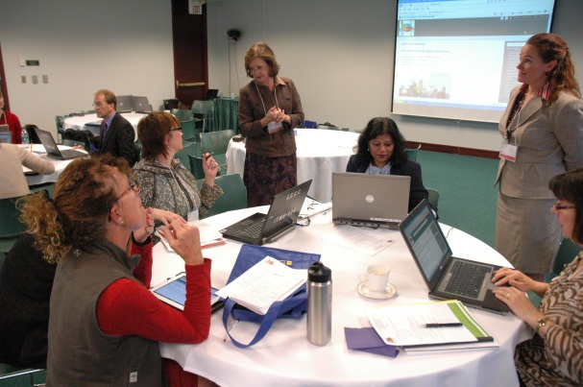
QM Implementation - 2011-2012
Progress
43 faculty trained in QM (APPQMR, PRC and MRC)
Two Master Reviewers and 16 Peer Reviewers
Peer Reviews: Quality Matters Recognized Courses
  Human Biology Online, Janis Thompson
  College 101 Online, Laurie Grimes
  Basic Algebra Online, Lisa Sheppard
  Sociology Online, Aimee Dickinson
  Computer Maintenance and Networking Online, Hikmat Chedid
Peer Reviews in progress:
  Women’s Health Online, Mary Jo DiGiandomenico
  Bioethics, Online, Rob Loftis
  Maternal Newborn Nursing Online, Barbra Wilford
  Principles of Marketing Online, Maria McConnell
  Anatomy and Physiology Blended, Kathy Durham
2011-2012:
May: APPQMR Workshop
Innovative Learning Project (ILP): Quality Matters Across the Curriculum
  Twelve faculty from all academic disciplines trained (APPQMR).
  Pilot project faculty served as mentors
  Informal peer reviews
Proposal for 2nd ILP project: Developing the LCCC Quality Assurance Rubric and Certification Process for Online and Blended Courses

Slide 5
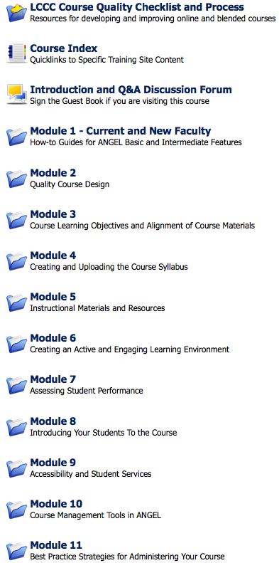
Faculty Training - 2012-2013
2012-2013
Faculty Training and Certification in Online and Blended Course Design for new online/blended faculty.
Course Development in ANGEL: A Self-Paced Training Course for all faculty.
New Course Quality Checklist added to training Fall 2013
Notes:
10-20 faculty in training course with QM overview and Course Quality Checklist.
Positive feedback faculty on self-paced training course
Fall CTE Workshop on Course Quality Checklist

Slide 6
The Faculty Experience

Slide 7
Preparing for QM Review
Fall 2010 - QM Training provided on-campus
Spring 2011 - Peer Review Process
Fall 2011 - Revised course based on feedback
Fall 2011 – Mentored a faculty member going through the QM training process
Spring 2012 & Summer 2012 – Made additional improvements to online design based on ongoing conversations with other online faculty
Fall 2012 – LCCC decided that the Women’s Health course will go through the QM Review

Slide 8
Preparing for QM Review
Spring 2013 - Dr. Jan Thompson conducted an internal review of Women’s Health course to prepare it for the QM review
Spring 2013 & Summer 2013 - made the necessary suggested changes
Fall 2013 – Women’s Health ready for QM review process

Slide 9
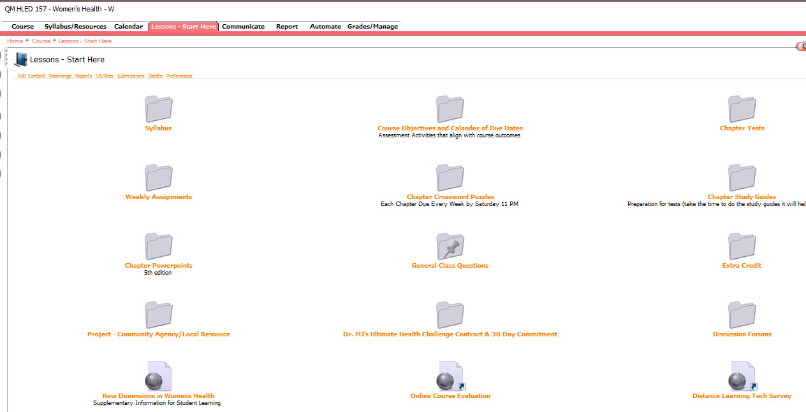
Women’s Health
Fall 2010 - Lessons

Slide 10
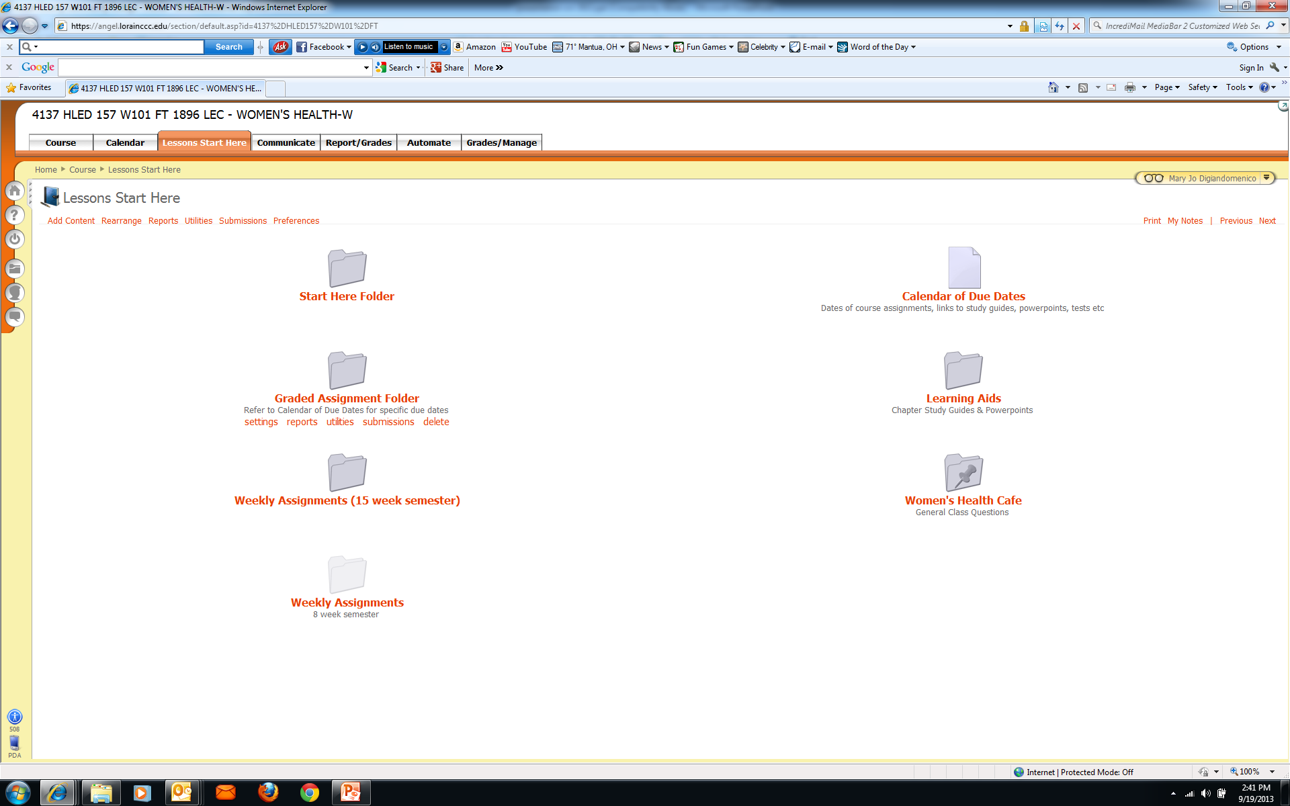
Women’s Health
Fall 2013 – Lessons

Slide 11
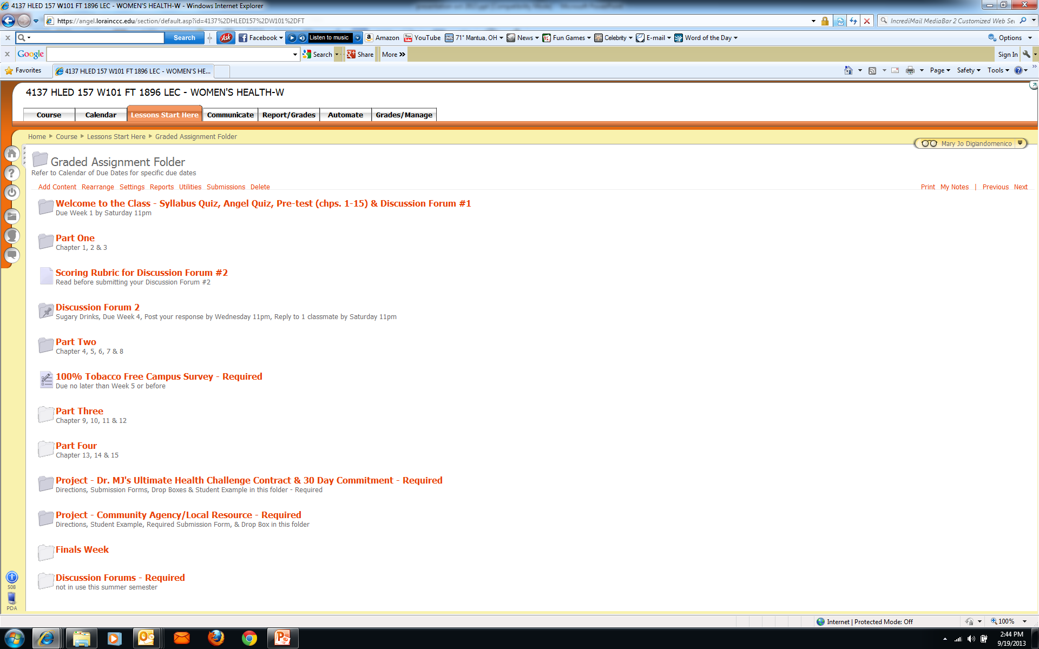
Women’s Health Fall 2013 - Graded Assignments Folder

Slide 12
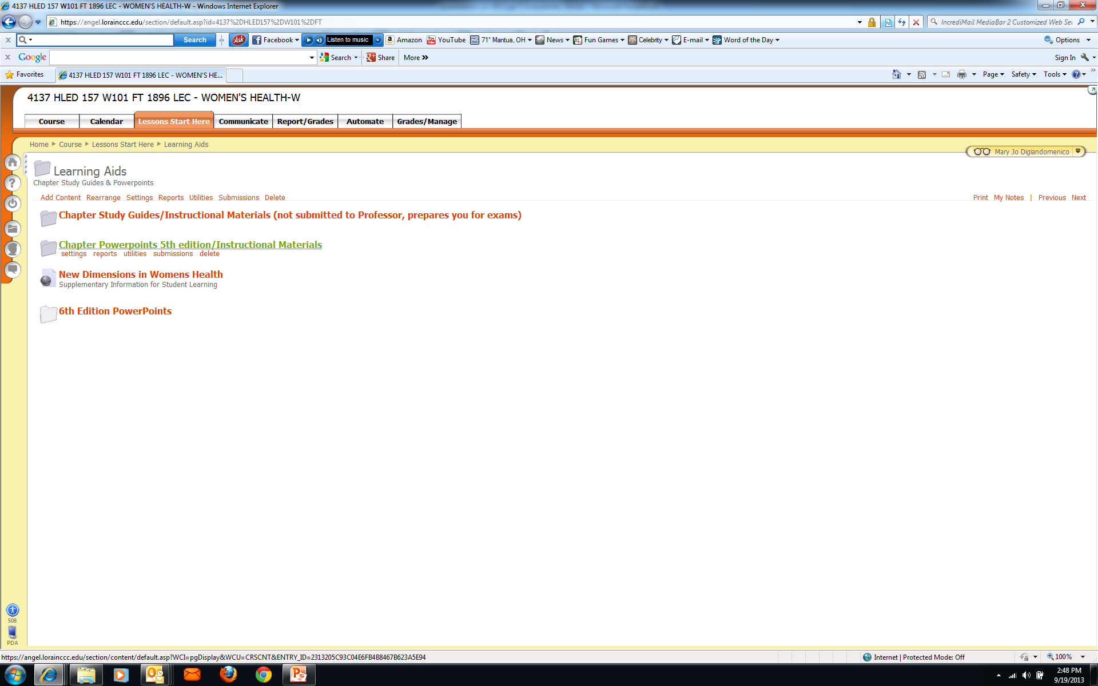
Women’s Health
Fall 2013 - Learning Aids Folder

Slide 13
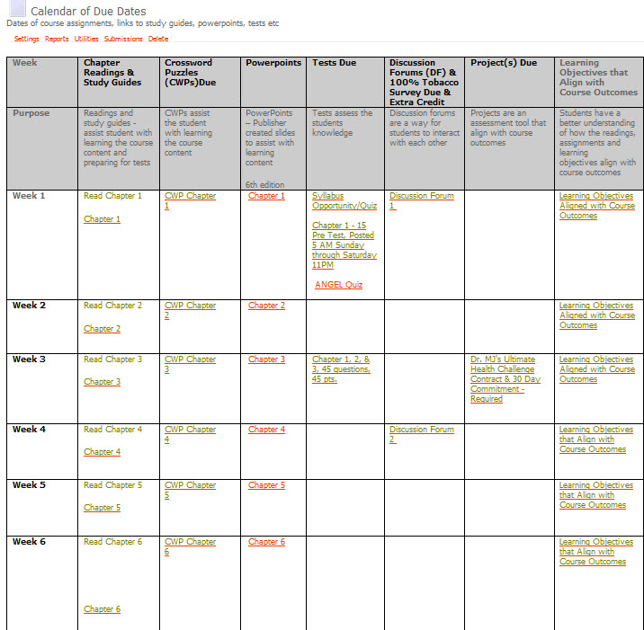
Women’s Health
Fall 2013 Calendar of Due Dates

Slide 14
Innovative Learning Project (ILP) Grants

Slide 15
What is an ILP?
Three types of grant opportunities are available to LCCC faculty
  Course Redesign
  Course Quality Assurance
  Innovative Learning Project
ILP engages in innovative learning strategies that promote student retention and student success

Slide 16
Criteria for an ILP Award
Supports principles of the Learning College and LCCC’s Vision 2.0 priorities
Describes the impact on student retention and student success
Assessment procedures are clearly established
Members are interdisciplinary and collaborative
Budget is appropriate
Overall content and design demonstrate quality, merit and efficiency

Slide 17
Further info…
Two ILP workshops are provided annually
Workshop facilitators provide expertise
Coordinator provides one-on-one guidance
Annual ILP Celebration in April – ”Noshing and Sharing”

Slide 18
Developing the Quality
Assurance Checklist

Slide 19
Design Process
Involved a review of numerous resources
Created by a cross-curricular team, including faculty and staff
Worked in small teams to create different parts of the checklist

Slide 20
Quality Assurance Checklist
Categories:
  Introduction/Getting Started
  Organizational Design/Navigation/Findability
  Learning Outcomes/Objectives
  Assessments
  Course Material/Interaction/Engagement

Slide 21
Quality Assurance Checklist
Within each category:
  Specific criteria were developed
  An importance “value” was assigned
Guidelines for checklist usage were created:
  For self-review
  For peer-review

Slide 22
Pilot, Part I
The project team used the checklist to review two courses: an online (QM recognized) course and a blended (previously unreviewed) course
Feedback from that experience led to some tweaking of the Quality Assurance Checklist and the review process

Slide 23
Pilot, Part II
The instructor of the blended course did revisions based upon review feedback
The project team returned to and reviewed the blended course
A pre-QM review was then done on the blended course using the QM Rubric

Slide 24
Finalizing the Checklist
An annotated checklist document was created:
  To provide more detail
  To direct faculty to the online training materials that would help courses meet the Quality Assurance expectations
  To facilitate self-assessment and self-improvement of online and blended courses by faculty

Slide 25
QUALITY ASSURANCE COURSE DESIGN GRANT PROJECTS

Slide 26

What Are These Grants?
CTE grant monies are available for instructors to have their online or blended course evaluated using the LCCC Quality Assurance Certification process
By utilizing the LCCC Quality Assurance Checklist, the faculty member will identify areas in his/her online or blended course that could be improved

Slide 27
PHASES OF THE GRANT PROCESS
Proposal submission:
Complete the proposal form
Place the survey link into a current section of course
Complete the self-assessment of your course using the QA Checklist
Initial semester:
Complete the Online Faculty Training Course
Revise course
Following semester:
Lead reviewer determines if course is ready for review
Three person review team formally reviews the course
If the course does not meet the standards, lead reviewer will work with instructor to revise the course so that it will meet the expected standards.

Slide 28
CRITERIA FOR QUALITY COURSE DESIGN PROJECT AWARDS
Self-evaluation of course using Quality Assurance Checklist | 25 pts.
Description of 3 enhancements planned for course | 25 pts.
Explain how these changes will improve retention and student to support Vision 2.0 | 15 pts.
Provide a pre-assessment student survey link in a current section of the course | 10 pts.
Do you require special services from an instructional design team? | 5 pts.
Do you need software, online resources, or assistance with creation of video, audio, or learning object content or other resources during your grant cycle? Cost? | 15 pts.
Are you willing to share your experience and results with CTE as a Professional Development workshop? Explain | 5 pts.

Slide 29

Seal of Excellence
  Score an overall total of 65/72 (85%)points earns the seal of Excellence

Slide 30
Presenters
Tammy Macek: Technical Applications Specialist/Distance Learning
tmacek@lorainccc.edu
Susan Paul: Interim Dean of Learning Resources/Distance Learning
spaul@lorainccc.edu
Mary Jo DiGiandomenico: Professor, Physical Education/Recreation
mdigiand@lorainccc.edu
Janis Thompson: Professor, Biology
jthompso@lorainccc.edu
Aimee Dickinson: Associate Professor, Social Science
adickins@lorainccc.edu

