Slide 1
Flipped, Hybrid, Online, Face-to-Face?!
Quality Design and Delivery are not Horses of Another Color
Matt Cockerell
Technologist/Instructional Producer
University of Kentucky
Matt.Cockerell@uky.edu
Dr. Sarah Kercsmar
Faculty Lecturer
University of Kentucky
Sarah.Kercsmar@uky.edu

Slide 2
Background
What is CIS 111?
How has CIS 111 been offered in the past?
Why are we offering CIS 111 in hybrid format?

Slide 3
What is CIS 111?
Writing
Speaking
Digital Projects
Interpersonal and Group Communication
n= approximately 75 sections and 2000 students/year

Slide 4
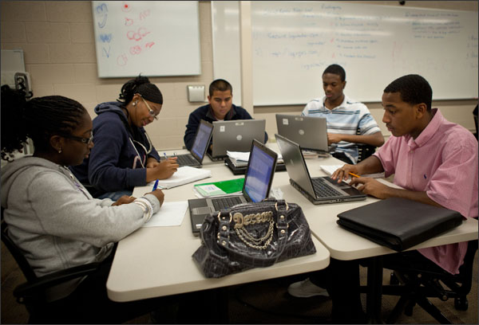

How has CIS 111 been offered in the past?
Face to Face
Fully Online

Slide 5
Why hybrid?
Grant opportunity
Classroom Space
Flexibility for
Students and Faculty

Slide 6
What does a hybrid class look like?
Schedule
Student Demographics
Classroom Activities

Slide 7
Schedule
Monday | Wednesday | Friday
ONLINE | F2F | ADOBE CONNECT

Slide 8

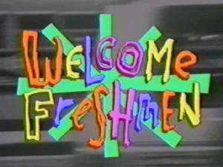
Student Demographics
Typical sequence:
  Fall – CIS 110
  Spring – CIS 111

Slide 9

Classroom Activities
CIS 111
Is NOT EQUAL
TO

Slide 10
Adobe Connect Demonstration
Link to classroom:
http://connect.uky.edu/qm2014/

Slide 11
What We Have Learned
Effects of F-2-F time with regards to technology
  Compared with Online Only
Instructor vs. Student expectations
  Online decorum
  Classroom management
Class Preparation Time

Slide 12
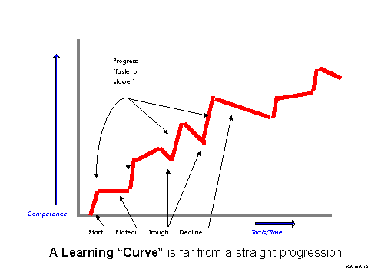

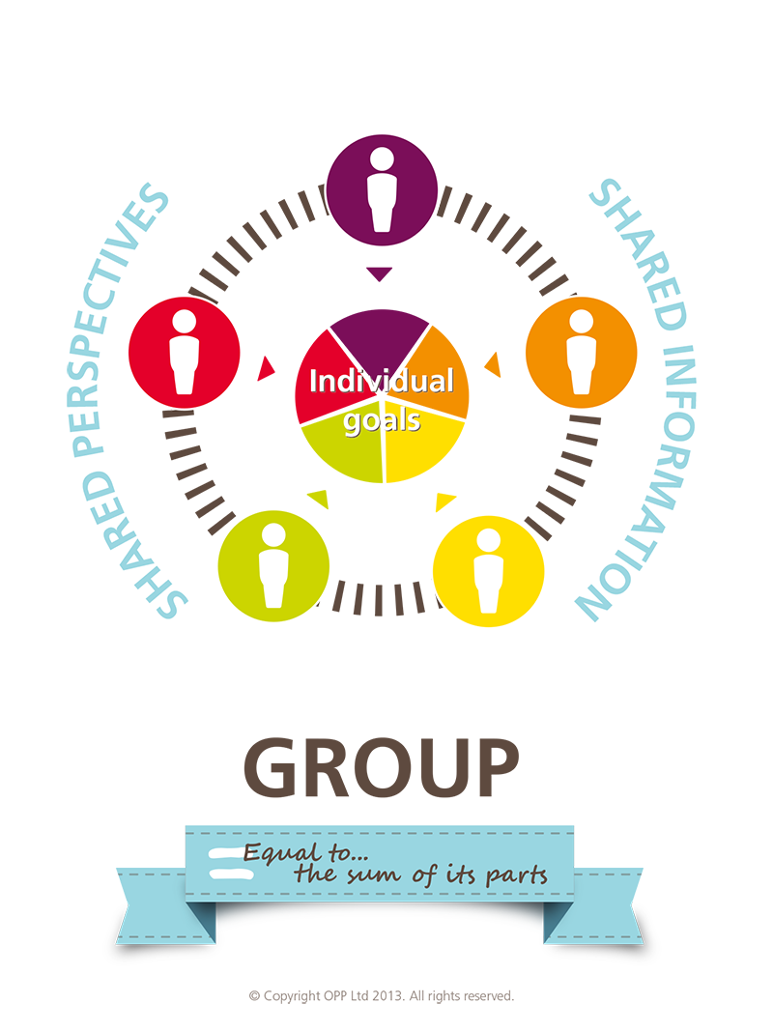
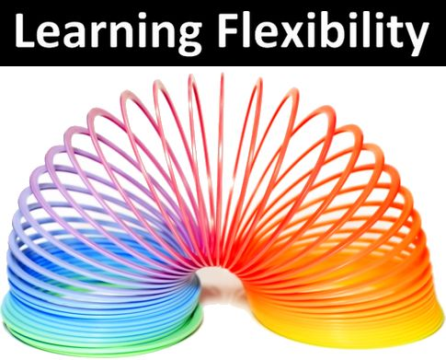

Challenges

Slide 13

Questions and Comments

