Slide 1
How we overcame the challenges of implementing standard 8
Erin Blauvelt, MEd
Instructional Designer
Excelsior College

Slide 2
Learning objectives
By the end of this presentation, you will be able to:
Develop online courses that meet Quality Matters Standard 8
Apply accessibility standards to an online course development process
Train staff members involved in the course development process to implement accessibility standards into online courses

Slide 3
Presentation overview
A little about Excelsior College
New Standard 8
Implementation Process

Slide 4
Tangible takeaways
Examples of:
  Division of Responsibilities List
  Accessibility Course Needs for Faculty
  Accessibility Standards Manual
  Resource List
Notes:
Examples of these four files are uploaded onto the QM Presentation Conference website.

Slide 5


A little about us…Excelsior College
Located in Albany, NY
Founded in 1971 as Regents College
Offers associate, bachelors, and masters degrees, certification programs and credit by assessment
Distance-only institution
Adult learner focused
Notes:
Want to quickly give you a little background on our institution so that our implementation process makes sense.

Slide 6
Our Course Design Team
Subject Matter Expert
Program Director
Instructional Designer
Course Development Specialist
Notes:
Each course development or major revision typically includes 4 team members.
Other team members may be included such as library, assessment or writing center staff.

Slide 7
1 course template -> all courses
ENG370
HSC220
master course template
NUR462
MLS624
IT325
Notes:
All of our courses are created using one master template, which includes a number of elements pre-loaded and begins each course with consistent navigation and layout.
Some elements include
Dreamweaver templates
Cascading style sheet
Navigation Bars
Policy information

Slide 8
New Standard 8
8.1: Course Navigation facilitates ease of use.
  Overall layout
    Consistent
    Easy to locate items
    Know location and navigate out to Homepage
    Table of contents
  Technical
    Intuitive labels (URLs)
    Tables have proper markup and are used only for data and content organization, not page layout
    Page hierarchy is clear (H1, H2, etc.)
Notes:
Jump right into the new standard!
You want your overall course and module layout to be consistent, with items easy to locate
There are a number of technical elements that need to be programmed on the back end to make sure that navigation is easy for someone using assistive technology.
URLs should be labelled with the destination’s title, not the URL itself.
Tables and page hierarchy should have proper markup so that assistive technology can read everything in the correct order.

Slide 9
New Standard 8
8.2: Information is provided about the accessibility of all technologies required in the course.
  Accessibility statements for:
    Learning Management System
    All other technologies in the course
  Logical place for statements:
    Syllabus
    Pages where software resides
Notes:
Accessibility statements are included for all technologies in the course, including the learning management system itself, plus any other technologies used.
The most logical places for these statements is the course syllabus or the pages where the software resides or is linked to. Personally, I think both locations is most helpful to students.

Slide 10
New Standard 8
8.3: The course provides alternative means of access to course materials in formats that meet the needs of diverse learners.
  Text-based or accessible alternatives for all non-text content
    Closed caption or transcripts for audio/video
    Plain-text equivalents (for multimedia, presentations, scanned PDFs, etc.)
    Alternative text, long descriptions, or captions for visual content (images, graphs, maps, non-text tables, etc.)
    Colors are not used to convey meaning
Notes:
Any non-text elements need text equivalents
If it isn’t text, it can’t be read by assistive technologies
This includes:
[Read list]

Slide 11
New Standard 8
8.4: The course design facilitates readability.
  Readability
    Logically labeled and grouped content
    Consistent fonts and text sizes
    Text stands out from the background
    Grammatical errors are minimal
  Minimize distractions
    White or negative space is used to facilitate organization
    Content serves instructional purposes
      Text and media are chosen carefully and content-related
Notes:
Course pages should be logical and consistent
Distractions such as little to no white space or content that isn’t directly related to instruction should be eliminated
Use only text, media, or images that are related to the instruction…don’t use flash just for flash!

Slide 12
New Standard 8
8.5: Course multimedia facilitate ease of use.
  Easy to:
    View
    Operate
    Interpret
  Graphics and animations are relevant to content
  Audio is clear
  Videos are resizable and chunked appropriately
  Movement through presentations can be controlled
  Media works in all platforms and browsers or has instructions on best to use
Notes:
Course materials should be easy to view and navigate through
Materials should give users the ability to control their navigation and viewing preferences and should function in all platforms and browsers unless otherwise stated).

Slide 13
Implementation Process
1
Analyze courses
2
Develop standards list/guide
3
Dissect course development process
4
Divide responsibilities
5
Develop and execute training plan
Notes:
This is the general process we used to implement Standard 8 into our course development process.
While we have been working to retrofit our existing courses based on Standard 8 for a few years, it is only this year that we have begun to implement it into the development process.

Slide 14
Implementation Process – Analyze Courses
Divide and conquer
  What elements are in your courses?
    What ADA standards match the elements in your courses?
    What ADA standards can be eliminated?
  What is your student population base?
    Are certain disabilities more common than others in your student population?
    Are there other students that could benefit from accommodations? (universal design)
Notes:
This step actually happened during our project to retrofit our existing courses into an accessible format.
To make the most out of your time and minimize efforts, you need to take a look at your courses and your student population base. Decide where to focus your time.
Are there elements in your courses related to Standard 8 that are more prevalent? Are there parts of the standards that you don’t have much of in your courses?

Slide 15
Implementation Process – Develop Standards List/Guide
Develop your own set of standards tailored to:
  Your courses
  Your student population
  Your disability services processes and policies
  Your resources
  Industry standards
  Quality Matters!
Notes:
When we looked at both the legal standards (ADA) and Quality Matters Standard 8, we were able to create our own standards list tailored to our institution.
This helped to make our list more relevant and focused (which helps when trying to get people to implement procedures).
The standards list also included specifications on how we wanted some standards dealt with, so that we made sure that we were tackling them in a consistent manner across all courses.
There are often different ways of meeting some standards, however it helped us to train to stick with one method in most cases.
This also helps our students get used to consistency.

Slide 16
Implementation process – dissect course development process
Who is involved?
  Can responsibilities be divided?
  Who is best equipped to deal with what standards/procedures?
Where could this be inserted into the process?
  Just one place?
  Multiple places?
How will you ensure accuracy?
  Honor system?
  Quality assurance testing?
Notes:
Next, we had to figure out where in our course development process does the implementation belong?
Take a look at the resources that you have and who is involved.
Does it make sense to insert these procedures in just one place in the process or multiple?
How will you check for accuracy?
With the number of people involved in our course development process, we decided to divide tasks amongst team members.
We also decided that procedures needed to be spread out over the development process, with preparations for inserting standards done during development, and technical details taken care of during programming of the course.
Honestly, we are still figuring out how to ensure accuracy. I will know more in a few months!

Slide 17
Implementation process – divide responsibilities
Technical
Back-end code
Media controls
Content
Descriptions for tags (tables, images, etc.)
Selection of accessible content (text-based PDFs)
Consistent formatting
HTML tags (tables, images, etc.)
Transcripts
Plain-text equivalents
Meaning of symbols and equations
Notes:
We decided we had to divide responsibilities for implementing these standards.
No one person could make all of the decisions and take care of everything. It is a team approach.
We could divide a lot of tasks based on whether they were more technical in nature or content-related. Our course programmers can’t make content-related decisions. Most of our faculty and subject matter experts don’t have the technical knowledge to prepare the back-end code.
Not everything can be divided between solely technical or content, as both need to work together in online learning.

Slide 18
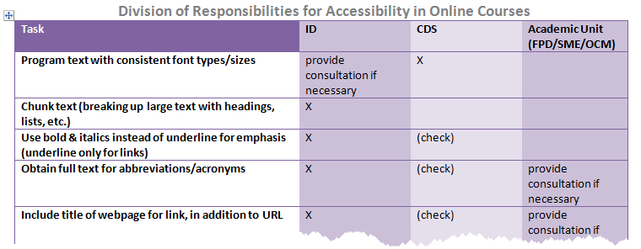
Implementation process – Divide responsibilities
Notes:
Here is an example of our division of responsibilities document.
You will see we divided responsibilities between three different staff types.
We have a number of tasks that may be the responsibility of one staff member, but another double-checks it or provides consultation if necessary.
This allows us to give responsibility for each task, while still upholding a team approach.

Slide 19
Implementation process – develop and execute training plan
Who is your target audience?
Do they need individual training or can everyone receive the same?
  Faculty Program Directors (content)
  Course Development Staff (design and technical)
    Instructional Designers
    Course Development Specialists
    Online Course Managers
Notes:
The last piece of the implementation process was to develop and execute a training plan.
You have to look at who the target audience is…which staff members will need training…and whether individualized training is needed.
We decided to divide up training by faculty, who were less directly responsible for implementing the standards and dealt more with content than technical elements…and course development staff, including instructional designers, course development specialists, who program the courses, and online course managers, who work for the academic units and make course edits.

Slide 20
Implementation process – develop training plan
Informational Sessions for Faculty Program Directors
  1-hour long
  Optional
  Offered in-person and at a distance
  Recorded for future reference
  Included information on:
    Accessibility in general
    Division of Responsibilities – who in the course development process will take care of what elements
    The elements needing to go into each new course development/major revision
    Dealing with special situations/accommodations requests
Notes:
We offered informational sessions for faculty program directors.
[Read details of training]

Slide 21
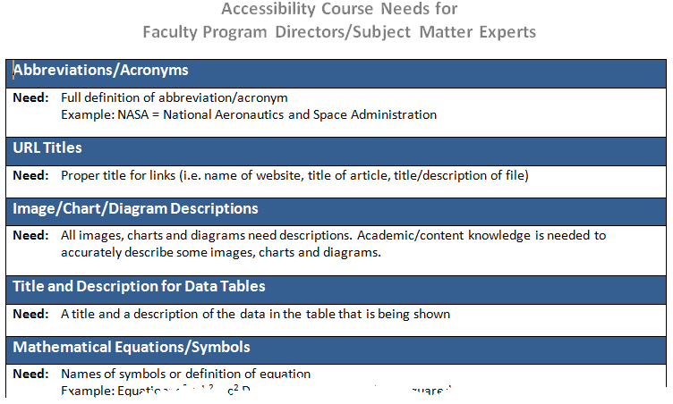
Implementation process – develop training plan
Notes:
This is an example of the document we gave to faculty on items that they may need to provide to instructional designers during the course development process.

Slide 22
Training/information distribution plan
Training Sessions for course development staff
  2-hours long
  Mandatory
  Offered in-person and at a distance
  Included information on:
    Accessibility in general
    Division of Responsibilities
    Details on accessibility standards
    Technical Information
    Hands-on practice
Notes:
We held training sessions for course development staff, which included instructional designers and technical staff.
[Read training details]

Slide 23
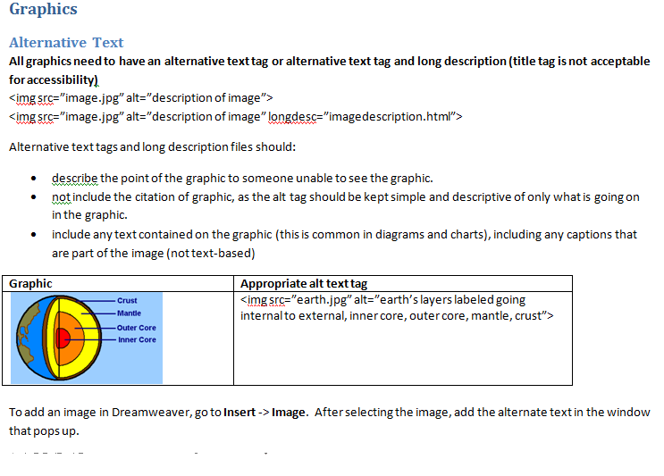
Implementation Process – develop training plan
Notes:
The training sessions included a standards manual.
This is an example of a page from the standards manual.
It includes details about how to handle different standards, examples, and instructions for Dreamweaver, which we use to program our courses.
Each of the documents that I’ve shown examples of today are uploaded onto the QM Conference Presentation website.

Slide 24

Please feel free to contact me at any time with questions!
(although I will be out of work most likely between November - January)
Erin Blauvelt
eblauvelt@excelsior.edu

