Slide 1

The Heart of What Matters:
The Creation of a Quality Online Continuous Improvement Plan
Sherrell Wheeler–Director Online Quality Assurance
Tanya Allred–Associate Professor of English
Karen May–Adjunct Faculty of Business and Accounting
Notes:
1

Slide 2
“eLearning doesn’t just ‘happen’! It requires careful planning and implementation.”
-Anonymous
Notes:
2

Slide 3
Session Outcomes
Explain the key elements in a successful QM process
Evaluate and modify the plan at the end of cycle
Evaluate a successful quality online continuous improvement plan from the perspectives of an administrator, a tenured faculty member, and an adjunct faculty member
Notes:
3

Slide 4
Internal Review Plan
Quality Assurance Team
All online faculty required to attend APPQMR
All online courses required to go through QM review within 3 years
New online courses must complete a pre-review before being offered
All courses have to use a template
Notes:
4

Slide 5
Obstacles
Getting faculty and administration buy-in
Reviewing campus colleagues
Locating faculty reviewers
Scheduling courses to be reviewed
Selecting a QA team
Notes:
5

Slide 6
New Obstacles
Preparedness for review deadline
Attendance at training sessions
Multiple courses from one faculty member due in same cycle
QA team rotation cycle
Communication issues
Leveling of workload for internal reviewers
Notes:
6

Slide 7
Our Revised Plan
Internal reviews for each instructor’s first review only
Cohort groups formed
All online instructors take the APPQMR course
Recruited top reviewers to become Master Reviewers
Transitioned from a template to a shell
Notes:
7

Slide 8
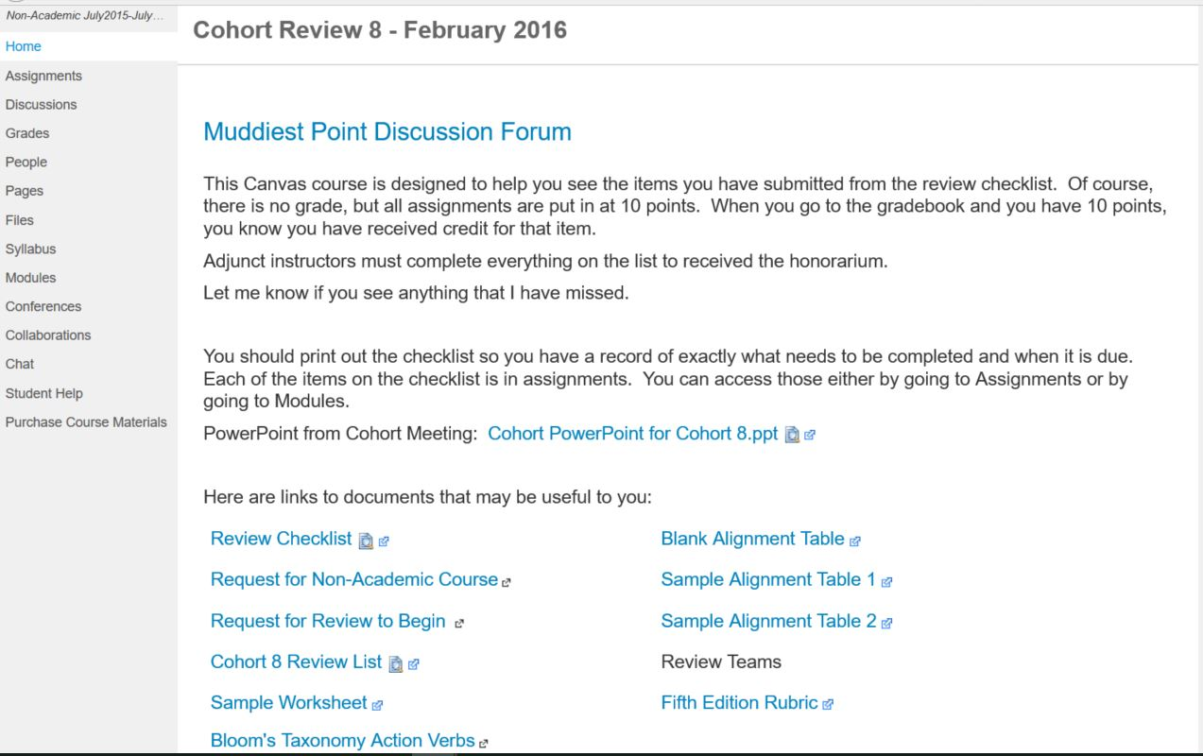

Slide 9
Professional Development
Monday Matters
Lunch and Learns
QM Training Courses
One-on-One Training
Online Teaching Course
LMS Training
Conference Presentations and Attendance
Utilizing the Shell

Slide 10
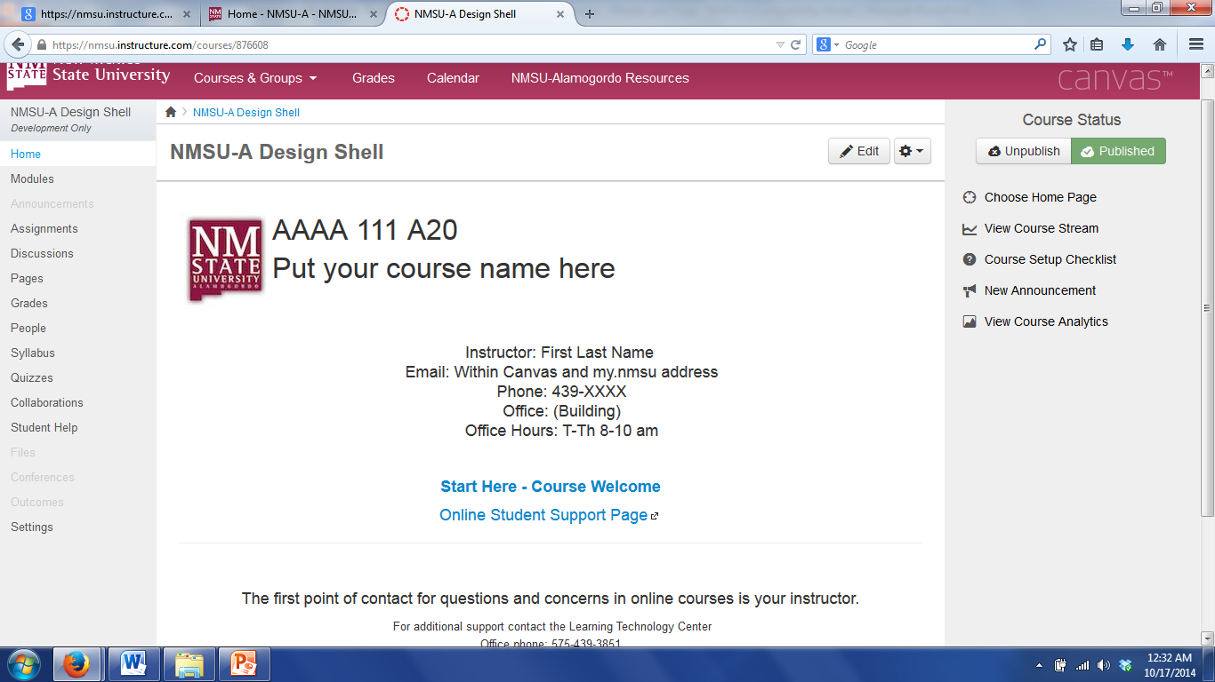

Slide 11
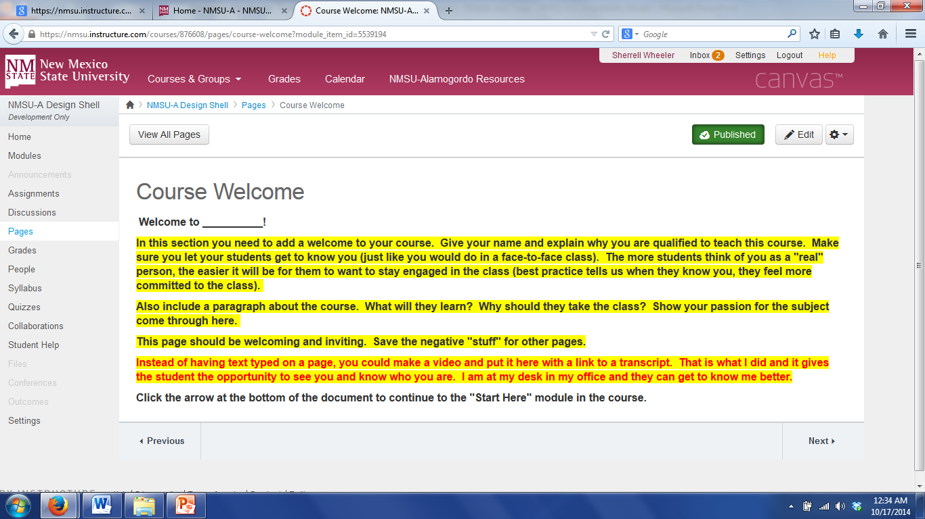

Slide 12
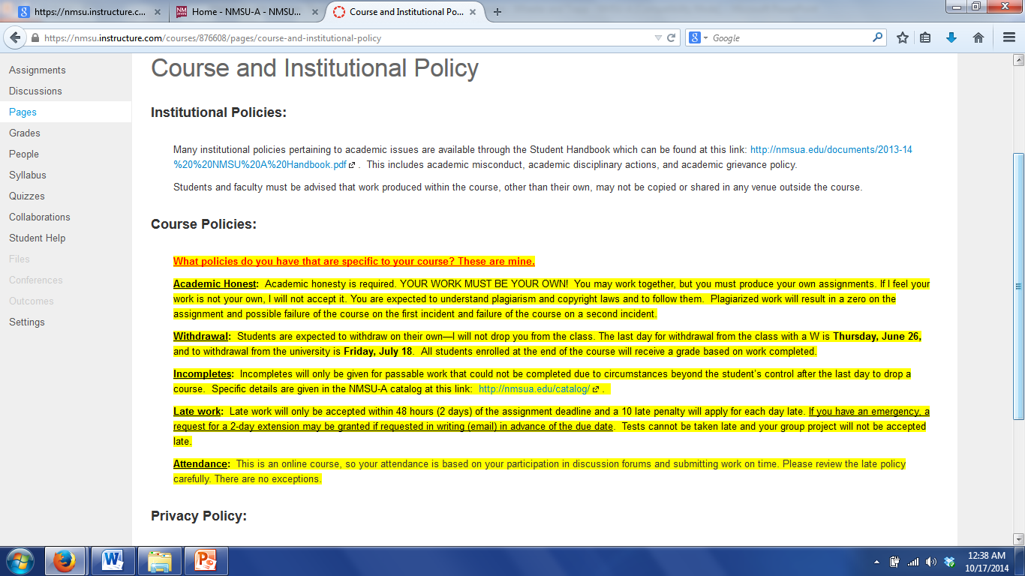
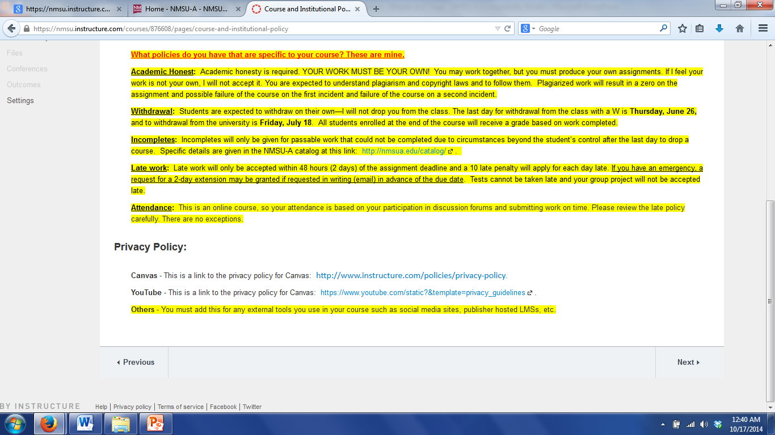

Slide 13
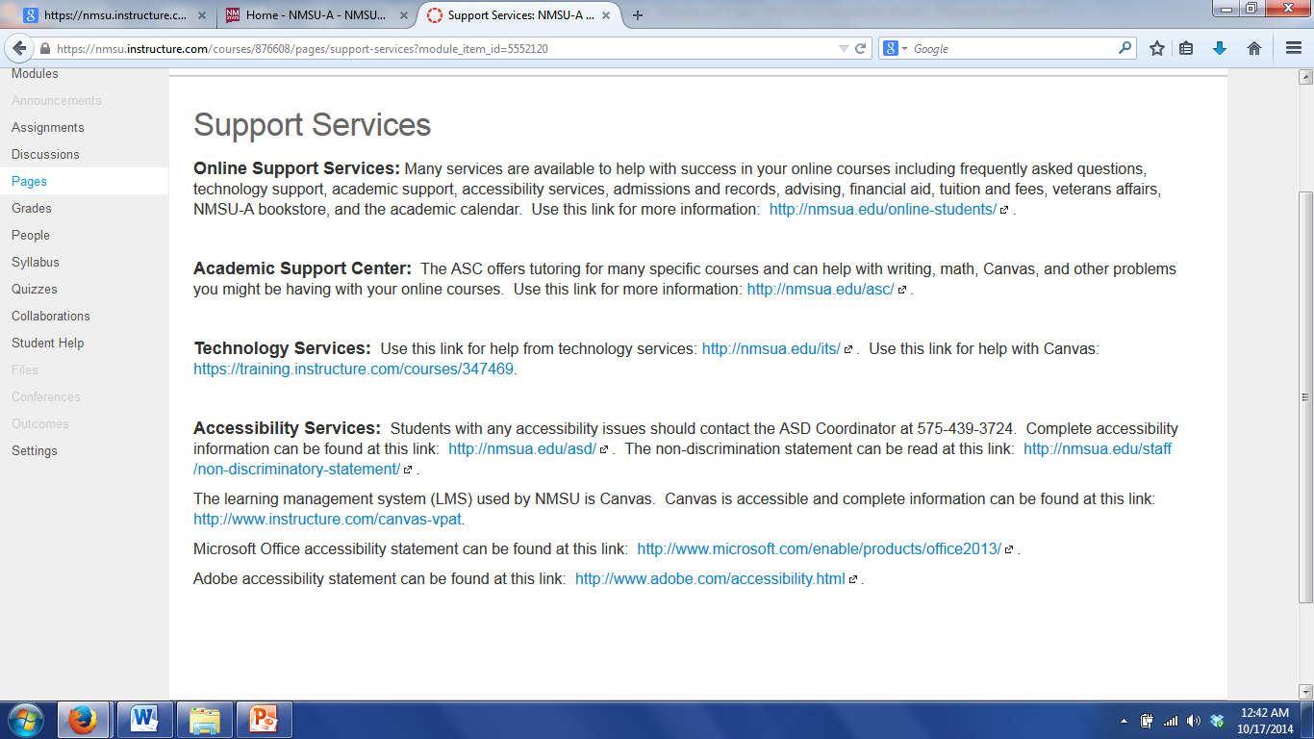

Slide 14

Celebration of Successes
President sends personal note card
Announced through “ALL” distribution list
Announced at convocation
Announced in campus newsletter
Celebration dinner
Addition of mark to course for meeting an internal review
Notes:
14

Slide 15
Our Perspectives
Administrator (Sherrell)
Tenured Faculty (Tanya)
Adjunct Faculty (Karen)

Slide 16
Questions?
Sherrell Wheeler - swheeler@nmsu.edu
Tanya Allred - tallred@nmsu.edu
Karen May – kgmay@nmsu.edu
Notes:
16

