Slide 1

Quality Matters 7th Annual Conference 2016
Continuous Quality Improvement of Quality Matters Standard 8 Using an A3 Lean Method
Jennifer Yee Cole, OTD, MHA
Nancy E. Krusen, PhD, OTR/L

Slide 2

Purpose of the paper
This presentation introduces the use of the A3 Lean method in conjunction with QM Standard 8 as a method for continuous quality improvement of online courses.
https://www.reference.com/home-garden/sunflowers-used-6789ef447adf6da4

Slide 3


Learning Objectives
Participants will be able to:
1. describe the process of an A3 Lean method of continuous quality improvement (CQI)
2. assess course compliance with QM Standard 8 using an A3 Lean method for CQI
3. seek additional resources for information about the A3 Lean method of CQI and QM Standard 8

Slide 4
What is Standard 8?
Accessibility and Usability
8.1 Course navigation facilitates ease of use.
8.2 Information is provided about the accessibility of all technologies required in the course.
8.3 The course provides alternative means of access to course materials in formats that meet the needs of diverse learners.
8.4 The course design facilitates readability.
8.5 Course multimedia facilitate ease of use.

Slide 5

What is Lean?
Originated business industry in order to:
eliminate waste
reduce errors
improve quality
https://www.ftd.com/blog/celebrate/sunflowers-facts

Slide 6
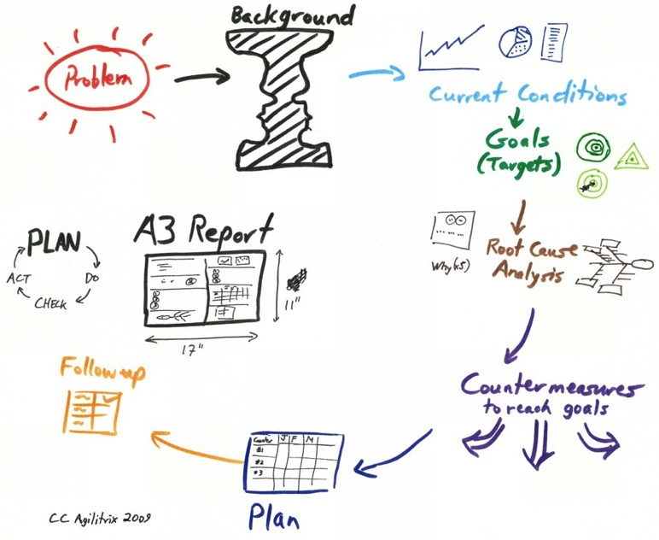
What is the A3 Process?
Identify issue
Diagram current state
Root cause analysis
Envision future state
Intervention(s)
Outcome metrics
Follow-up plan
http://agilitrix.com/2010/07/use-a3-technique-to-solve-serious-problems/

Slide 7
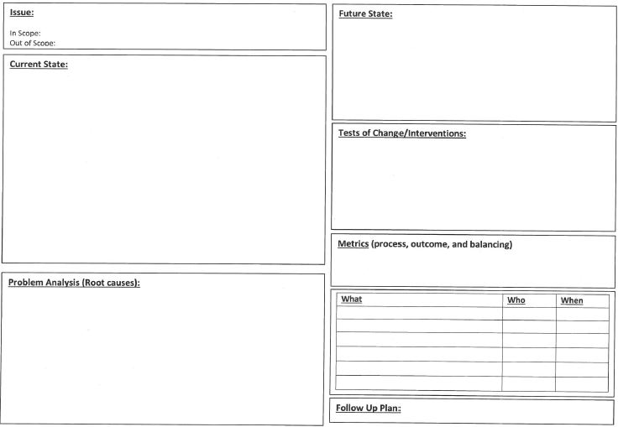
What is A3 Process?
Everything fits on a single sheet of paper
Notes:
Refer to handout
Highlight each of Boxes
Simplify into one page
5Whys
Root Cause

Slide 8
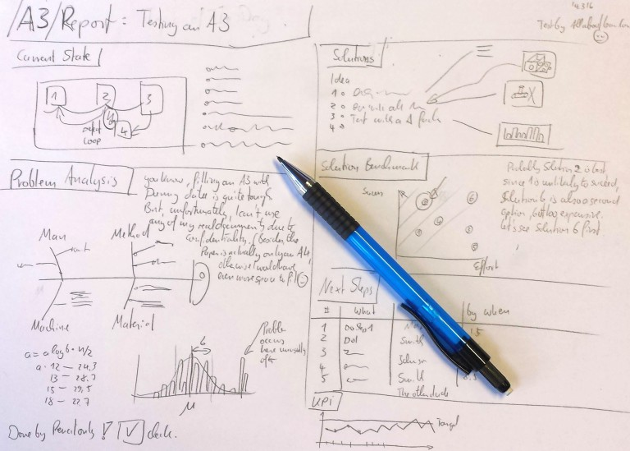
http://www.allaboutlean.com/a3-report-part-2/

Slide 9
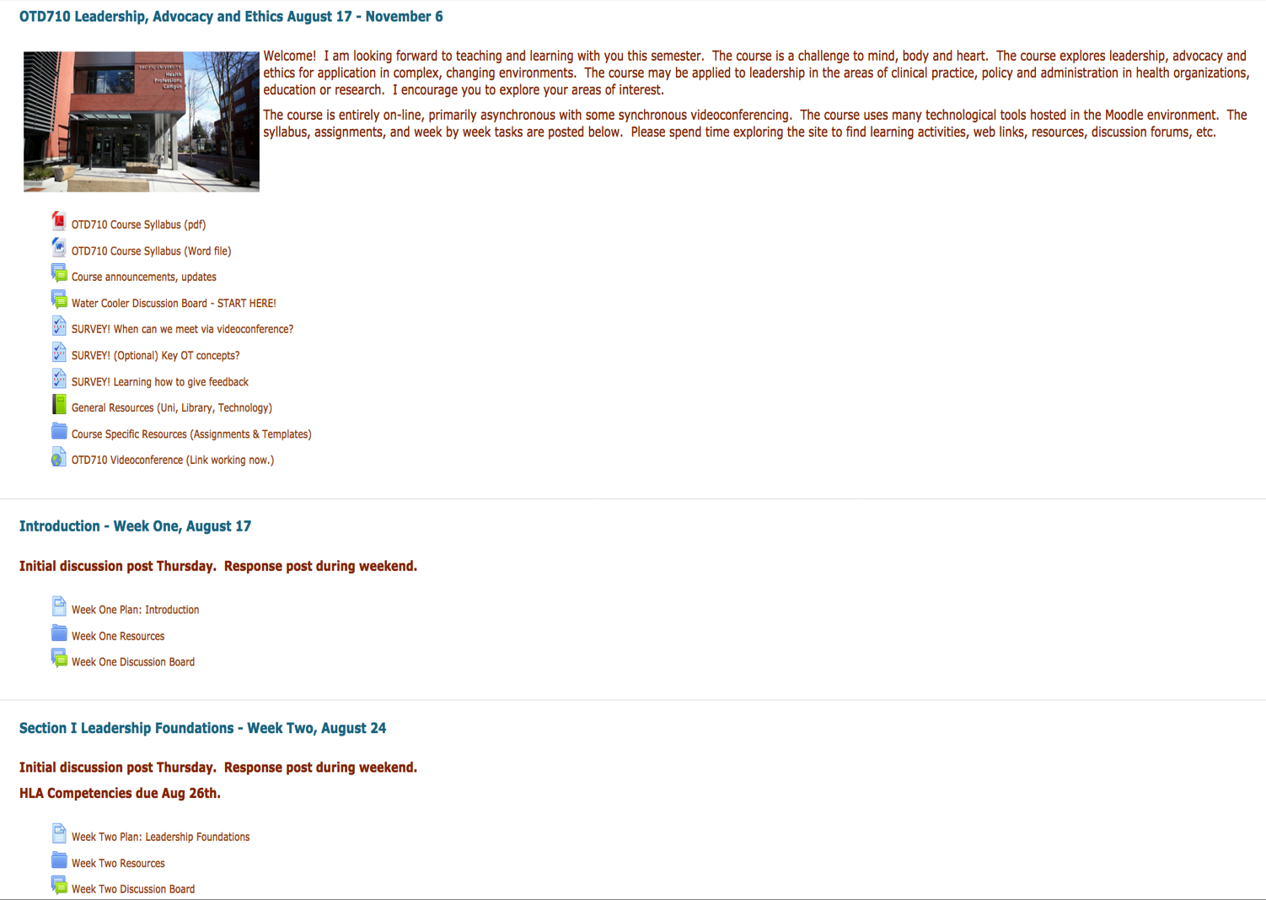

Slide 10
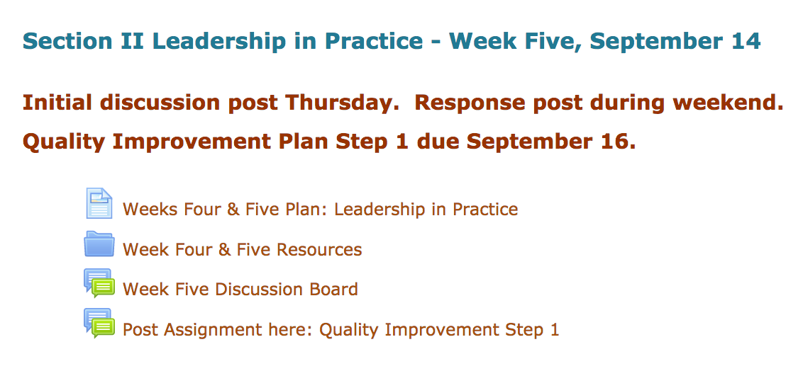
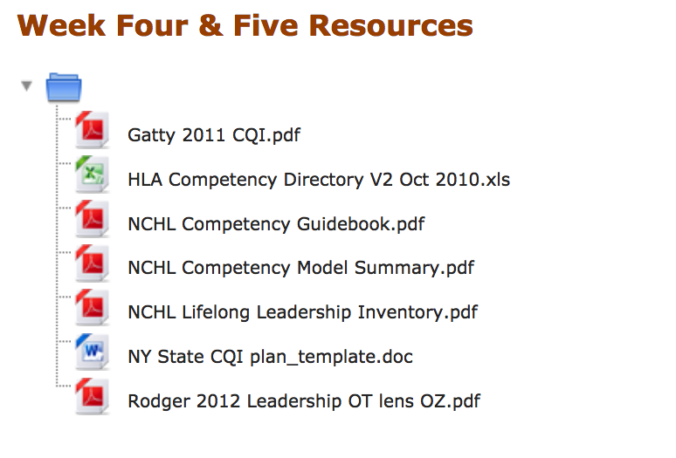

Slide 11
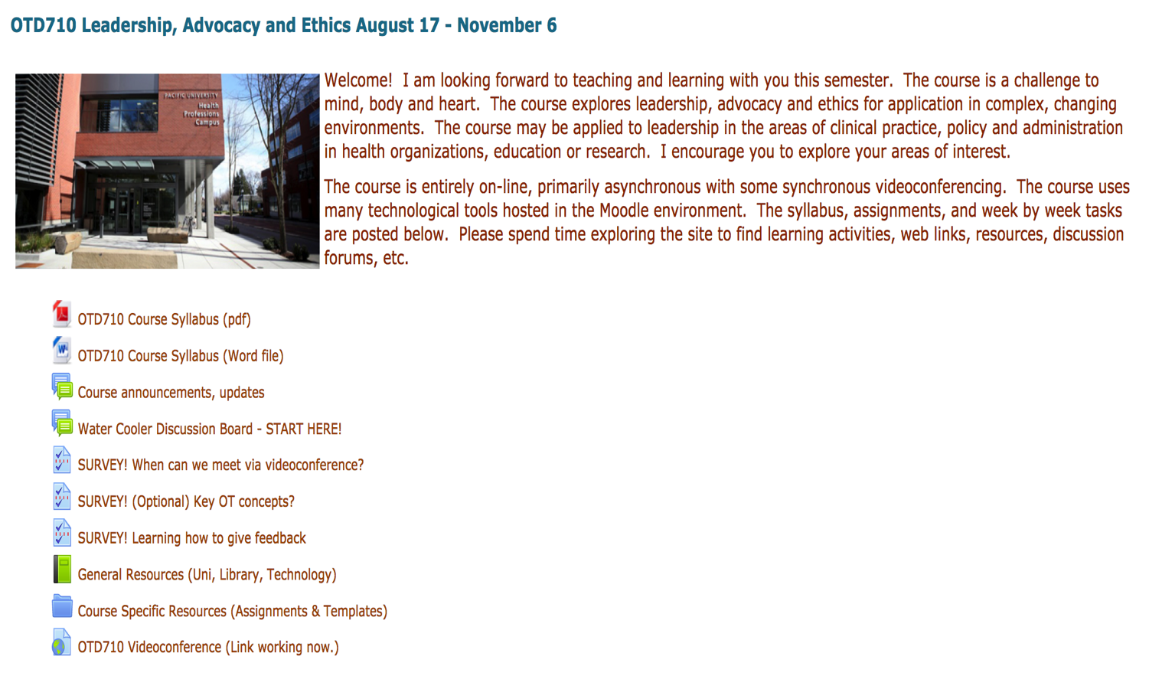

Slide 12
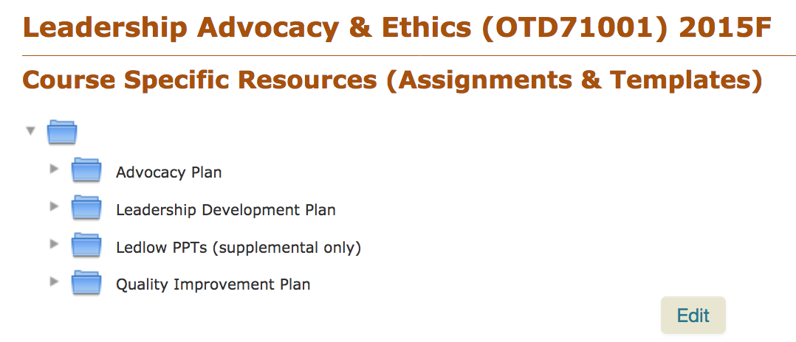
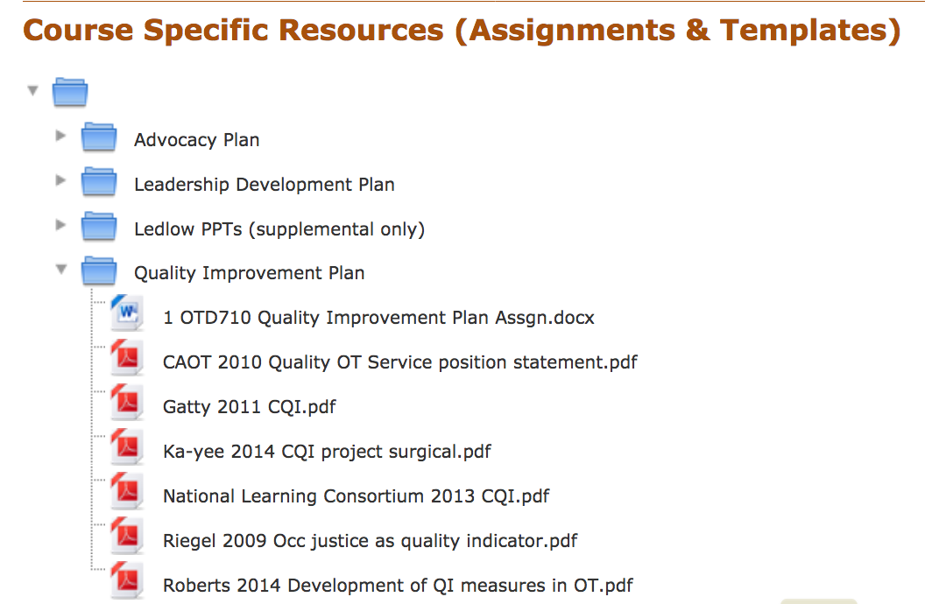

Slide 13
What is A3 Process?
Everything fits on a single sheet of paper
Notes:
Refer to handout
Highlight each of Boxes
Simplify into one page
5Whys
Root Cause

Slide 14
What is A3 Process?
Everything fits on a single sheet of paper
Notes:
Refer to handout
Highlight each of Boxes
Simplify into one page
5Whys
Root Cause

Slide 15
Root Causes – 5 ‘Why’s
Issue: The Washington Monument was disintegrating.
Why? Use of harsh chemicals
Why? To clean pigeon poop
Why so many pigeons? They eat spiders and there are a lot of spiders at monument
Why so many spiders? They eat gnats and lots of gnats at monument
Why so many gnats? They are attracted to the light at dusk.
Solution: Turn on the lights at a later time.
https://www.isixsigma.com/dictionary/5-whys/

Slide 16
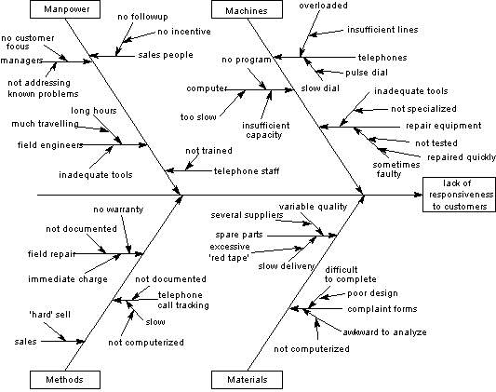
Root Causes – Fishbone diagram

Slide 17
What is A3 Process?
Everything fits on a single sheet of paper
Notes:
Refer to handout
Highlight each of Boxes
Simplify into one page
5Whys
Root Cause

Slide 18
Implementation Plan
What | Who | Date | Complete
Change modules to collapsible | NEK | 11.2016
Duplicate CQI assignment folder | NEK | 11.2016
Move duplicate to CQI modules | NEK | 11.2016
Redesign modules to include: Course goals Learning objectives Learning activities | NEK | 11.2016
Make sure links are live | NEK | 11.2016
Review for usability | TA/Peer | 12.2016
Review using QM rubric | Tatiana | 12.2016

Slide 19
Follow-up
What | Who | Date | Complete
Monitor student inquiries re CQI assgn Eliminate 99% location queries during course | NEK
Learning analytics to compare module login time from previous to current course Decrease ‘hits’ on assignment folder in course intro material by 50% | NEK
Post course/instructor eval Reminders for >70% response | Kelly/ NEK
Analyze learner eval comments No complaints re scrolling No complaints re unable to locate | Faculty/ NEK

Slide 20
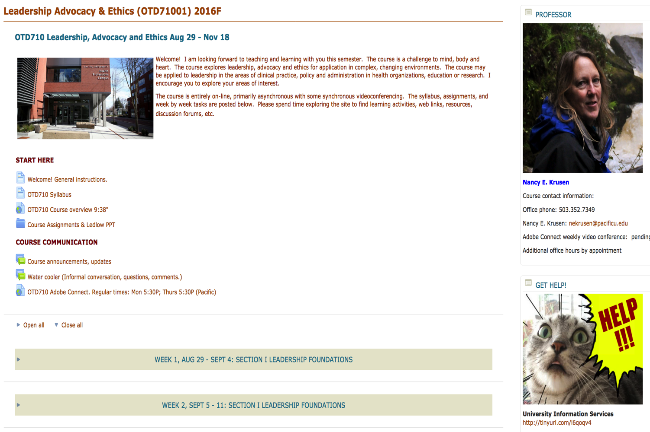

Slide 21
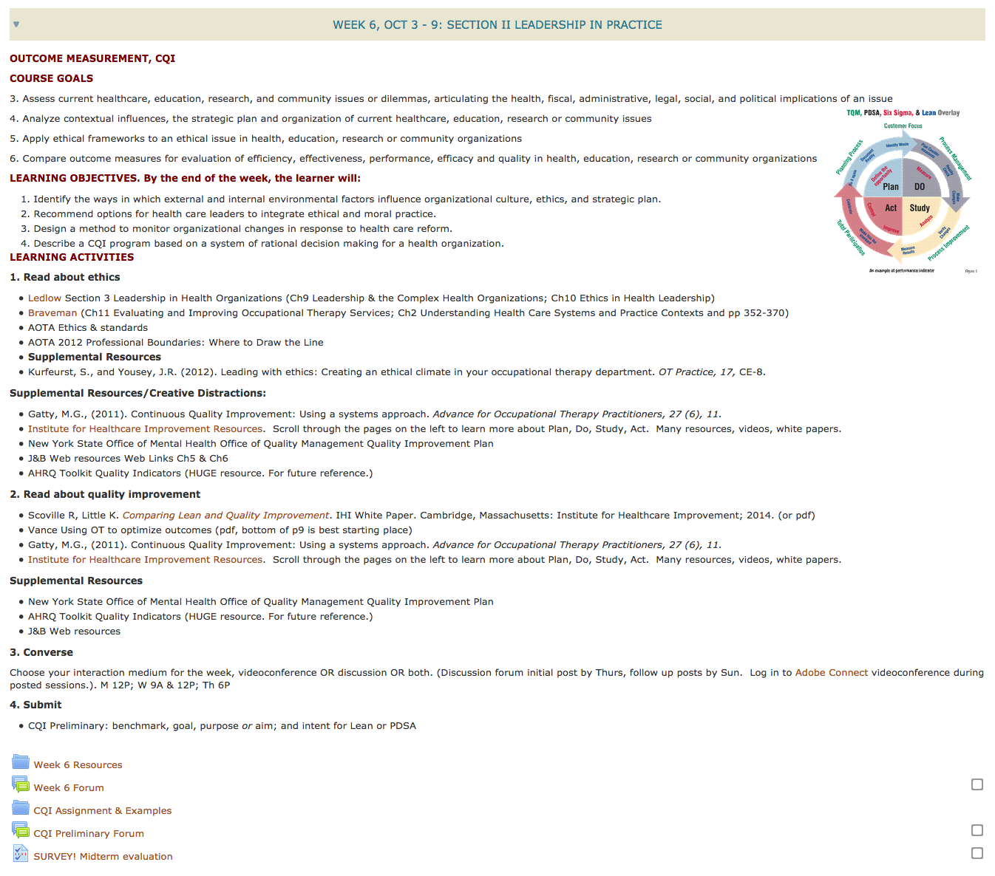

Slide 22
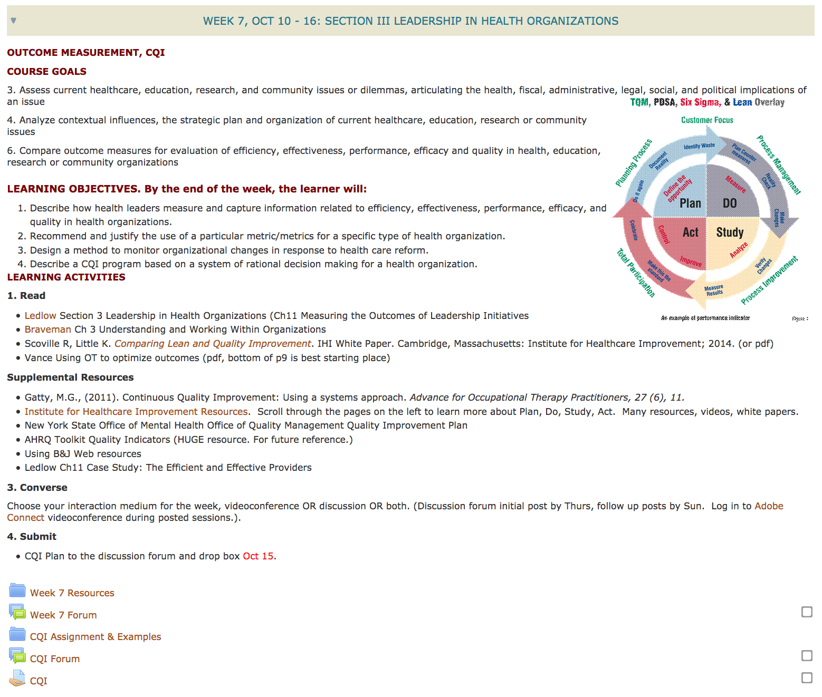

Slide 23
Implications/Key messages
Tool is easy to use.
Easy to understand for novice faculty.
Intuitive way of analyzing, then developing an action plan.
Fits on one page.
Can target specific elements of Standard 8.
Streamlining the process instead of adding patches to fix it.

Slide 24
(Lagniappe – Design tip)
PARC Design
Proximity – grouping related elements
Alignment – visual connections
Repetition – reusing elements
Contrast – difference

Slide 25
Resources
Hines, P., Found, P., Griffiths, G., & Harrison, R. (2008). Staying Lean: Thriving, not just surviving [PDF document]. Retrieved from http://www.leanenterprise.org.uk/index.php?option=com_docman&task=doc_download&gid=94&Itemid=3
PARC Design. http://www.presentationzen.com/chapter6_spread.pdf
Pelletier, L. (2011). A3: The basic problem solving tool [PDF document]. Retrieved from http://www.umassmed.edu/uploadedfiles/fmch/faculty_resources/fall11_pelletiera3.pdf

Slide 26

Comments? Questions?
Jennifer Yee Cole, OTD, MHA jycole@pacificu.edu
Nancy E. Krusen, PhD, OTR/L nekrusen@pacificu.edu

