Slide 1

Quality Matters and Continuous Academic Innovation
Erin Berman, Project Manager & Senior Instructional Designer
Charles Cosmato, Director, CITL
Susan Van Patten, Director, Faculty Development
Center for Innovative Teaching and Learning
RADFORD UNIVERSITY
RADFORD
UNIVERSITY

Slide 2
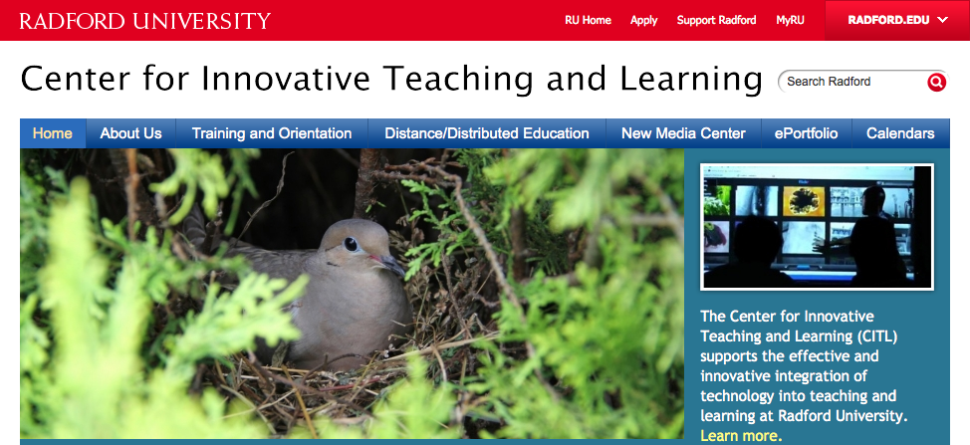
Center for Innovative Teaching & Learning
RU
RADFORD
UNIVERSITY

Slide 3
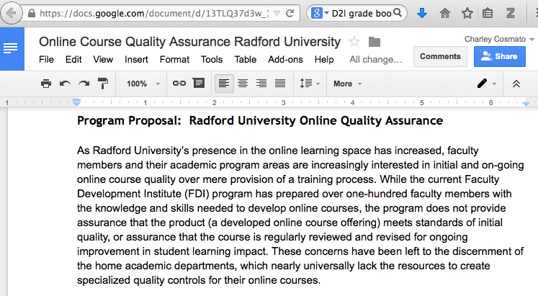
RU
RADFORD
UNIVERSITY

Slide 4

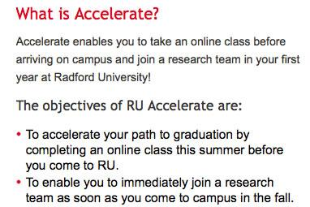
Key to Success:Academic Project Partnership
RU
RADFORD
UNIVERSITY

Slide 5
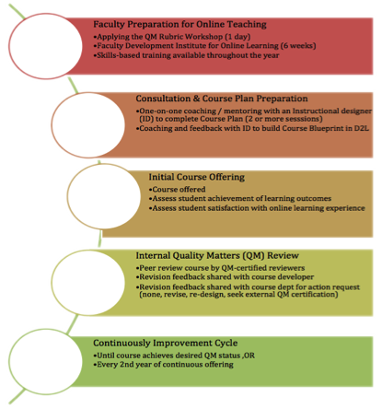
RU
RADFORD
UNIVERSITY

Slide 6
how does course improvement relate to innovative academic program development?
RADFORD
UNIVERSITY

Slide 7
Imagine… what new programs at your institution can use QM as the foundation of a continuous innovation platform?
RADFORD
UNIVERSITY

Slide 8
Thanks!
RU
RADFORD
UNIVERSITY
Erin Berman, Project Mgr & Senior Instruct Designer
Charles Cosmato, Director, CITL
Susan Van Patten, Director, Faculty Development

