Slide 1
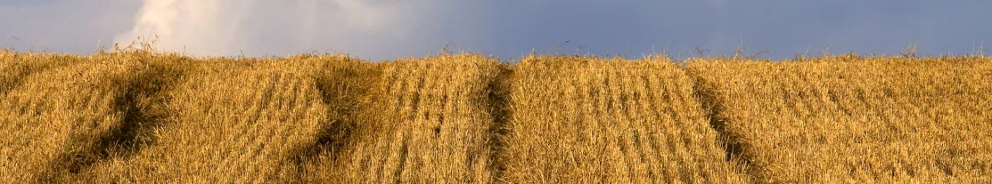



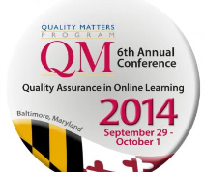
Harvesting the Benefits of QM Culture for Institutional Accreditation
David Shulman, Ph.D.
Campus President,
Broward College Online
Yaping Gao, Ed.D.
District Director of
Instructional Design

Slide 2

Harvesting the Benefits of QM Culture for Institutional Accreditation
Topics
What Do Accreditors Want To See?
How Can Quality Matters Help?

Slide 3


Harvesting the Benefits of QM Culture for Institutional Accreditation
What Do Accreditors Want to See?
As part of the re-accreditation process in October 2013, Broward College Online relied on two key documents to drive the conversation with Southern Association of Colleges and Schools (SACS).
SACS Guidelines for Addressing Distance and
Correspondence Education
The BC Quality Standards for Online Course Design which include all official QM standards plus a few Broward-specific standards.
Notes:
https://bconline.broward.edu/shared/Tutorials/Instructors/Resources/eLearningResources/BCQualityStandards50-QM5thEd.pdf

Slide 4

Harvesting the Benefits of QM Culture for Institutional Accreditation
What Do Accreditors Want to See?
SACS Best Practices #1: Institutional Context & Commitment
Did Broward College Online have these capabilities?
Provide and facilitate the instructional and technical support relationships.
Provide training and support to participating instructors and students.
Assure compliance with copyright law.
Maintain appropriate academic oversight.

Slide 5

Harvesting the Benefits of QM Culture for Institutional Accreditation
What Do Accreditors Want to See?
SACS Best Practices #2: Curriculum and Instruction
How did we focus on learning and outcomes?
What provisions exist for instructor-student and student-student
interaction?
Is instructor response to student assignments timely?
What technologies are used for program interaction?
How successful are the program outcomes as indicated by surveys, comments, or other measures?

Slide 6

Harvesting the Benefits of QM Culture for Institutional Accreditation
What Do Accreditors Want to See?
SACS Best Practices #3: Faculty Support
How were our faculty supported for delivering online instruction?
What support services are available to those responsible for developing courses?
What support services are available to those faculty teaching the classes?
What orientation and train professional development are available?

Slide 7

Harvesting the Benefits of QM Culture for Institutional Accreditation
What Do Accreditors Want to See?
SACS Best Practices #4: Student Support
Are we serving today’s online students?
What steps are taken to retain students in the program?
What is the history of student retention in this program?
Do students feel that they are part of a community?

Slide 8

Harvesting the Benefits of QM Culture for Institutional Accreditation
What Do Accreditors Want to See?
SACS Best Practices #5: Evaluation and Assessment
How do we provide evidence based reporting of course objectives being met?
How is ongoing program assessment and development conducted?
Does it cover the learning outcomes, retention, resources, and services?
Who is involved in the process of planning for improvement?
Has the process had measurable results to date?

Slide 9

Which of the following is not among SACS best practices discussed in this session? a. evaluation and assessment b. student support c. institutional commitment d. curriculum and instruction e. type of LMS f. faculty support
Harvesting the Benefits of QM Culture for Institutional Accreditation
Notes:
Answer: e. technology infrastructure

Slide 10
Which of the following is or are not being currently addressed in the QM Rubric? a. evaluation and assessment b. student support c. institutional commitment d. faculty support e. curriculum development
Harvesting the Benefits of QM Culture for Institutional Accreditation
Notes:
https://www.qualitymatters.org/node/2305/download/QM%20Standards%20with%20Point%20Values%20Fifth%20Edition.pdf
Answer:
c. Institutional commitment
d. faculty support

Slide 11
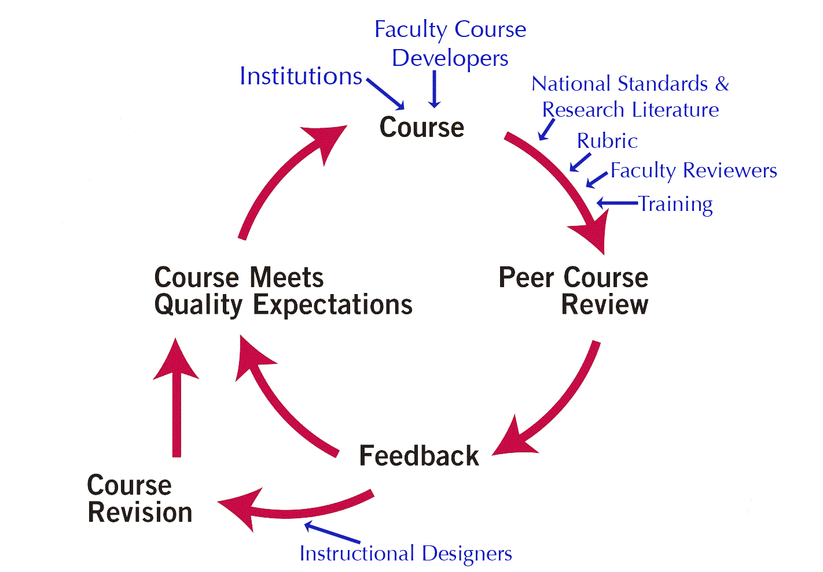
Harvesting the Benefits of QM Culture for Institutional Accreditation
How can Quality Matters help?
~ Ten Distinct Ways ~
1. Accountability for the Delivery and Quality of Online Courses
QM’s Peer Review Process provides the framework for continuous improvement and consistent quality of our online and blended courses.
QM Peer
Review
Process
II
Continuous Improvement Model

Slide 12
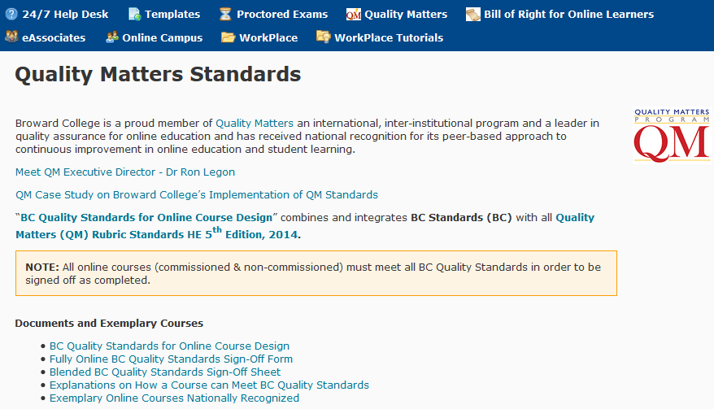
Harvesting the Benefits of QM Culture for Institutional Accreditation
How can Quality Matters help?
2. Institutional Effectiveness and Commitment to Quality Online Education
QM’s Guiding Principles and Continuous Improvement Model facilitate and support institutional commitment to quality.
Notes:
https://www.qualitymatters.org/principles-orpdf/download/The%20Principles%20of%20Quality%20Matters-OR.pdf
- Continuous - The process is designed to ensure that all reviewed courses will eventually meet expectations
Centered – on research, on student learning, and on quality
Collegial – faculty driven, peer-to-peer process
Collaborative – based on collaboratively identified evidence; review is not prescriptive; three peer reviewer and faculty developer as the team

Slide 13
Harvesting the Benefits of QM Culture for Institutional Accreditation
How can Quality Matters help?
3. Curriculum and Instruction
QM’s emphasis on the alignment among key components in the Rubric ensures the preeminence
of student learning outcomes, assessment and measurement as the bedrock of curriculum content integrity.
QM General Standards:
2. Learning Objectives (Competencies)
3. Assessment and Measurement
4. Instructional Materials
5. Course Activities & Learner Interaction
6. Course Technology
Key components must align
in order to ensure student success.

Slide 14
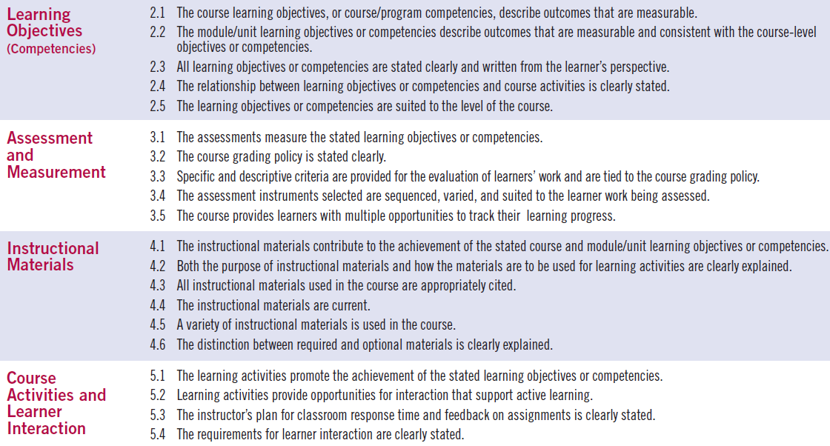
Harvesting the Benefits of QM Culture for Institutional Accreditation
How can Quality Matters help?
3. Curriculum and Instruction
QM Rubric ensures quality course design for online teaching and learning.
Notes:
This slide can be deleted.

Slide 15


Harvesting the Benefits of QM Culture for Institutional Accreditation
How can Quality Matters help?
4. Faculty Involvement in Curricula Development
QM is an instrument that facilitates faculty involvement in every aspect and every phase of online and blended course development.
QM course review process involves faculty in every step.
Faculty developers required to complete 20-hour training that incorporates QM standards.
Course and syllabus templates are used by faculty to incorporate all elements and components that meet QM standards.
Many faculty receive official QM training, have their own courses QM certified, and become QM certified Master reviewers and/or peer reviewers.

Slide 16
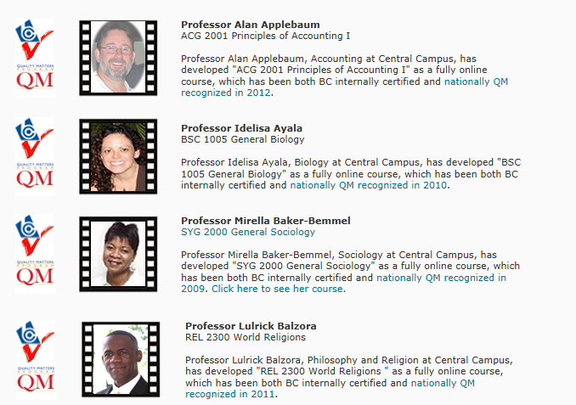



Harvesting the Benefits of QM Culture for Institutional Accreditation
How can Quality Matters help?
4. Faculty Involvement in Curricula Development
43 courses officially QM certified / 33 faculty / a dozen Peer Reviewers / 4 Master Reviewers
Notes:
https://bconline.broward.edu/shared/Tutorials/Instructors/Resources/eLearningResources/exemplary_courses.html

Slide 17
Harvesting the Benefits of QM Culture for Institutional Accreditation
How can Quality Matters help?
5. Technological Delivery Modes
QM GS-6 Course Technology ensures the appropriateness of the delivery technology in supporting usability and attainment of learning outcomes and competencies.
Various ways faculty engage students:
Standard communication tools
Social network
Interactive activities
Multimedia assets
Some gamification incorporation
Tracking tools such as Intelligent Agents
Synchronous/collaborative tools such as Bb Collaborate

Slide 18

Time for a little break with a guessing game!
Harvesting the Benefits of QM Culture for Institutional Accreditation

Slide 19
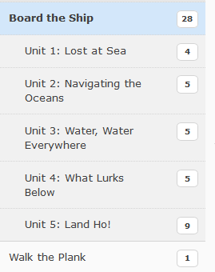
Harvesting the Benefits of QM Culture for Institutional Accreditation
Notes:
This slide can be deleted.

Slide 20

Harvesting the Benefits of QM Culture for Institutional Accreditation

Slide 21
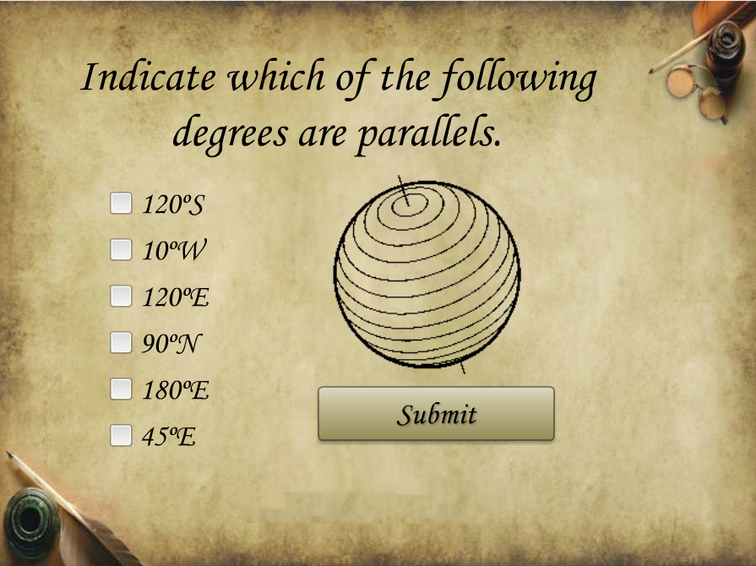
Harvesting the Benefits of QM Culture for Institutional Accreditation

Slide 22
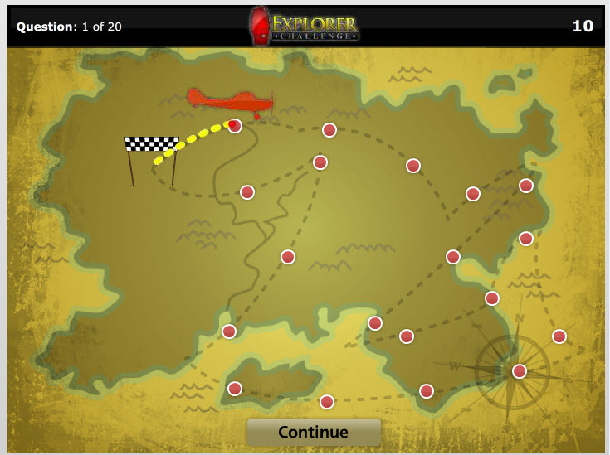
Harvesting the Benefits of QM Culture for Institutional Accreditation
Notes:
This slide can be deleted.

Slide 23
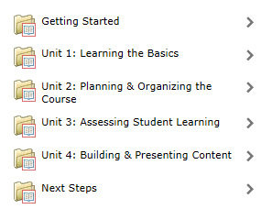
Harvesting the Benefits of QM Culture for Institutional Accreditation
How can Quality Matters help?
6. Faculty Support and Training
QM Standards drive the structure of our professional development.
Building Quality Online Courses (20-hour PD credits)
Notes:
https://www.qualitymatters.org/node/2305/download/QM%20Standards%20with%20Point%20Values%20Fifth%20Edition.pdf

Slide 24
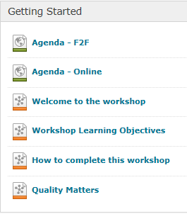
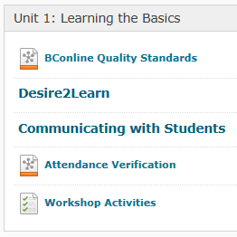
Harvesting the Benefits of QM Culture for Institutional Accreditation
How can Quality Matters help?
6. Faculty Support and Training
QM Standards drive the structure of our professional development.
Notes:
This slide can be deleted.

Slide 25
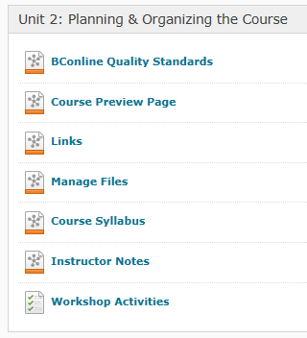
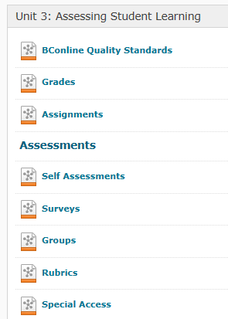
Harvesting the Benefits of QM Culture for Institutional Accreditation
How can Quality Matters help?
6. Faculty Support and Training
QM Standards drive the structure of our professional development.
Notes:
This slide can be deleted.

Slide 26
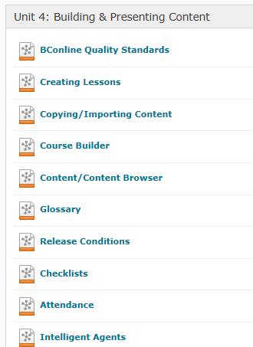
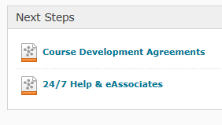
Harvesting the Benefits of QM Culture for Institutional Accreditation
How can Quality Matters help?
6. Faculty Support and Training
QM Standards drive the structure of our professional development.
Notes:
This slide can be deleted.

Slide 27
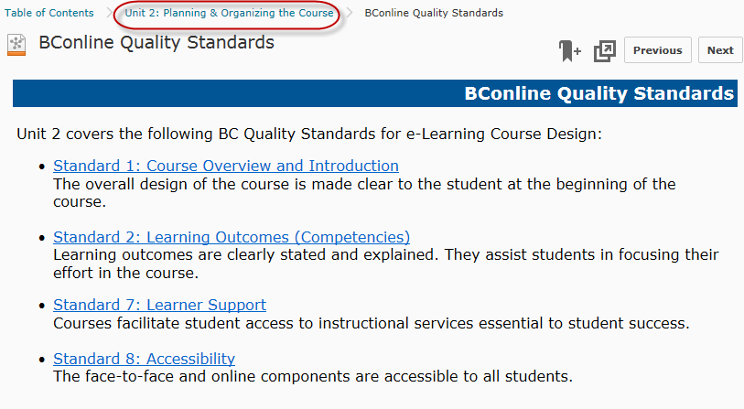
Harvesting the Benefits of QM Culture for Institutional Accreditation
How can Quality Matters help?
6. Faculty Support and Training
QM standards drive the structure of our professional development.

Slide 28

Harvesting the Benefits of QM Culture for Institutional Accreditation
How can Quality Matters help?
7. Interaction
QM GS-5 Course Activities and Learner Interaction establishes and adds to the fabric of online delivery a clear understanding and standards for ensuring adequate, quality interaction occurs in the online learning environment.
Engage Students with Content
Engage Students with Instructor
Engage Students with Each Other

Slide 29
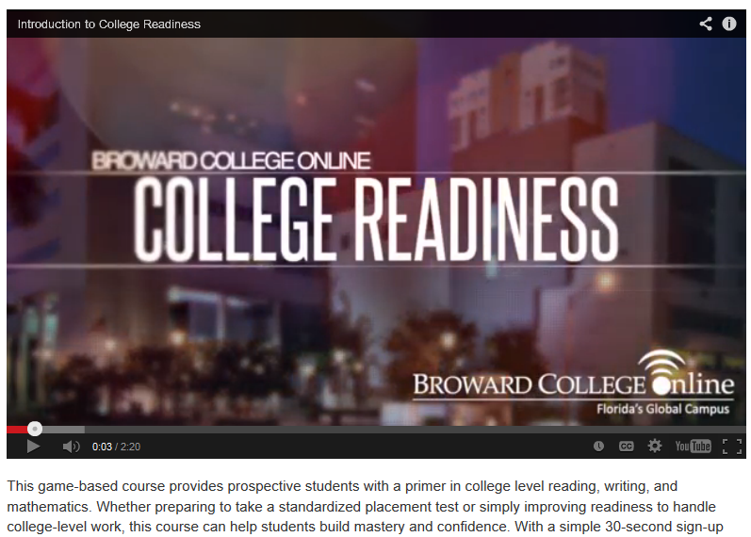
Harvesting the Benefits of QM Culture for Institutional Accreditation
How can Quality Matters help?
8. Academic Resources and Student Support
QM GS-7 Learner Support ensures that course development includes information and links to resources that support online learners.
Notes:
Add some video segment timelines in case we have time to show:
Introduction - 00:35-00:45
Reading – 2:00
Unit 5 Patterns of Organization
Game! Patterns I (Drag and Drop)
Writing – Lesson 3: Subordination and Coordination
Game! Subordination and Coordination (Wheel Spin)
Math - Lesson 1.14 Order of Operations
Game! Order of Operations (Cardstack)

Slide 30
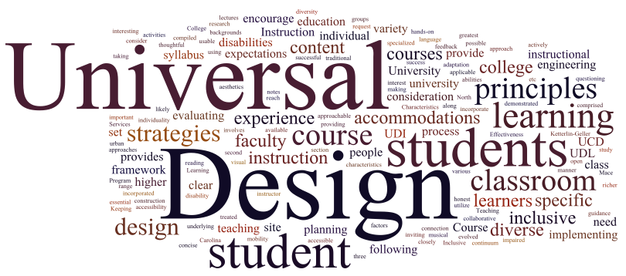
Harvesting the Benefits of QM Culture for Institutional Accreditation
How can Quality Matters help?
9. Accessibility
QM GS-8 Accessibility and Usability ensures that course development is inclusive of all learners, regardless of any accessibility issues.
Image source:
http://tepblog.uoregon.edu/blog/index.php/universal-design-in-college-instruction/

Slide 31
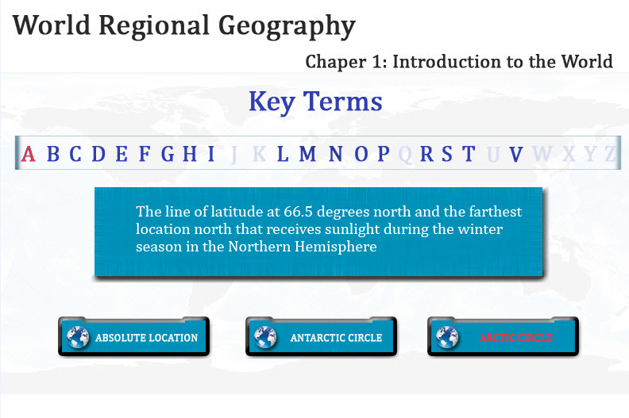
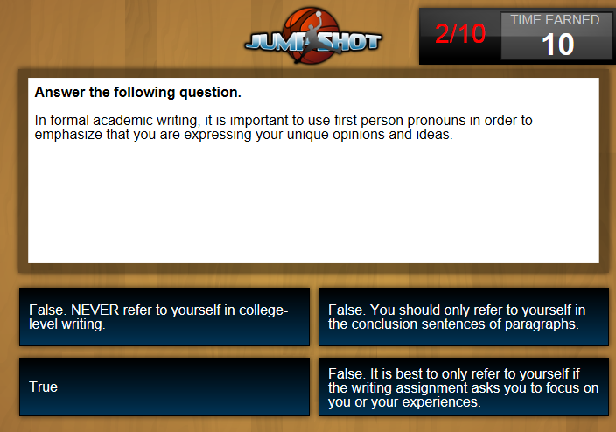
Harvesting the Benefits of QM Culture for Institutional Accreditation
How can Quality Matters help?
10. Course Evaluation
QM was provided to our SACS visiting committee as an example as the main method employed to evaluate the quality of online courses.

Slide 32
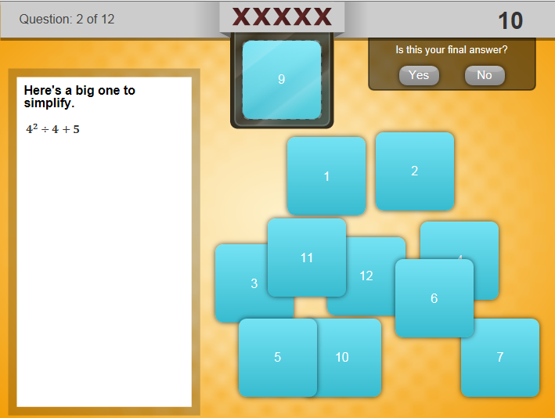
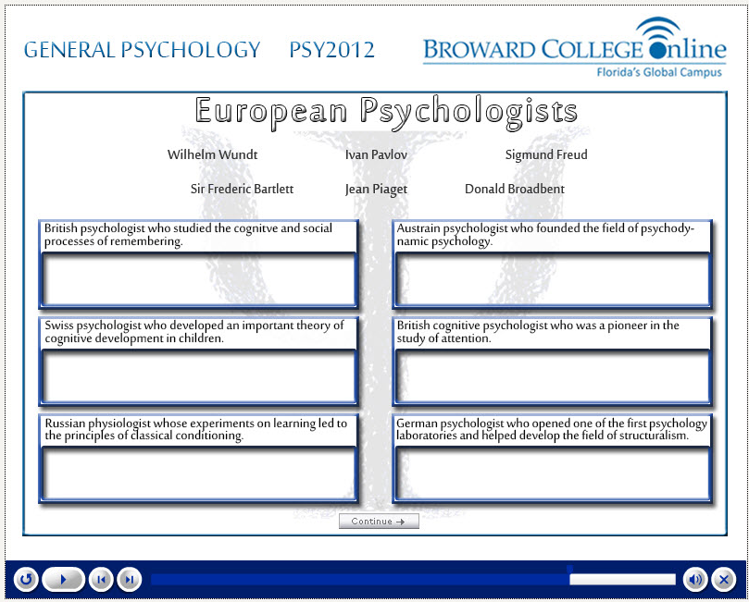
Harvesting the Benefits of QM Culture for Institutional Accreditation
How can Quality Matters help?
10. Course Evaluation
QM was provided to our SACS visiting committee as an example as the main method employed to evaluate the quality of online courses.

Slide 33



Harvesting the Benefits of QM Culture for Institutional Accreditation
Thank You!
        Broward College Online – Florida’s Global Campus
        225 E. Las Olas Boulevard, Ft. Lauderdale, FL 33301
        954-201-7900
        David Shulman dshulman@broward.edu
        Yaping Gao ygao@broward.edu

