Slide 1
PERFECTLY CLEAR?
MAYBE NOT
Nathalie Rennell
8th Annual QM Conference
November 2, 2016

Slide 2


Slide 3
Learning Objectives
Discuss the history of variable student outcomes on a key assignment, despite “clear” instructions, template and exemplar.
Explain the methodology used to evaluate student performance on a key assignment.
Using QM Standard 3.3 as a guide, collaborate with colleagues on developing strategies to improve student performance on a key assignment.

Slide 4
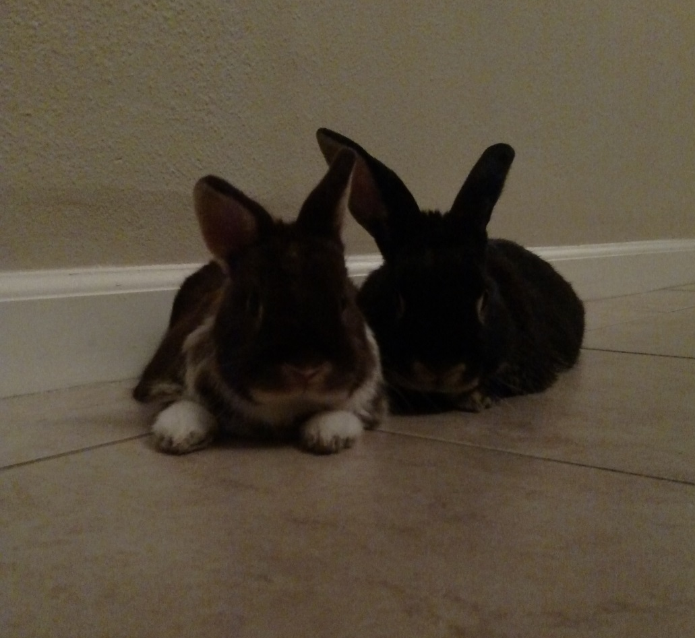
Short Poll

Slide 5
The “WHY”
Why not perfectly clear?
Why this assignment?
Why this section of the assignment?
Why now?

Slide 6
The “WHAT”
What done to make instructions “perfectly clear”?
  What changes made to design of specific section of the assignment?
  What best practices were followed?
    Template
    Colleague review and feedback
    Student feedback
    Exemplar
    Voiced instruction using VoiceThread
    Grading Rubric

Slide 7
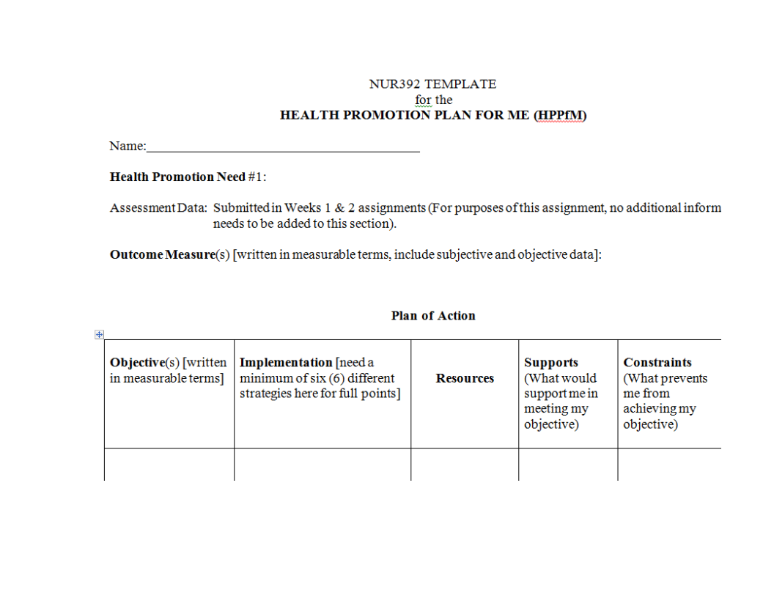
Initial Template

Slide 8
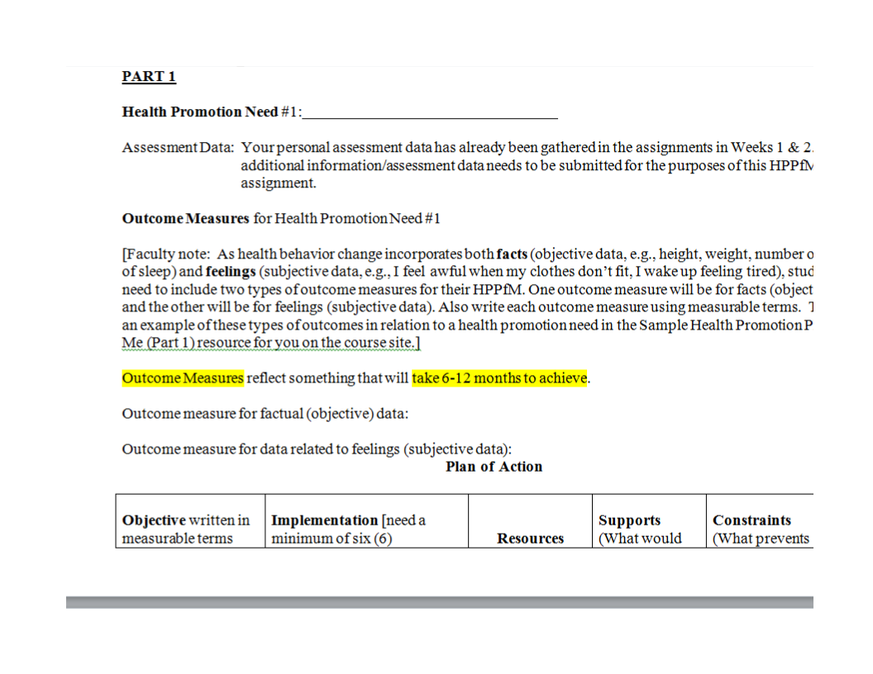
Current Template

Slide 9
Results
Term | Fall A 2015 | Fall B 2015 | Spring A 2016 | Spring B 2016 | Fall A 2016
Number of students, grading faculty & resources | N = 45 Fac. = 2 Initial template, VT for intro | N = 37 Fac. = 2 Revise1 template, VT for intro | N = 29 Fac. = 1 Initial template, VT for intro | N = 33 Fac. = 2 Revise 2 template Revise exemplar, VT | N = 28 Fac. = 2 Revise 2 template, screen capture
% of students duplicating outcome measures & objectives | 47% | 38% | 52% | 54% | 32%

Slide 10
QM Standard 3.3
“SPECIFIC and descriptive CRITERIA are provided for the EVALUATION of student’s work and participation and are tied to the course grading policy.”

Slide 11
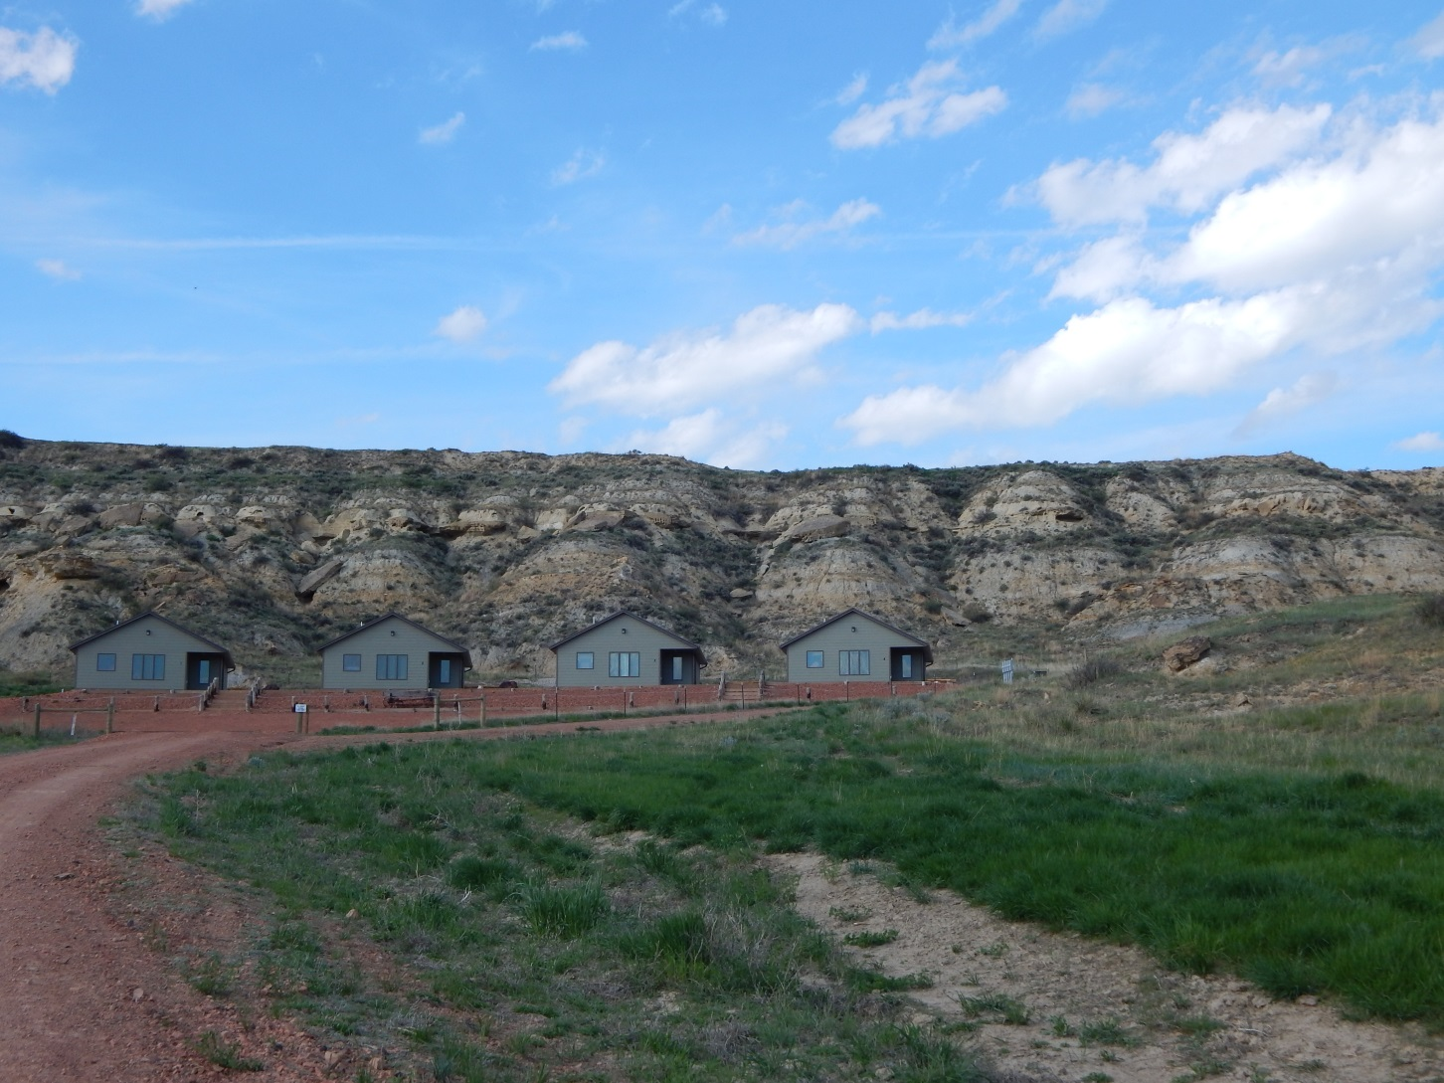
Perfectly Clear Ideas

Slide 12
Thank you!
Questions?
Contact: nathalie.rennell@asu.edu

