Slide 1

At Large! QM Reviews at Multi - Campus Districts
Susan Long
Dallas Colleges Online

Slide 2
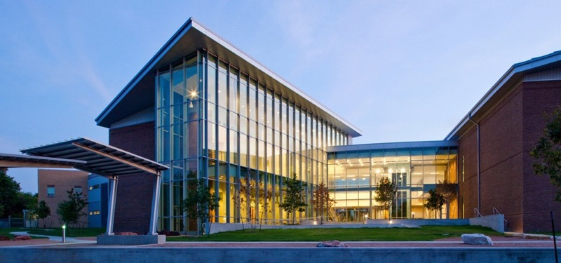
The History of Quality Matters at DCCCD
Science Building, Cedar Valley College, Dallas County Community College District
Background:
We started subscribing to Quality Matters in 2006 as a district-wide initiative to improve online course design.
We started reviews in 2007 and had 6 courses QM certified.

Slide 3
QM District Organization
DCCCD

Slide 4
College District Overview
We have 7 colleges:
Brookhaven College
Cedar Valley College
Eastfield College
El Centro College
Mountain View College
North Lake College
Richland College

Slide 5
District Administration
District Office
District Service Center
The LeCroy Center (Location of Dallas Colleges Online)

Slide 6
District Administration
Quality Matters

Slide 7
QM Coordination
District QM Coordinator located at The LeCroy Center
Each college has a QM College Contact

Slide 8
QM Coordinator Responsibilities
APPQMR Workshops
Facilitate QM Reviews
Provide information sessions to the colleges
Assist faculty with preparing courses for a review when asked
Liaison between QM and college contacts

Slide 9
QM College Contact Responsibilities
Promote QM at campus
Identify courses that will go through a review
Coordinate a local informal review of the course
Supply the QM Coordinator with a list of courses at the beginning of each academic year

Slide 10
Benefits and Challenges
Large System Coordination

Slide 11
Benefits and Challenges
Benefits
  1 employee can train and facilitate reviews
  More available peer reviewers
Challenges
  Agreement on procedures
  Getting all campuses involved equally

Slide 12
QM Review Procedures
DCCCD

Slide 13
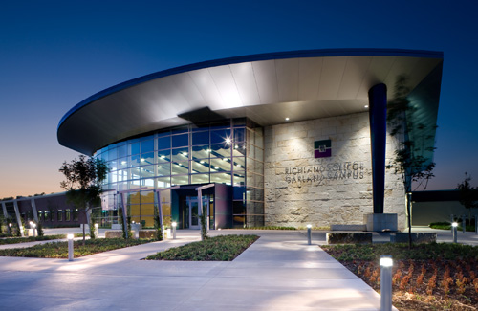
Overview
Richland College, Garland campus, Dallas County Community College District
We have a 12 page review process document approved by our distance learning committee (DELT).

Slide 14
Faculty Requirements
Must attend QM training - either the APPQMR or the online Introduction to Quality Matters
Must be willing to provide materials to the peer reviewers
Must be willing to communicate with the review team and fill out the course worksheet

Slide 15
Course Requirements
Must have been taught at least 2 semesters online
Must contain course and module-level objectives that are measurable
Must contain a Start Here or Getting Started content area with instructions on how the students will start the course
Must contain grading policies and grading turn-around times
Have gone through a local informal review

Slide 16
Promoting quality matters
DCCCD Colleges

Slide 17
Promotion Strategies
Website
Go talk to Deans and VPs of the colleges
Hold information sessions at the colleges
Provide online training
Provide sample courses
Colleges each promote in their own way

