Slide 1

The Road to Quality - A Panel Discussion on Campus Implementation
October 2016

Slide 2
Presenters
Elizabeth McMahon
  Instructor and QMC, Northland Community and Technical College
  Co-Coordinator, Minnesota Online Quality Initiative
  QM Certified Master Reviewer, Course Review Manager and Facilitator
Karen LaPlant
  Instructor and QMC, Hennepin Technical College
  QM Certified Peer Reviewer
Julie Reginek
  Instructor and QMC, Ridgewater College
  QM Certified Peer Reviewer
Robin O’Callaghan
  Instructional Designer and QMC, Winona State University
  Co-Coordinator, Minnesota Online Quality Initiative
  QM Certified Master Reviewer, Course Review Manager and Facilitator

Slide 3
The Road to Quality - A Panel Discussion on Campus Implementation
Elizabeth McMahon
  Instructor and QMC, Northland Community and Technical College
  Co-Coordinator, Minnesota Online Quality Initiative
  QM Certified Master Reviewer, Course Review Manager and Facilitator

Slide 4
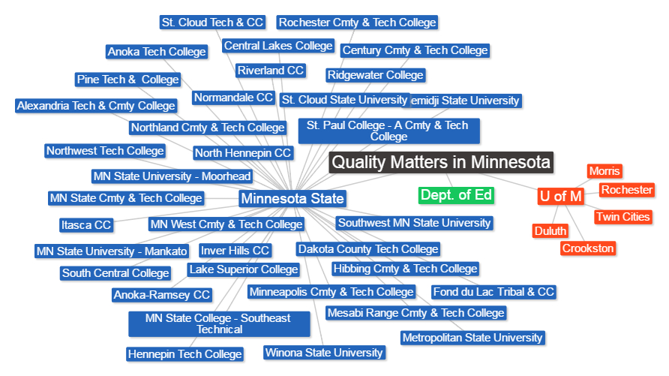




QM Affiliate Institutions in Minnesota
Joint QM subscribers since 2008
Notes:
Current as of 10/8/
Minnesota State College and University System
435,000 + students/ 54 campuses
2 Faculty Unions
University of Minnesota
70,000 students/ 5 campuses
Participation is voluntary for individuals & institutions
Higher Ed Systems collaborate for professional development and course reviews

Slide 5
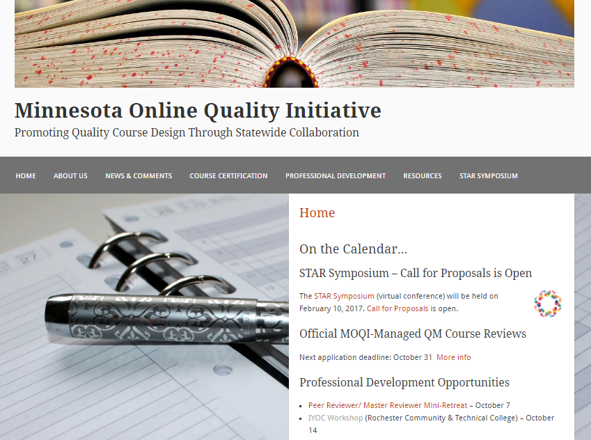
MOQI
Coordinates
Learn More about MOQI @http://minnesota.qualitymatters.org
QM Professional Development
Official QM Course Reviews
Other webinars, workshops and conferences

Slide 6
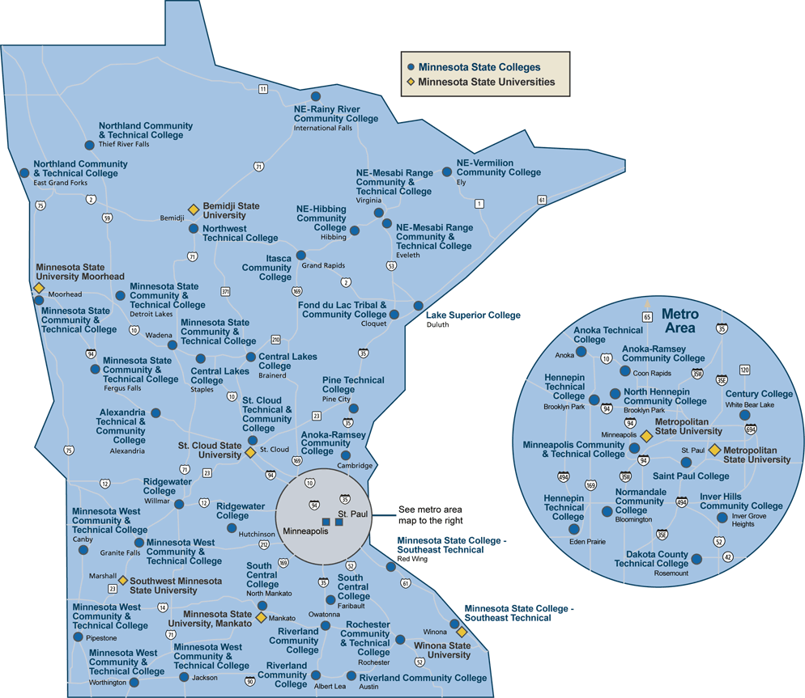
Inter-institutional collaboration increases course quality and builds a network of shared expertise. Each institution chooses own approach to QM implementation.

Slide 7
Goals of Collaboration
For Learners
Improved learning experience
For Institutions
For System/s
National recognition for statewide improvement based on collaboration
Increased satisfaction
Trained faculty
Implementation Plans
Improved courses
High quality online courses
Notes:
For Learners
Significant positive impact on learner satisfaction, retention and achievement in online courses in Minnesota through the development and delivery of online courses that meet high standards of course design.
For Institutions
Provision of significant, course development support for administrators, faculty and staff developing and delivering online courses and an effective and sustainable way for each to demonstrate its commitment to offering high quality online courses and programs.
For the MnSCU System
Provision of effective, coordinated assistance in building statewide access to sustained, continuous training, online course development support and the ability to demonstrate institutional and statewide support for high quality online learning in Minnesota.
Intentional and strategic

Slide 8
The Road to Quality - A Panel Discussion on Campus Implementation
Karen LaPlant
Quality Matters Peer Reviewer and Coordinator
Information Technology Faculty
Hennepin Technical College

Slide 9
Hennepin Technical College
Introducing Quality Matters on campus
Gaining acceptance or buy-in
Establishment of a training program
Procedures for faculty to have courses reviewed
Lessons learned

Slide 10
Online courses
1886 D2L "courses" using D2L Brightspace for Fall
This is the break down:
294 = Courses in Development
120= Committees, training, clubs etc.
1159 = Face to Face courses
203 = Blended
110 = Totally Online

Slide 11
Introduction
Created a flyer after initial QM announcement
Sessions for faculty to stop and ask questions
Offer training in various ways: online and in-person
Offer groups or networks of faculty training together
Collaborated with 2 other local colleges in metro area

Slide 12
ACCEPTANCE
First year received basically no budget
Convinced administration to create budget for years 2-5
Gained faculty acceptance or buy-in by communication
Incorporated QM Best Practices when training in D2L
Convinced faculty that design NOT content is reviewed!
Faculty may now choose to self-assess if not formally

Slide 13
ESTABLISHMENT
Established a QM work group within eLearning Team
Created a QM Presence Online through a new webpage
Created a monthly newsletter to highlight training and accomplishments (In The Q) and sent by e-mail blast
State wide group in known as MOQI (Minnesota Online Quality Initiative) is very helpful and has a website and offers training
  Promoting Quality Course Design Through Statewide Collaboration

Slide 14
PROCEDURES
Active QM Coordinator
  Helpful to be faculty and a Peer Reviewer or Master Reviewer
Procedures for faculty to have their courses reviewed
  Where to go and what to do
  Volunteer at my college with no stipend or release-time attached
Set-up a priority list
Develop peer mentors (trained in QM) to guide faculty

Slide 15
LESSONS LEARNED
Create a committee to meet and discuss
Develop trained mentors
Find early adopters to help motivate other faculty
Spread excitement by word of mouth
Personal pride by announcing certification college-wide

Slide 16

QM COURSE Recognition AT HTC
2012 - 2 Courses
2013 - 12 Courses
2014 - 12 Courses
2015 – 4 Courses
2016 - expect 5
Think of how many students are affected!
Notes:
MnSCU started with QM 2009. WSU 2012

Slide 17
SUMMARY
Need administration support and commitment (budget)
Need committee and community support of faculty, trainers, instructional designers, curriculum specialists, etc.
Need an internal process
Need a priority list
Success for us is 50 faculty have completed QM training (APP/IYOC)
Success is 3 Master Reviewers and 6 Peer Reviewers

Slide 18
The Road to Quality - A Panel Discussion on Campus Implementation
Julie Reginek MS, ACC, EDU, CDP
MEPAP and Activity Director Program Instructor
Health Support Specialist (HSS)
Online Curriculum Specialist/D2L Trainer
Ridgewater College

Slide 19
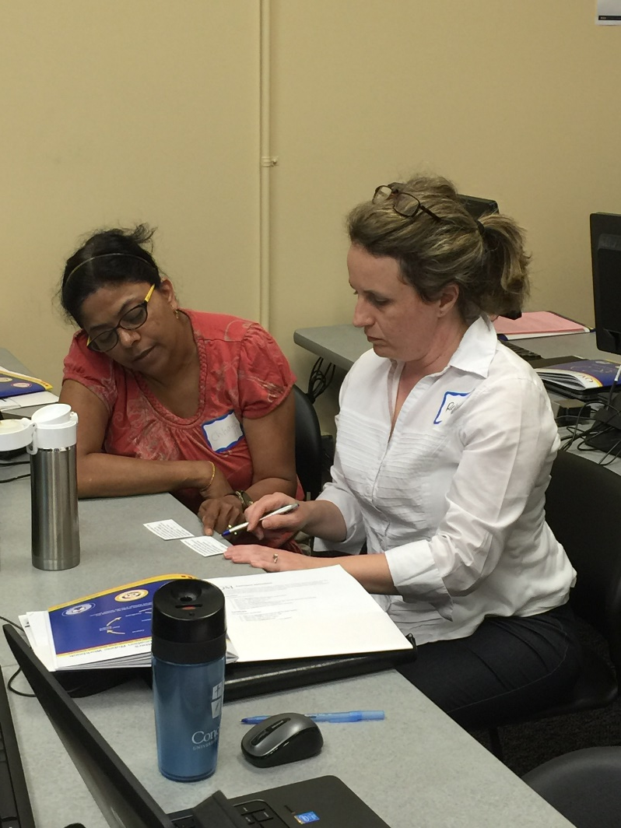
Ridgewater College creating a QM Culture
Faculty Support
  Summer Bootcamp
    APPQMR
    IYOC
  Desire2Learn Tools
  Instructional Design to support Quality Matters Standards
  One on One with faculty

Slide 20
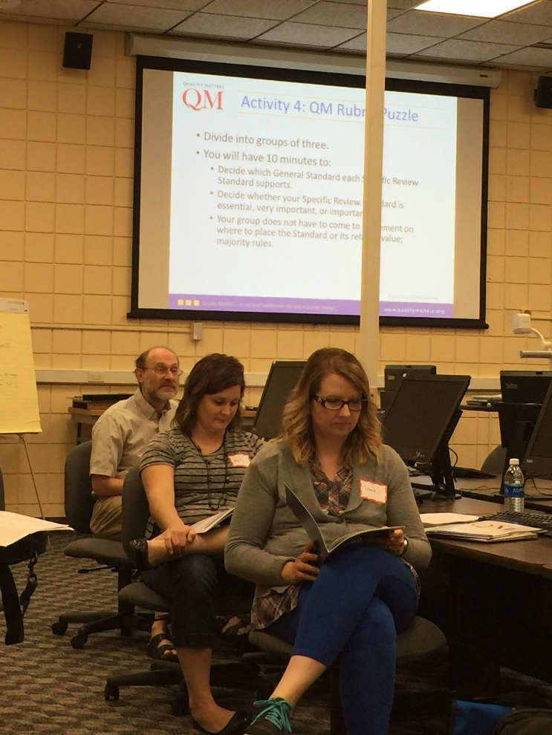
Ridgewater College creating a QM Culture
Administration Support
  Financial Support
  Institutional subscription
  Institutional Representative
  QM training for faculty
  QM conference participation
  In-service Day
  Dean’s Council

Slide 21
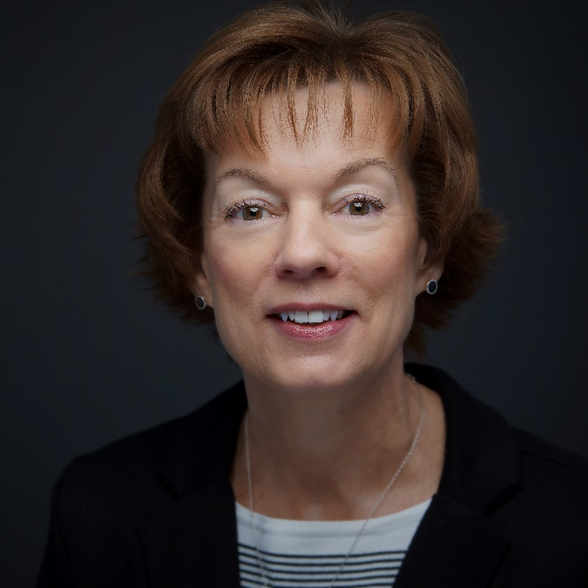
From Administration…….
As an academic administrator I appreciate that Quality Matters is a faculty-centered, peer review process that ultimately benefits our students. Ridgewater College is committed to supporting every faculty member interested in pursuing this professional development process.
QM aligns with and fortifies the College’s
vision of excellence and student centeredness;
mission of quality education; and
values focused on student success and continuous improvement.

Slide 22
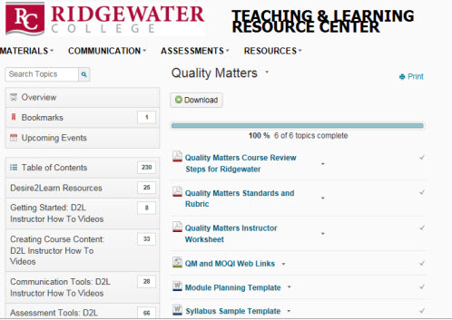

Ridgewater College
Teaching and Learning Center

Slide 23
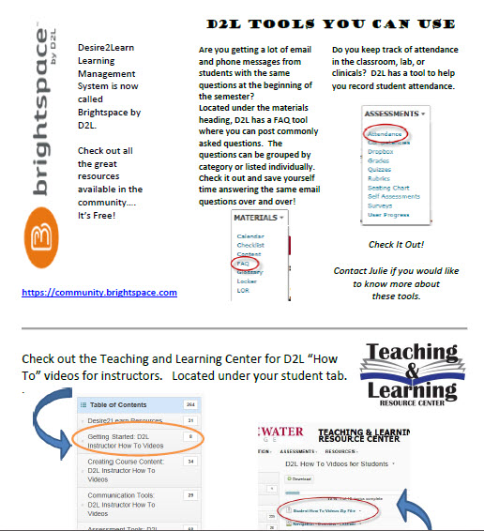
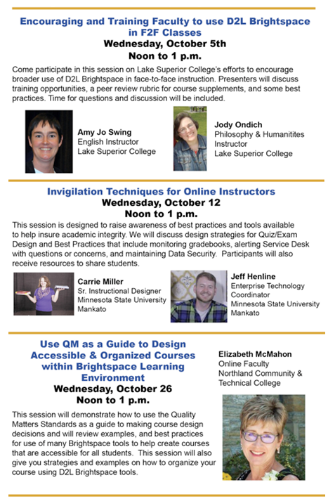
Ridgewater College
Creating a QM Culture

Slide 24
Ridgewater College
Creating a QM Culture
Where do I start and what do I do?
  Meet with me
  QM Starter Kit
  Informal review
  Toot your horn!

Slide 25
The Road to Quality - A Panel Discussion on Campus Implementation
Robin O’Callaghan
Quality Matters Peer Reviewer, F2F Facilitator & QM Lead Coordinator
Senior Instructional Designer
Faculty
Winona State University

Slide 26
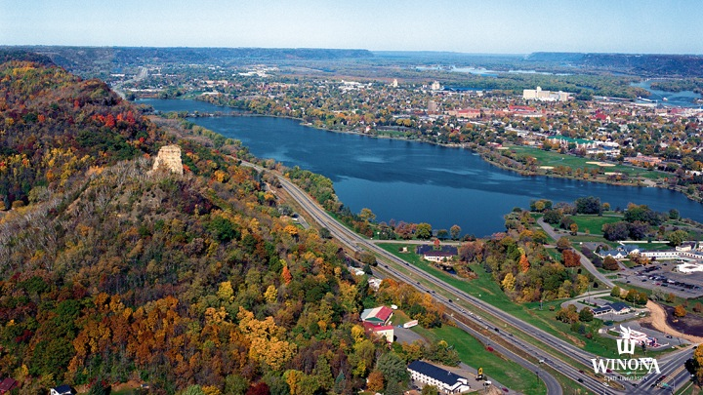
WSU and QM at a Glance
          Professional Development – Applying the QM Rubric and Improving Your Online Course
          8 Peer Reviewers & 5 Master Reviewers
35 QM Recognized Courses
Funding Model – ITS and Administrative Funding. Special project funding of strategic areas.
Notes:
3 Undergraduate Programs
4 Graduate Programs
3 blended/hybrid programs
50-75 courses are offered online during the academic year
120 Summer courses are online

Slide 27
WeTeach Program
Quality Matters Recognition
Bi-Weekly or Weekly
1:1 Meetings
Foundation/Advanced
Summer Cohort
WeTeach Foundations & WeTeach Advanced
Provide a flexible format
Allow instructors to become a online student
Showcase tools and model an online course
Allow opportunities to discuss online learning with other instructors

Slide 28
Advantages & Disadvantages
Advantages
Disadvantages
Flexibility for instructors
Faculty workload
Collaboration
“Self-select” the instructional materials
Evidence of completion
More time to manage for facilitators
Alignment of all program
“Self-select” could miss key components
Not streamlined for those who need structure
Notes:
ROBIN

Slide 29
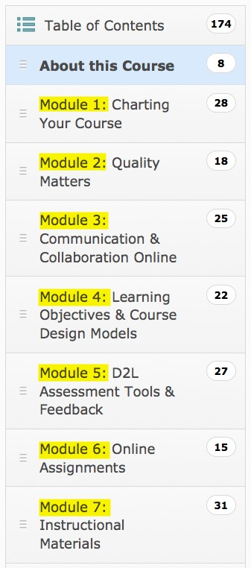
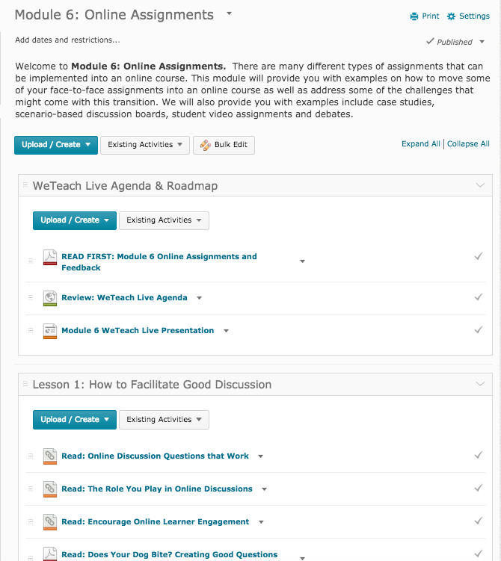
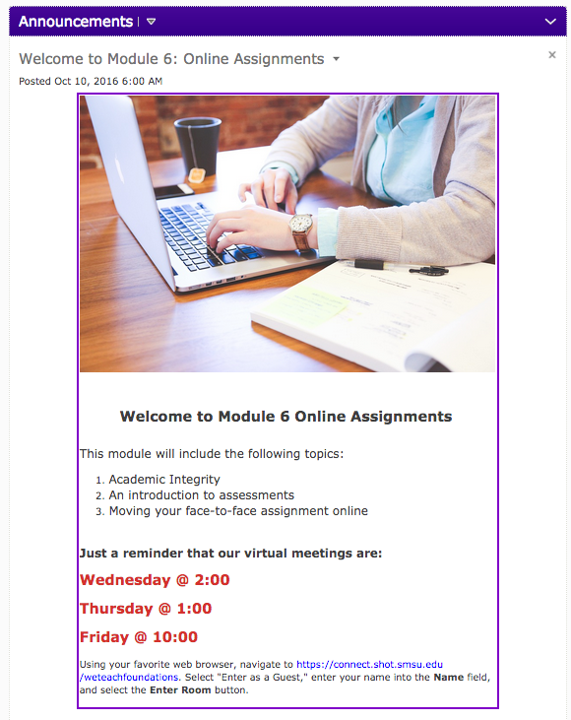
WETeach Program FOUNDATIONS
7 modules
7 virtual sessions
Online content & assignments
Certificate at the end that can be included in PDP
Weekly news items and emails

Slide 30
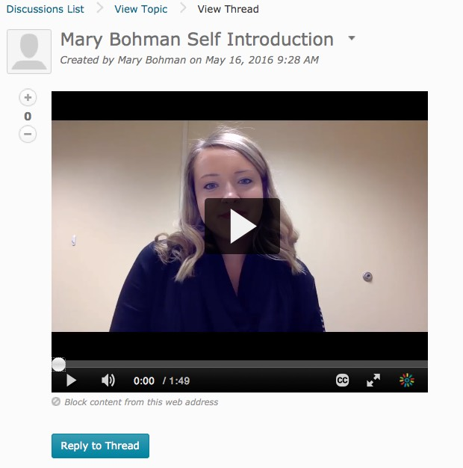
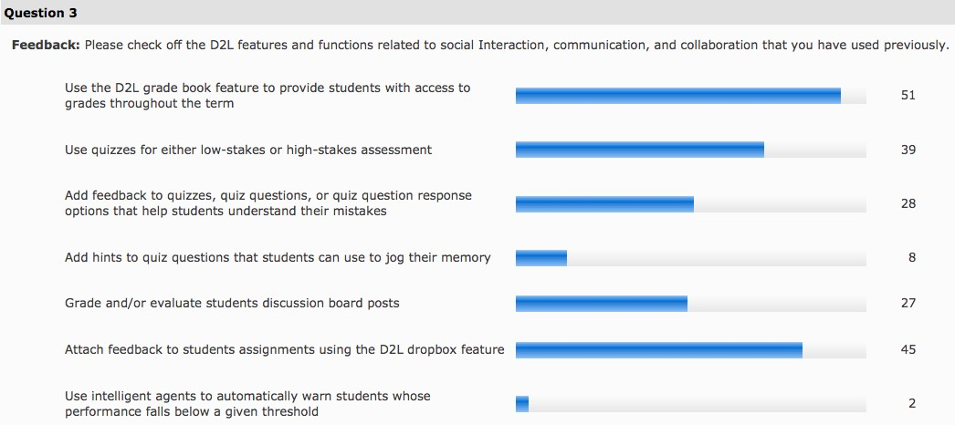
Assignment Examples
Video introduction & Video presentation (Discussion Board)
D2L usage survey (Survey Tool)
Netiquette Instructions (Group Dropbox)
Notes:
Learning Objectives Self-Assessment
(Self Assessment Tool)
Hot Seat Discussion Board
(Discussion Board)

Slide 31
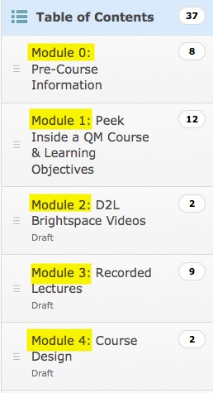
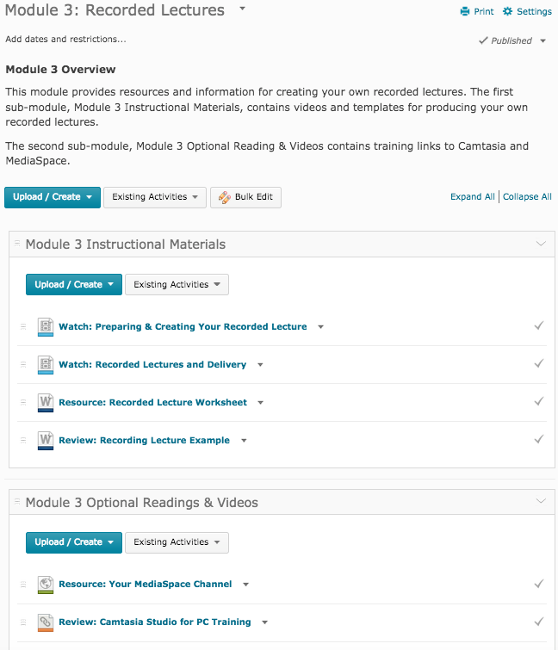
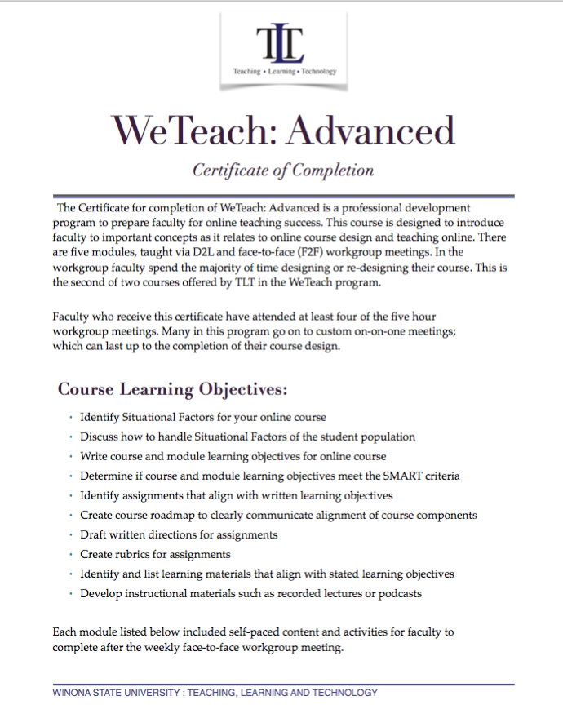
WETeach Program ADVANCED
4 modules (1 pre-course module)
4 F2F sessions
Online content & assignments
Certificate at the end that can be included in PDP
Hands-on, building components for their course
Preparation for 1:1 meetings

Slide 32
Strategies for administration & Faculty buy-in
Offer the APPQMR course to faculty, deans and administrators
Communicate institutional and faculty benefits through workshops and virtual meetings
Communicate our professional development plan around QM and online teachings
Create strategic plan by college
  Track all 1:1 meeting with faculty. This would include notes and “level” of help.
  Track by college, course, QM reviews, QM Renewal and WeTeach Certificate
  Summary by college distributed every fall
  Faculty can use the data for the PDP and PDR

Slide 33
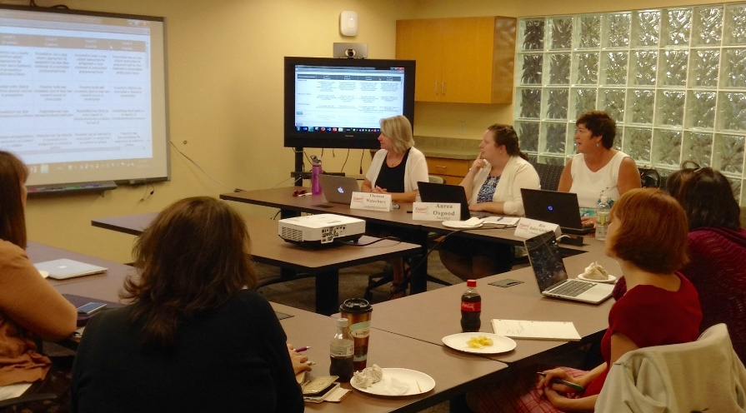
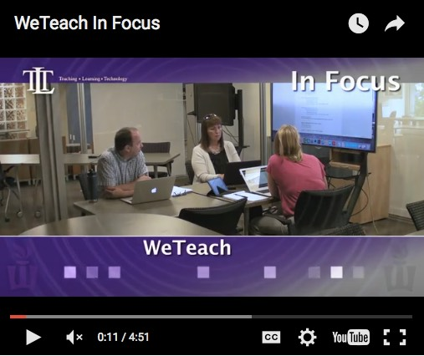
Tools to Communicate WeTeach Program
Targeted emails to faculty
Expert Showcase & 20-Minute eClinics to gain faculty interest
Wiki description of the courses with a promotional video

Slide 34
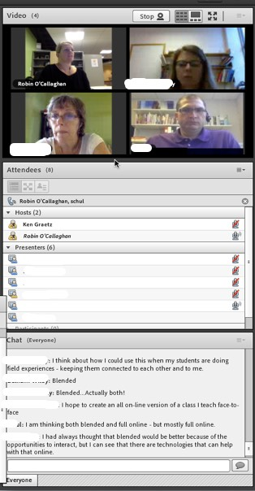
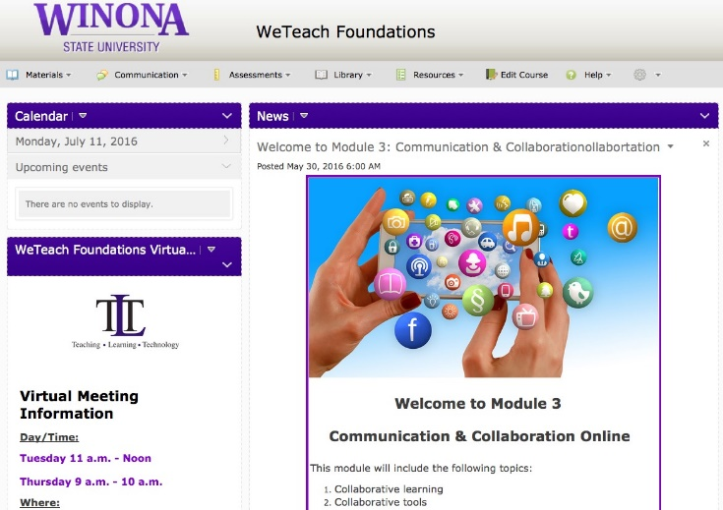
Tools to Communicate WeTeach Program
D2L – LMS
Doodle – Scheduling
Adobe Connect – WeTeach Foundation Virtual Meetings
ITV/Jabber – WeTeach Advanced

Slide 35
Questions?
Please feel free to contact any of us:
Elizabeth.McMahon@northlandcollege.edu
Karen.LaPlant@hennepintech.edu
Julie.Reginek@ridgewater.edu
ROCallaghan@winona.edu

