Slide 1

The QM K-12 Rubric as a Course Development Roadmap
Kristi Peacock & Krista Tomaselli

Slide 2
Objectives
Participants will be able to do the following:
Integrate the QM K-12 Rubric into the Course Development Process.
Develop institution-specific best practices for meeting QM Standards and apply those practices to the course development process.
Apply the QM K-12 Rubric standards to course and lesson templates to support the course development process.

Slide 3

Our Story

Slide 4

Section 21f of the Michigan School Aid Act
With the consent of the student’s parent or legal guardian, students enrolled in a public local district or public school academy in any of grades 6 to 12 are eligible to enroll in up to two online courses per term.
(MCL 388.1621f)

Slide 5
What is an “online” course?
Section 21f defines an online course as a “…course of study that is capable of generating a credit or a grade, that is provided in an interactive internet‐connected learning environment, in which pupils are separated from their teachers by time or location or both, and in which a teacher who holds a valid Michigan teaching certificate is responsible for determining appropriate instructional methods for each pupil, diagnosing learning needs, assessing pupil learning, prescribing intervention strategies, reporting outcomes, and evaluating the effects of instruction and support strategies.”

Slide 6
How do we ensure quality?
Starting in 2014, in order for an online course to be eligible for 21f, the State of Michigan began requiring online content providers to make their courses available through a statewide catalog known as micourses.org. In order for a course to be active in this catalog, the course had to go through a review process. It was recommended that the review be conducted by a third party.

Slide 7

Getting started
Late summer of 2014, twenty-five staff members attended a one-day K-12 Applying the QM Secondary Rubric professional development training.
Prior to going through the QM training, our organization hired independent contractors to review our courses, but these reviewers did not go through a formalized review process, and as a result we discovered inconsistencies in the quality of the reviews returned.

Slide 8
Starting in the fall of 2015, we began putting our courses through a QM-Managed Review. This is when we really started to embrace Quality Matters and its review process.
We initially submitted about 13 courses for review before we changed our development process.

Slide 9

QM Feedback
The QM reviewer feedback was the key and driving force behind the development of our new course development process!
We used the feedback generated from these 13 reviews to help us rethink our approach to designing courses.

Slide 10
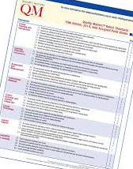
The Process
We divided up the 8 QM general standards among our staff. Each person conducted an in-depth study of the standard, annotations, and the feedback we had received from those original reviews.
Standard 8 Example

Slide 11
The Discovery!
We soon discovered that many of these standards can be addressed in a standard course template, student orientation(Unit 0), and lesson template. In addition, for the standards not able to be addressed with one of these three things, we started to develop our ID Best Practices guide.

Slide 12

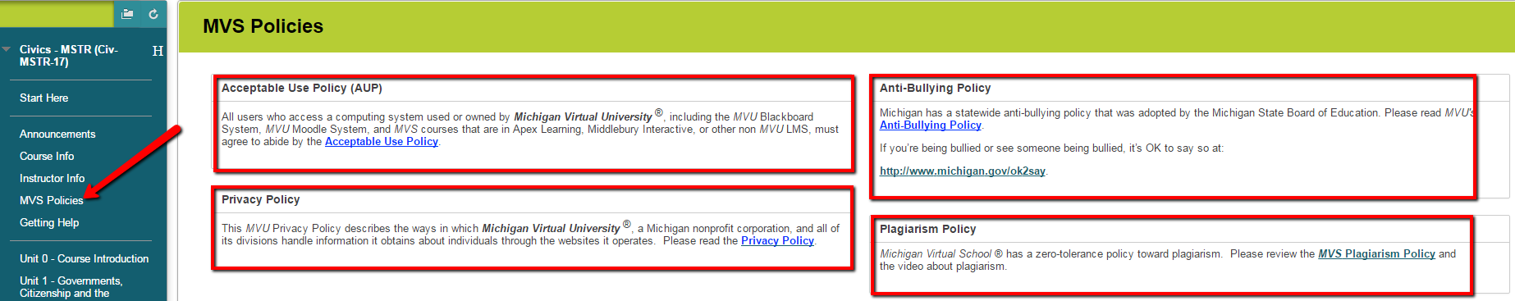
Blackboard Standard Course Template
Some things were easy enough to simply add to our Master Course Template.
Standard 7.1 & 1.4

Slide 13
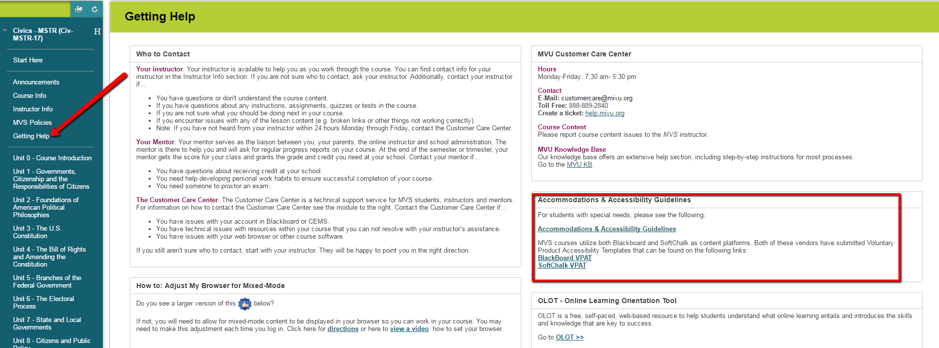
Blackboard Standard Course Template
Standard 8.1

Slide 14
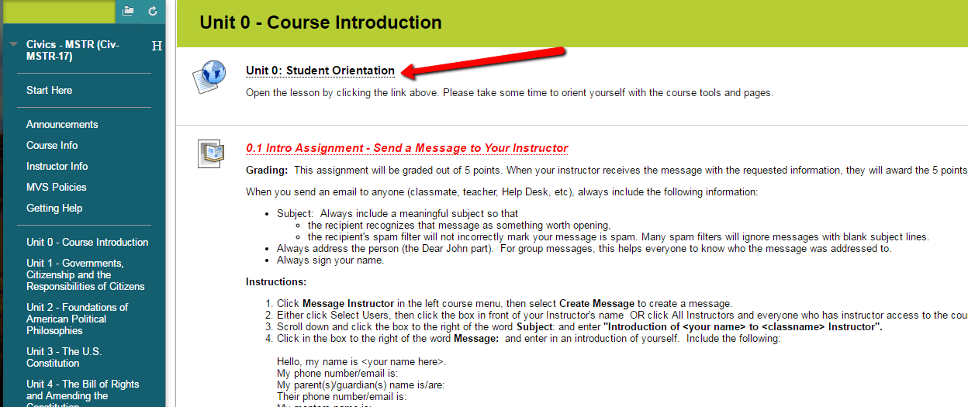
Unit 0 - Student Orientation

Slide 15
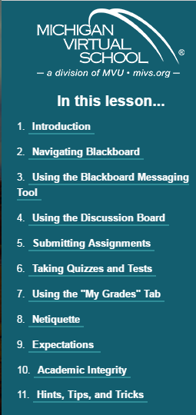
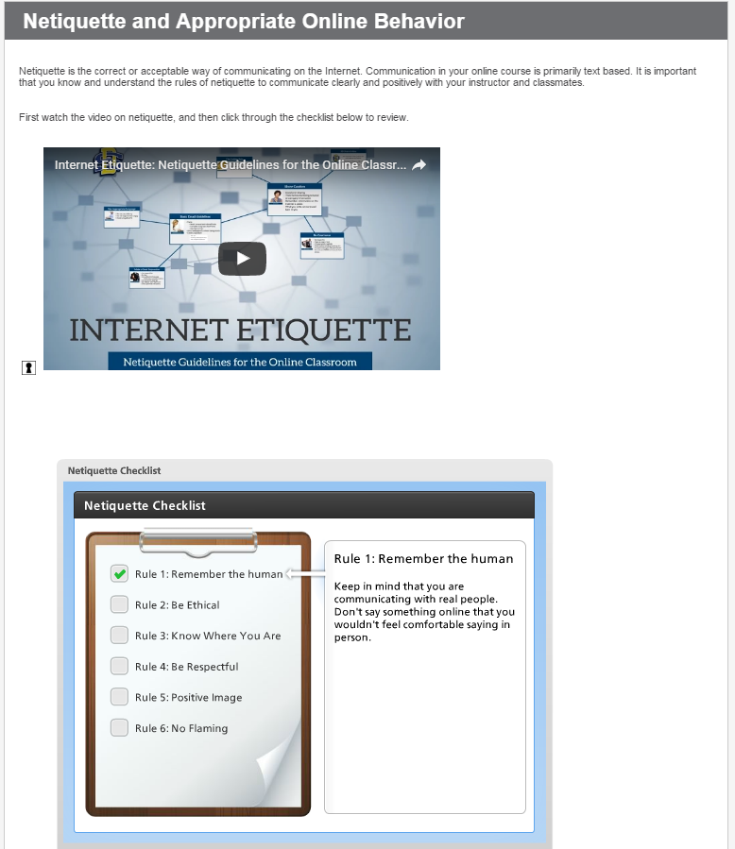
Unit 0 - Student
Orientation
Standard 1.3

Slide 16
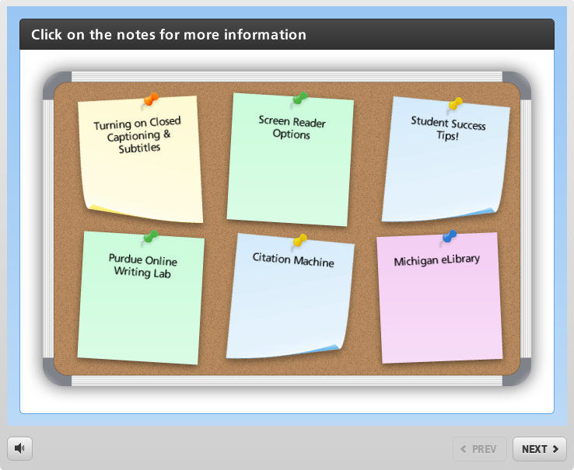
Unit 0 - Student
Orientation
Standards 7.3, 7.4, & 8.1
Using our Student Orientation, we were able to address several QM standards with one engaging activity.

Slide 17
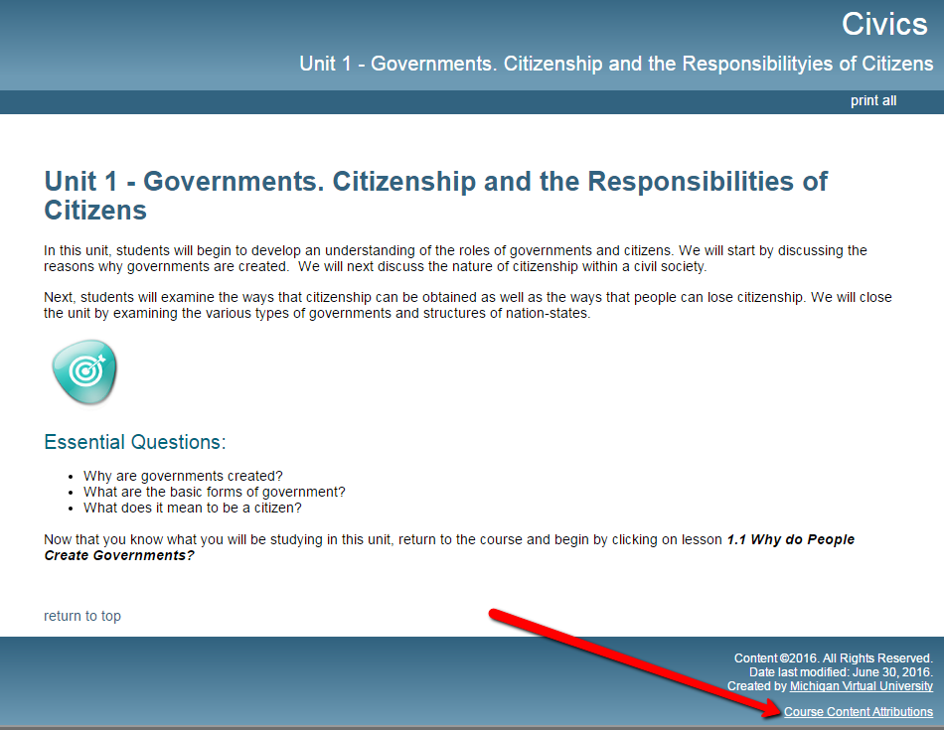
SoftChalk Template
Standard 4.7

Slide 18
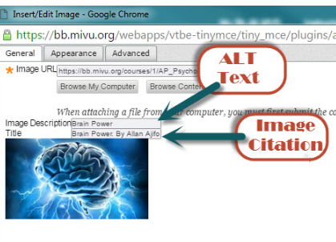
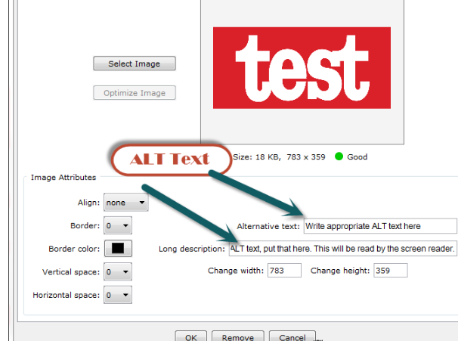

SoftChalk & Bb Best Practices
Standard 4.7 — Standard 8.2

Slide 19
Putting it all together
This document is an accumulation of all the information that our product development team generated during this process.
ID Best Practices

Slide 20
Our Roadmap
Send a few courses through a QM Review
Use QM Reviewer feedback to drive the development of your templates and ID Best Practices
Divide up the research on each QM Standard
Apply existing QM feedback and/or brainstorm ways to address the QM Standards in your templates
Create an ID Best Practices document

Slide 21
Resources
Blank QM Standard Template
Blank ID Best Practices
Sample QM Standard Template
Sample ID Best Practices
Roadmap Handout

Slide 22
Any questions?
Thank You!
You can find us at @ ktomaselli@mivu.org
kpeacock@mivu.org

