Slide 1

SMALL GROUP DISCUSSION
Please reflect on the following questions with those around you or individually:
How do you currently caption in your institution?
What is your biggest captioning challenge?
What do you hope to gain from this session?

Slide 2


IT MAKES CENTS: AFFORDABLE IN-HOUSE CAPTIONING

Slide 3
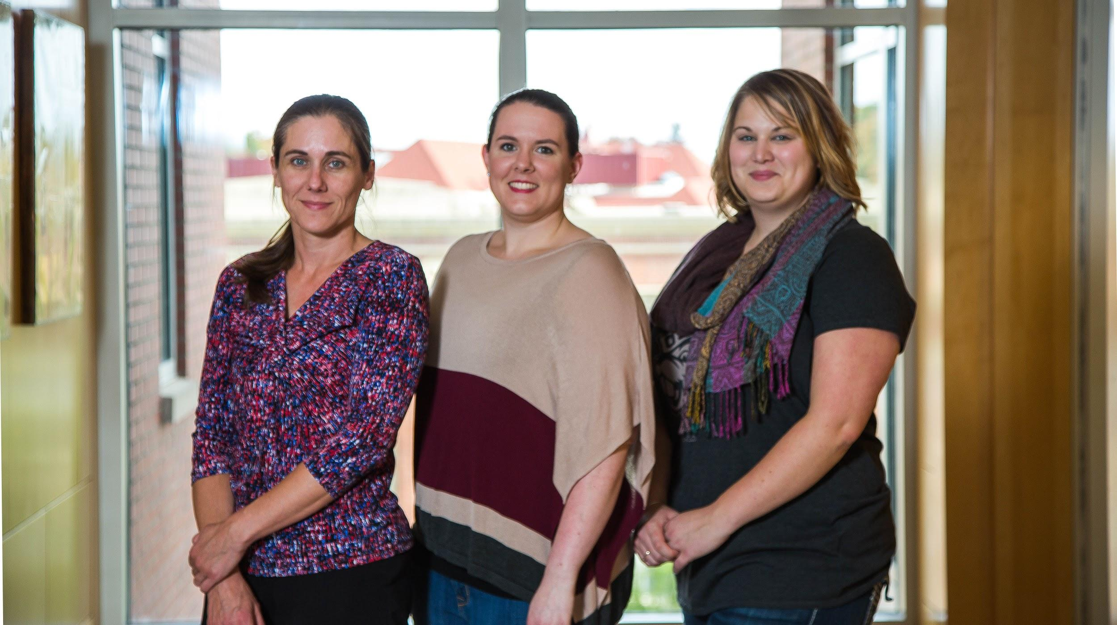
INTRODUCTIONS

Slide 4
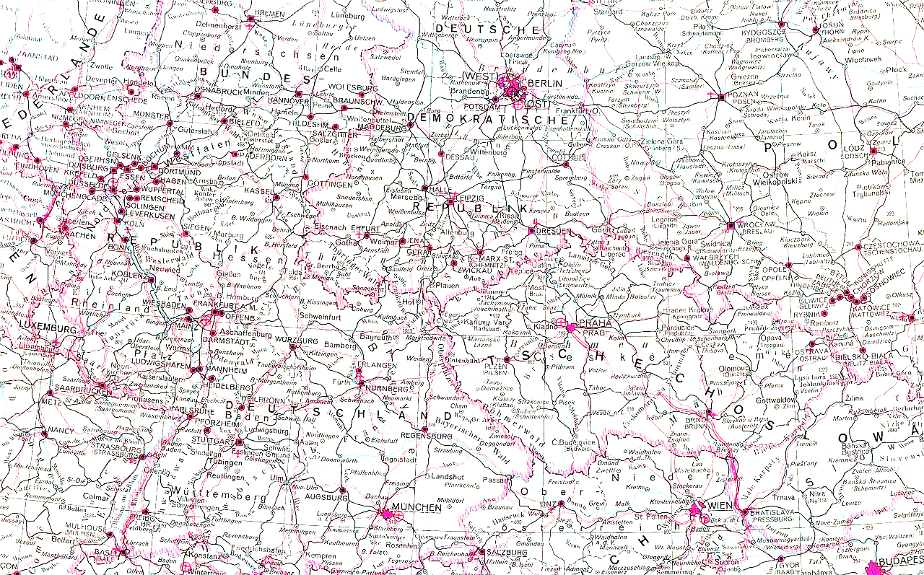
LEARNING OBJECTIVES
Outline how Ecampus at Oregon State University solves the special challenges of meeting Standard 8.3 to achieve excellence in their online courses.
Explain how student employees, a task management system and YouTube are being used to produce accessible content efficiently and affordably at Ecampus.
Evaluate and share strategies for affordably meeting Standard 8.3 at your own school or within your own course.

Slide 5

QUESTION:
Do you currently have a process in place to create captions for your courses?

Slide 6
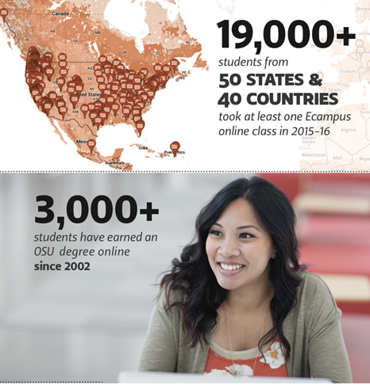
INTRODUCTION TO ECAMPUS
STUDENTS

Slide 7
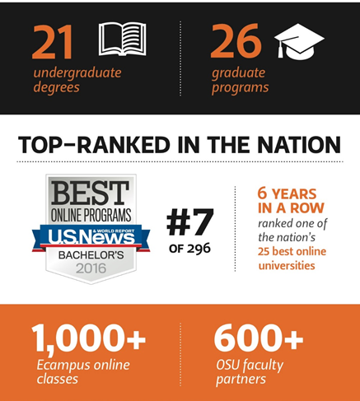
INTRODUCTION TO ECAMPUS
DEGREE PROGRAMS

Slide 8
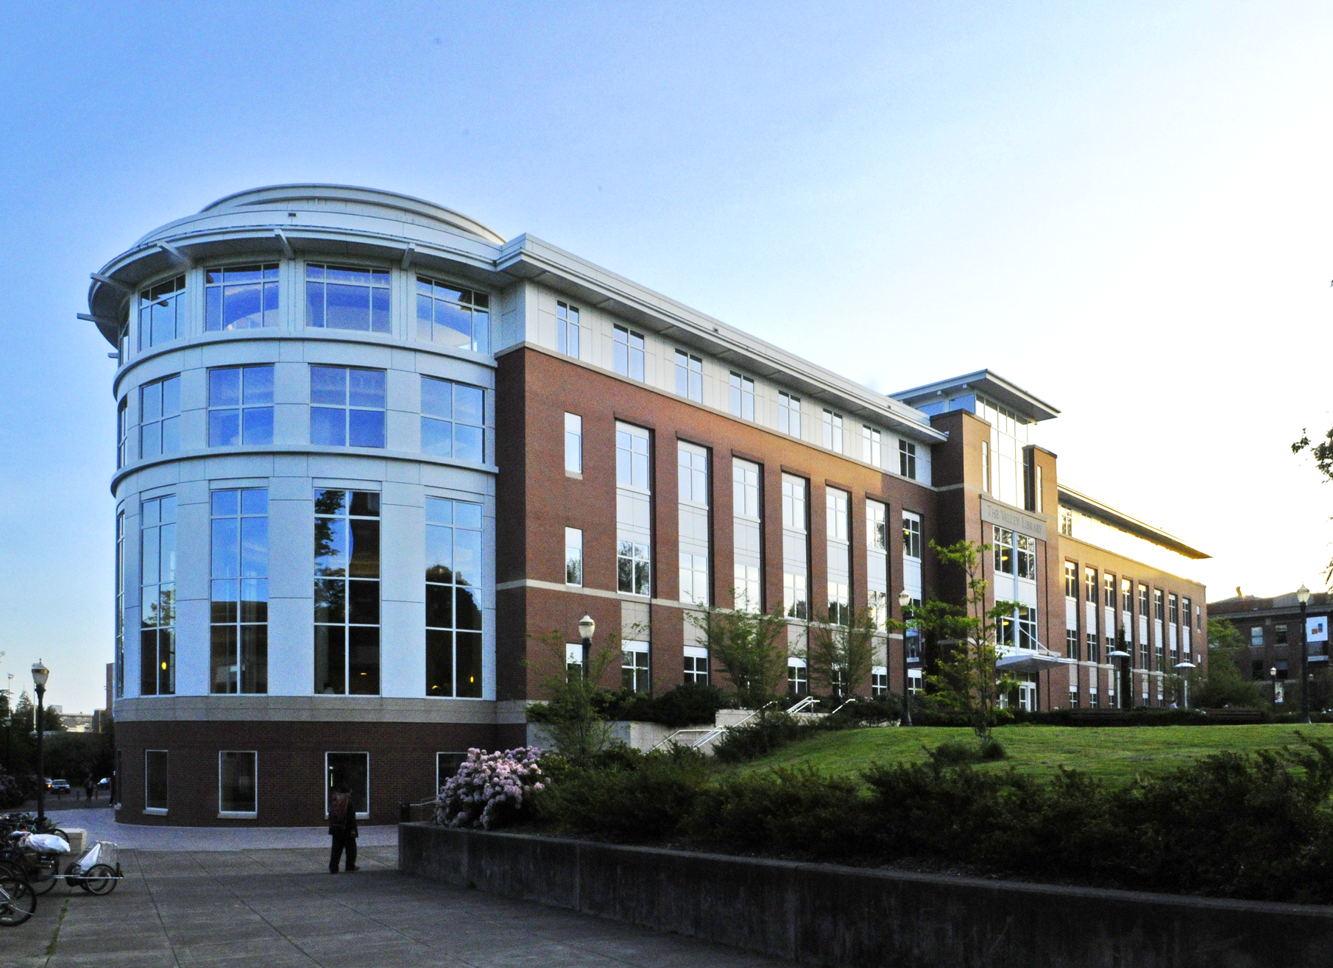
ECAMPUS ORGANIZATIONAL STRUCTURE
Extended Campus
Open Oregon State
Ecampus
Summer Session
Professional and Continuing Education
Course Development and Training
Department and Learner Services
Marketing and Enrollment
Research

Slide 9
COURSE DEVELOPMENT AND TRAINING TEAM
Instructional Design
Media Development
Ecampus
CDT Roles
Course Building
Faculty Training & Support

Slide 10

ECAMPUS IS A PARTNER

Slide 11

DISABILITY ACCESS SERVICES

Slide 12

A QUALITY MATTERS INSTITUTION
Launched QM Initiative in 2012
Internally
Faculty - Voluntary adoption

Slide 13
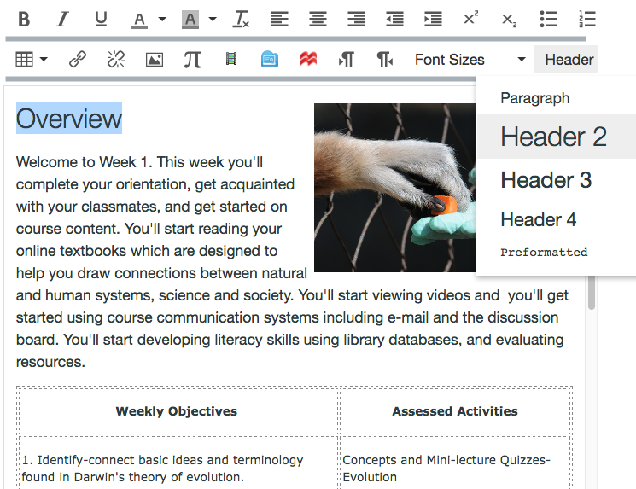
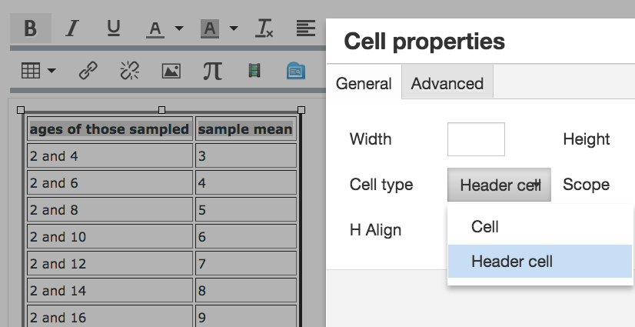
STANDARD 8.3
“The course provides alternative means of access to course materials in formats that meet the needs of diverse learners”

Slide 14
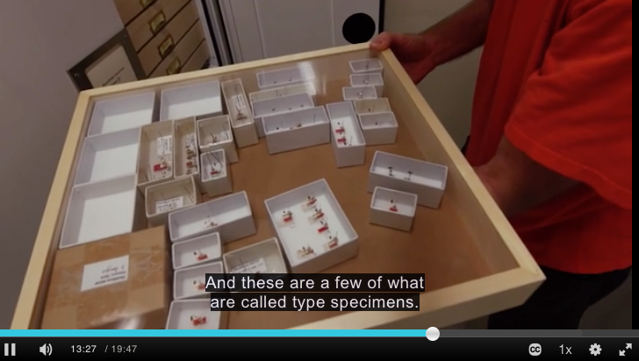
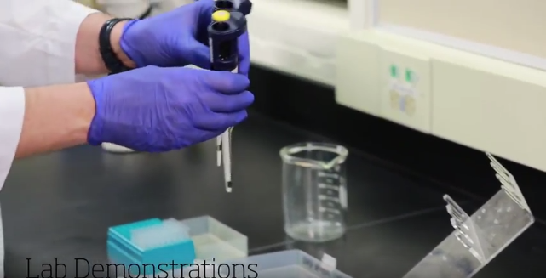
STANDARD 8.3 ANNOTATIONS
“Videos and animations are captioned, or text transcripts are readily available”.
“If the audio corresponds with the visual content in a way that conveys meaning, captions provide an equivalent experience…”
“...the general accuracy of the alternate content is verified.”

Slide 15

WHY IS 8.3 IMPORTANT TO OUR STUDENTS?
“I find that I retain more information when I can hear and read simultaneously.”
“I have 2 young kids at home and listening to (or even concentrating on) the speaking in a video is often times not so easy.”
“I can read faster than the video and
time is precious.”
Yogurt by MOEVIEW, CC BY-NC-ND

Slide 16
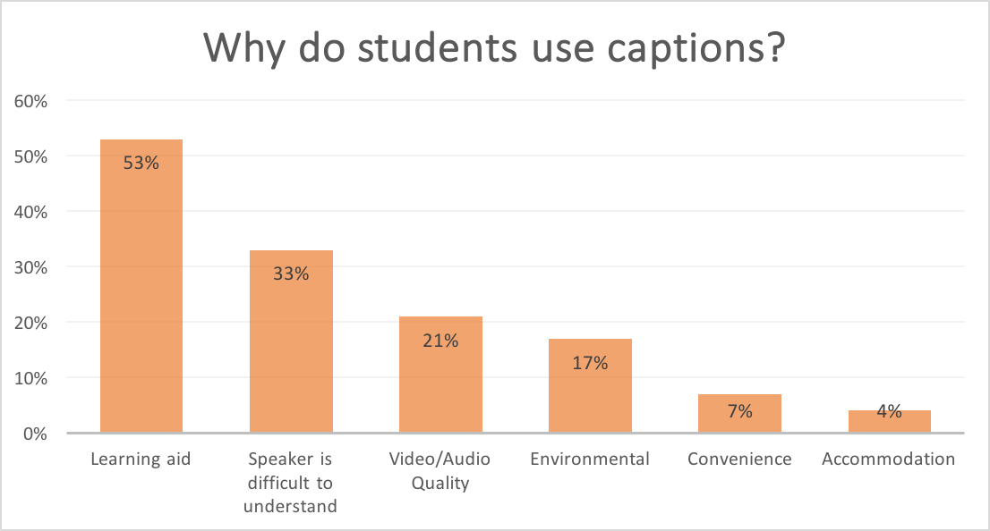
STUDENT USE AND PERCEPTIONS OF CLOSED CAPTIONS IN THE FULLY ONLINE CLASSROOM

Slide 17

QUESTION:
What issues have you encountered with a captioning process?

Slide 18

CHALLENGES

Slide 19

CHALLENGES

Slide 20

CHALLENGES

Slide 21

CHALLENGES

Slide 22


Slide 23

BEFORE...

Slide 24

WHAT WE TRIED WITH CAPTIONING

Slide 25

FINDING A PROCESS
Media is created by Ecampus
Media links added project management software
Students workers select media and transcribe
Students create timing files with YouTube
Timing files are uploaded to media server
Instructors notified for quality assurance

Slide 26

WHAT WE’RE DOING NOW - STUDENTS

Slide 27
WHAT WE’RE DOING NOW - THE NUMBERS
60 minute video:
Students:
60 minute video = 4 hours to caption;
at $10.00/hour,
$40 for captioned video
Outsourcing:
60 minutes;
$2-$4 per minute,
$120.00 for captioned video
Conclusion: students are 3-6 times less expensive, after initial training investment

Slide 28
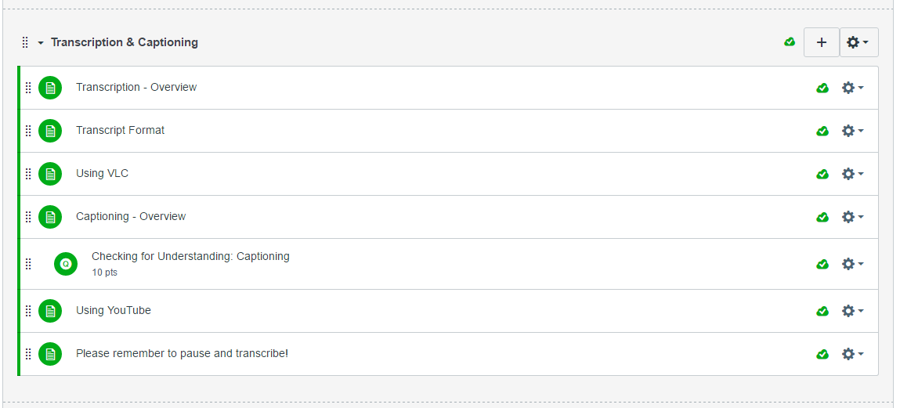
WHAT WE’RE DOING NOW - STUDENTS

Slide 29

WHAT WE’RE DOING NOW - PROJECT MANAGEMENT

Slide 30

WHAT WE’RE DOING NOW - PROJECT MANAGEMENT
Tracking
  Google Sheets

Slide 31
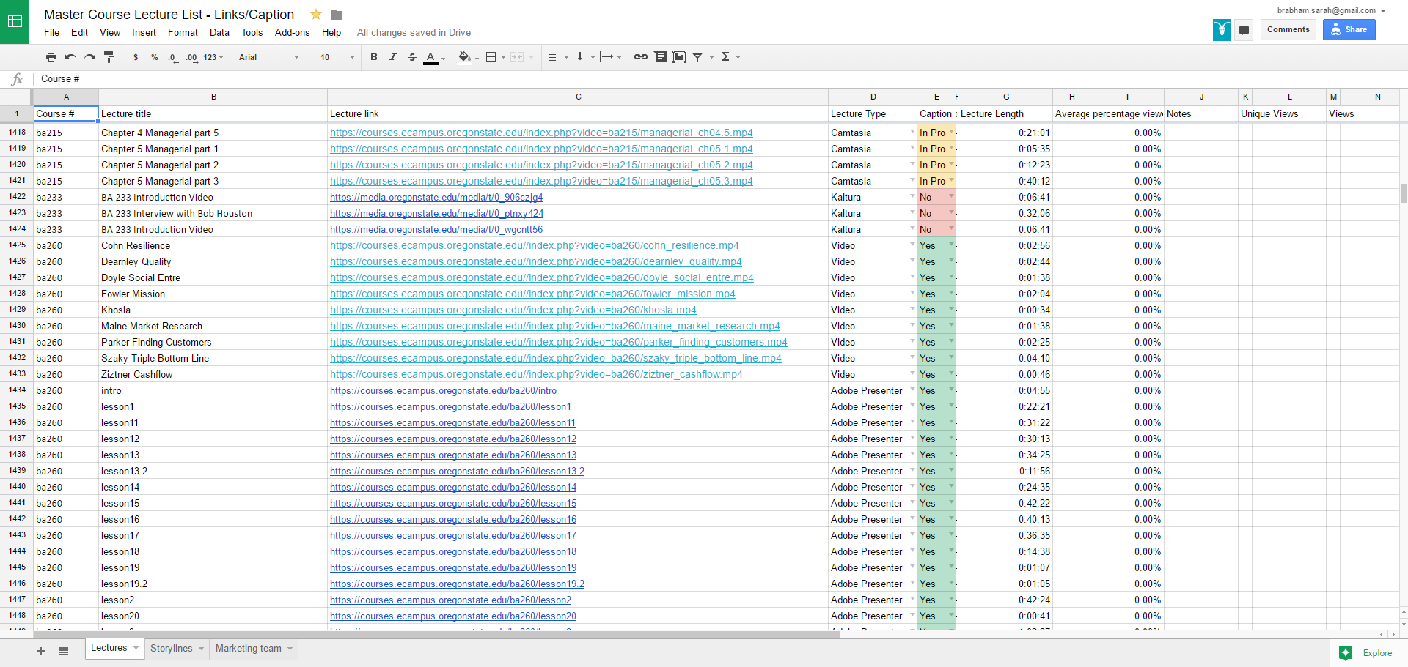
WHAT WE’RE DOING NOW - PROJECT MANAGEMENT

Slide 32
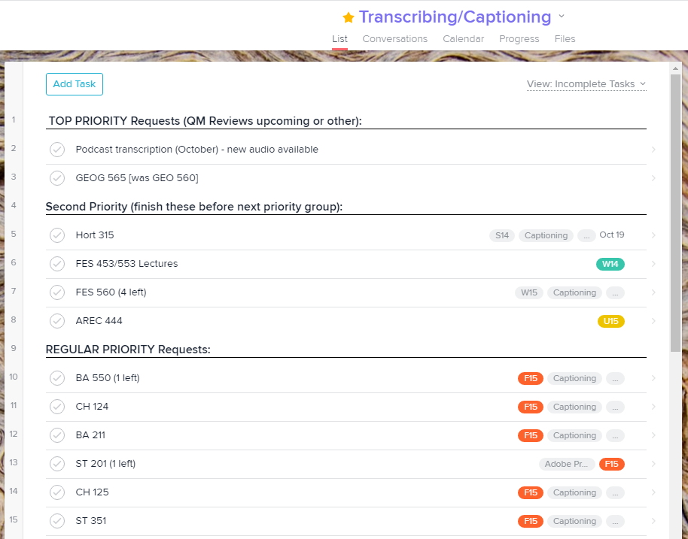

WHAT WE’RE DOING NOW - STUDENT WORKFLOW

Slide 33
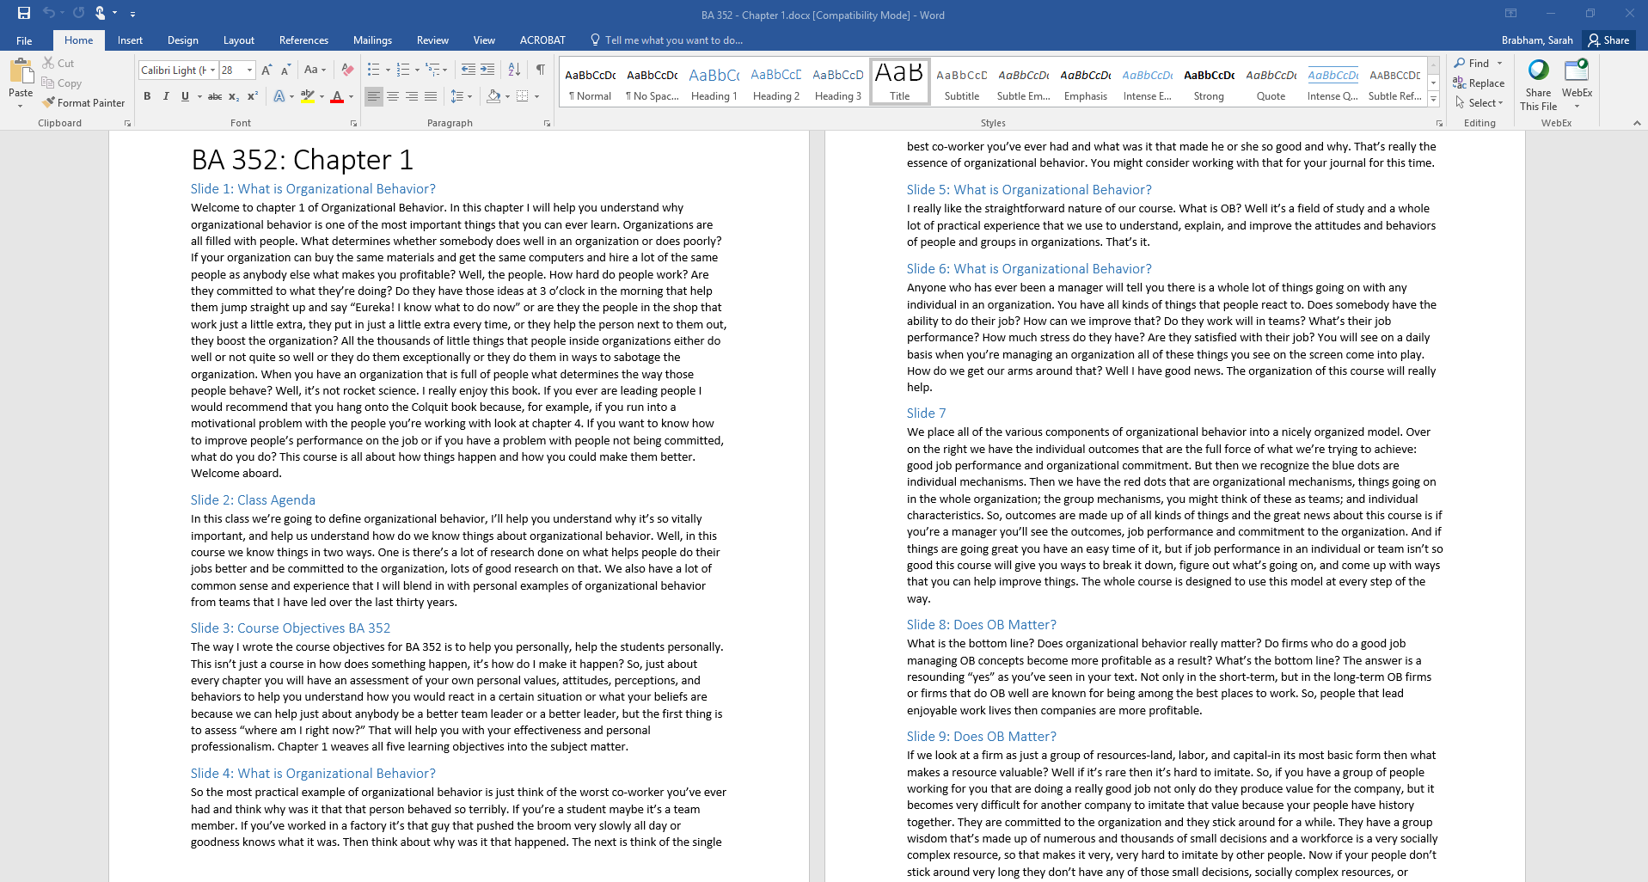
WHAT WE’RE DOING NOW - STUDENT WORKFLOW

Slide 34
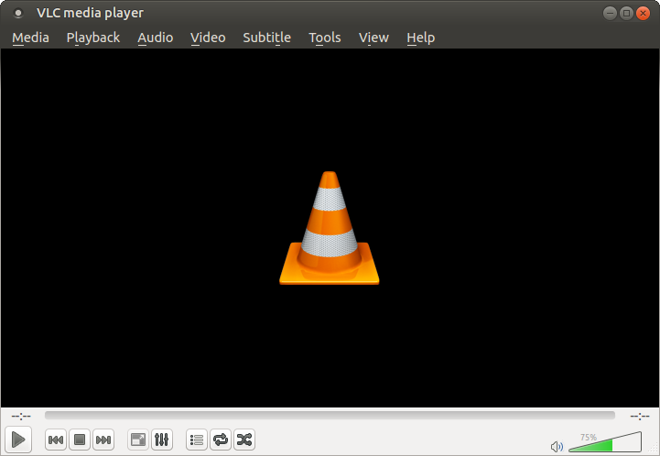
WHAT WE’RE DOING NOW - STUDENT WORKFLOW

Slide 35

What we’re doing now - Student Workflow

Slide 36

WHAT WE’RE DOING NOW - QUALITY ASSURANCE

Slide 37
REVIEW OF THE FULL PROCESS
Media is created by Ecampus
Media links added in Asana
Students workers select media
Students transcribe
YouTube to create SRTs (timing files)
SRT files are uploaded and link updated
Instructors are emailed transcripts to review

Slide 38

WHAT WE’RE STILL WORKING ON

Slide 39

WHAT WE’RE STILL WORKING ON
Students captioners still aren’t perfect
  Self selection vs. prioritizing
  Avoiding longer lectures
  Quality control
  Keeping student training up to date

Slide 40
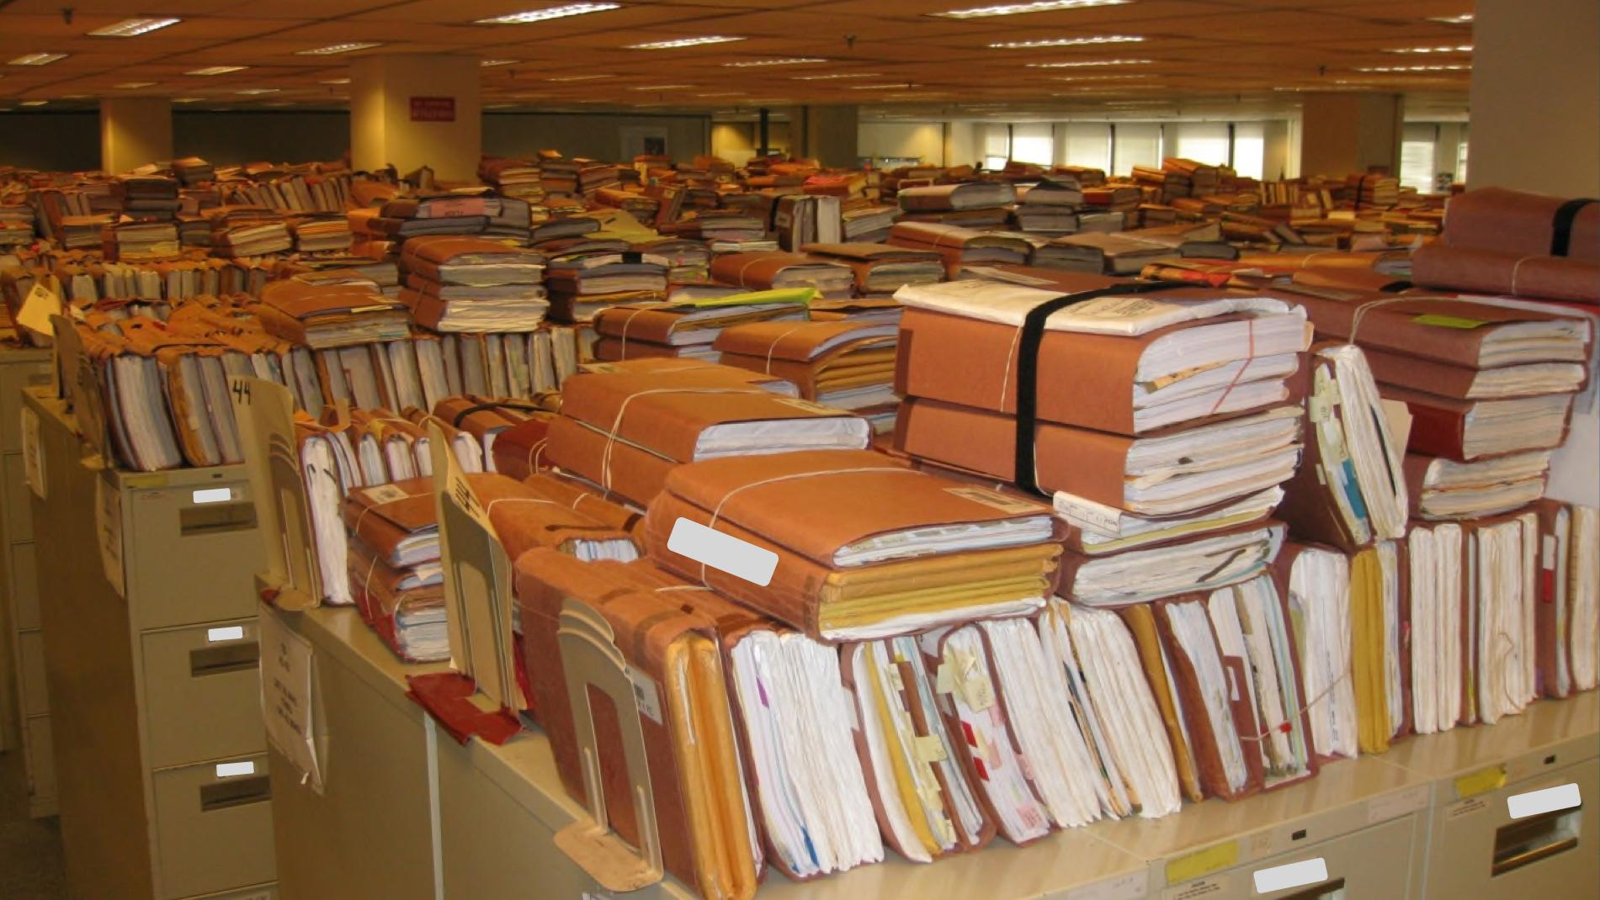
WHAT WE’RE STILL WORKING ON

Slide 41

QUICK GROUP DISCUSSION
What was the most valuable idea/strategy/tool for you from today’s presentation?
In what ways can you use the information presented today to improve your own process?
What other strategies, tools, processes, etc., are you using to solve the issue of captioning at your institution?

Slide 42
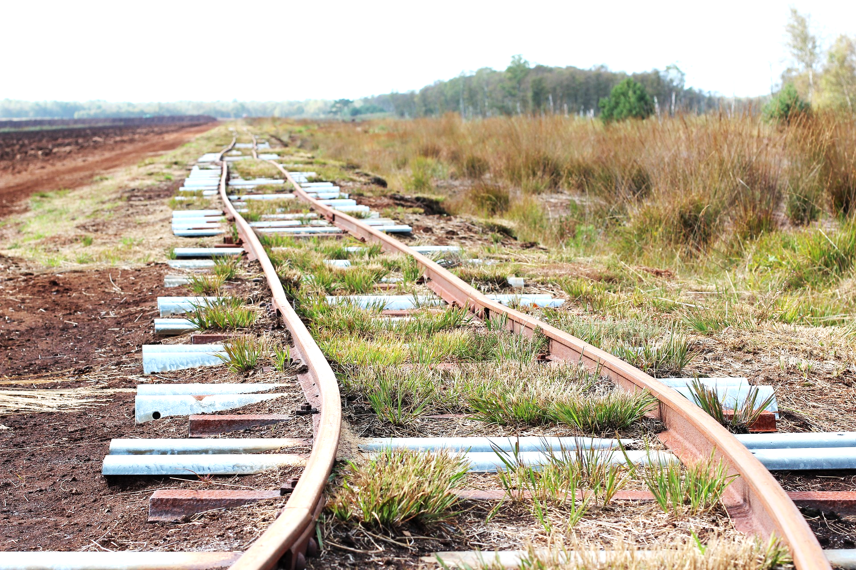
CONSTANTLY IMPROVING PROCESS

Slide 43

QUESTIONS?

Slide 44

SURVEY

