Slide 1
Starting Off Right
Engaging Activities for Kick-Starting the Development of Learning Outcomes
Presenter: Kim Woodruff
Director of Instructional Design, Manhattan College

Slide 2
Learning Objectives
Discuss the writing of effective learning outcomes as a critical and rewarding step in the course design process
Use Bloom's Taxonomy and accompanying activities as tools for developing course learning outcomes and for facilitating this process with others
Explore strategies for maintaining alignment between learning outcomes, course activities, instructional materials and assessments and for facilitating alignment with others

Slide 3
Background
The activities described in this presentation were developed as part of the first workshop in a series of four workshops required for online and hybrid course designers
Prior to this first workshop, course designers are asked to identify the general course goals (usually already in existence) and identify topic names for the 7 weeklong modules
The course development model used is a backward design approach
The first workshop focuses on the writing or learning outcomes and identifying assessment strategies
Courses are generally 7 weeks long and learning outcomes are written for each weeklong module

Slide 4
Step 1: The Warm-up
Activity:
Course Content Considerations
Notes:
How it works
Course designers participate in a quick write warm-up activity consisting of prompts about their course’s “content”

Slide 5
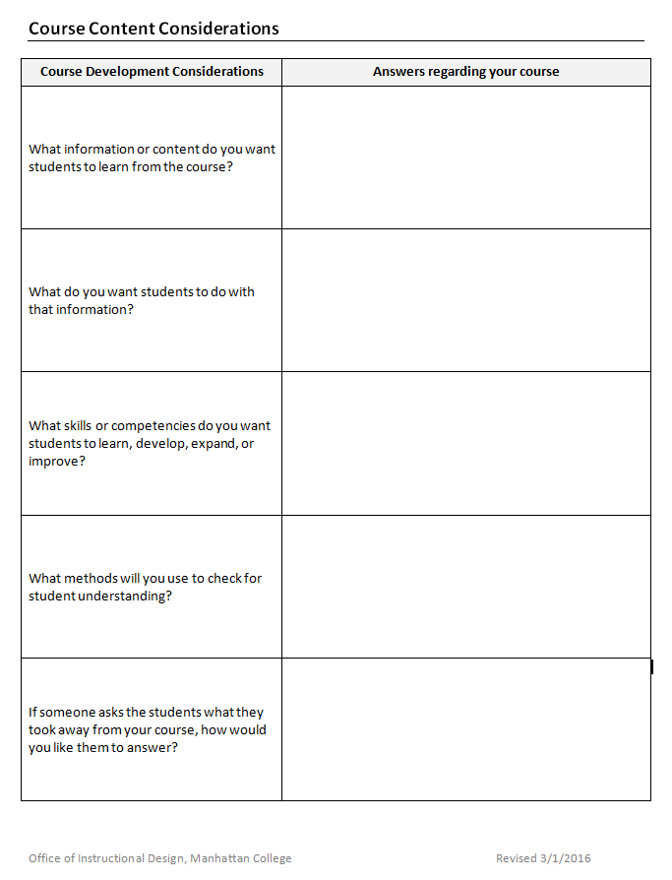

Slide 6
Step 1: The Warm-up
Why it works
  Course designers get to think, write and talk about the curriculum and assessment for their course in a non-threatening and familiar way
  It helps course designers to think about the course in terms of “takeaways” rather than just “content”
  It sets the stage for writing learning outcomes
  It helps the instructional designers learn more about each course and what is important to the course designers

Slide 7
Step 2: Getting to Know Bloom’s
Activity:
Verb Sort
Notes:
How it works
After a brief overview of Bloom’s Taxonomy, course designers sort verbs into the appropriate level category
Course designers discuss and debate their findings with other workshop participants

Slide 8
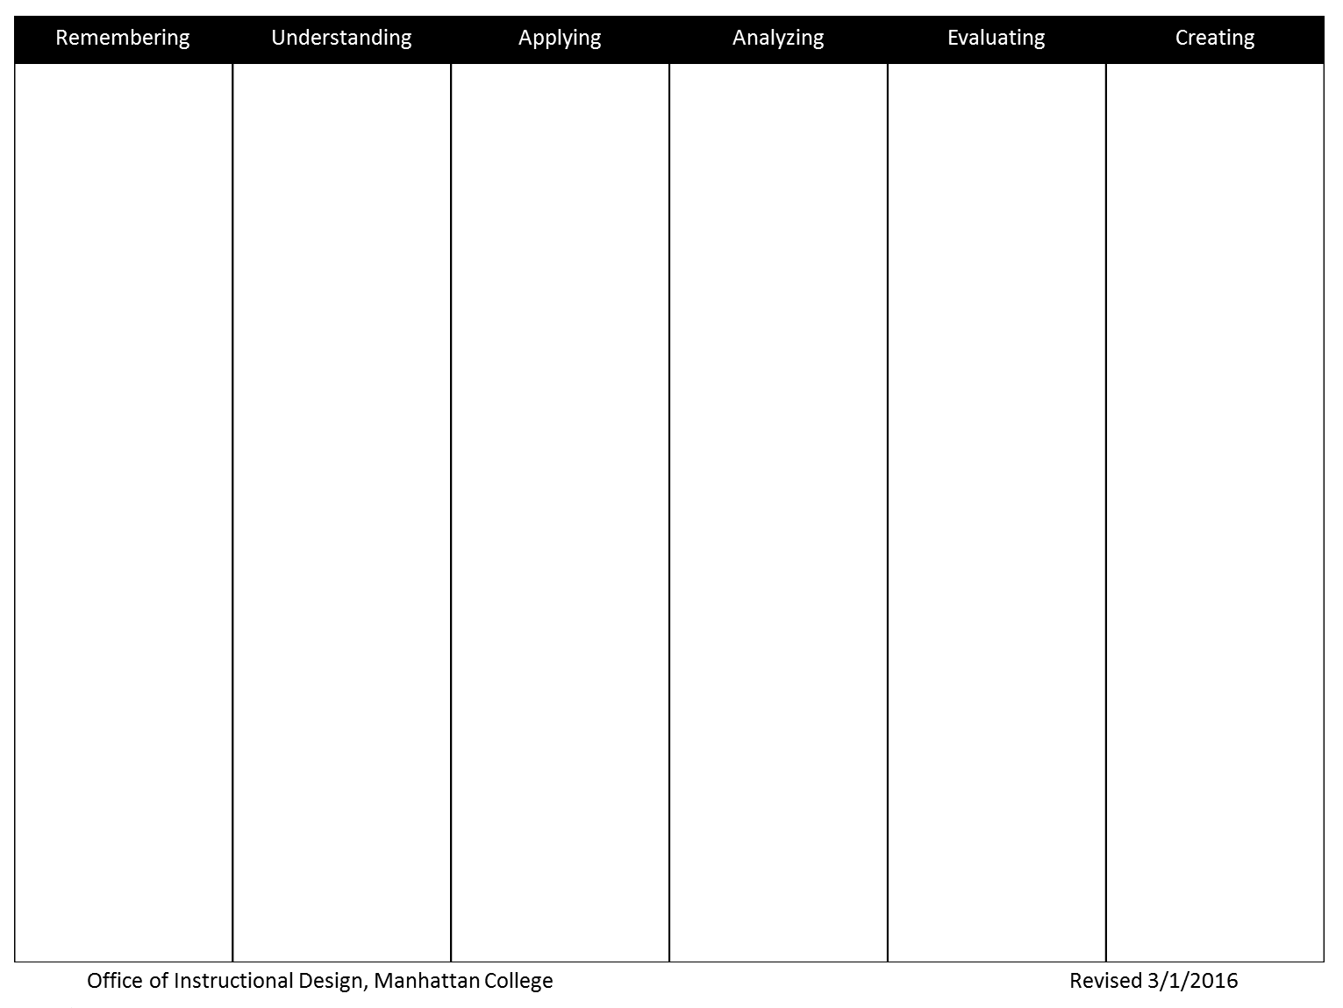

Slide 9
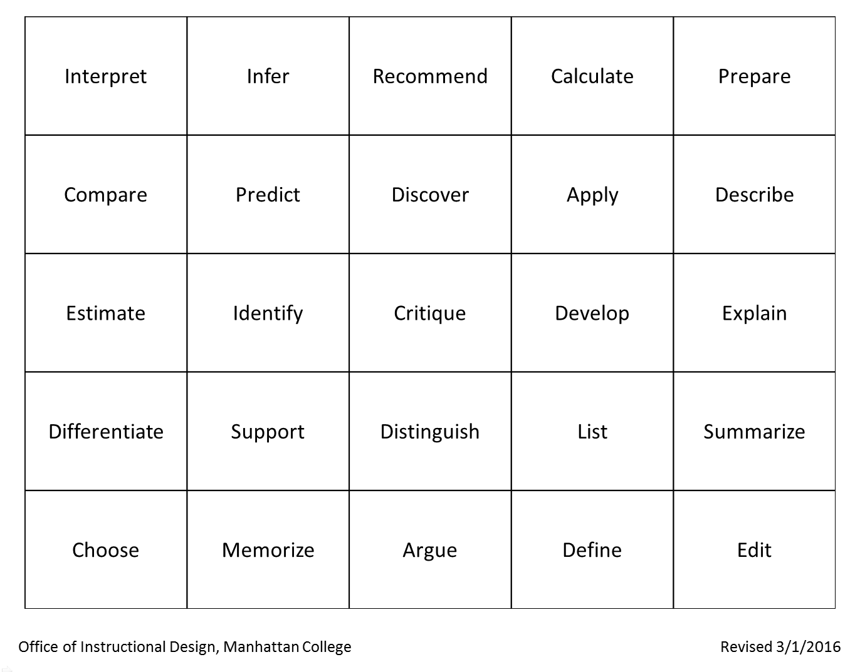

Slide 10
Step 2: Getting to Know Bloom’s
Why it works
  Course designers get to interact with the levels of Bloom’s Taxonomy in a meaningful way
  Course designers gain an appreciation of the importance of nuance in selecting verbs for learning outcomes; that verbs can be understood differently within different contexts and choosing the best possible verb will help clarify the meaning of their learning outcomes

Slide 11
Step 3: Bloom’s as a Tool
Activity:
Verb Wish-List
Notes:
How it works
Course designers are given an extensive list of verbs categorized according to Bloom’s taxonomy
Using a highlighter, course designers select a “wish-list” of verbs to create a “verb pool” they can choose from when writing learning outcomes
Course designers reflect on the verbs selected and the levels of Bloom’s taxonomy that are represented

Slide 12
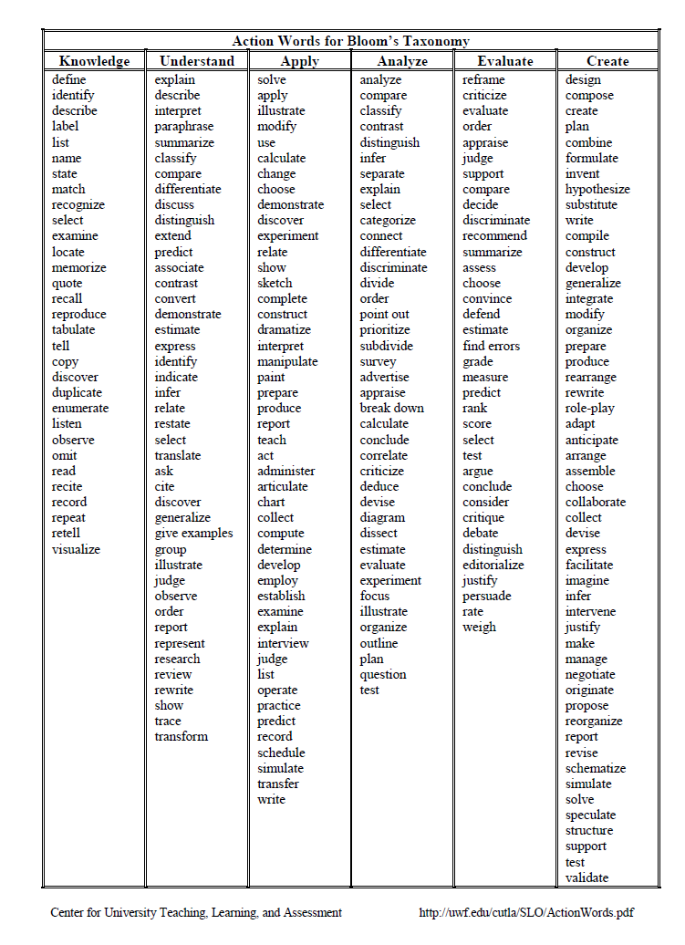

Slide 13
Step 3: Bloom’s as a Tool
Why it works
  Course designers become familiar with a useful tool for writing learning outcomes
  Course designers are given a “head-start” for the actual writing of learning outcomes
  Course designers think carefully about what they want their students to do as part of the course
  Course designers see a visual representation of how their course fits within Bloom’s taxonomy and have an opportunity to reflect on this before proceeding with the writing of the specific learning outcomes

Slide 14
Step 4: Drafting Outcomes
Activity:
Whole Group Practice
Notes:
How it works
Course designers practice writing learning outcomes based on the workshop activities they have participated in
Course designers use their verb “wish-list” to draft outcomes for the first week of their course

Slide 15
Step 4: Drafting Outcomes
Activity:
Writing Week 1 Outcomes
Notes:
How it works
Course designers practice writing learning outcomes based on the workshop activities they have participated in
Course designers use their verb “wish-list” to draft outcomes for the first week of their course

Slide 16
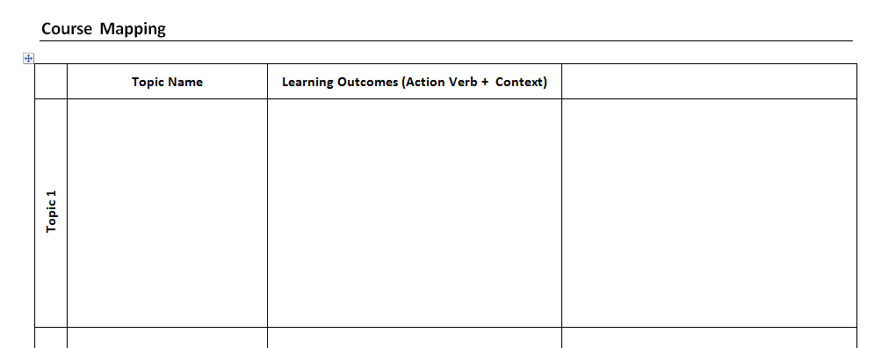

Slide 17
Step 4: Drafting Outcomes
Why it works
  Course designers see how outcomes relate to something that they have experienced
  Course designers have an opportunity to practice before working on their own
  Instructional designers can intervene if any course designers are on the wrong track
Notes:
How it works
Course designers practice writing learning outcomes based on the workshop activities they have participated in
Course designers use their verb “wish-list” to draft outcomes for the first week of their course

Slide 18
Step 5: Identify Assessments
Activity:
Assessment Wish-List
Notes:
How it works
Course designers use highlighters to select assessment strategies they are interested in using from a list of options

Slide 19
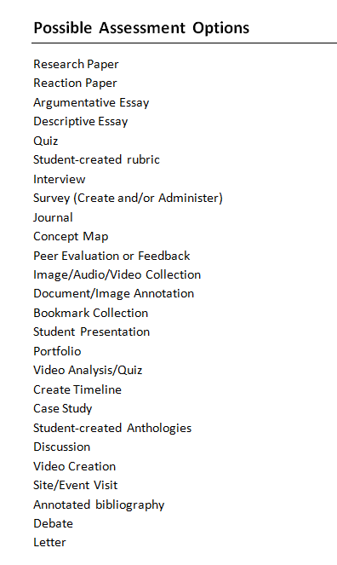

Slide 20
Step 5: Identify Assessments
Activity:
Matching Assessments
and Outcomes
Notes:
How it works
Course designers identify which assessment strategy they will use for each of the learning outcomes they have written

Slide 21
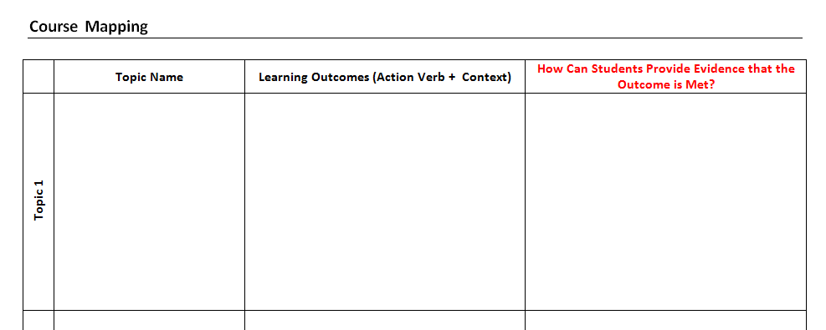
The second workshop focuses on strategies for delivering content and strategies for providing opportunities for students to engage with content and practice skills

Slide 22
Step 5: Identify Assessments
Why it works
  Course designers see first hand how the backward design process works
  Assessments are identified early-on in the process and are not something to be dreaded
  Alignment issues between outcomes and assessments are avoided

Slide 23
How Do Faculty Respond?

Slide 24
Results

