Slide 1

Discussion Points for Launching a QM Initiative in a Community College Environment
Leadership and Engaging Stakeholders
November 3, 2015
Micheline Besner
Harpreet Singh

Slide 2

Learning Objectives/ Discussion Points
Share best practices for continuously improving processes and documents, customized to an institutional landscape.
Identify the key challenges in faculty and management “buy-in” of the QM initiative.
Discuss elements of support for the QM initiative with regards to professional development and building capacity across the institution.

Slide 3

Algonquin College Hybrid and Online Quality Assurance Standards (HOQAS)
Adapted Quality Matters framework and rubric for use within our institutional setting

Slide 4
best practices for continuously improving processes and documents
Discussion Point 1:

Slide 5
Does your institution have a process for reviewing and/or developing online and blended courses?

Slide 6


Slide 7

Reviewer Training

Slide 8
Have you developed documentation for your institution’s QM process?

Slide 9
Hybrid and Online Quality Assurance Standards (HOQAS) Website
http://www.algonquincollege.com/hoqas/

Slide 10
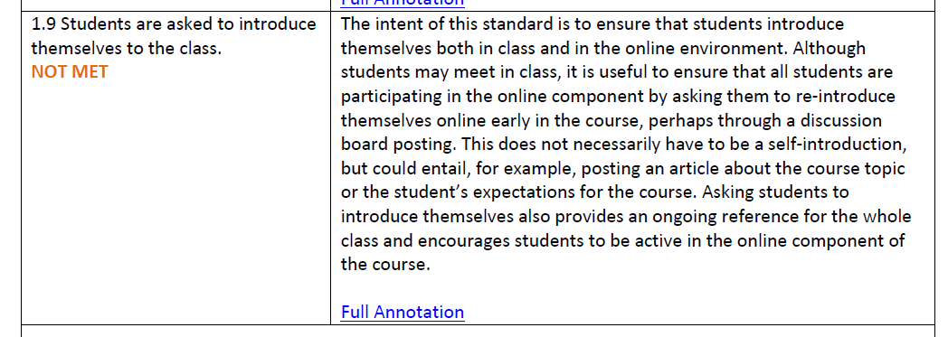
HOQAS Review Report Document - Example

Slide 11
key challenges in creating and maintaining faculty and management “buy-in” for a QM initiative
Discussion Point 2:

Slide 12
What challenges do you face in creating and maintaining faculty and management buy-in for a QM initiative?

Slide 13
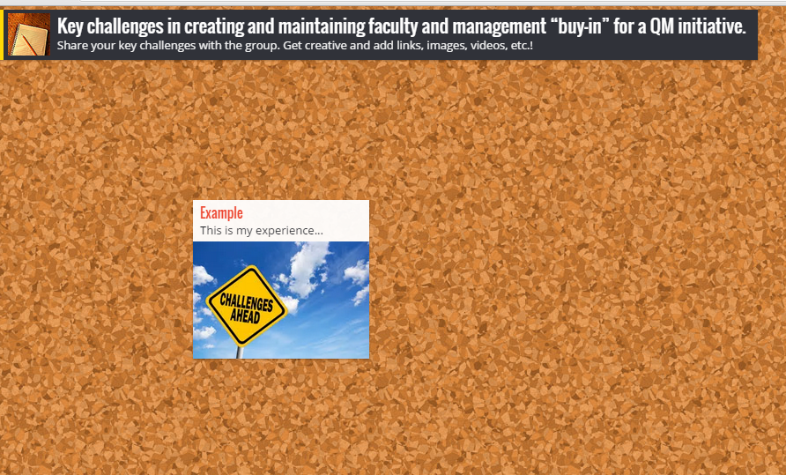
Padlet Board
http://padlet.com/besnerm1/QMchallenges

Slide 14
Our 5 Key Challenges
Reviewing courses that haven’t been designed according to the QM standards
Compensating faculty for making revisions
Receiving a sustainable stream of submissions for review
Creating buy-in for aligning development with the standards
Spreading knowledge about the process and identifying champions

Slide 15
elements of support for the QM initiative
Discussion Point 3:

Slide 16
What elements of support for the QM initiative are in place at your institution?

Slide 17
Professional Development
  Professional Development sessions on designing and teaching hybrid (blended) and online courses
  Proposed creation of course for faculty designing and/or teaching hybrid and online courses

Slide 18


Slide 19
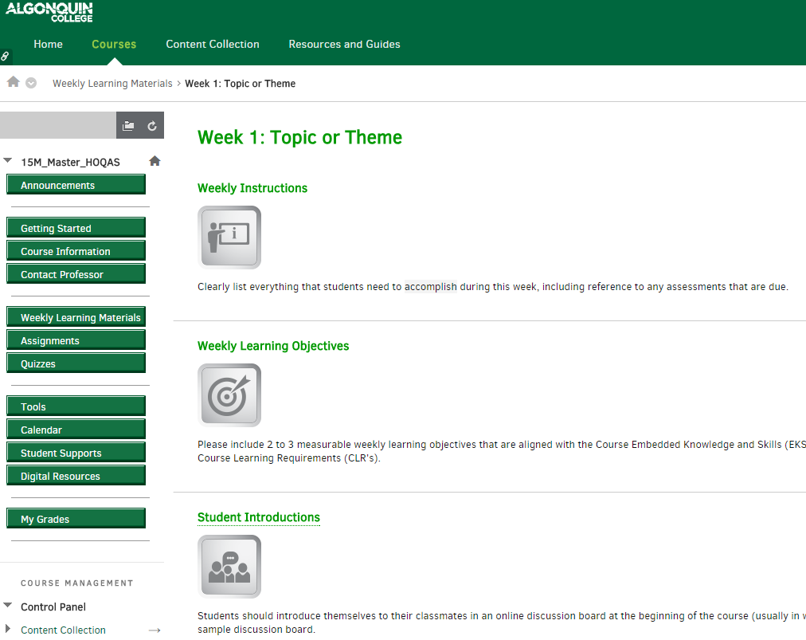
Building Capacity – HOQAS Blackboard Template

Slide 20
Thank you!
Questions?

