Slide 1
QM and Digital Credentialing Along the Oregon Trail: A Convergence of Best Practices from a Two-Year Study and Cross-Institutional Collaboration

Slide 2

A Flashback…Oregon Trail II

Slide 3
Objectives
Differentiate between historical approaches utilized nationally to identify triggers for faculty adoption of QM principles.
Examine the impact of digital credentialing on QM training and faculty motivation, scale and behavioral change.
Assess potential approaches for similar projects at participants’ institutions.

Slide 4
Historical Approaches
Trendlines with QM adoption and reasons are becoming more apparent—
  The sequential QM Success Stories now include 2 years of institutional “stories” about QM
  The QM conference archive lists 4 prior years of conference presentations *
    Adoption
    Implementation
    Digital badging
      Melissa Edwards, Montana State University – Northern, Badges? We Ain’t Got No Digital Badges
    * This does not include a review of QM Regional Conferences
    Website: https://www.qualitymatters.org/past-conference-presentations

Slide 5
What Can We Do to Address Different Stakeholders?
QM Champions
Faculty
CAO / Provost
Institutional Effectiveness

Slide 6
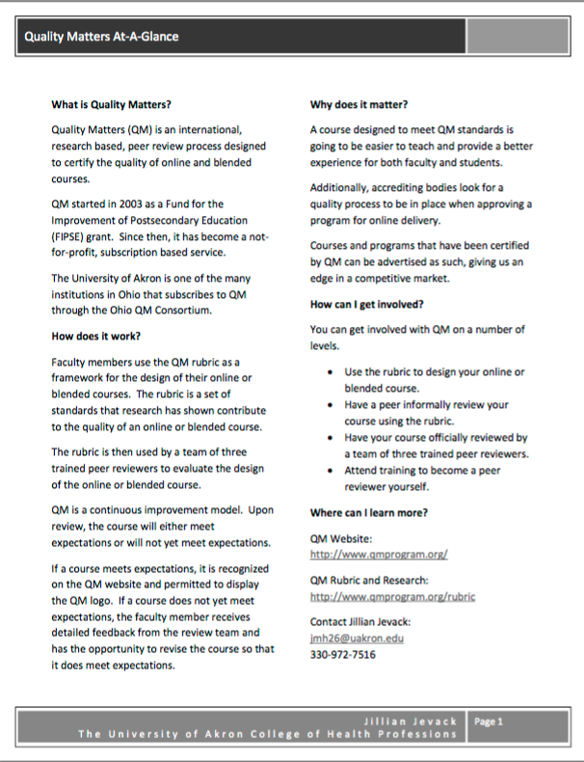
Consider Developing a Handout to Share with Stakeholders
Developed and shared by Jillian M. Jevack, QM Instructional Designer at 2012 QM Conference
Visit https://www.qualitymatters.org/4th-annual-conference-presentations
Search for word “Jevack”
At-a-Glance Document:
What
How
More Info

Slide 7
Consider a QM Faculty-in-Residence Program
eLearning Faculty in Residence
  Faculty Receives a Stipend, Work 10 hours a week with the eLearning Department
  At Kathleen’s institution, faculty was already a QM Master Reviewer
  This facilitated other development of QM
Consider developing a student fee – create a new fee to compensate faculty
  Won’t work? Consider release time
  Approach a VP of Instruction – can they establish a fee?
Get Creative
  Offer to Pay for QM course and QM trained faculty who would then review two courses
Connect the proposal to the university mission
Shared by Kathleen Chambers, QM Coordinator at North Seattle College, 2014 QM Conference
Visit https://www.qualitymatters.org/2014-annual-conference-presentations
Search for “Introducing QM to Tough Customers”

Slide 8
Consider development of a course template meeting half of QM standards
New Mexico Community College:
  Implemented QM through use of a course template:
  Template met 50% of QM Standards
  Remaining standards were addressed by faculty: instructional activities, assessments, etc.
Presentation led by Bonnie Bailey, Patricia Miera and Brian Sailer at Central New Mexico Community College
2013 QM Conference
Visit https://www.qualitymatters.org/2013-annual-conference-presentations
Search for “Creating a Quality Matters Culture”
University of Mississippi Medical Center:
  Implemented QM prior to undergoing LMS transition
  Head-start for faculty—course template now incorporated all of QM section 1 and 7, most of 2 and 8
    Presentation by Terry Pollard and Rebecca Butler at University of Mississippi Med Center
    2015 QM Conference
    Visit https://www.qualitymatters.org/7th-annual-qm-conference-presentations
    Search “Transition Lassoed by QM: Capitalizing on a New LMS by Integrating QM Principles in Training”

Slide 9
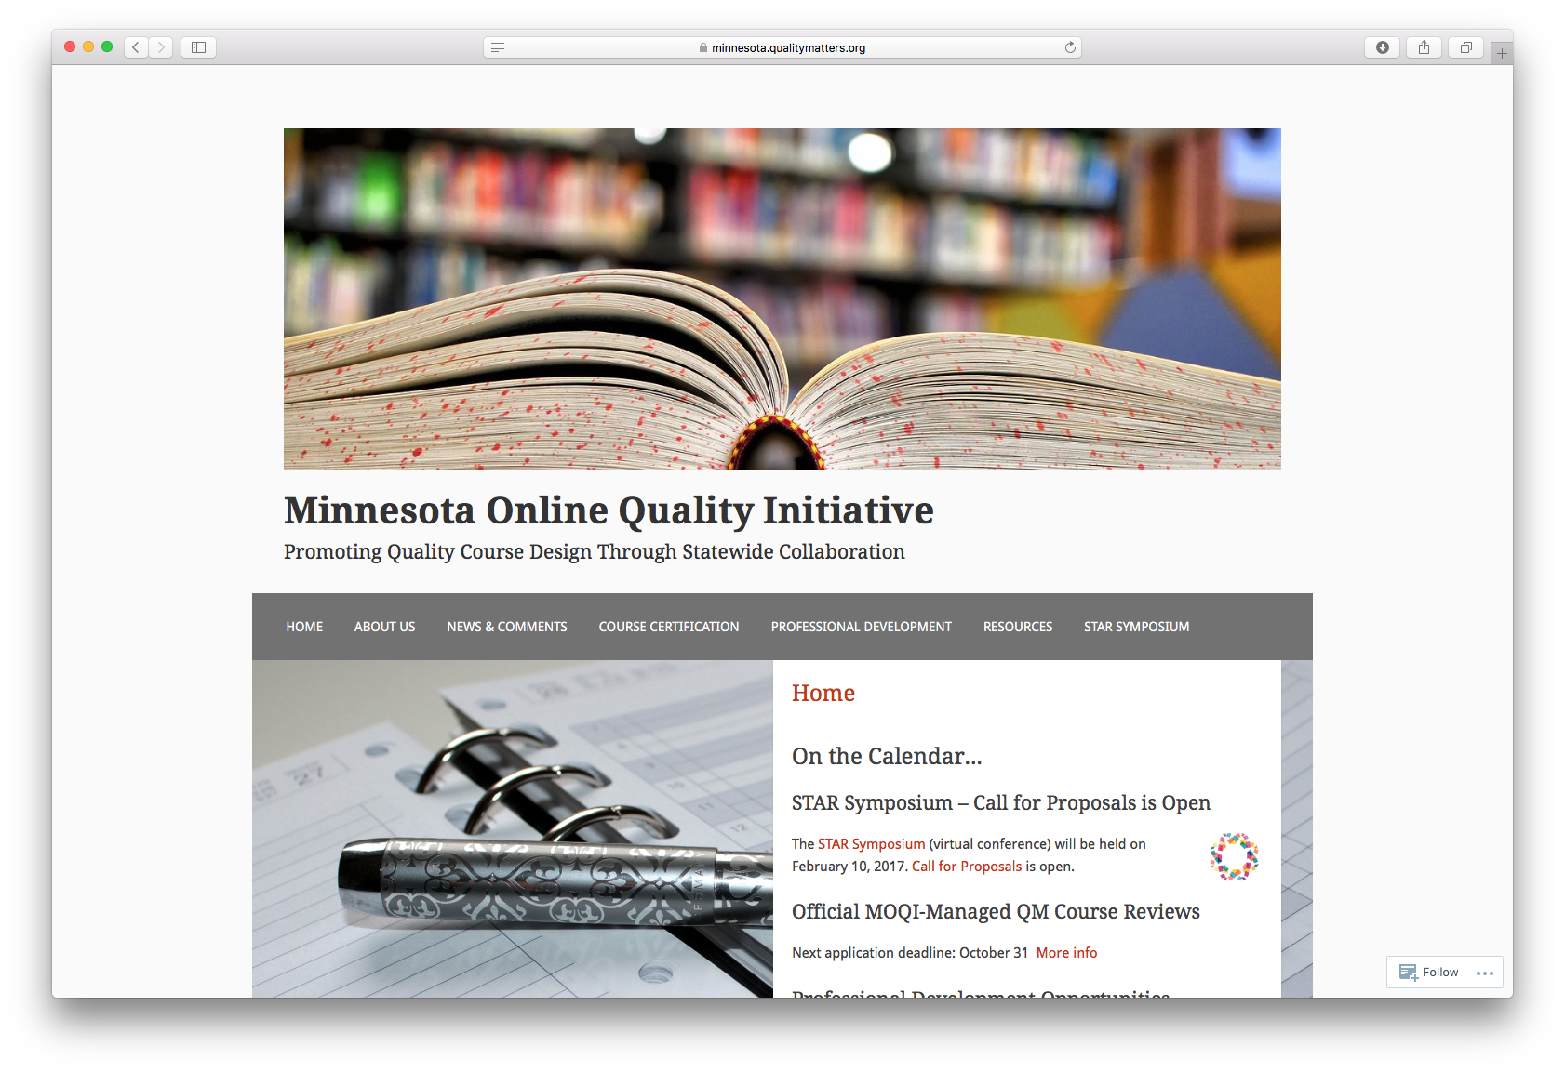
Consider other statewide adoptions
West Virginia in 2012
  One representative trained from all institutions of higher ed
  317 faculty were trained in 9 month period
    Presentation led by Dr. Roxann Humbert, Statewide Director of Higher Education e-Learning, West Virginia Higher Education Policy Commission and Dr. Monica Garcia Brooks, Asst. VP for Information Technology at Marshall University
  Minnesota in 2013
    https://minnesota.qualitymatters.org

Slide 10
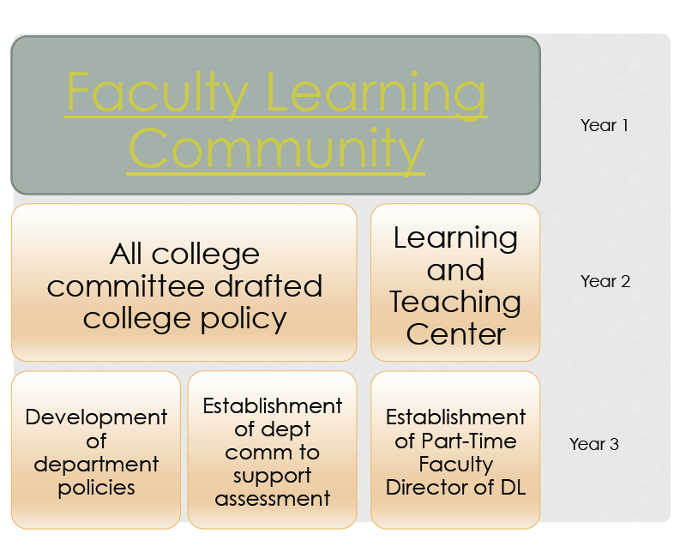
Consider Policy Development
Consider a longer timeframe to implementation
  Creating Institutional Policies that Incorporate QM Roundtable by Pam Rankey, Ruth Benander, and Ann Witham, University of Cincinnati Blue Ash College, Ohio, 2013

Slide 11
Ideas from Conversations, Presentations
What leads to QM buy-in?
  Portfolio Development
  Evidence for Promotion and/or tenure
  Top-down approach – new policy or procedure
  Bottom-up / word-of-mouth
  Centers for Teaching and Learning / Investments in ID and elearning staff
  Financial incentive for faculty
  If you can find those early adopters...

Slide 12
What is a Digital Credential?
“Badges are digital tokens that appear as icons or logos on a web page or other online venue. Awarded by institutions, organizations, groups or individuals, badges signify accomplishments such as completion of a project, mastery of a skill, or marks of experience.”
7 Things you Should Know About…Badges http://net.educause.edu/ir/library/pdf/eli7085.pdf
“Today’s badges are digital credentials that represent skills, interests, and achievements earned by an individual through specific projects, programs, courses, or other activities. There is a learning ecosystem behind the badges that make them powerful and connected credentials. This ecosystem is made up of badge ‘issuers,’ badge ‘earners,’ and badge ‘consumers.’
Expanding Education and Workforce Opportunities Through Digital Badges http://all4ed.org/reports-factsheets/expanding-education-and-workforce-opportunities-through-digital-badges/

Slide 13
Benefits of a Digital Credentialing Program
•Evidence-based with clear criteria
•Portable
•Shareable across multiple platforms
•Reporting allowing for greater insight
•Holistic representation of achievements
•Progress tracking for learners
•Metadata for faculty to evaluate learning

Slide 14
UMMC Pilot Project
•One year pilot during the 2016-2017 academic year
•Partnering with Credly Inc.
•Quality Matters in SON and SHRP
•Quantitative and Qualitative Research to measure perceptions and participation

Slide 15
Intended Outcomes:
•Evaluate Faculty Perception of Digital Credentialing
•Evaluate Credly as vendor and explore other potential vendors (Badger, Acclaim, etc.)
•Create standardized badges
•Explore interfaces to existing systems (HealthStream, Canvas, My Site)
•Recommend governance model
•Examine Scalability

Slide 16
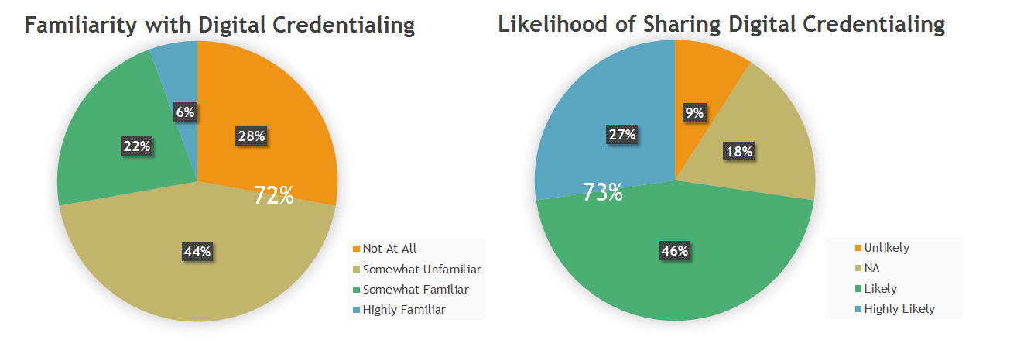
Pre-participation Survey Results

Slide 17
Post-Participation Evaluation
Survey
  potential changes in perception
  value/usefulness
  usage at UMMC
  willingness to use for student instruction
Usage Metrics from Credly Application
  Number Awarded
  Number Claimed
  Number shared to social media
  Number downloaded

Slide 18
QM Training
Faculty have the option to complete the training in-class or online.
QM Training consists of 5 courses.
Participants learn about QM, complete individual self-assessments, and spend time evaluating their courses with instructional development staff.
Upon completion of the training, participants receive a UMMC Level 5 Badge, as well as the QM credential.

Slide 19
QM Series – Course 1
Course 1 - Orientation and the Quality Matters Rubric
  Overview of Quality Matters
  The Course Review Process
  The Rubric
    Assignments:
      Complete Course Survey
      Mini-Course Review
      Complete Quiz 1

Slide 20
QM Series – Course 2
Course 2 – Course Objectives and Alignment
  Importance of Course Objectives and Alignment
  The Course Blueprint
    Assignments:
      Complete the Course Blueprint

Slide 21
QM Series – Course 3
Course 3 – Self-Review
  Review the Rubric
  Annotations
  Overview of Next Steps
    Assignments:
      Complete Course Self-Review

Slide 22
QM Series – Course 4
Course 4 – Consultation and Course Preparation
  Consultation with Instructional Development Team
  The Course Review Worksheet
    Assignments:
      Complete Course Review Checklist
      Final Course Preparation
      Submit to QM
      Complete Course Survey

Slide 23
QM Series – Course 5
Course 5 – Final Course Review
  Meet with Review Team
  Make Final Course Revisions
    Assignments:
      Receive QM Certification

Slide 24
Open Discussion
How has your institution implemented QM?
What worked well?
What recommendations would you share with other institutions seeking to Utilize QM to Achieve QA?
Details, please!

Slide 25
Presenters
Christian Pruett, PhD, Assistant Professor and Director of Instructional Development and Distance Learning, UMMC School of Nursing, cpruett@umc.edu
Terry Pollard, Assistant Professor and Director of Instructional Development and Distance Learning, UMMC School of Health Related Professions, tpollard@umc.edu
Heidi Shoemake, Senior IT Program Manager, Division of Information Services, hshoemake@umc.edu
Rebecca Butler, Assistant Professor and Coordinator of Instructional Development and Distance Learning, UMMC School of Health Related Professions, rbutler@umc.edu

