Slide 1
Instructional Design Groundwork:
How to build an online faculty community using a
Canvas course

Slide 2
Outcomes for Community Development
During sessions, attendees will productively engage with other faculty to construct and contribute ideas to a scholarly teaching knowledge base.
Outside of the sessions, attendees will create a peer support network throughout the course and share ideas/resources in the course wiki.
Following each quarter’s session cycle, attendees will seek out other professional development opportunities such as the Course Design Institute or Innovations Academy to create and refine new instructional skills.
Throughout the year, attendees will recruit and appoint other faculty peers to attend the course sessions.

Slide 3
Stages of Community Development
Interaction- Weekly progression that includes robust dialogue with other attendees
Motivation- Trust established within the community
Mobilization- Community comes forward and takes action to resolve their issues
Self-reliance- Community becomes partially or fully capable of sustaining the momentum of activities

Slide 4
Stage 1: Interaction
Faculty discusses presentation topic.
They begin to perceive that they share some common experiences.
They exchange ideas in order to get feedback and to help other faculty.

Slide 5
Stage 2: Motivation
Faculty exchange ideas and this collaboration begins to build trust in the group
They begin to connect with each other outside of the meetings as a means for peer support
They begin to think about their instruction more in terms of development and enrichment

Slide 6
Stage 3: Mobilization
Faculty begin to see areas of instruction that they would like to improve
They begin to seek out more opportunities that support their vision
Their peer support continues to help motivate the group into seeking out development opportunities

Slide 7
Stage 4: Self-reliance
Faculty become master innovators and leaders in their pedagogical practices
They support other faculty and bring new faculty into the community
Instructional innovation and efficacy increases within the institution

Slide 8
Canvas Users Learning Together(eCULT)
Elements of the Course:
Updating Welcome Page weekly
Creating a Face to Face Conversation Space
Creating an online Conversation Space using Canvas tools
Leading weekly Sessions on various topics

Slide 9
Welcome Page
Welcome to eCult(Canvas Users Learning Together)
As we head into fall quarter, eCULT (Canvas Users Learning Together) is going to broaden its offerings for informal faculty professional development. In short, if you want to talk about teaching with other teachers, then eCULT is for you! Our main focus will be on educational technology with Canvas, but we’ll also discuss other methods of engaging students. A community for teachers created by teachers!
Go to course

Slide 10
Creating a conversation space
If you answer yes to any of the following questions, then you have something to contribute:
Do you teach an online, hybrid, or web-supported class?
Would you like a place to talk about this mode of teaching with other teachers?
Are you looking for new ways to think about teaching and learning?
Do you have iPad tips and tricks to share with others?
Are you interested in how other faculty use Canvas?

Slide 11
Canvas Tools for Communication
Discussions- Keeps up weekly interactions on particular topics of interest
Conferences- Allows members to attend who would otherwise not be able to make it with sharing a desktop and/or files.
Collaborations- Engages attendees to contribute and keep up the feeling of involvement.
Pages/Wikis- Attendees can feel productive and engaged with building community resource pages

Slide 12
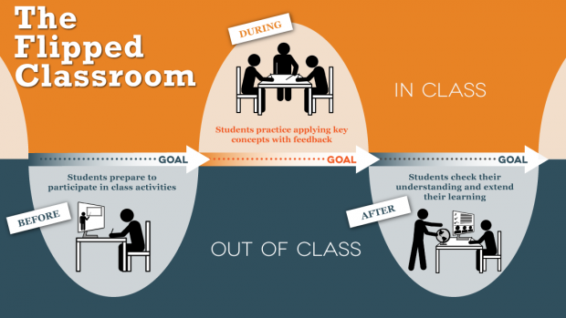
Sessions
Flipped Classes
What are the best ways to integrate Flipped strategies into your course design? How can you use Flipped design classes to reach all types of learning styles?

Slide 13

Sessions
Universal Design with Canvas
Support & Accessibility: how do you help students with technical problems and support? How do you make your class accessible to all learners? What can we do to support Universal Design principles?

Slide 14
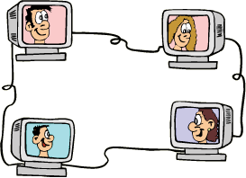
Sessions
Netiquette
Online interactions: how do you promote active learning, create connections, and engage students? What are the challenges of synchronous learning? How do you manage activities such as discussion boards to ensure civil and enriching interactions?

Slide 15

Sessions
Academic Dishonesty and eLearning
What are some signs that can indicate academic dishonesty in an online, hybrid or web-enhanced format? What are some methods to improve authentic sourcing and submitting?

Slide 16
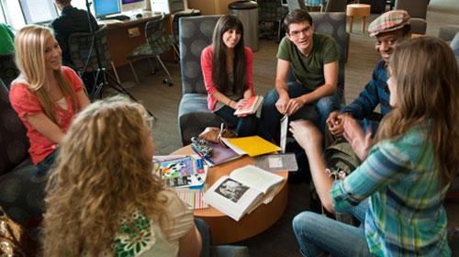
Sessions
Motivation for the Online Student
Design and student engagement: how do you increase student input, design creative assignments, and set an engaging
tone online? How do you build an online
community, create consensus, design reflective
exercises, and/or encourage critical thinking?

Slide 17

Sessions
Designing for Generation Z
What are the main characteristics of a Generation Z Learner? How can we design our Web-enhanced, Hybrid, and Fully online courses to meet the needs of the Gen Z learner? What are some observed differences between Generation Z and other Generations in the classroom?

Slide 18
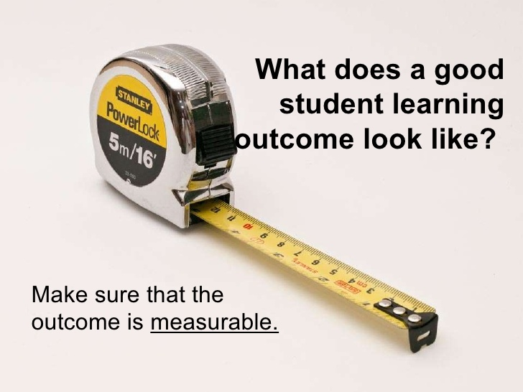
Sessions
Outcomes Assessment in eLearning Courses
Online Assessment: how do you assess learning objectives and how do you explain grading policies and criteria? How do you know they “got it” in your OL or HY course? Learning objectives: how do you define and align learning objectives in your class? Do we have to work harder to help students make those connections in OL and HY courses?

Slide 19
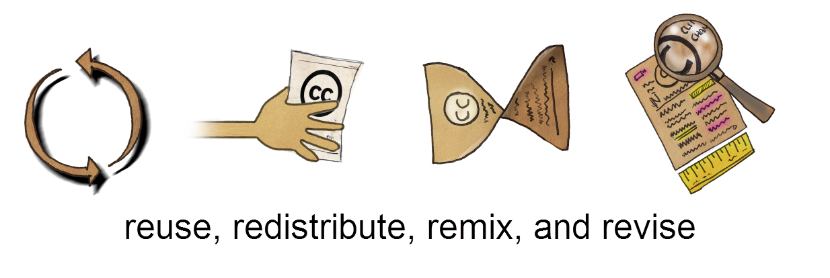
Sessions
Using Open Source Technology with Canvas
Online resources: how do you use open online source materials in your class to attain learning objectives? Share what’s the most useful open source material outside of the LMS.

Slide 20
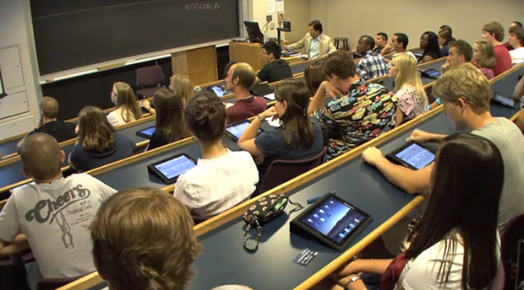
Sessions
iPad Share Out
What are you doing with your iPad in the classroom? Share your best App. Tell others what you are doing.

Slide 21

Sessions
Summer/Fall Course Planning Ideas for Canvas
eCULT attendees will be polled prior to this meeting. Navigating online classes: how do you design effective online courses? What changes are you going to make for next quarter? We’ll examine a course with a limited design from the student’s perspective.

Slide 22
Qualities to Sustain a Community
Social Qualities- Elements of peer relationships that allow members to feel connected through their socioemotional interactions
Technical Qualities- Elements of peer relationships that allow members to feel challenged through cognitive enrichment
The inclusion of both qualities build a greater sense of personal and professional self-efficacy which can maintain momentum towards a professional development community

Slide 23

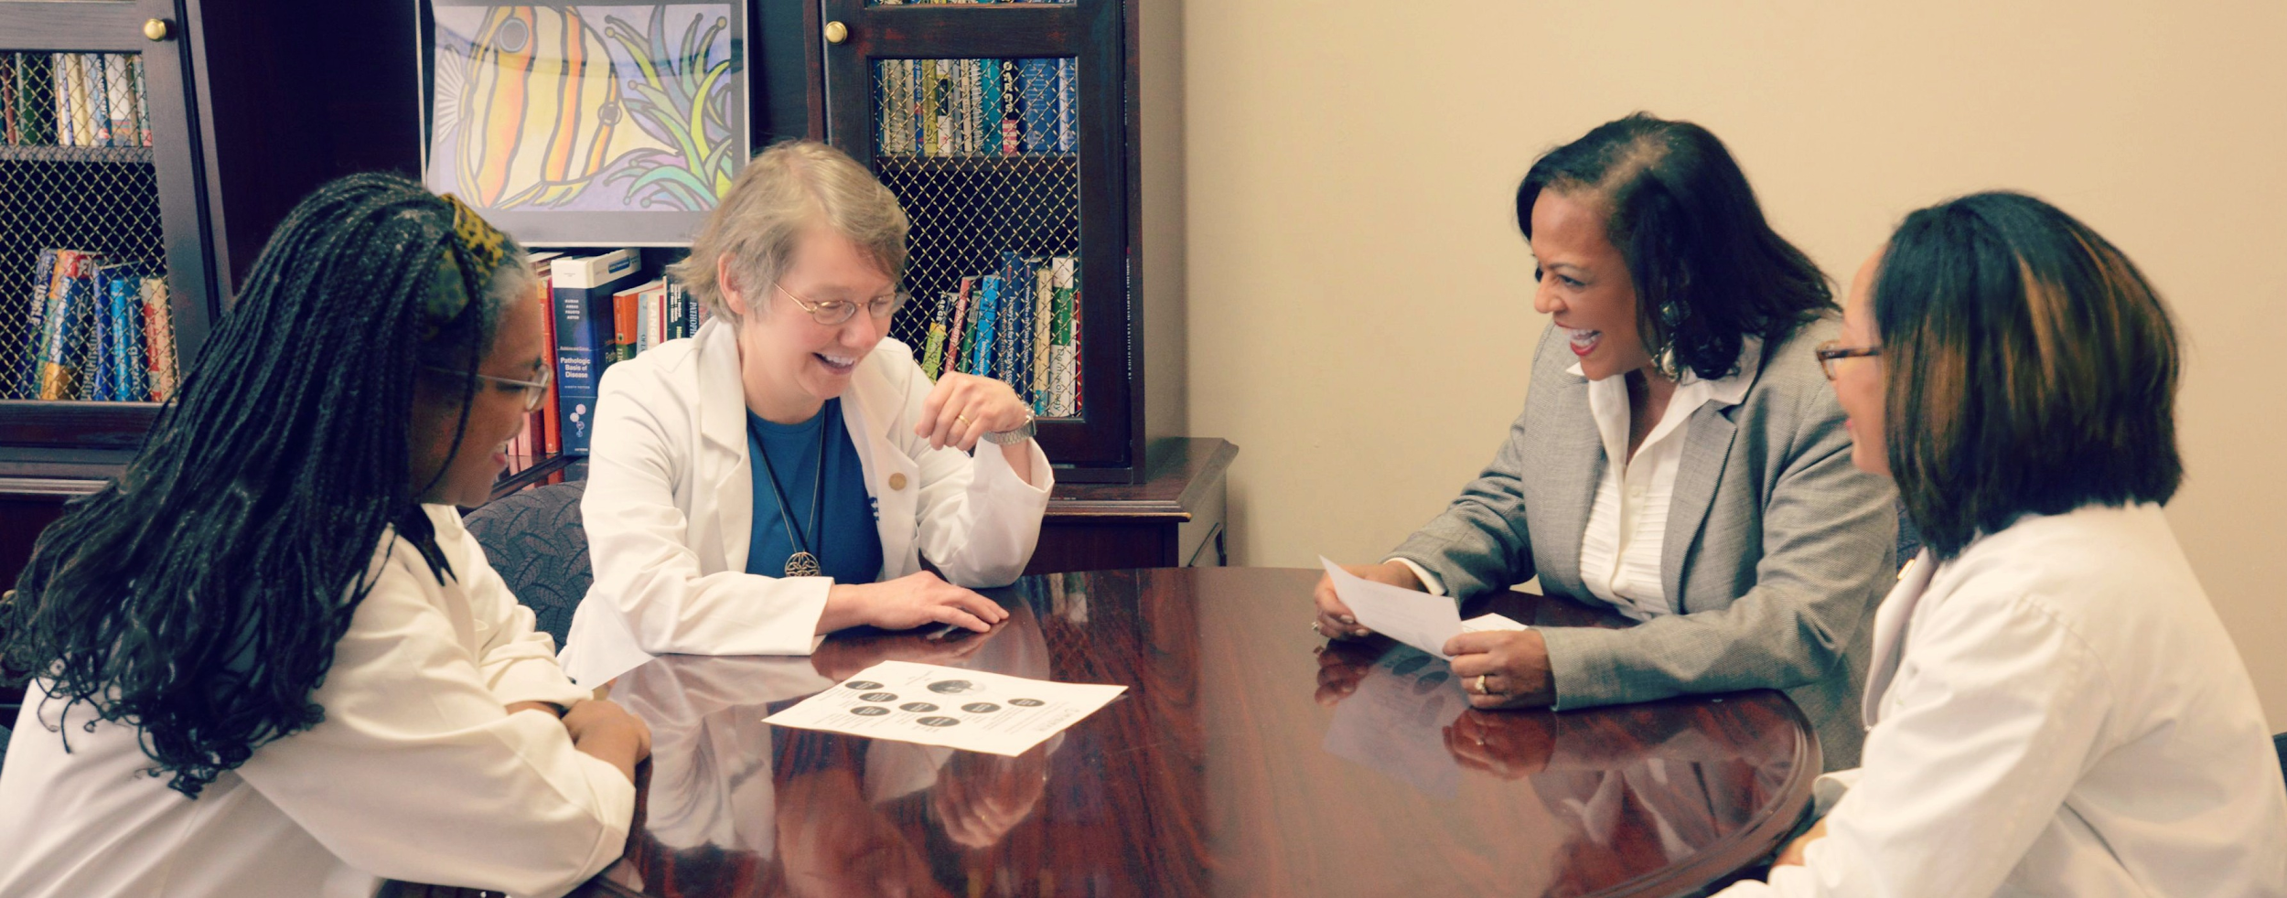
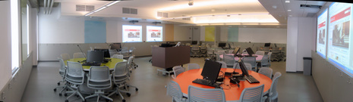
Social Qualities for Faculty Community Development
Safety and Trust
Openness
Respect
Responsiveness
Collaboration
Relevance
Challenge
Enjoyment
Empowerment

Slide 24
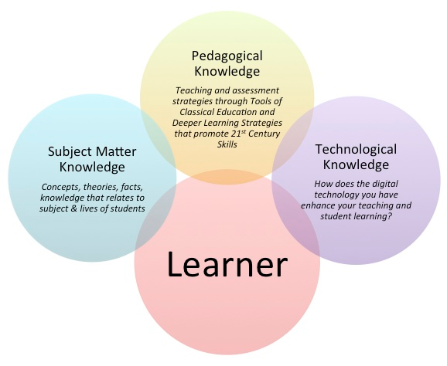
Technical Qualities in Faculty Community Development
TPACK:

Slide 25
References
FLC Qualities- US Department of Education Fund for the Improvement of Post-Secondary Education (FIPSE) and the Ohio Board of Regents.http://www.units.miamioh.edu/flc/qualities.php
Qualities image- http://www.msm.edu/Education/QEP/LearningCommunities.php
Qualities image- www.mcgill.ca
Qualities image- http://recyclewithkbk.podbean.com/e/sustainability-at-everett-community-college/
4 stages of Community Development- http://www.aku.edu/mc-pk/departmentprofiles/communityhealthsciences/Pages/UHP.aspx
http://www.sun-associates.com/tlresources.html
Technological Pedagogical Content Knowledge(TPACK)- http://successfultechnologyintegration.weebly.com/instructional-design-models.html
5 Stages of Community Life- https://buildingdialogue.files.wordpress.com/2010/09/5stages.pdf
Stages in group development- https://www.learning.ox.ac.uk/media/global/wwwadminoxacuk/localsites/oxfordlearninginstitute/documents/supportresources/lecturersteachingstaff/developmentprogrammes/StagesinGroupDevelopment.pdf
flipped class image- http://ctl.utexas.edu/teaching/flipping-a-class
UDL image- https://competition.adesignaward.com/competitions/universal.html
netiquette image- https://everettcc.instructure.com/courses/1054908/pages/netiquette-game
academic integrity image- http://academicintegrity.rutgers.edu/resources-for-students
student engagement image- http://www.evansville.edu/studentengagement/organizations.cfm
generation z image- http://www.icademyglobe.org/article.php?id=1047
outcomes image- http://www.slideshare.net/Joe_McVeigh/writing-effective-learning-outcomes-9985003
oer image- http://indesvirtual.iadb.org/course/index.php?categoryid=18
ipad image- https://sites.google.com/site/drnormanherr//workshops/ipad-workshop
planning course image- http://www.theeducators.co/blog/wp-content/uploads/2013/05/planning
TPACK image- http://www.brightmindsconnect.com/

