Slide 1
Through the Looking Glass: Examining QM through Different Lenses in the Development of an Online EMBA.
Presenters:
Dr. Karen Donovan
Ms. Cindy Hart &
Dr. Elizabeth Vitullo

Slide 2
Overview
We will discuss a case study of online program development of the Executive MBA program and implementation of the QM process from inception to review.

Slide 3
Objectives
Discuss models or processes that can be utilized at home institution.
2. Identify concerns/considerations for each stakeholder.
3. Describe strategies to create buy-in of the Quality Matters (QM) process from faculty.

Slide 4
University Perspective
State of West Virginia adopted QM in 2012.
All online courses must meet QM standards by 2016.
Critical to develop and implement a process to meet QM standards.
Important to leverage university, college and faculty support at all stages of the QM implementation.

Slide 5

Partnerships
WVU originally planned to have courses reviewed through QM or the state committee; however due to budget cuts, it was decided in late 2013 that institutional reviews would be conducted.
This required that Academic Innovation partner with colleges to train faculty to become peer reviewers and identify internal review teams.

Slide 6


Program Quality
Given the importance of institutional reputation and the competitive nature of the distance learning market, it was essential that the EMBA online program meet the same high standards as the face-to-face courses/program.

Slide 7
Program Development
iDesign staff dedicated to development of the online EMBA program
  3 instructional designers
  2 instructional designers
Grants
  Academic Innovation contributed $28,000 in funding for course development of seven courses.
  Courses had to go through an internal review to be sure courses met QM standards prior to faculty being issued $4,000.

Slide 8

Program Support
Faculty and support staff were required to attend training prior to program launch.
  Navigating the LMS (Blackboard)
  Understanding the gradebook
  Incorporate synchronous tools
Support didn’t end upon the launch of the program. Academic Innovation and Information Technology Services continue to provide design and technology support as needed.

Slide 9






Program Perspective
WVU’s Online Executive MBA
Award Winning Faculty

Slide 10
WVU Executive MBA History
Program Inception
Face-to-face delivery across the state
  Program structure – 48 credit hours
  Classes 2 evenings week from 6-9pm
  Target market – professionals
Market realities and opportunities
Academic Innovation Grant

Slide 11
Working with the Faculty
Change is difficult ☺
Invited select faculty to participate
Faculty paired with designer – QM standard
Six month lead time for course development
Regular check-ins with faculty

Slide 12
Online Best Practices Meeting
Started early in the process of transitioning to online
Faculty shared accomplishments, frustrations, resources, etc.
Presentation by course designers and other experts
Once the program was up and running, presentations transitioned to best practices in teaching and other issues related to online learning

Slide 13
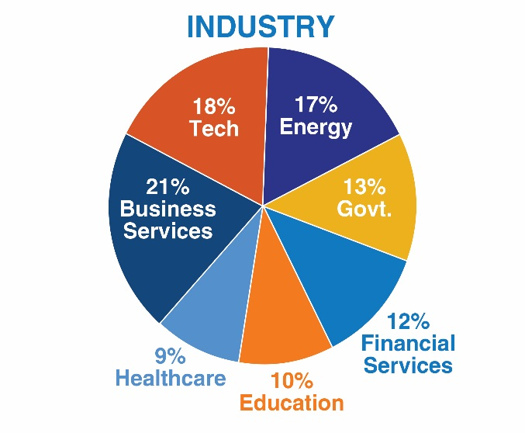
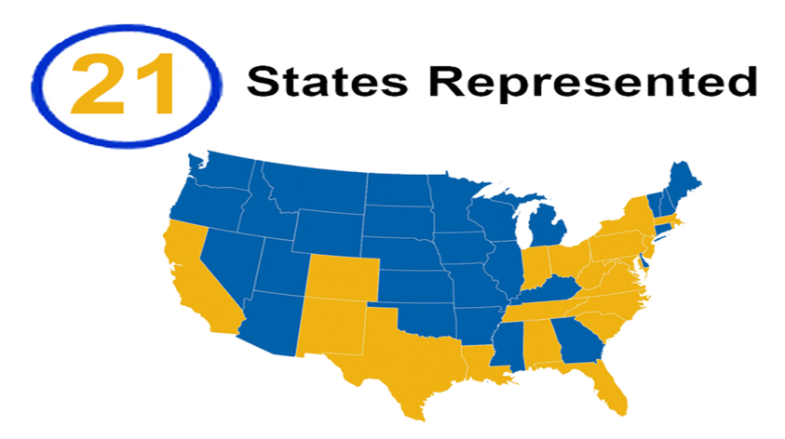
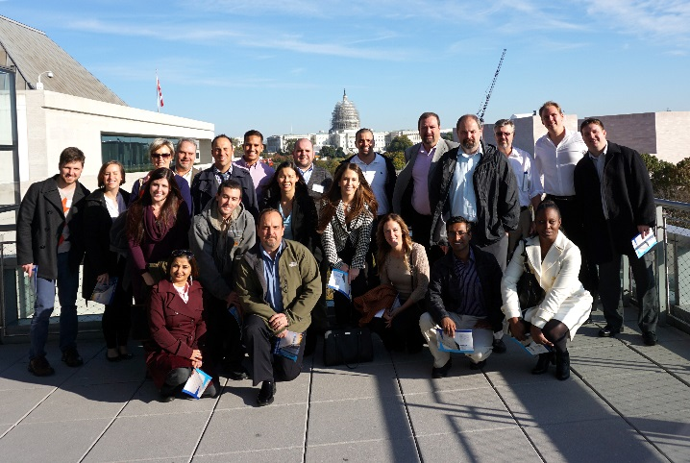
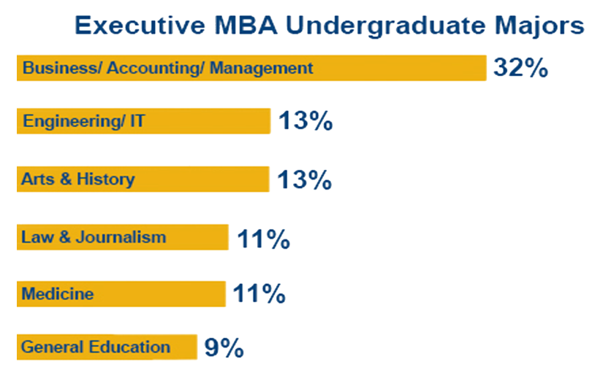
Executive MBA Student Profile

Slide 14
QM & the Executive MBA Program
Created a framework and set expectations for courses
Discussed as part of the recruitment process as a differentiator
Inclusion of the QM standards in program details for ranking surveys
Provides an iterative process for review of courses

Slide 15
Closing the Loop:
Reviewing and Revising Courses
WV approved as a member of SARA 2014
HEPC mandates that all online courses and programs at state institutions must meet QM standards by 2016.
WVU decides to conduct institutional reviews

Slide 16

Panic sets in….
70 online courses offered by the College…..

Slide 17

Regrouping to Creating Faculty Buy-In
Spring 2014 Wish List
  Two or more faculty from each discipline
  Make the process easy
  Secure funding for an incentive structure
  Continued cooperation
  Quality reviews

Slide 18
Phase I: Applying the Rubric
Two full-day sessions scheduled at the College
  One in May and one in July
QM trainers conducted the session
Bribe them with food ☺
University facilitated interface with QM for Phase II

Slide 19

Phase II – Peer Reviewer Course
Goal: have training completed by the start of Fall Semester
Compensated after Phase II completed
20 reviewers trained to date!

Slide 20
Process
Teams of three created
  Content matter expert serves as team leader
Only courses offered more than 1 time were reviewed
University provided organizational support and interface with the QM system
Ample time to compete reviews
  8 weeks so 2 per semester for each team

Slide 21

Team Effort !!
Communication
Feedback
Common problems revamped at College level
The process is working really well!

Slide 22
Thank You
Questions?

