Slide 1
Applying Quality Matters Standards To a Hybrid Nursing Research Course
Improving Student Engagement
Melissa McNeilly, MSN RN
Quanza Mooring, PhD RN
QM Regional Conference
March 18, 2016

Slide 2
Objectives
Identify strategies for application of QM standards in a hybrid/blended course.
Discuss the importance of course alignment for hybrid/blended courses.
Identify strategies to combat resistance to implementation of QM standards in hybrid/blended courses.

Slide 3
How many of you have taught a hybrid course?
Please answer at the following website:
    Kahoot survey
From your phone go to Kahoot.it and enter the PIN seen on the screen.

Slide 4
Nursing 470: Research for Evidence Based Practice
Offered for 4 year BSN students
The class is held one day a week:
    In-person (11 sessions)
    Online (4 sessions)
It is also offered completely online through the RN-BSN
Each session is 1 hour and 50 minutes
Notes:
This course is a true hybrid course in that it only meets one day a week. 4 out of 15 class days would be online and not face-to-face.
This course is also offered in the RN-BSN program. Which is a completely online program.

Slide 5
Before QM
Dissatisfied students
Activities did not meet course objectives
Poor understanding of course content
Survey from first day of class
Notes:
The course contained article critiques, review of literature, and a discussion board to allow students to answer a question about research. This was the students first and only course related to research. The assignments were based on a higher level of knowledge and research skills which the learner did not yet possess. The students were confused and struggle with the course. The assignments were created for the higher level students in an online environment. Students felt the course was a waste of time and not beneficial to their learning. The students did not understand why research in nursing was important or how it applied to them.

Slide 6
Deciding on QM
Better course design and delivery
Alignment of course objectives and assignments
Meaningful faculty/student engagement
Enhanced knowledge acquisition for learners
Notes:
QM is mainly associated with the online method of instruction. In applying the standards, to the nursing hybrid research course that overall delivery and outcome of the course was impacted. Originally the course was very tiresome and confusing for the students. The face-to-face portion consisted of power points reviewing the material in the text book or questions to answer from the students reading. The interaction between professor and student was limited. The students just memorized the material, not fully understanding the content,
The assignments and lecture did not fully meet the course objectives.

Slide 7
Process to Change Course
Observe and gather data
Review QM standards
Apply the QM standards to the course
Align the objectives and assignments
Notes:
When a new faculty took over the course (Quanza) the first semester the course was taught as previously taught. (Spring of 2014) Notes were taken and student evaluations of the course were reviewed. A survey was given to the students in the beginning and end of each semester.
The instructor teaching the course and the course leader both took courses in QM training.
Spring of 2015 Some new changes were made. The Fall of 2015 the major QM changes to the course were made.
The changes were worked on and implemented the following year based on the QM guidelines and standards. Objectives were reviewed and assignments were changed or new assignments created to alignment with objectives so the students could meet the objectives and understand the learning process. The students were able to visualize and piece together why assignments were important.

Slide 8
Course Alignment: Objectives, Resources
Re-writing Objectives:
Prior Course | New Course
13 Objectives | 6 Objectives
Remembering/Understanding | Application/Analysis
QM standard alignment? | Align with QM standards
No outside resources | Videos, articles, and technology
Notes:
Re-writing
narrowed to only 6
Had to keep some that seemed to be incongruent with content because of program SLOs
Increased Bloom’s level to application and analysis for course level
Wrote unit level objectives to align with QM standards
No outside resources had been used previously, so pulled in technology, videos, other articles

Slide 9
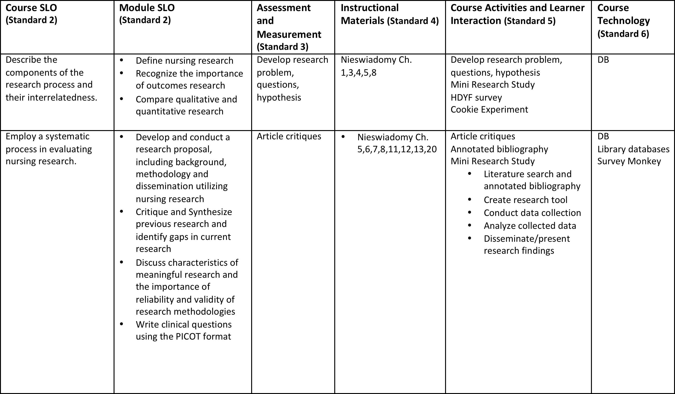
New Course Alignment: Use the Chart…

Slide 10
Creating Alignment: Assignments
Creating new assignments:
Old Course Assignments | New Course Assignments
Not directly aligned with objectives | Directly aligned with new objectives
Based on older text | Current text & research processes
Writing intensive
Individual effort | Group project
Focused solely on in-depth research process | Focuses on understanding & implementation of research process
 | How to distinguish adept research/articles
Notes:
Creating New Assignments
Previously assignments were writing intensive, and all individual
Covered in-depth research process
Recreated the course to be more engaging and meaningful to students
The goal was for the students to understand/implement the steps of the process, and how to distinguish rigorous/good research/articles
Semester-long group project that built up to a complete research study and presentation

Slide 11
Week by Week Guide
Orientation
First steps in the research process
ONLINE- exploring the research process
Steps of the Research Process
Legal and Ethical Research Issues
ONLINE- Identify theoretical framework
Quantitative Research Design
Qualitative Research Design
Population/Measurement/Data Collection
ONLINE
Data Collection Day
Data Analysis
ONLINE
Communication/Dissemination/Utilization
Presentation Day
Notes:
How Do you feel survey, your perception of research/evidence based practice
Select a topic, basics of qualitative vs. quantitative research
Write problem statement, research questions, hypotheses, create survey monkey account
Review problem statement, hypotheses and refine them; choose methodology (qual, quant, mixed methods)
Fill out an IRB application, create an informed consent
Complete annotated bibliography and find theoretical framework for study
Discuss specifics of quantitative research design
Discuss specifics of qualitative research design
Decide who population is and what measurements will be used, how to perform data collection
Defend reliability of questions, quantitative groups create survey in survey monkey and post link to DB, peers complete survey
Qualitative groups collect data (focus group, interviews, etc)
Analyzed data, decided which statistics to use, identified themes for qualitative groups
Informatics day
Discussed importance of dissemination, worked on articles, examined criteria for publishing in journals
Poster Presentations

Slide 12
Barriers to Change
What are your biggest barriers to change?
Complete Survey Number 2
  Kahoot Survey 2
  Click to access survey

Slide 13
How to Combat Resistance
Overcoming the “this is how it’s always been done” attitude
5 Helpful Steps
Step 1: Recognize the need for change
Step 2: Don’t be afraid to speak up
Step 3: Don’t be afraid to try something different
Step 4: Don’t be afraid to fail, just make adjustments and move forward
Step 5: Allow other faculty to see the progress
Notes:
This class had been taught for several years, by graduate level faculty who conducted their own research. Additionally, it has the same objectives as the online research course taught to practicing nurses.
Step 1: Recognize the need for change (survey to previous research students, feedback)
Step 2: Don’t be afraid to speak up (Spoke with team lead for the course about the need)
Step 3: Don’t be afraid to try something different (created a flipped class, despite past course outline)
Step 4: Don’t be afraid to fail, just make adjustments and move forward (Some assignments didn’t work out, but I adjusted during the semester, and accepted student feedback)
Step 5: Allow other faculty to see the progress (Invited faculty to the poster presentation and they saw the improvement/growth, welcomed the changes in other courses)
Student feedback on the course was also helpful! Pick articles/content that are interesting and familiar to students;

Slide 14
Outcomes and Student Feedback
Getting students to embrace the importance of Research
First day of class
Surveys at the end of semester
Notes:
Most students enjoyed the process
All said they learned about research
First day- survey only 3 people said they liked/interested in research
Last day- 85% said they liked research, could see themselves doing research in the future, and understood the steps of the research process
-100% said they preferred the format of this class to how it was described by other students the previous year

Slide 15
Student Feedback….
Survey Comments Prior to QM changes
“Assignments and expectations for those assignments were very vague.”
“Lectures were hard to follow, and often times boring, but it wasn't Mrs. Mooring's fault, just the material wasn't the most interesting. She tried her best to make it as interesting as she could incorporating activities (cookie testing, interviews, etc.)”
“The class was pretty boring and hard to understand. I never really understood everything. It was hard to pay attention so early in the morning to a class about research. “

Slide 16
Student Feedback….
Survey Comments After QM Changes (Fall 2015)
“…. made it as easy as possible to gather information for the paper we had to write.”
“Having the research process designed to complete weekly assignments worked really well! Helped us manage time and not be overwhelmed.”

Slide 17
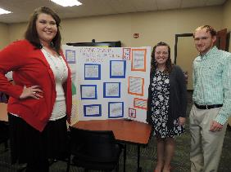
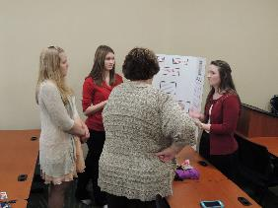
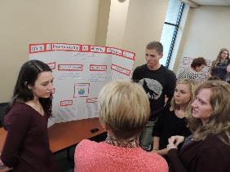
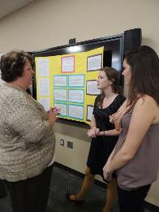
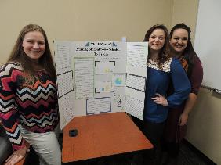
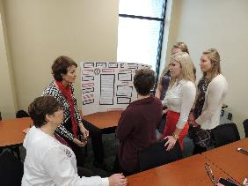
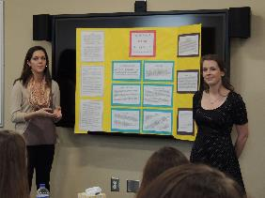
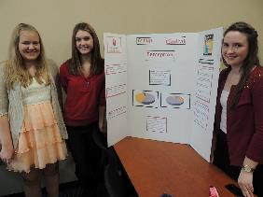
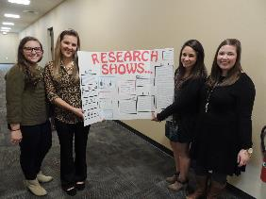

Slide 18

Questions?

