Slide 1

Building a Network to Disseminate
QM Principles
Emily Daniell Magruder, PhD
Institute for Teaching & Learning, CSU Chancellor’s Office
Hilda Baca-Fetcenko, EdD
Teacher Education, CSU Dominguez Hills
Ashley Skylar, PhD
Quality Assurance Project Manager, CSU Chancellor’s Office
Notes:
Add logos for CSU and CSUDH

Slide 2
Overview
• Context
CSU System-wide Quality Assurance Program
• Quality Assurance at CSU Dominguez Hills
The DH Network and E-Academies
• Lessons Learned
Notes:
Add logos for CSU and CSUDH

Slide 3
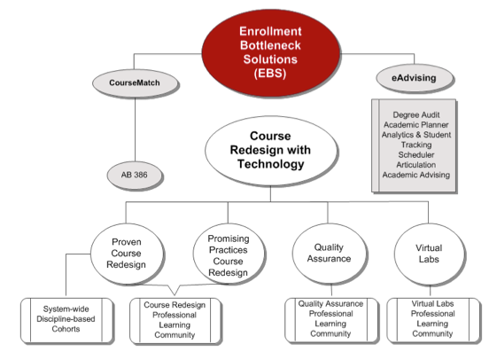

California State University
Strong CA IHE focus. Governor has invested but…
  Not interested in “same old way” of increasing sections
  Interested in changing education process
  Using today’s technology and innovations
  How do we address the 21st Century Learner?
“Course Redesign with Technology” program to eliminate bottlenecks and close achievement gaps
Quality Assurance a core essential
  Plays well with all of our efforts!
Notes:
[EDM Note: Recover header that was lost when copying.]
Describe your system/consortium
(If your system or consortium exists only for the purpose of subscribing to QM, you can skip this and go to slide #2. Otherwise, introduce us to the purpose and structure of your group, its institutions and other key stakeholders, a description of its culture ((will vary by institution, but as a backdrop to the QM implementation identify any common culture elements across the system…what do people really value, fear, believe in, desire, understand the role of the system, etc.))

Slide 4

















QM in California State University
System-Wide Subscription to QM
Joined in 2012, now with 17 affiliate campuses (Savings $37,400)
450 faculty and staff trained thru April 2015 (Savings $68,750)
System Provides “Online & F2F APPQMR Sessions”
    No cost to the participants
  F2F Sessions: North 1/1/15 & South 1/14/15 =
    2 more sessions offered Summer 2015
  Online Sessions: 12/5/14, 1/5/15, 2/2/15, 3/2/15 =
    4 more sessions offered Summer 2015
34 Trained
53 Trained
Notes:
Describe system approach to QM
(Tell us the purpose of the system subscription and its goals, how long the system has subscribed, what entity(ies) serves as the system lead, who are the affiliate institutions and any other key stakeholders, and any eligibility criteria for new affiliates (who can affiliate).

Slide 5
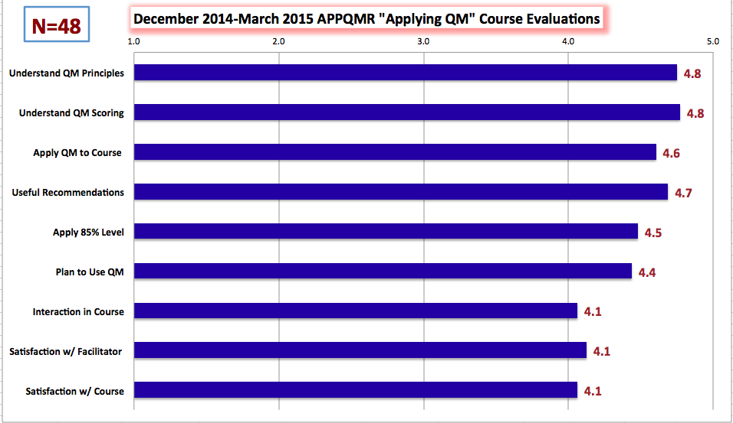
Feedback from Faculty/Staff about QM Sessions

Slide 6
Steps to Set up
Subscriber Managed Reviews
Goal 1: Continue to solicit faculty/staff to complete “QM Peer Reviewer” Certification (conduct informal QOLT/QM reviews on their campus)
-55 faculty have taken QM PRC and working to identify eligible (must have taught online in past 18 mos.) faculty interested in joining CSU cadre of Trained QM Peer Reviewers
Goal 2: Continue to build cadre of trained CSU QM Peer Reviewers - Currently 25
Goal 3: Identify Faculty/Staff interested in “Fast Track” to serve on 2 QM Reviews by June 2015– Currently 14 working on their 1st or 2nd QM Review (across 9 campuses)
Goal 4: Faculty/Staff who have served on 2 QM Reviews by June 2015 complete the Master Reviewer Certification Course over Summer 2015
Goal 5: Pilot “Subscriber Managed Reviews” with 2-3 campuses this summer (6-10 courses)
Goal 6: Network with other system consortiums to develop a “CSU Bartering System” for Managing affordable and sustainable QM recognized “Subscriber Managed Reviews”
Notes:
Ashley

Slide 7


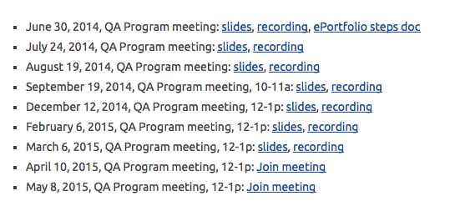
Fostering a Professional Learning Community
Sharing experiences and resources
Discussing local policies and practices
qa.csuprojects.org

Slide 8
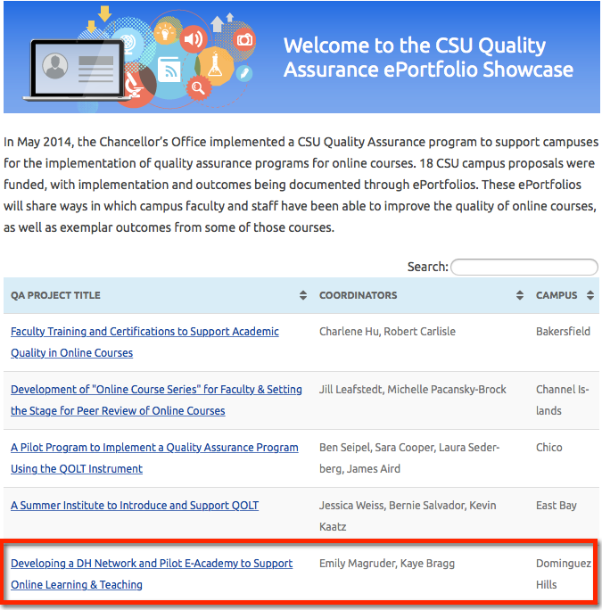

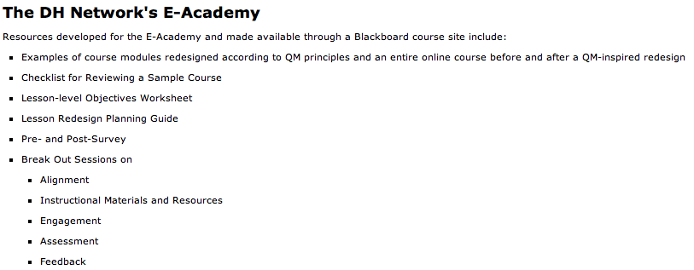
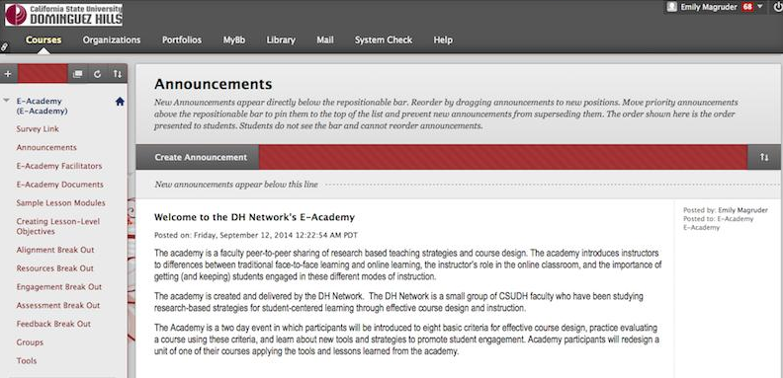
Quality Assurance Grants Support Campus QA Activities
http://tinyurl.com/DHNetwork

Slide 9
Quality Assurance at CSU Dominguez Hills
About DH
Research Informing Network Design
Forming the Network & Collaborating
E-Academy Design
Leverage via Curriculum Committee
Lessons Learned

Slide 10
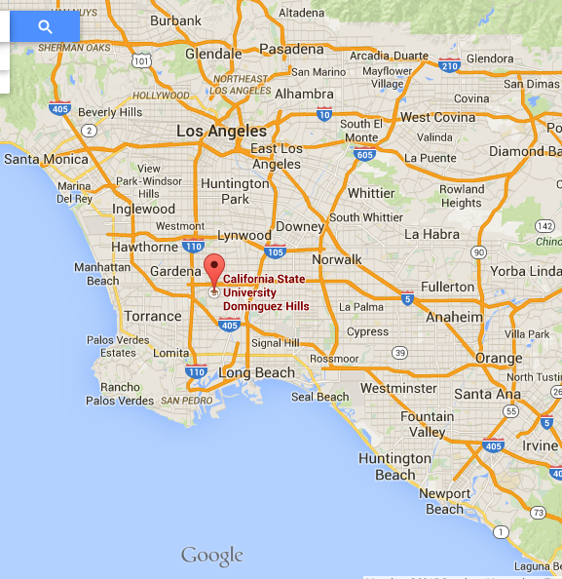
About Dominguez Hills
Urban metropolitan university:
  14,000 students
  700 faculty
New leadership
  Ambitious student success goals
Online course program/ stats
Faculty Development Center reopened 2013
Notes:
Urban metropolitan university: add student demographics here: % part-time working adults; women:men; first gen; Pell grant
New leadership = new pres, provost, several new deans and assoc deans; uptick in faculty hiring
Add online stats
Faculty Development Center: tech support from 2008-2012; first raises since 2008 this year

Slide 11
Research Informing Network Design
Why hasn’t technology disrupted academics’ teaching practices?
To answer this question, Blin and Munro turned to activity theory.
• “Activities are collective and motivated by the need to transform an object.”
• “Activity systems move through relatively long cycles of qualitative transformations.”
Cox, McIntosh, Reason and Terenzini found no significant relationship between institutional policies and “culture of teaching” in study of 45 institutions.
“We yearn for frictionless, technological solutions. But people talking to people is still the way that norms and standards change.”
-- Atul Gawande via Milt Cox and Laurie Richlin
Notes:
Blin and Munro: metacognition required to use tools well comes with time. Without it, breakdown is catastrophic.
-- impediments to “disruption” include pace and delivery mode of training; sense that technology doesn’t fit mode of teaching, sense that it is unfamiliar.
-- early uses tend to mimic traditional teaching. Some disciplines are beginning to find different uses.

Slide 12
Peer-to-Peer Sharing Network
Needs
Capitalize upon unique forms of engagement available online
Provide a framework for discussing online teaching and learning.
Orient and retain faculty.
Goals
Create Network
Design and Deliver E-Academy
Disseminate Best Practice for Online and Hybrid Course Design
Notes:
Original Grant ($10,000) = Needs & Goals.

Slide 13
Creating the Network
Recruiting Faculty
Taking QM Courses
Collaborating
May
June-July
July-August
Notes:
Recruiting Faculty:
-- 5 faculty: 2 from SOE; 2 from NBS; 1 from CAH; 2 TT; 3 lecturers
-- offered stipend
Took a collection of QM courses: Teaching Online; Designing Your Online Course; Applying the QM Rubric
-- some were in same course at same time
Collaborating
-- not something we had done before

Slide 14
E-Academy Design
Desired Outcomes
Redesign one module of a current course
Option to receive stipend for full re-design and in-house peer review
Format
F2F
Going Hybrid
Agenda
Intro to QM criteria
“Mapping” and Alignment
2 Fridays, 2 weeks apart
2 consecutive days (Friday & Saturday)
Applying QM Rubric to Sample Course
Breakouts on materials, engagement, assessment, accessibility and feedback
Time to work and present
Follow-up consultation with Network members
Notes:
What we observed: self-affirmers; embracers; not used to producing on the spot; we underestimated time and level of instruction need with technology

Slide 15
Lessons Learned
Building a Network
Designing an
E-Academy
Run a pilot.
Faculty as Learners
Resistance is reduced by exposure to exemplars and opportunity to experience and explore.
Deliverables
Time commitment
Compensation
Have clear expectations on:
Allow time for faculty to learn to use new tools and practice.
Design for flexible scheduling
f2f
online
Hybrid
compressed
expanded
Structured pair sharing and peer critique prompts honest self-assessment.
Keep learning active and participatory (but expect different learning styles).
Model constructive feedback.
Offer parallel tech tool workshops.

Slide 16



Unexpected Leverage
Notes:
UCC announced intention to pay closer attention to instructional contact time and accessibility when reviewing proposals to offer courses in online or hybrid modalities.
→ Led to requests for consultations.

Slide 17
References
“The DH Network for Quality Assurance.” CSU Dominguez Hills, QA ePortfolio Summer 2014.
http://contentbuilder.merlot.org/toolkit/html/snapshot.php?id=21377770715745
Blin, F. and Munro, M. “Why hasn’t technology disrupted academics’ teaching practices? Understanding resistance to change through the lens of activity theory.” Computers and Education 50 (2008): 475-490.
Cox, B. E., McIntosh, K.L., Reason, R. D., and Terenzini, P. T. “A culture of teaching: Policy, perception, and practice in higher education.” Research in Higher Education 52.8 (December 2011): 808-829.
Cox, M. D. and Richlin, L. “From bench to bedside in faculty development: Using implementation science.” Presentation at POD Annual Conference, November 2013.
Gawande, Atul. “Slow ideas: Some innovations spread fast. How do you speed the one’s that don’t?” New Yorker (July 29, 2013). http://www.newyorker.com/magazine/2013/07/29/slow-ideas.
Retrieved April 9, 2015.
Karasavvidis, I. “Activity Theory as a conceptual framework for understanding teacher approaches to information and communication technologies.” Computers and Education 53 (2009): 436-444.

