Slide 1
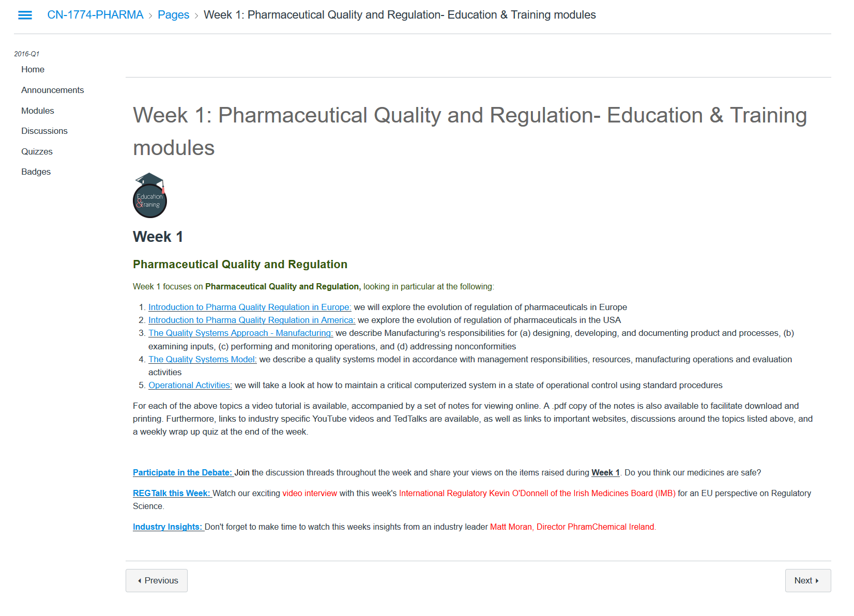
Step 1
Step 2
Step 3
No copyright.
All images/content, unless otherwise noted: "CN-1774- Pharma." So You Want to Work in the Pharmaceutical Industry. Dublin Institute of Technology & GetReskilled, 18 May 2016. Web. 24 Oct. 2016. <https://learn.canvas.net/courses/630>.
Notes:
"CN-1774- Pharma." So You Want to Work in the Pharmaceutical Industry. Dublin INstitute of Technology & Get Reskilled, 18 May 2016. Web. 24 Oct. 2016. <https://learn.canvas.net/courses/630>.

Slide 2
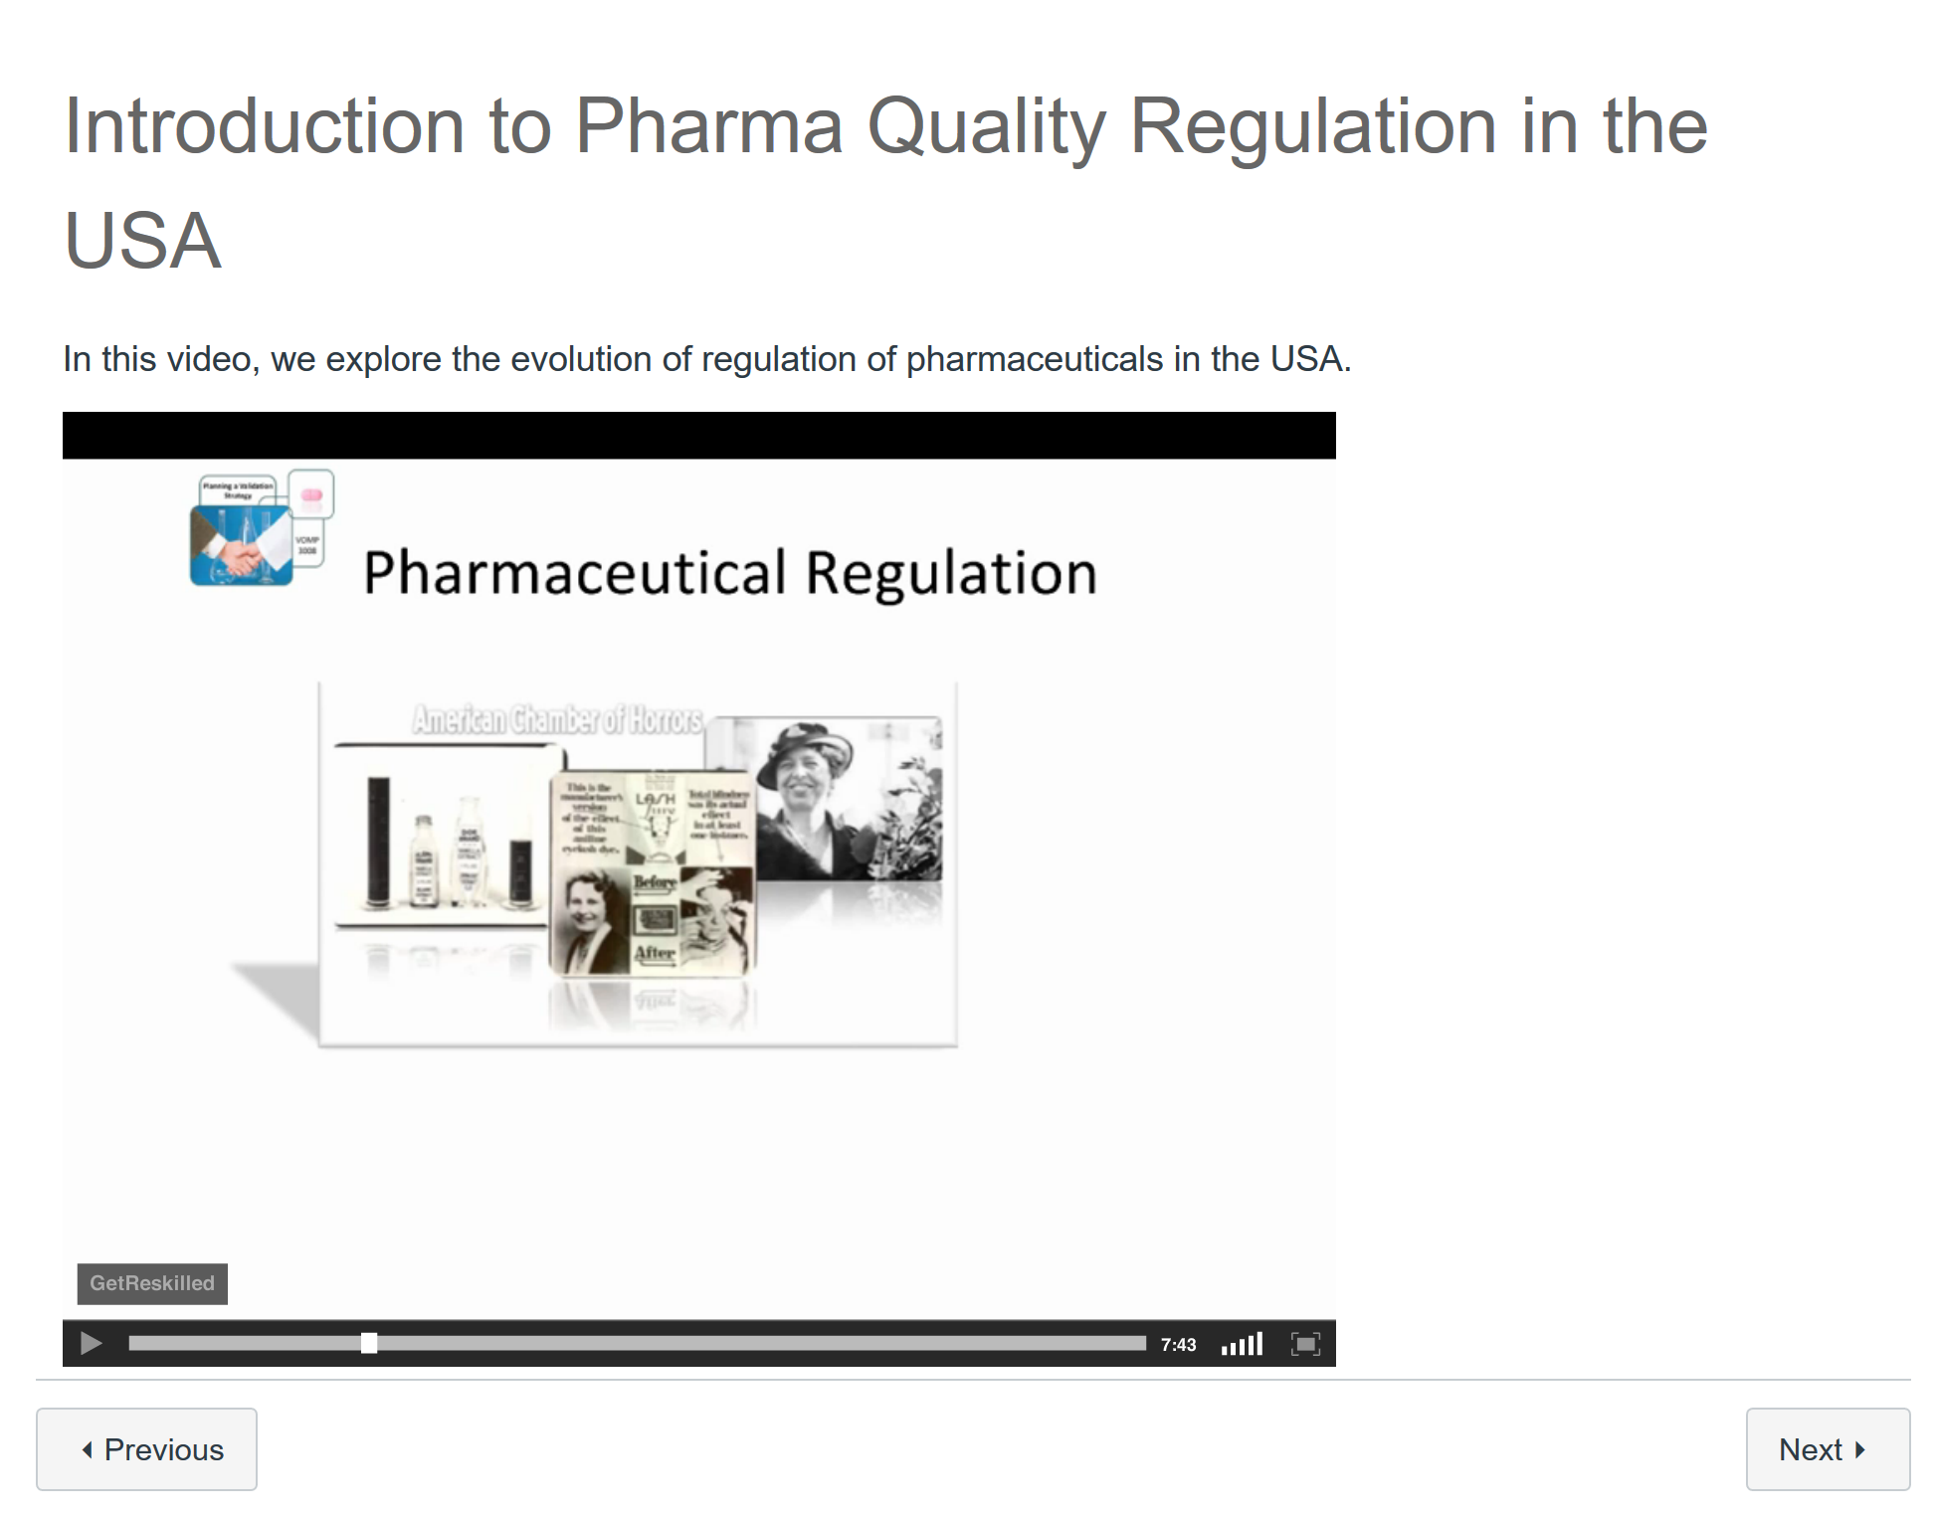
All images/content, unless otherwise noted: "CN-1774- Pharma." So You Want to Work in the Pharmaceutical Industry. Dublin Institute of Technology & GetReskilled, 18 May 2016. Web. 24 Oct. 2016. <https://learn.canvas.net/courses/630>.

Slide 3
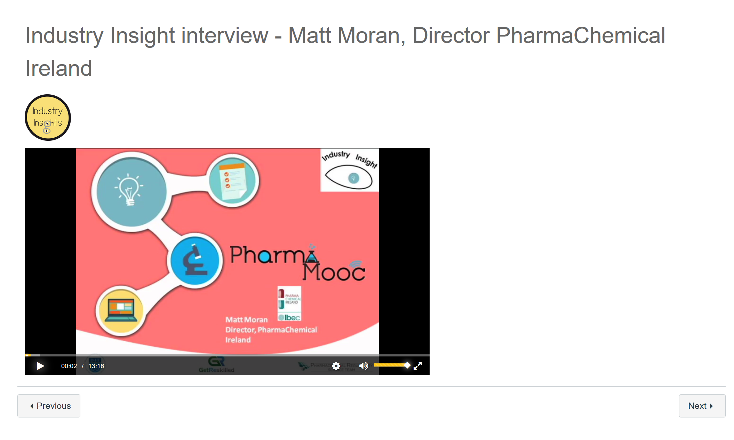

All images/content, unless otherwise noted: "CN-1774- Pharma." So You Want to Work in the Pharmaceutical Industry. Dublin Institute of Technology & GetReskilled, 18 May 2016. Web. 24 Oct. 2016. <https://learn.canvas.net/courses/630>.

Slide 4
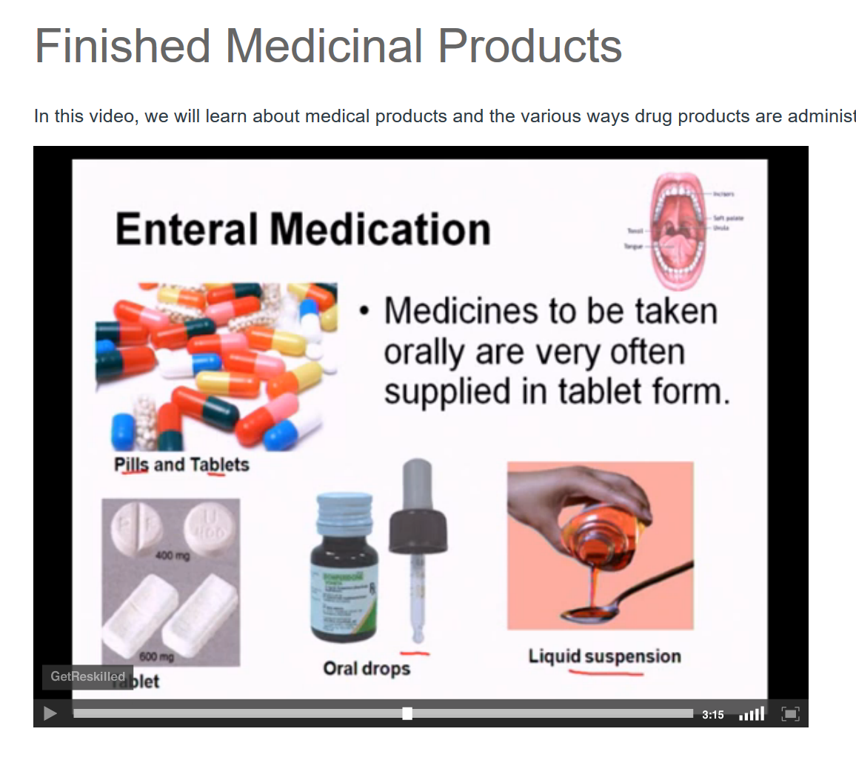
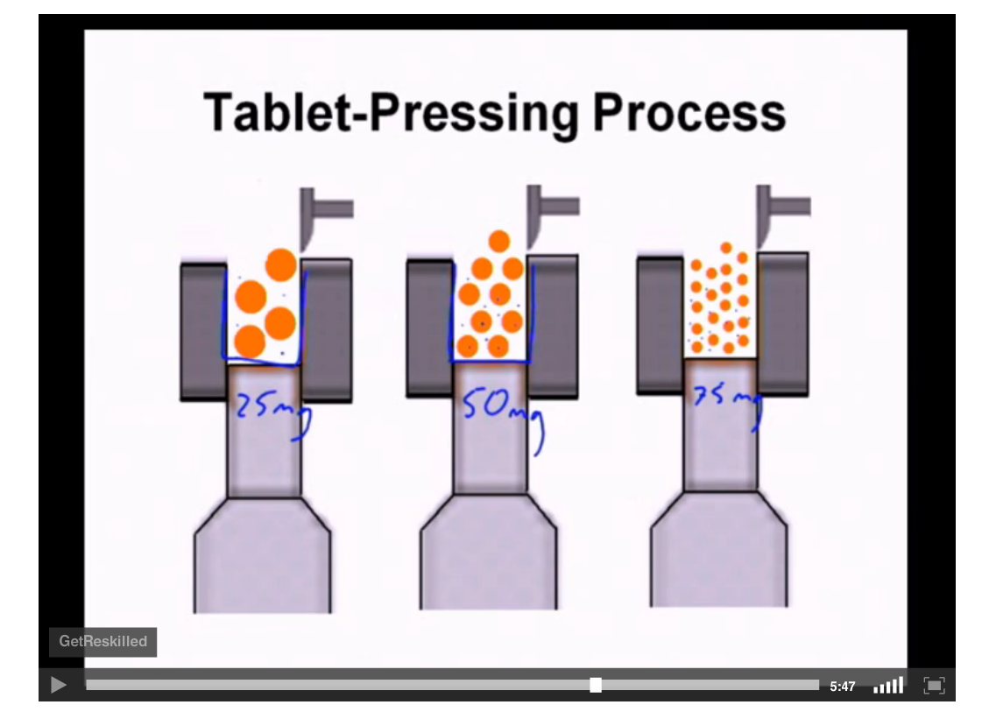
All images/content, unless otherwise noted: "CN-1774- Pharma." So You Want to Work in the Pharmaceutical Industry. Dublin Institute of Technology & GetReskilled, 18 May 2016. Web. 24 Oct. 2016. <https://learn.canvas.net/courses/630>.

