Slide 1
Remember the QMCs!
QMC Feedback Session 11-3-15

Slide 2

Get Social!
Questions / Ideas / Suggestions:
@QMTechnology
#QMCFeedback
#qmconf2015

Slide 3
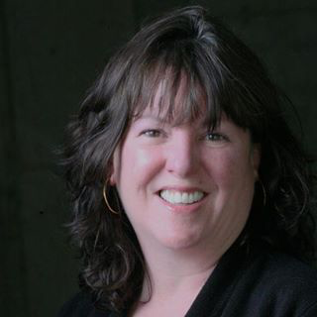
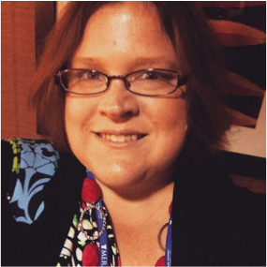
Your Presenters
Marijane Hakun
Subscriber Services Manager
mhakun@qualitymatters.org
Julie Henn
Director of Technology / CIO
jhenn@qualitymatters.org

Slide 4
Session Objectives
To learn about and discuss new and planned enhancements to subscriber tools, processes and resources
To share ideas to help QM serve QM Coordinators more effectively
#QMCFeedback

Slide 5
What’s New - MyQM
Email Individuals By Role, By Training, By Institution
QM Success Stories Available in Reference Library
Individual Profiles Display Professional Development Taken and Professional Development Delivered
Bulk Enrollment for Professional Development Sessions
#QMCFeedback

Slide 6
What’s New – CRMS / MyCR
Certification Mark Embed Code
Auto Save On Reviewer Worksheets / Self Reviews
Delete Internal Reviews from CRMS
MyCR: Preview Rubric
Internal Reviews: Assign a reviewer from any institution within a statewide system.
New Comments Area for Self Reviews
Updated Editors (to latest version of CKEditor).
Coming Soon! Recognized Course Search
#QMCFeedback

Slide 7
What’s New - Reporting
Added Tooltips to QMC Reports & Custom Reports
New Professional Development Custom Report Options
Reports Now Include Role Application Status (Active, Suspended, Expired)
#QMCFeedback

Slide 8
What’s New – Re-Theming
Coming December 2015!
MyQM, CRMS, MyCR
Redesigned UI based on Member Feedback
Feedback Advisory:
  Steven Crawford – Arizona State University
  JJ Johnson – Pierce College, Washington State
  Beth McMahon – Minnesota Online
#QMCFeedback

Slide 9
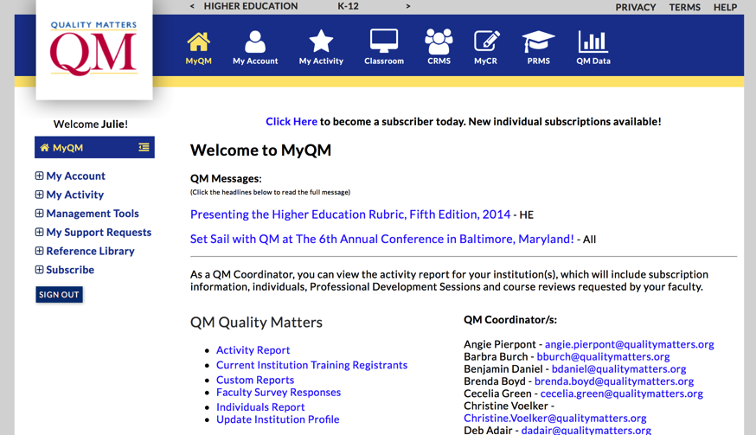
What’s New – Re-Theming
#QMCFeedback

Slide 10
What’s New - MyCR
My Custom Reviews (MyCR) system
Available to all member institutions to support Custom Quality Assurance Processes (not just course design!)
  Customizable Rubrics
  Customizable Course Worksheet
  Customizable Notification Emails
Wed. 8:35 (Salon D) – ‘Adapting a Web-Based Tool to Streamline Internal Quality Assurance’
#QMCFeedback

Slide 11
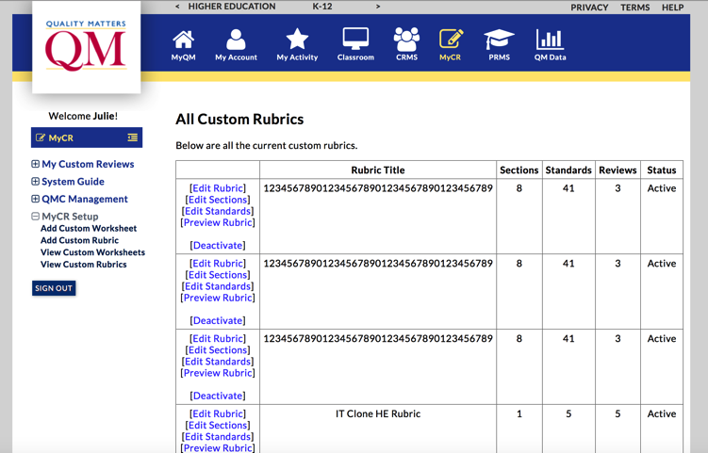
What’s New - MyCR
#QMCFeedback

Slide 12
Enhancement: Membership Recognition
Opportunity: QM Members should be recognized for commitment to course quality assurance.
QM Member Mark for Website, Would be available as HTML embed code
Link to Member Information Page
  Membership Status
  Membership Duration
  Implementation Details – Courses Reviewed, Professional Development, Conference Attendance
  Customization – Institution Statement
#QMCFeedback

Slide 13
Planned Enhancement: “Super QMC” Role
Opportunity: QMCs need to grant access to others to help manage QM implementations.
Elevated role to grant access to reports
All the privileges of the QMC role plus reporting
Other designees could receive QMC role with full access to functionality currently restricted to QMCs
What admin privileges do you need to grant to others?
Are there any other privileges of the QMC role that others should not be granted?
#QMCFeedback

Slide 14
QMC System Privileges
Privilege | Role
Institution / Statewide System (Lead QMC) Reporting (Activity Report, Custom Reports, Individuals Report) | Super QMC
Update Institution Profile | QMC
View, Add, Edit, Email, Manage Individuals and Individual Affiliations | QMC
Email Notification for Individual Affiliation, Training Registration | QMC
Setup / Activate MyCR | QMC
Access all Open & Closed Course Reviews | QMC
Delete Internal Course Reviews | QMC
Access to Course Certification Mark Embed Code | QMC
Receive QMC Communications from QM | QMC
#QMCFeedback

Slide 15
Enhancement: Social Networking Integration
Opportunity: Make it easier for QMCs and individuals to promote QM accomplishments
Add “Share” features with language within MyQM
  Recognized Courses
  Professional Development Completion
  Individual Certifications
  Milestones (QMC Reporting)
Join Tim Lombardo & Julie Henn 11/3 at 3:40
‘Not So Lone Stars: Connecting the Global #Qmmunity Using Social Media’
#QMCFeedback

Slide 16
Thank You!
We want to hear from you!
Julie Henn jhenn@qualitymatters.org @juliehenn
Marijane Hakun mhakun@qualitymatters.org
#QMCFeedback

