Slide 1
All Hands on Deck!
QM Coordinator Jam Session
October 1, 2014

Slide 2
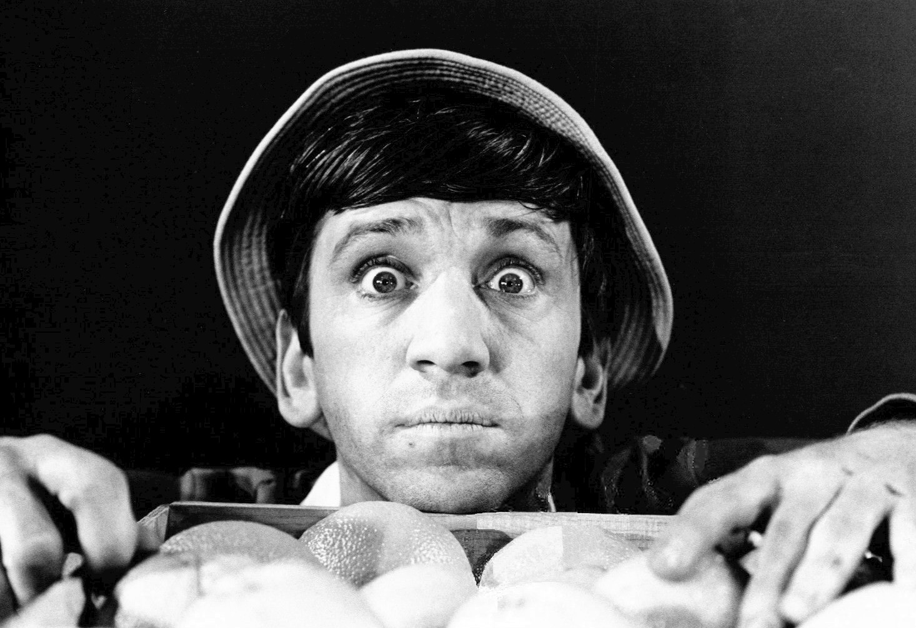

“What did I get myself into?”

Slide 3

Travel Itinerary
QMC Online Scavenger Hunt Excursion
New Activities
Future Destinations
Sound Off!

Slide 4

Online Scavenger Hunt
Find a partner or two
New to QM? Pair with a seasoned QMC
Connected device needed
Locate as many items as possible in 25 minutes
PRIZES!

Slide 5
New Activities
  My Custom Reviews (MyCR) https://www.qmprogram.org/mycr/
  Role Applications for Master Reviewer, Course Review Manager
  Subscriber Map https://www.qualitymatters.org/subscriber-map
  Subscriber Case Studies https://www.qualitymatters.org/case-studies
  Communications Toolkit https://www.qualitymatters.org/communications-toolkit

Slide 6
New Activities
  eLearning Marketplacehttps://qualitymatters.org/marketplace
  IDA Website https://ida.qualitymatters.org
  Enhanced Research Library https://www.qmprogram.org/qmresources/research/
  MyQM Sign In / Account Creation
  https://www.qmprogram.org/myqm/
  Recognized Course Mark “Widget”
  @QMTechnology https://twitter.com/qmtechnology

Slide 7

Future Destinations
  Policy/Process Review
  Data Feeds / API
  Badges
  Re-theming of MyQM / CRMS / MyCR

Slide 8
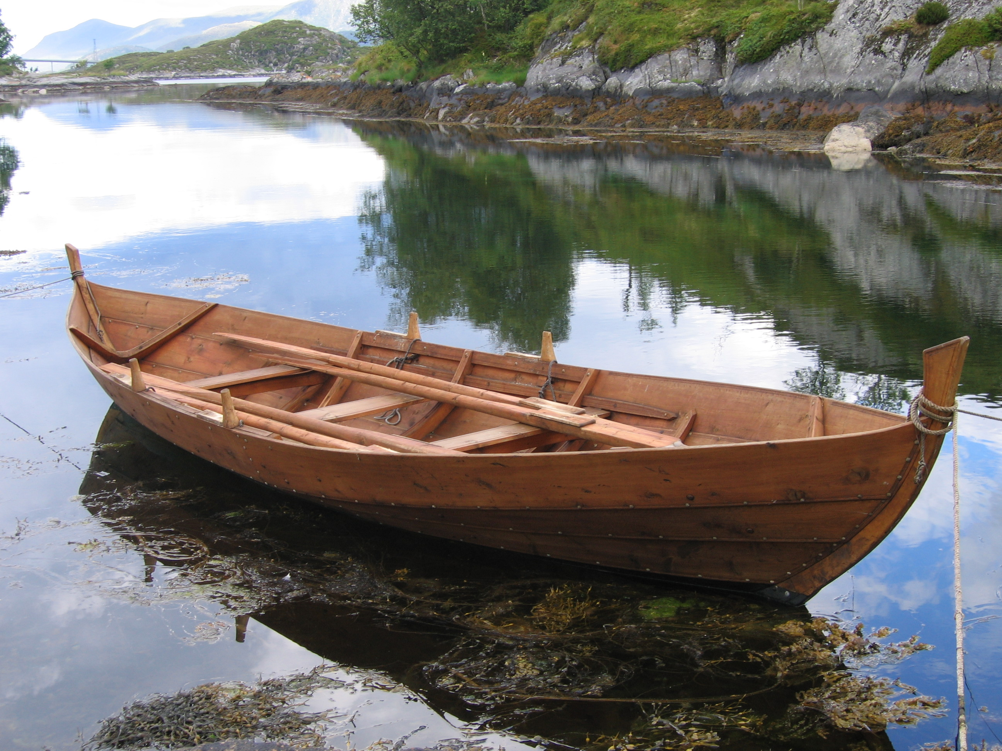
Future Destinations
  Chat Support
  Improved Reporting
  Page-Specific Help w/Report Definitions
  Historical Tracking of Institution Affiliation for Activity Reports

Slide 9
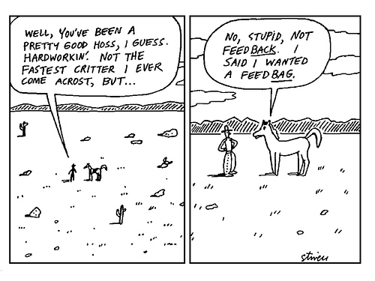
Sound Off / Feedback
How can QM better support your institution’s implementation?

Slide 10
Questions?
Contact:
Julie Henn or Marijane Hakun
jhenn@qualitymatters.org / mhakun@qualitymatters.org
@QMTechnology

