Slide 1
Piloting a QM-Inspired Quality Assurance Process
for All Online Course Offerings at a Midsized University

Slide 2
Context
Bowling Green State University, OH, USA
Approximately 20,000 students (online & f2f)
Online degree programs
  4 Bachelor
  10 Masters
  8 Certificates
Online courses offered
  Fall, Spring, Summer terms
  6-, 8- and 16-week formats
  469 courses offered online fall 2017

Slide 3
QM Relationship
Ohio Consortium (http://www.qmohio.org/)
  60 institutional members
Multiple sessions of QM workshops
  Applying the QM Rubric (APPQMR)
  Improving Your Online Course (IYOC)
More than 100 BGSU faculty members APPQMR
Appr. 20 faculty members are QM reviewers
Multiple internal QM reviews
Less than 10 courses through formal QM review process

Slide 4
Delimma
Provost charge to review all online courses for course quality
QM rubric and APPQMR fairly pervasive on campus
How to proceed?

Slide 5
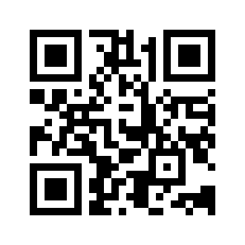
Socrative Feedback
Room 896306
Use QR code to connect

Slide 6
Socrative Feedback
Connect to responses:
https://b.socrative.com/teacher/#launch

Slide 7
Challenges
CBA restrictions on IP, faculty autonomy, academic freedom
Comparison on what processes happening in f2f courses
Large number of courses

Slide 8
Begin with Syllabus
A clear statement on course expectations
The schedule and methods of assessment
Indicators of support for student success
Pedagogical efforts that engage students in the learning process

Slide 9
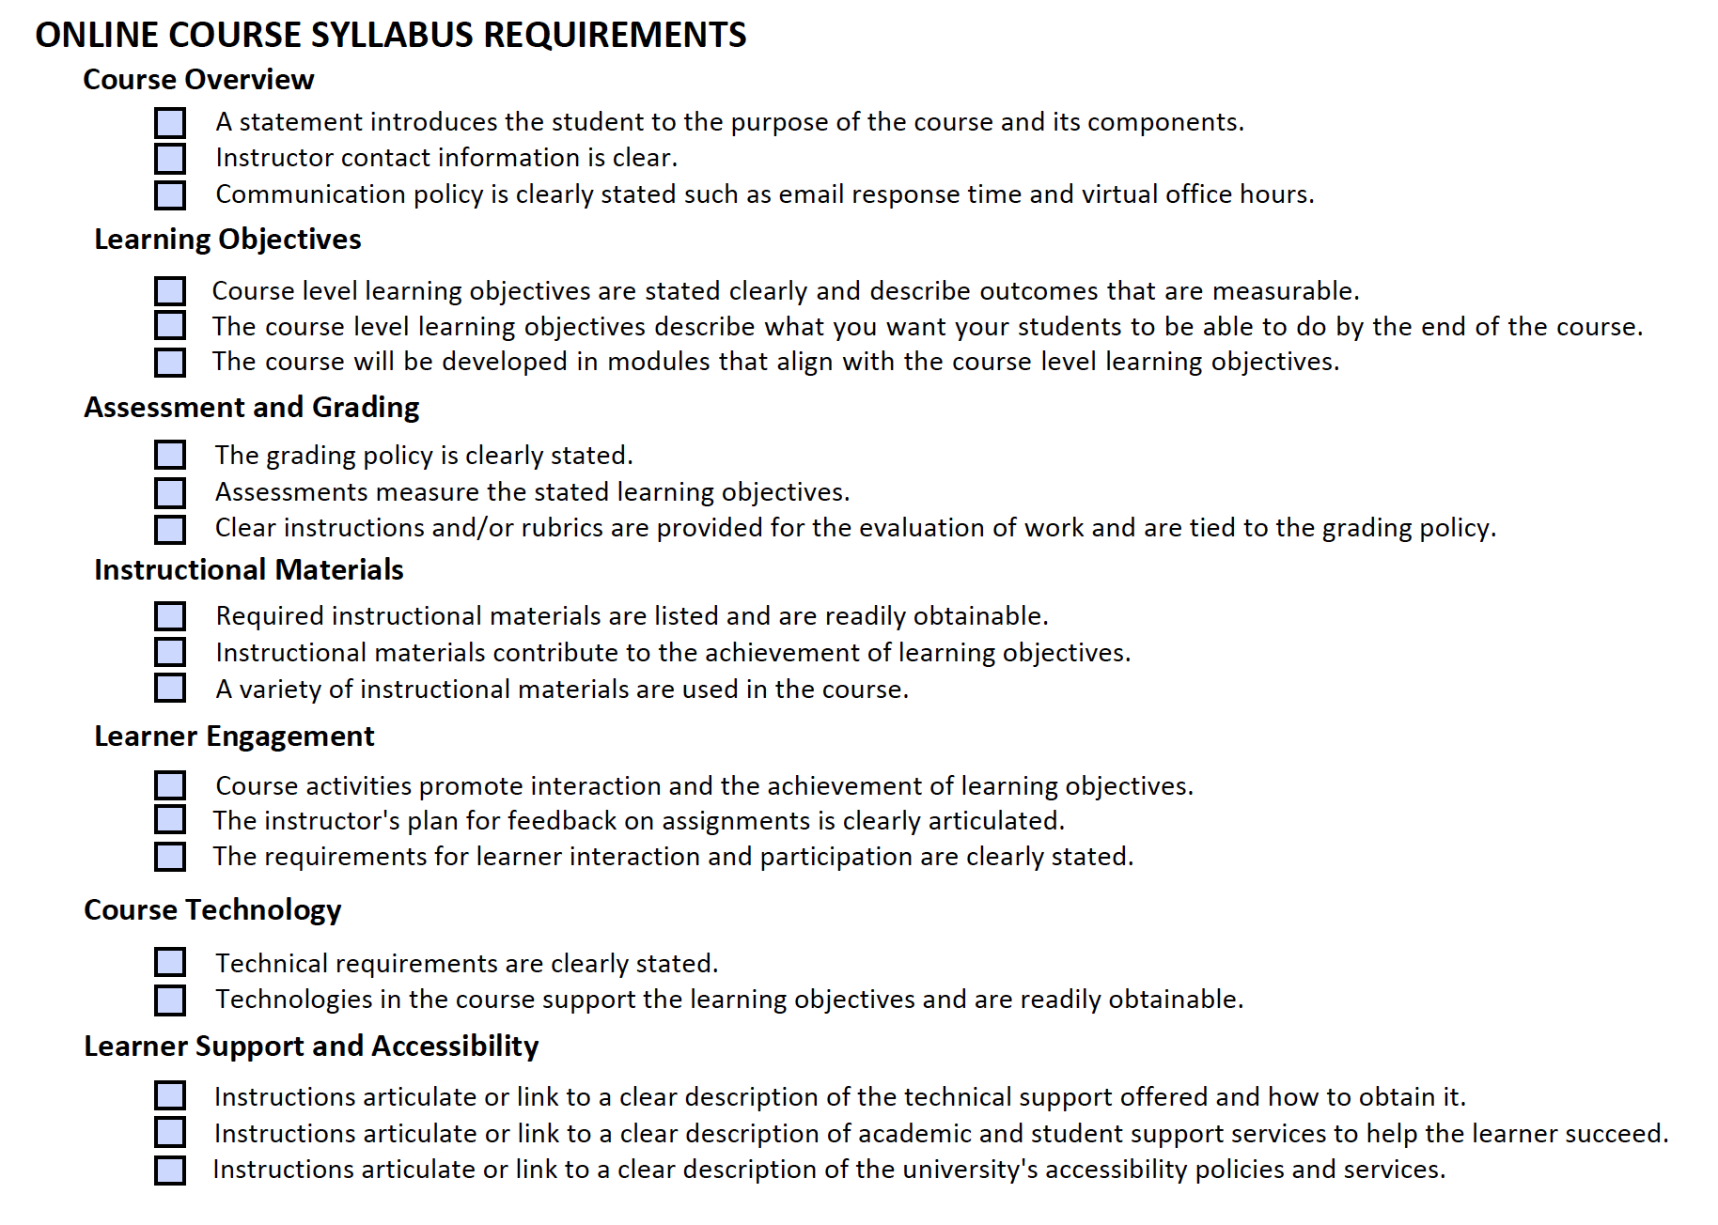
Pilot Review Process
Team of identified expert online instructors
Using developed form, 2 team members review each syllabus

Slide 10
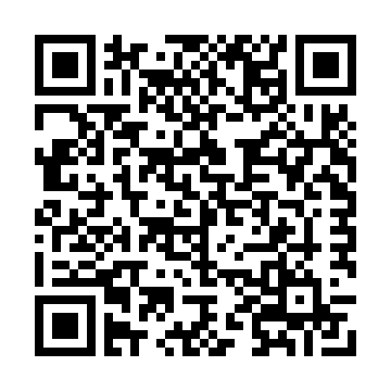
QM Connections
Educaplay link

Slide 11
Pilot Reviews
Spring 2016 & Fall 2017
Only BGP Online Courses
Capacity of faculty review team

Slide 12
Issues?

Slide 13
Reflections
A start
Massive undertaking
Faculty aversion
Skinny Syllabi
Finding a path forward
QM Impact

Slide 14

Thoughts? Questions?
Savilla Banister
sbanist@bgsu.edu
Bowling Green State University
Ohio,USA

