Slide 1
Set Sail on a Three-Course Tour:
Three examples of a QM Reviewed Course
Krista MacDonald Doña Anna Community College
Sharon Lalla New Mexico State University
Becky Adams University of New Mexico

Slide 2
Set Sail on a Three-Course Tour:
Three examples of a QM Reviewed Course
Becky Adams
Instructor and Director Online Course Development and Faculty Services
University of New Mexico

Slide 3
Set Sail on a Three-Course Tour:
Three examples of a QM Reviewed Course
Becky Adams
Theory & Practice of Distance Learning

Slide 4
Set Sail on a Three-Course Tour:
Three examples of a QM Reviewed Course
Becky Adams
QM Standard 1
Course Overview and Introduction

Slide 5
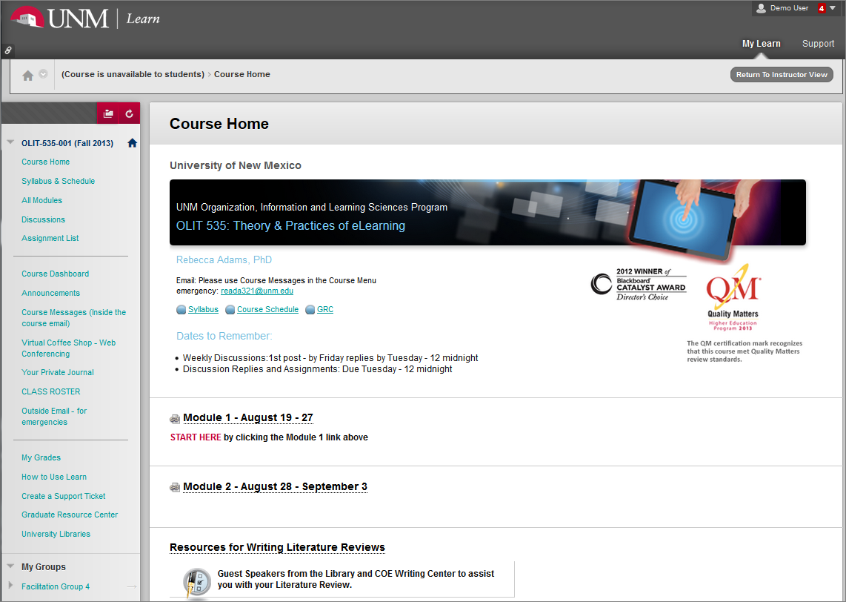
Start Here
Description of course (1 min)
Notes:
1.1 - Start Here – added
1.2 – Purpose and Structure – via Welcome Video/Syllabus/Orientation Module
1.3 – Ettiquette/Nettiquette – left out

Slide 6
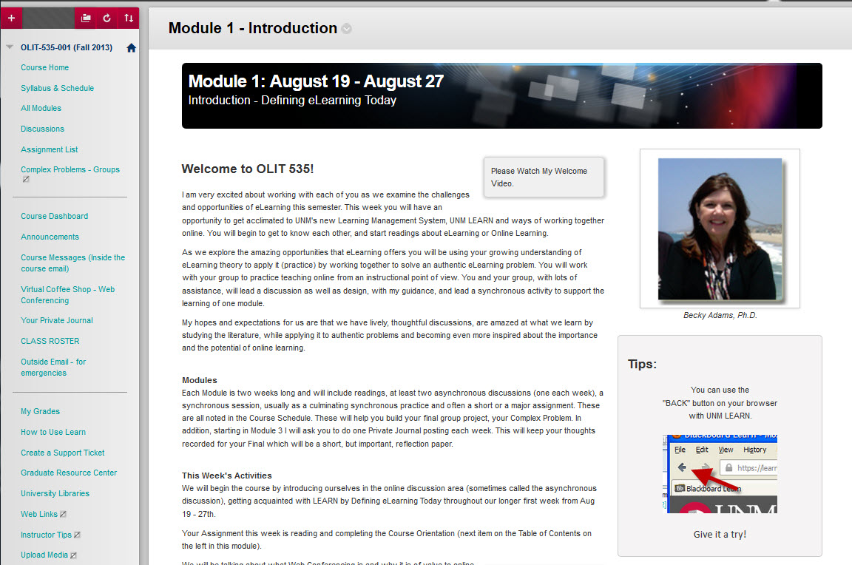
Purpose & Structure
Description of course (1 min)
Notes:
1.1 - Start Here – added
1.2 – Purpose and Structure – via Welcome Video/Syllabus/Orientation Module
1.3 – Ettiquette/Nettiquette – left out

Slide 7
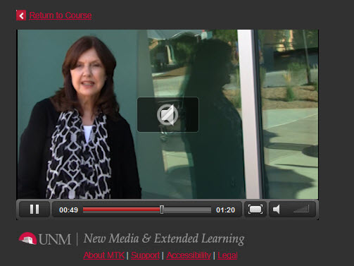
Purpose & Structure
Description of course (1 min)
Notes:
1.1 - Start Here – added
1.2 – Purpose and Structure – via Welcome Video/Syllabus/Orientation Module
1.3 – Ettiquette/Nettiquette – left out

Slide 8
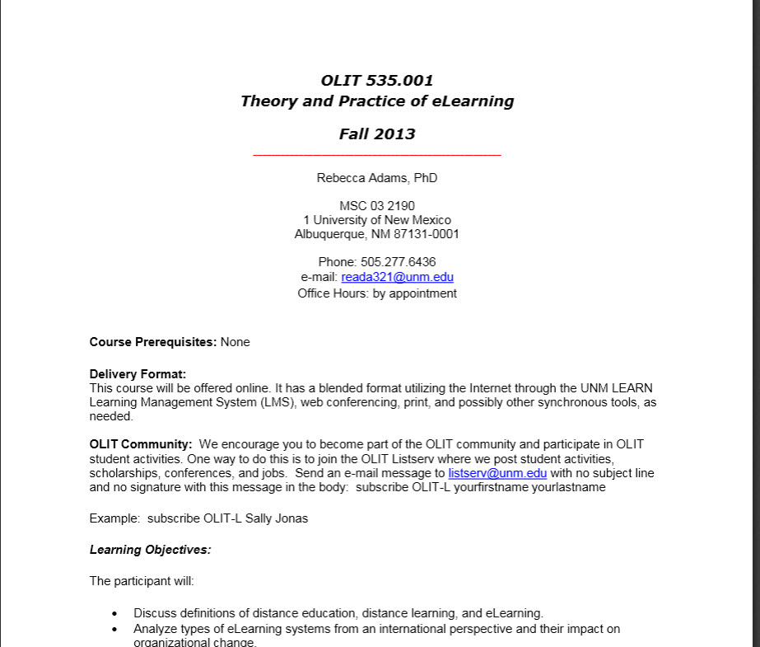
Purpose & Structure
Description of course (1 min)
Notes:
1.1 - Start Here – added
1.2 – Purpose and Structure – via Welcome Video/Syllabus/Orientation Module
1.3 – Ettiquette/Nettiquette – left out

Slide 9
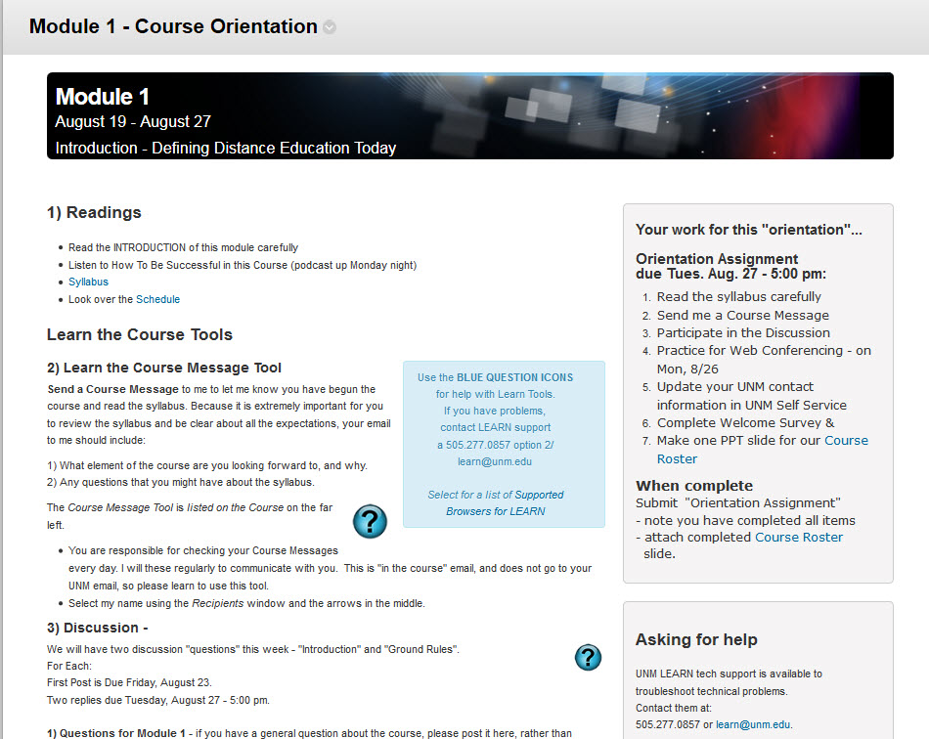
Purpose & Structure
Description of course (1 min)
Notes:
1.1 - Start Here – added
1.2 – Purpose and Structure – via Welcome Video/Syllabus/Orientation Module
1.3 – Ettiquette/Nettiquette – left out

Slide 10
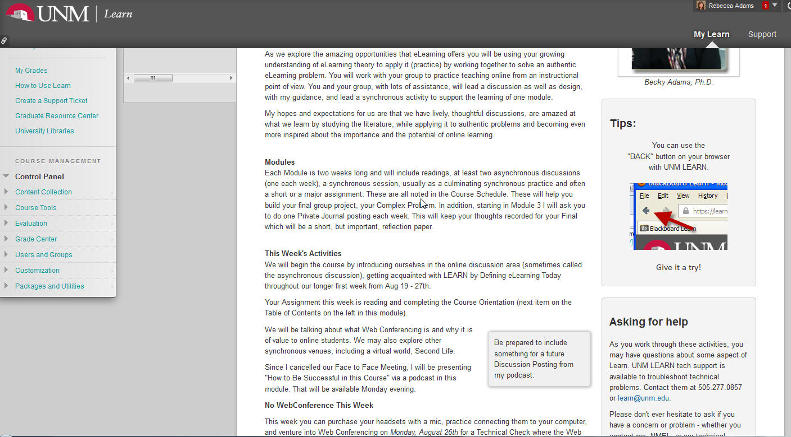
Structure
Tour the course, with emphasis on 2, 5, 6, 7.

Slide 11
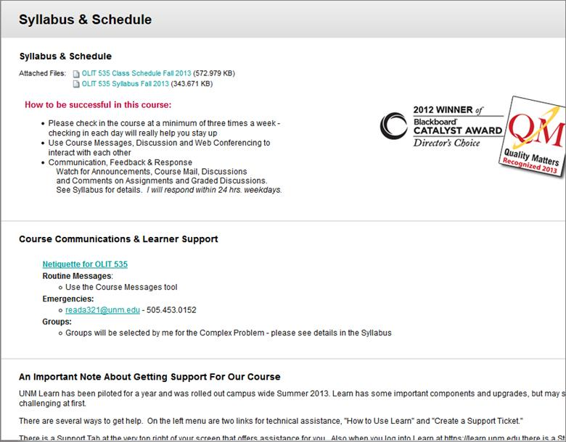
Netiquette
Description of course (1 min)
Notes:
1.1 - Start Here – added
1.2 – Purpose and Structure – via Welcome Video/Syllabus/Orientation Module
1.3 – Etiquette/Nettiquette – left out

Slide 12
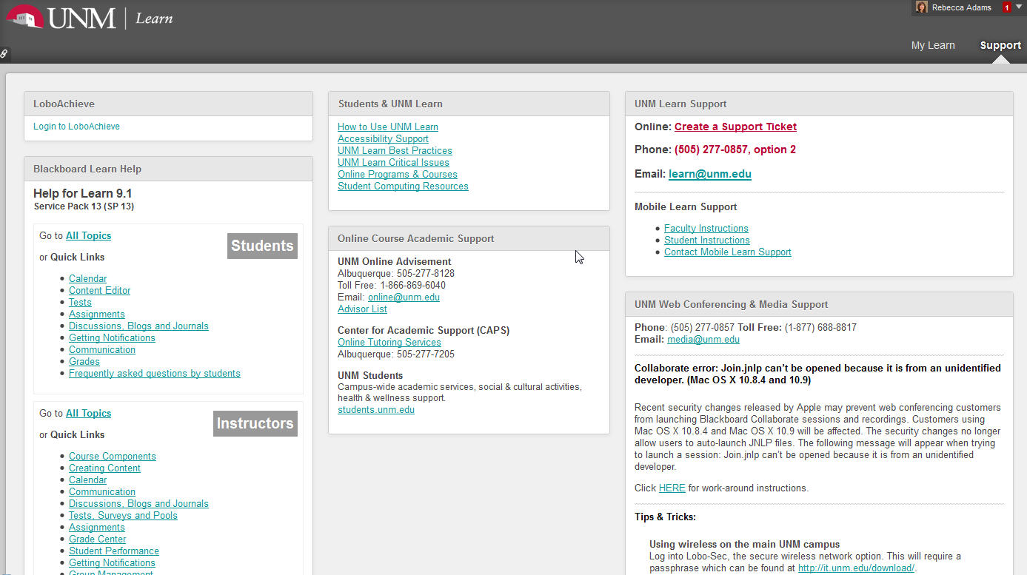
Policies
Tour the course, with emphasis on 2, 5, 6, 7.

Slide 13
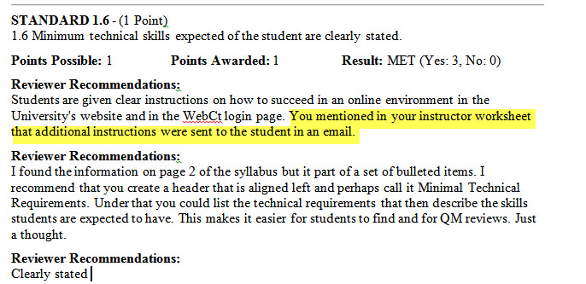
Policies
Description of course (1 min)
Notes:
1.4 (now) 1.6 (then) – Policies – guided to Instructor Worksheet
1.5 – Minimum Tech Requirements – syllabus
1.6 – Prerequisites – Left Out
1.7 – Minimum Technical skills – syllabus, email on website prior to the course
1.8 – Instructor Introduction – “Your introductions are FABULOUS!!! I really enjoyed the text introduction and the video introduction. They are both so warm and really make you feel welcome :) Excellent work here! I do a lot of research and writing on "High Touch" and this is an exemplar example of that :) “
1.9 – Learners introduce themselves to class – use that at the end “goals” email.

Slide 14
Set Sail on a Three-Course Tour:
Three examples of a QM Reviewed Course
Becky Adams
QM Standard 2
Learning Objectives (Compentencies)

Slide 15
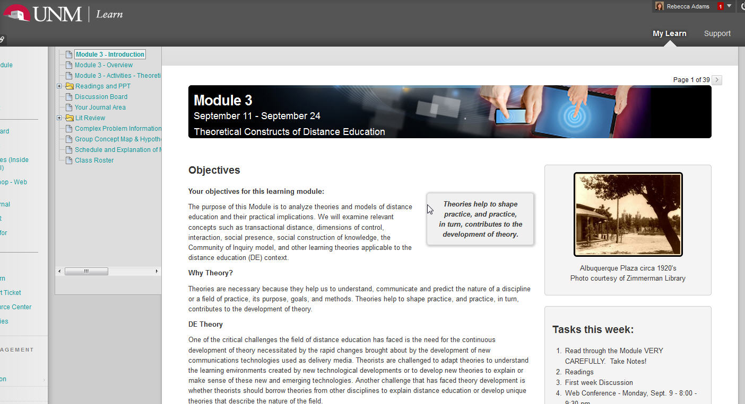
Course Design
Approach to Design (2 min)
Notes:
2.1 – Course Objectives are measurable – in syllabus
2.2 - Module/unite objectives are measurable and consistent with Course Objectives
2.3 – Stated clearly and written from learner’s perspectives

Slide 16
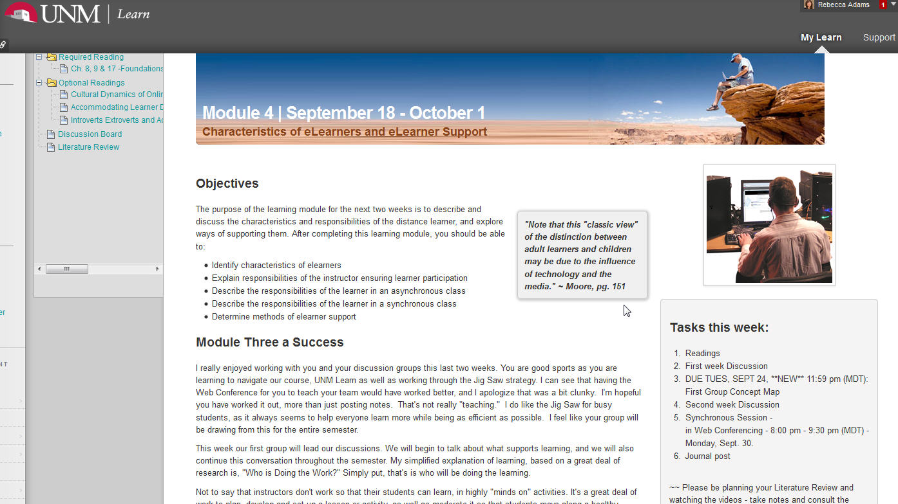
Course Tour
Tour the course, with emphasis on 2, 5, 6, 7.
Notes:
2.3 – Stated clearly and written from learner’s perspectives
2.4 (new) – Relationship between learning objectives and course activities is clearly stated.
2.5 - …are suited to the level of the course

Slide 17
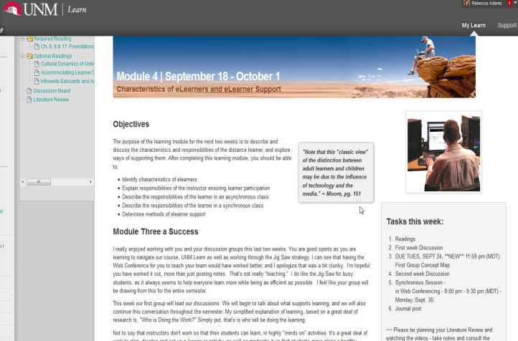
Learning Objectives
“The course learning objective are measurable…I
think you can actually enhance them and make the
course more "action-oriented" by slightly
augmenting what is there.
Right now the students will be able to primarily
discuss, examine, and analyze. This is all
important but as someone who will be potentially
hiring one of your graduates, I would ask "But
what can they do?
…I suggest that you expand what you have and consider things such as
"Develop a systems approach for analyzing the advantages and disadvantages with recommendations regarding various course delivery systems and...."
See how this goes from simply analyzing to creating an actionable approach - you could also have develop a process for…”

Slide 18
Set Sail on a Three-Course Tour:
Three examples of a QM Reviewed Course
Becky Adams
QM Standard 3
Assessment and Measurement
Notes:
3.1 – Assessments measure the state learning objectives.
3.2 - Course grading policy is stated clearly

Slide 19
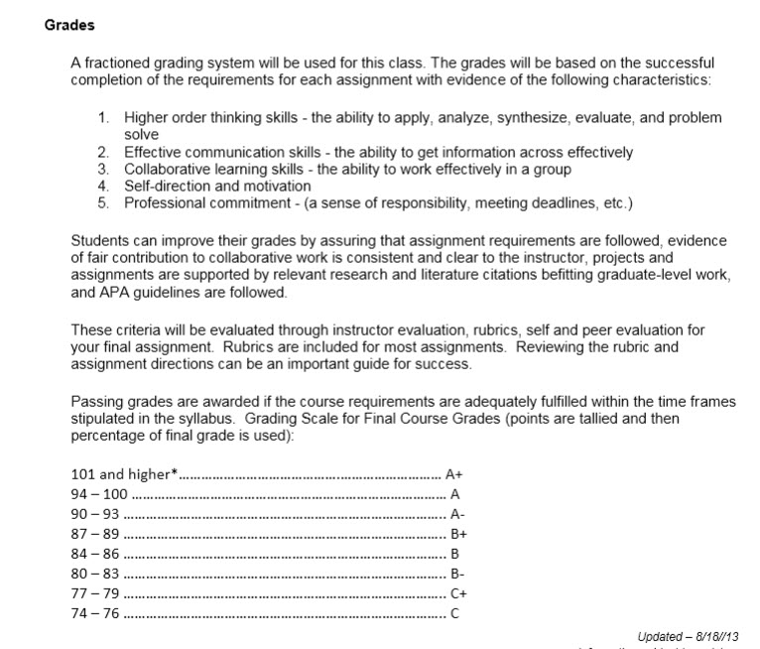
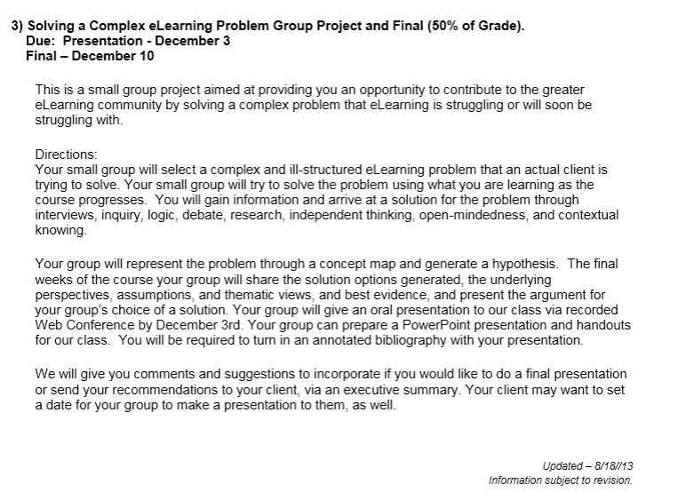
Assessment and Measurement
Notes:
3.2 - Course grading policy is stated clearly
3.3 - Specific and descriptive criteria are provided for evaluation of learner’s work – tied to grading policy - RUBRICS

Slide 20
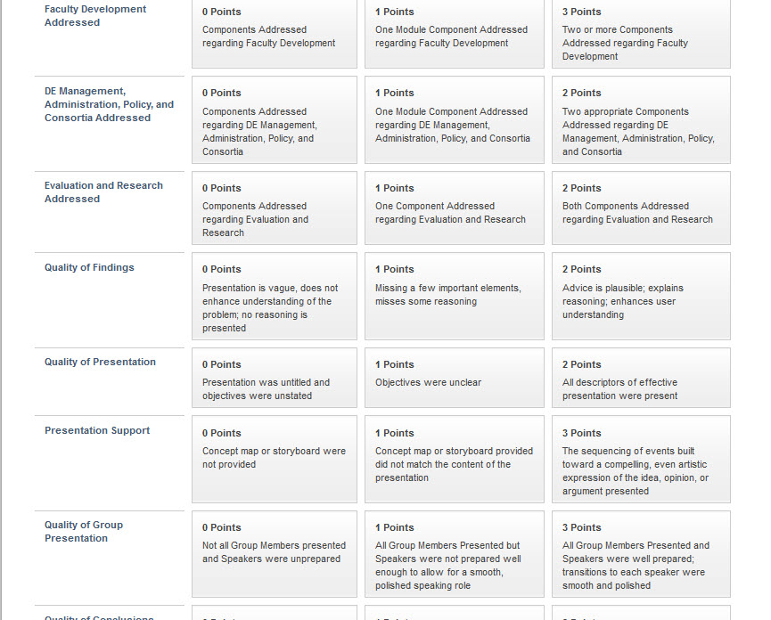
Assessment and Measurement
Notes:
3.2 - Course grading policy is stated clearly
3.3 - Specific and descriptive criteria are provided for evaluation of learner’s work – tied to grading policy - RUBRICS

Slide 21
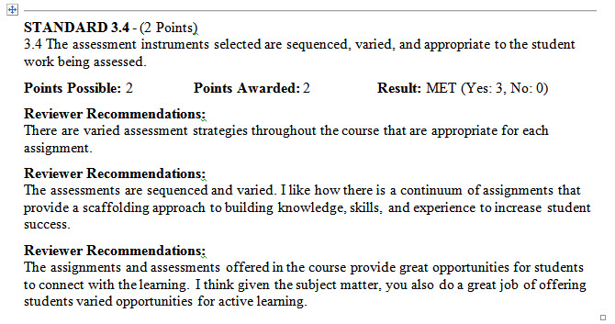
Assessment and Measurement
Notes:
3.4 – Assessment instruments selected are sequenced, varied and suited to the learning work being assessed. – Complex Problem built from a “continuum – scaffolding to build knowledge, skills and experience for student success”

Slide 22
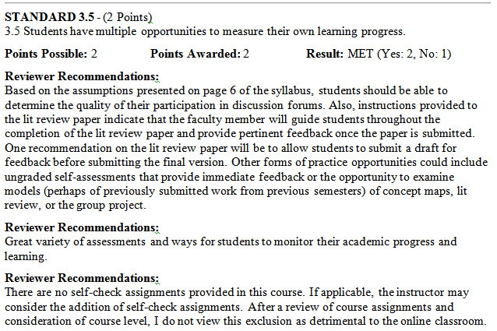
Assessment and Measurement
Notes:
3.5 – learners have multiple opportunities to track their learning progress – discussion forums include feedback for practice activities (concept map), lit review can be redone, journal – I added self checks due to this feedback.

Slide 23
Set Sail on a Three-Course Tour:
Three examples of a QM Reviewed Course
Krista MacDonald
Asst. Professor, Communication and Online Education Coordinator
Doña Anna Community College

Slide 24
Set Sail on a Three-Course Tour:
Three examples of a QM Reviewed Course
Krista MacDonald
Principles of Human Communication

Slide 25
Set Sail on a Three-Course Tour:
Three examples of a QM Reviewed Course
Krista MacDonald
QM Standard 4
Instructional Materials
Notes:
4.1 The instructional materials contribute to the achievement of the stated course and module/unit learning objectives or competencies.
4.2 Both the purpose of instructional materials and how the materials are to be used for learning activities are clearly explained.
4.3 All instructional materials used in the course are appropriately cited.
4.4 The instructional materials are current.
4.5 A variety of instructional materials is used in the course.
4.6 The distinction between required and optional materials is clearly explained.

Slide 26
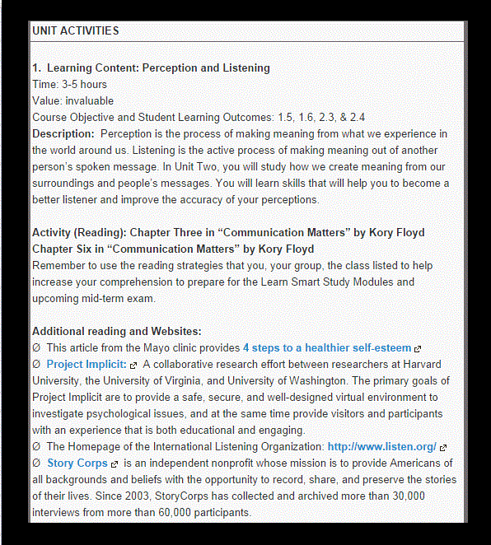
Instructional Materials
Notes:
My Unit Learning Plans address how instructional materials help students meet course and module objectives.

Slide 27
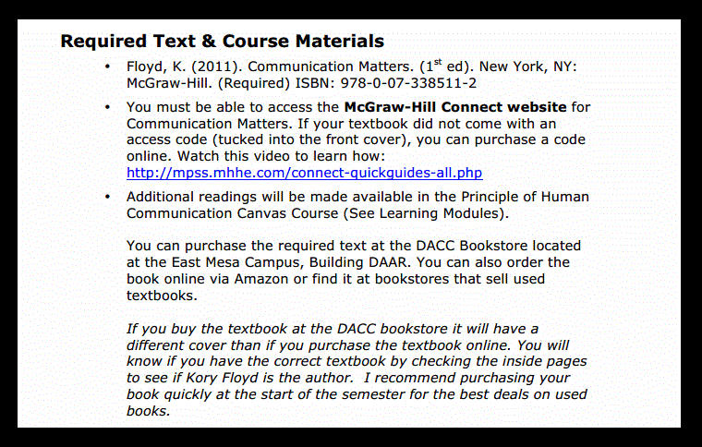
What’s Required?
Notes:
In my course syllabus, I state the required instructional materials using APA format.

Slide 28
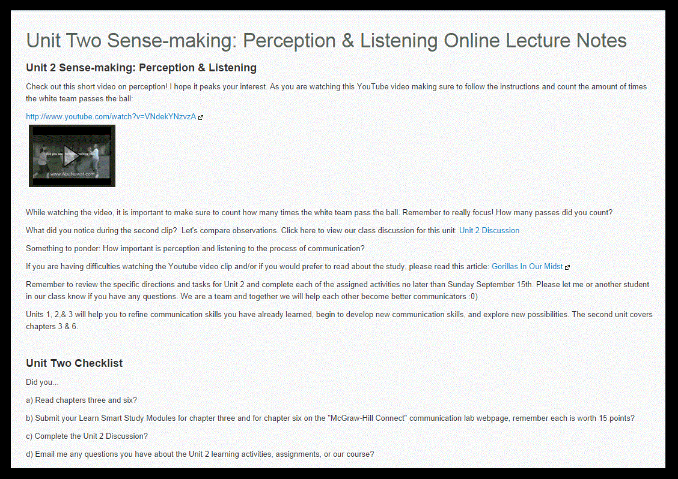
Variety

Slide 29
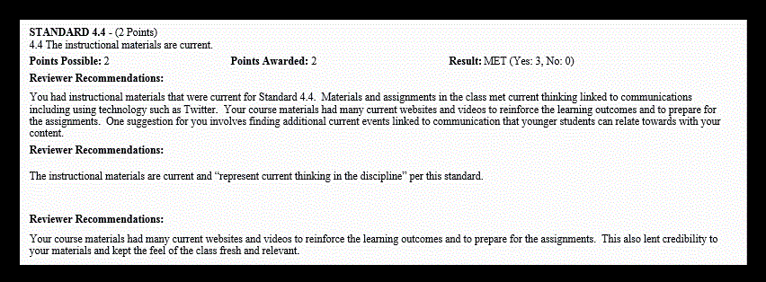
Reviewer Recommendations

Slide 30
Set Sail on a Three-Course Tour:
Three examples of a QM Reviewed Course
Krista MacDonald
QM Standard 5
Course Activities and Learner Interaction
Notes:
5.1 The learning activities promote the achievement of the stated learning objectives or competencies.
5.2 Learning activities provide opportunities for interaction that support active learning.
5.3 The instructor’s plan for classroom response time and feedback on assignments is clearly stated.
5.4 The requirements for learner interaction are clearly stated.

Slide 31
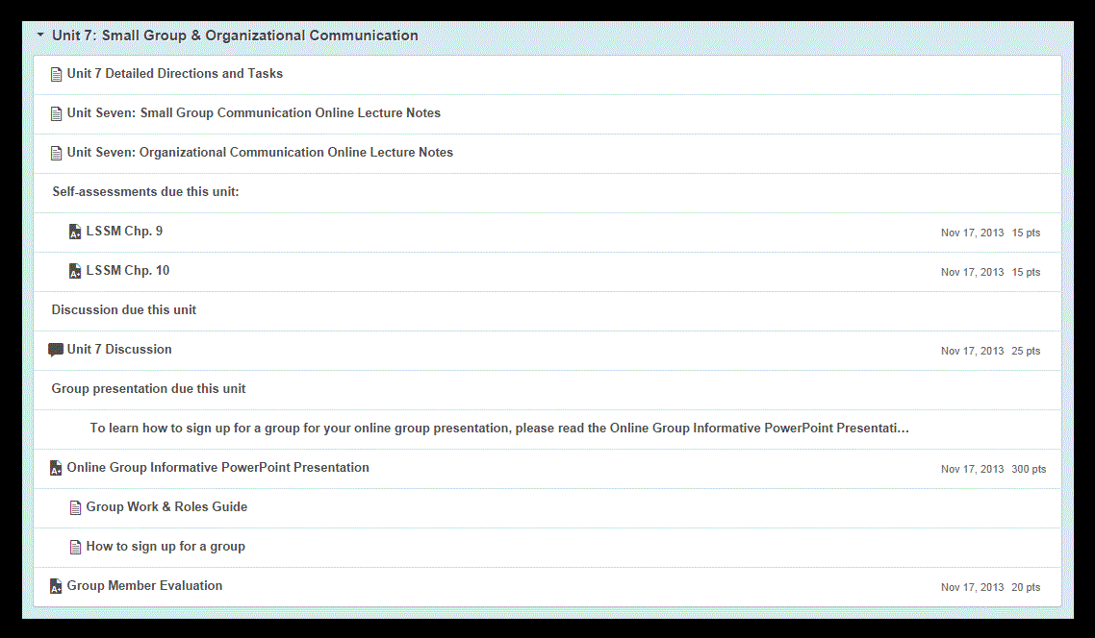
Learning Activities

Slide 32
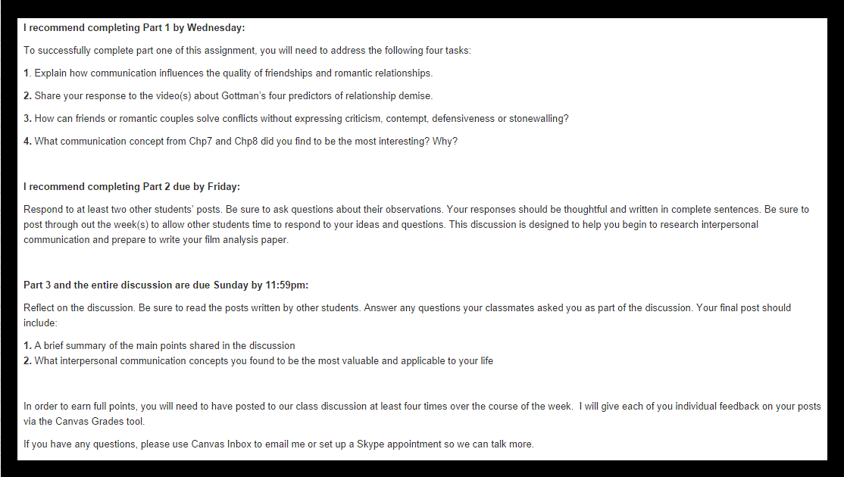
Interaction & Active Learning
Student-Content
Student-Student
Student-Instructor

Slide 33
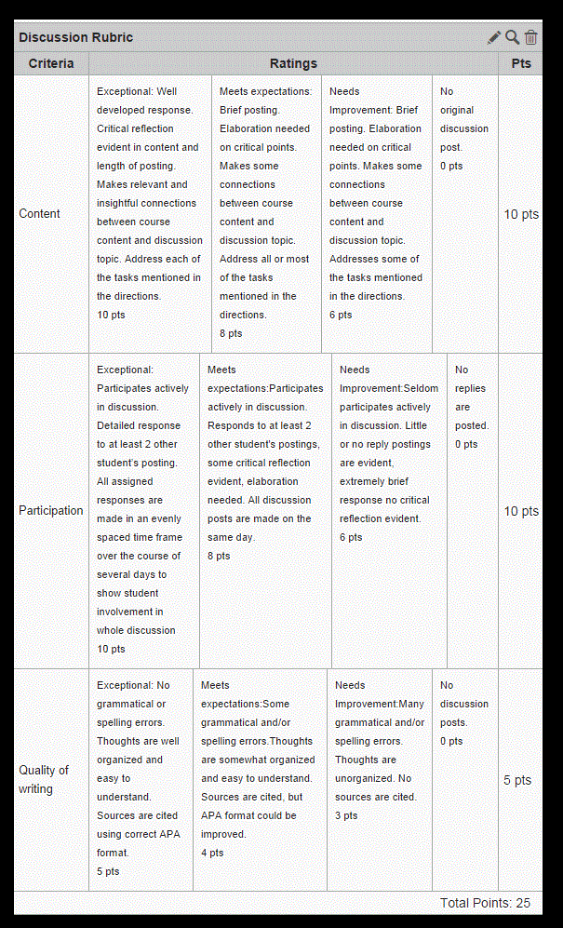
Interaction & Active Learning

Slide 34
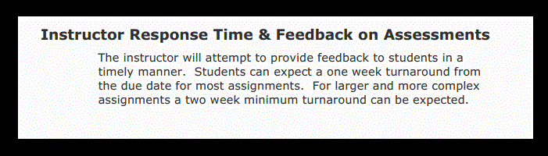
Response Time

Slide 35
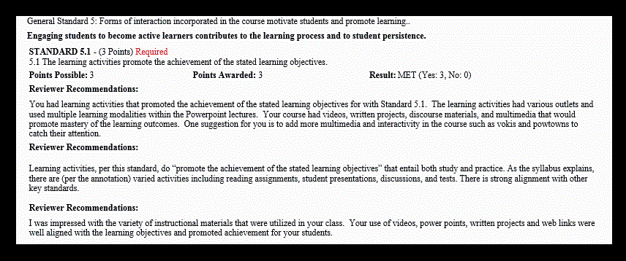
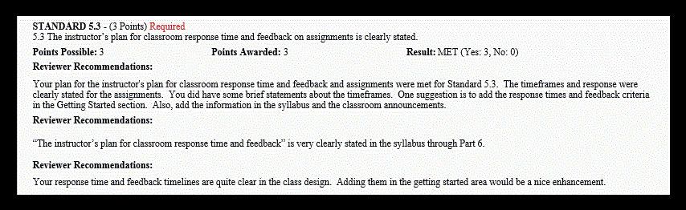
Reviewer Recommendations

Slide 36
Set Sail on a Three-Course Tour:
Three examples of a QM Reviewed Course
Krista MacDonald
QM Standard 6
Course Technology
Notes:
6.1 The tools used in the course support the learning objectives and competencies.
6.2 Course tools promote learner engagement and active learning.
6.3 Technologies required in the course are readily obtainable.
6.4 The course technologies are current.
6.5 Links are provided to privacy policies for all external tools required in the course.

Slide 37
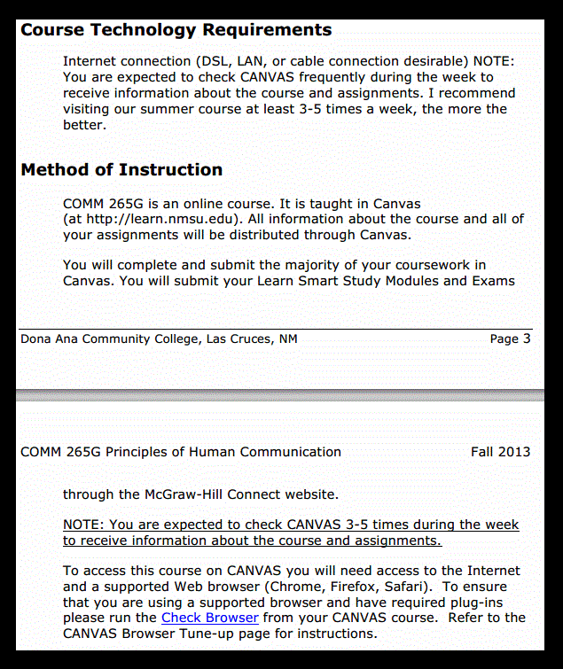
Course Tools & Media
Discussion
Chat
Grade Book
Storage

Slide 38
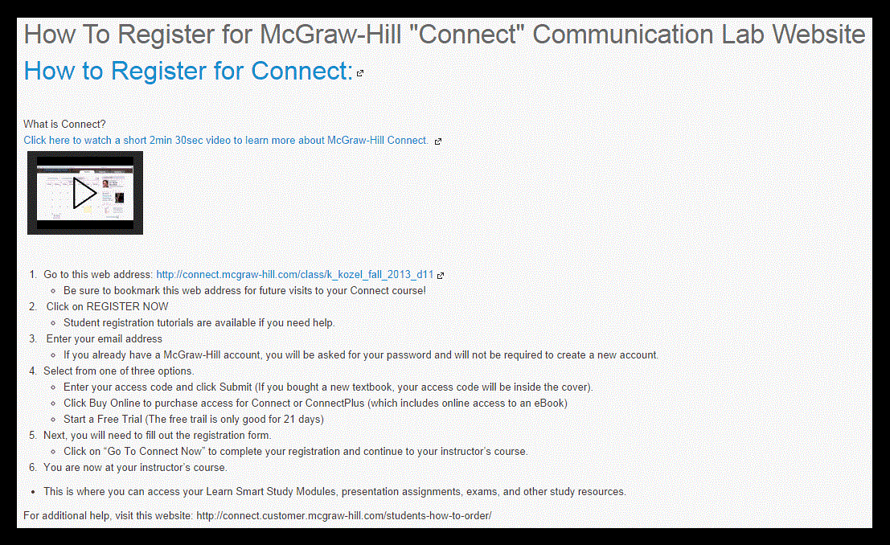
Course Tools & Media
Learning Analytic Study Modules/Games
Media Support Videos

Slide 39
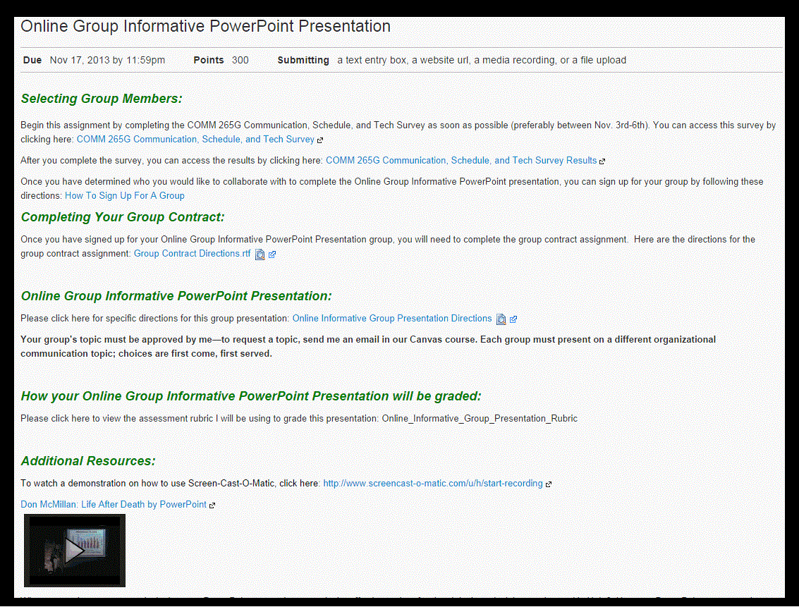
Course Tools & Media
Google Drive Form
Screen-Cast-O-Matic Presentation
Website and Video Resources

Slide 40
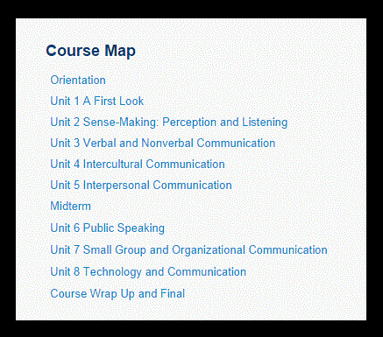
Course Navigation

Slide 41
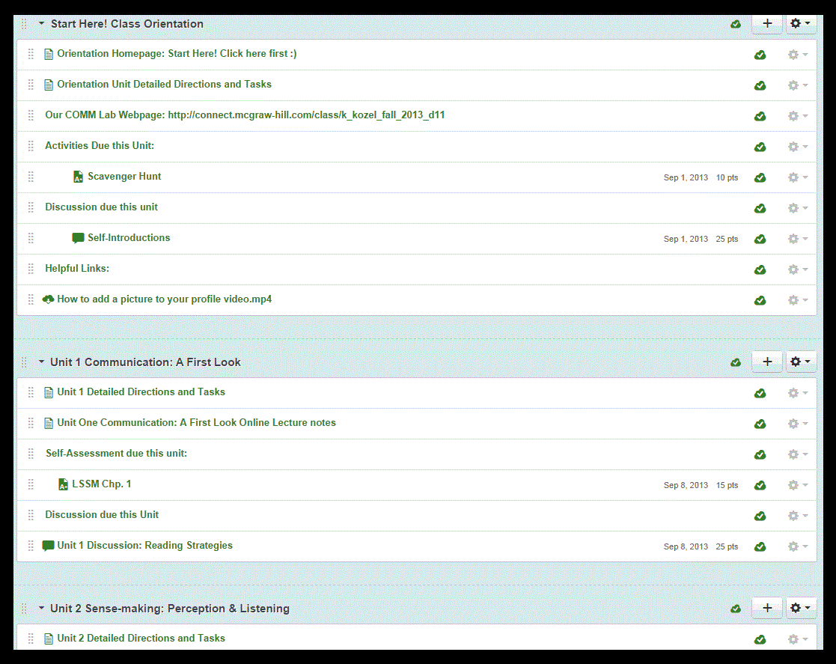
Course Navigation

Slide 42
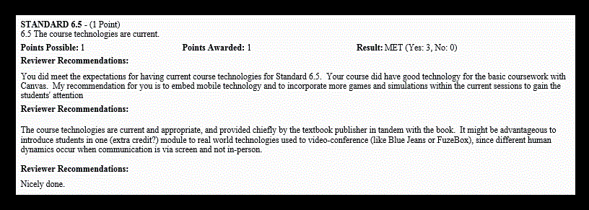
Reviewer Recommendations

Slide 43
Set Sail on a Three-Course Tour:
Three examples of a QM Reviewed Course
Sharon Lalla, Ed.D.
Asst. College Professor COE and Instructional Innovation & Quality
New Mexico State University

Slide 44
Set Sail on a Three-Course Tour:
Three examples of a QM Reviewed Course
Sharon Lalla, Ed.D.
EDLT 579: Universal Design for
Online Course Design

Slide 45
Set Sail on a Three-Course Tour:
Three examples of a QM Reviewed Course
Sharon Lalla
QM Standard 7
Learner Support
Notes:
7.1 The course instructions articulate or link to a clear description of the technical support offered and how to obtain it.
7.2 Course instructions articulate or link to the institution’s accessibility policies and services.
7.3 Course instructions articulate or link to an explanation of how the institution’s academic support services and resources can help
learners succeed in the course and how learners can obtain them.
7.4 Course instructions articulate or link to an explanation of how the institution’s student services and resources can help learners succeed and
how learners can obtain them.

Slide 46
QM 7: Learner Support
7.1 Technical Support
7.2 Accessibility Policies
7.3 Academic Support
7.4 Student Services

Slide 47
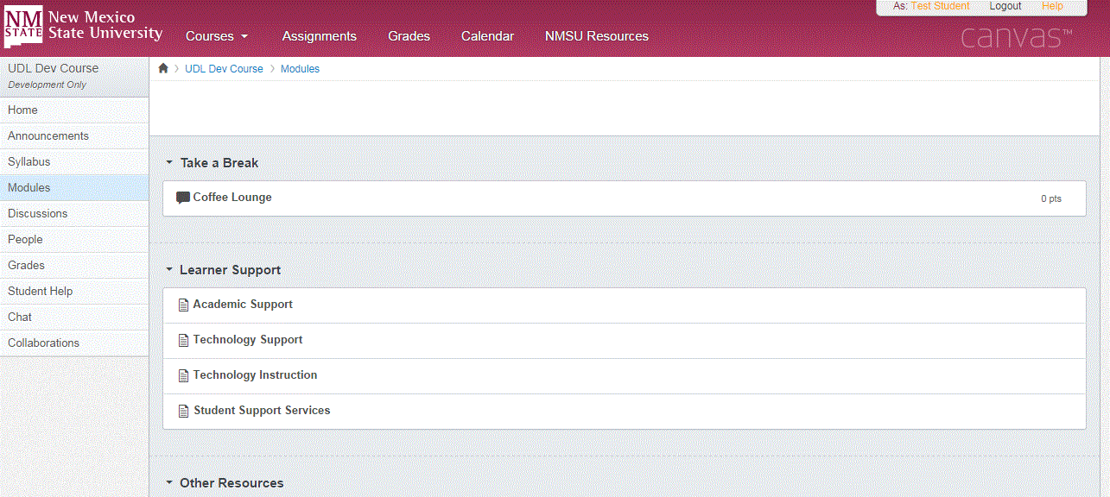

Slide 48
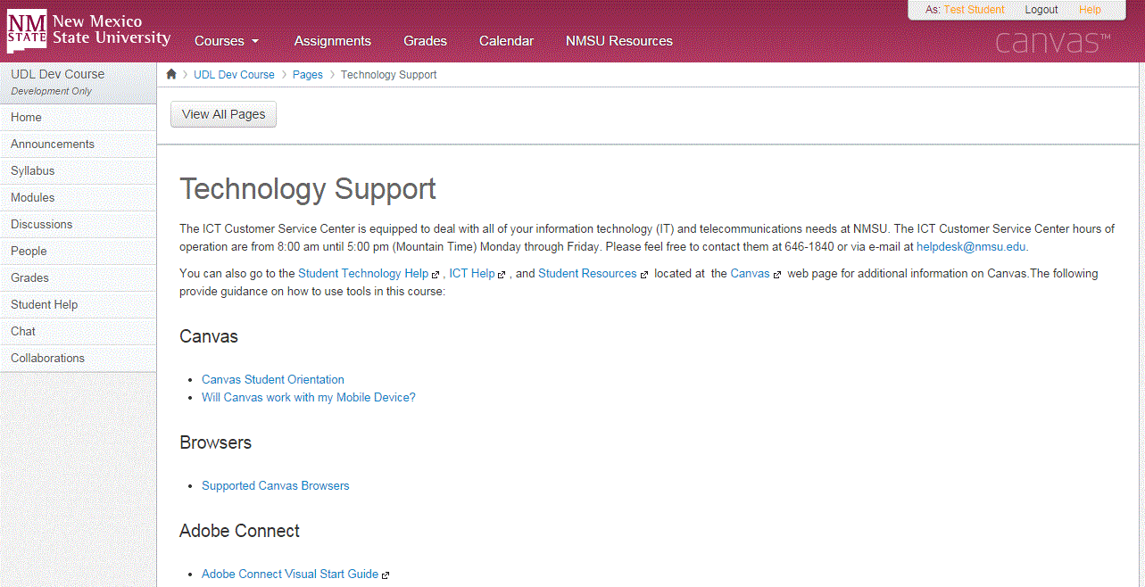

Slide 49
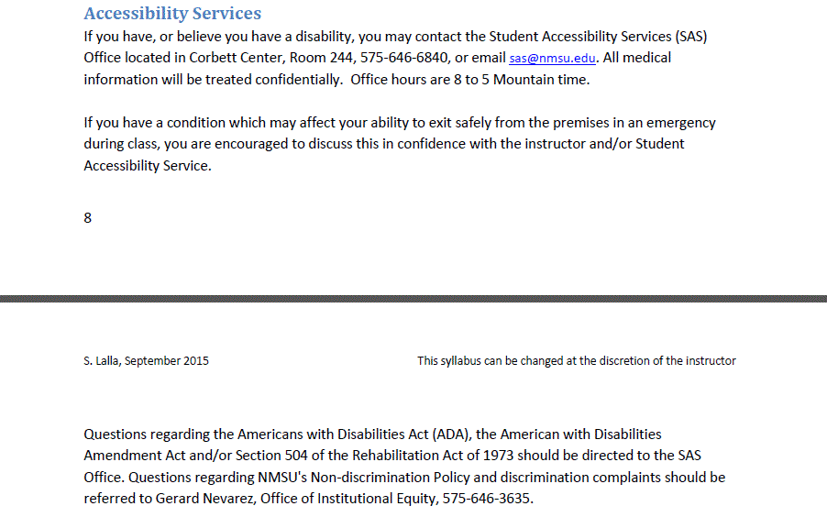

Slide 50
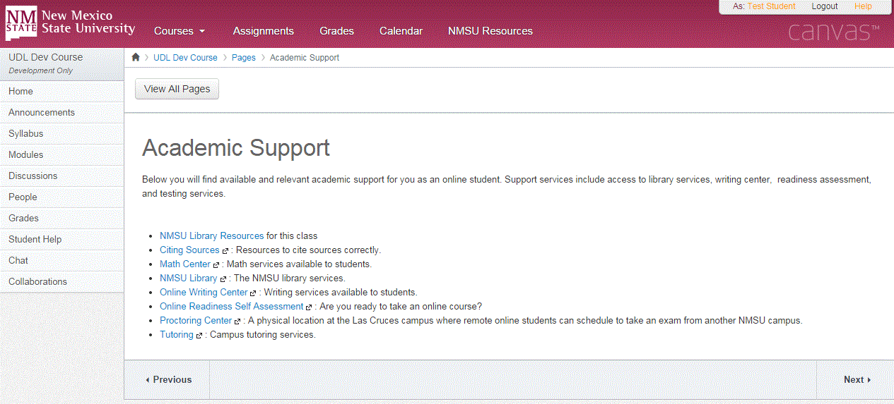

Slide 51
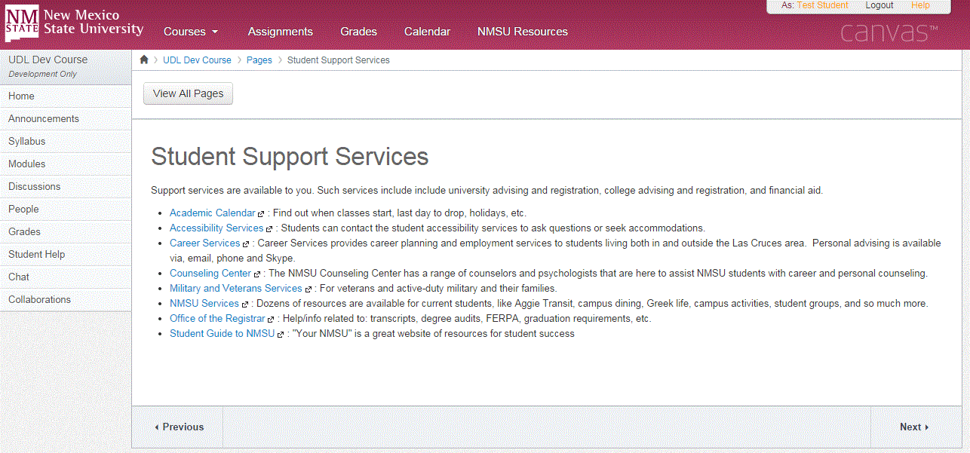

Slide 52
What I learned from the
review about QM7……

Slide 53
Set Sail on a Three-Course Tour:
Three examples of a QM Reviewed Course
Sharon Lalla
QM Standard 8
Accessibility and Usability
Notes:
8.1 Course navigation facilitates ease of use.
8.2 Information is provided about the accessibility of all technologies required in the course.
8.3 The course provides alternative means of access to course materials in formats that meet the needs of diverse learners.
8.4 The course design facilitates readability.
8.5 Course multimedia facilitate ease of use.

Slide 54
QM 8: Accessibility & Usability
8.1 Navigation
8.2 Accessible Technologies
8.3 Multiple Materials
8.4 Readability
8.5 Ease of Use

Slide 55
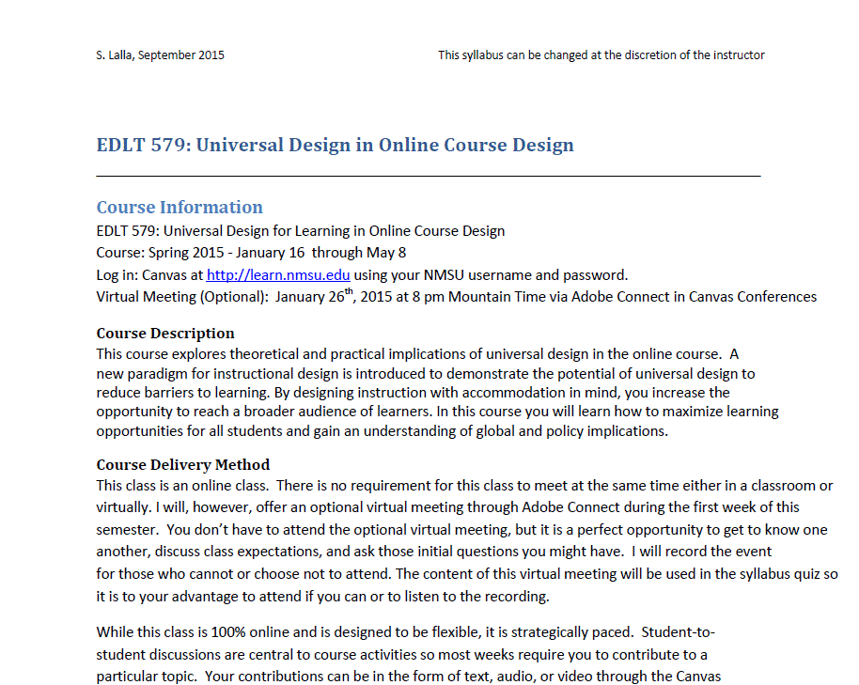

Slide 56
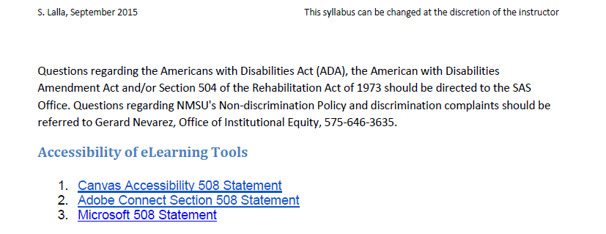

Slide 57
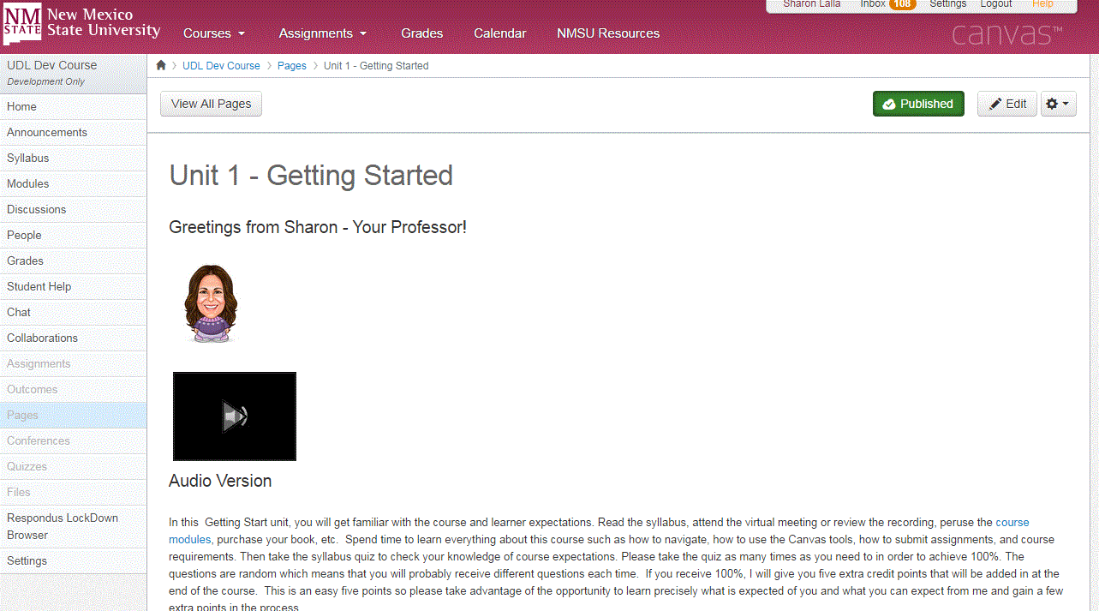

Slide 58
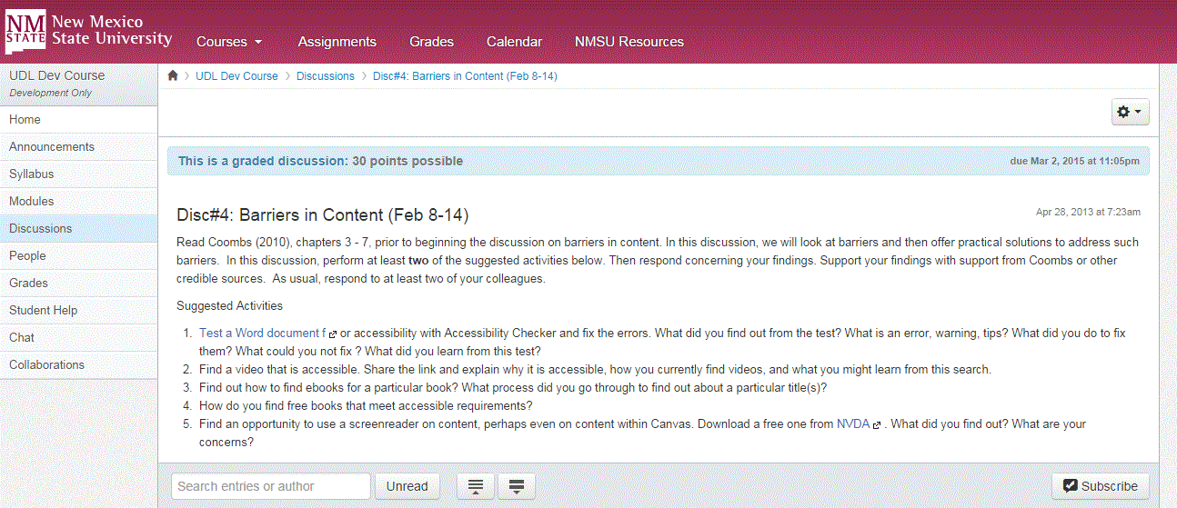

Slide 60
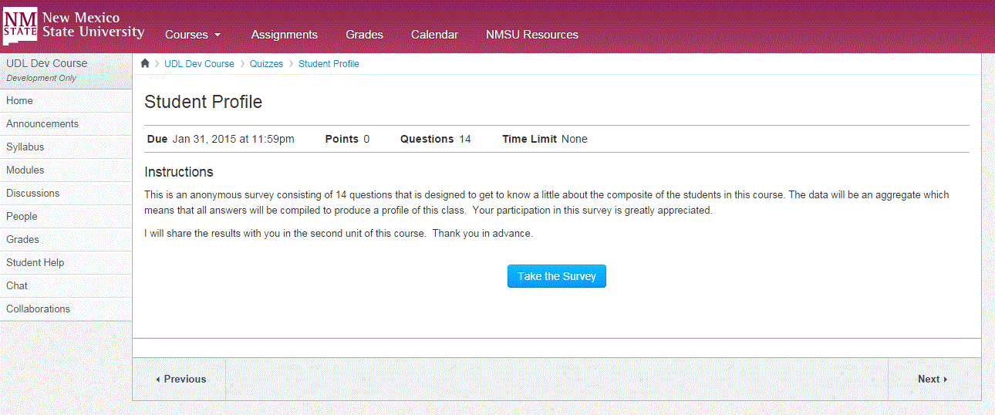
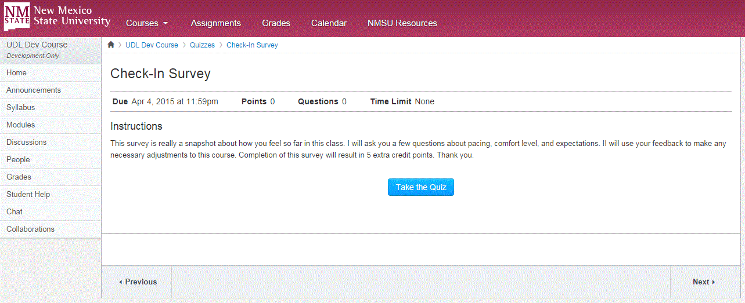
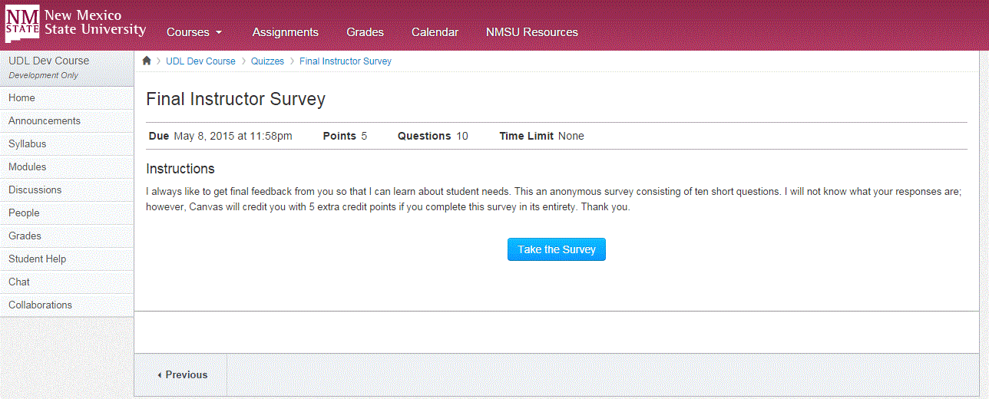

Slide 61
What I learned from the
review about QM8……

Slide 62
Set Sail on a Three-Course Tour:
Three examples of a QM Reviewed Course
Thank You!

Slide 63
Set Sail on a Three-Course Tour:
Three examples of a QM Reviewed Course
Krista MacDonald Doña Anna Community College
Sharon Lalla New Mexico State University
Becky Adams University of New Mexico

