Slide 1
Moving On Up: Using Websites For Teacher and Staff Training
Darrin Jones
Online Support Services Coordinator
Cloud County Community College
Concordia, Kansas

Slide 2

One-Third of U.S. Students Use School-Issued Mobile Devices
By David Nagel
04/08/14
http://thejournal.com/Articles/2014/04/08/A-Third-of-Secondary-Students-Use-School-Issued-Mobile-Devices.aspx?p=1

Slide 3


Slide 4


Slide 5


Slide 6
“Energy and persistence conquers all things.”
—Benjamin Franklin

Slide 7
O snail
Climb Mount Fuji
But slowly, slowly!
― Kobayashi Issa

Slide 8
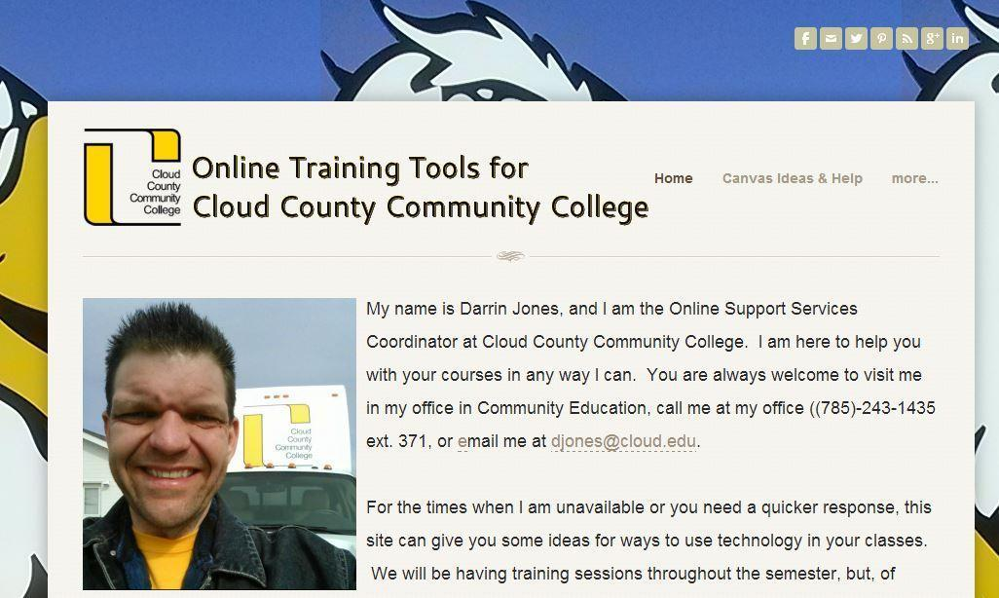
otcccc.weebly.com

Slide 9
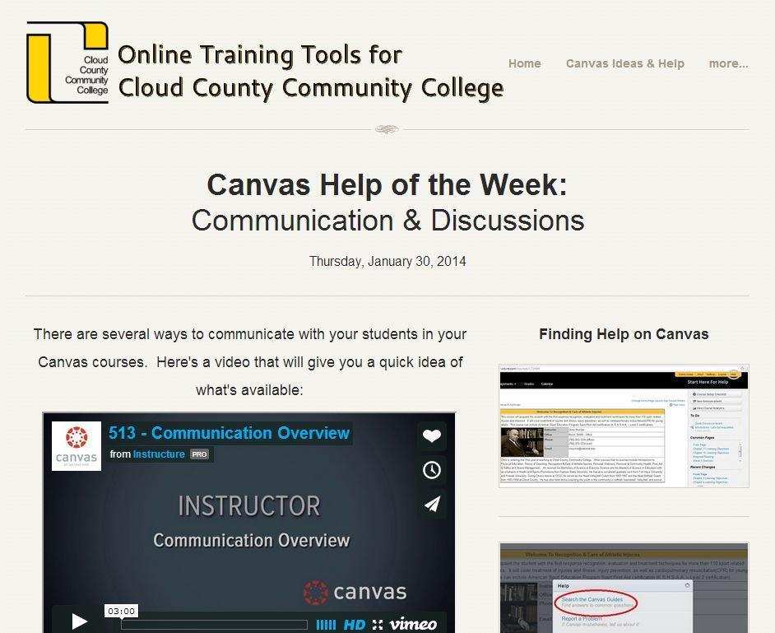

Slide 10
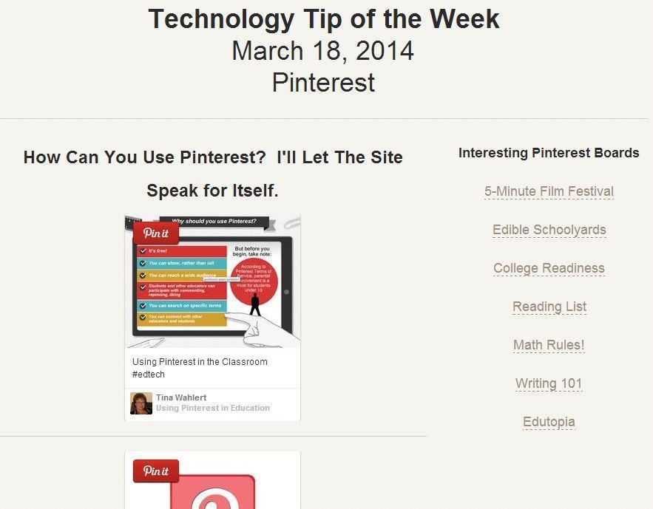

Slide 11


Slide 12
“I appreciate the sharing of information.”
“I have enjoyed the information and while sometimes I did not have time to read things right then, I appreciate that they are out there.”
“It has allowed me to learn more about Canvas - specifically since I am an adjunct and not on campus during the day when I can ask someone.”
“I have a folder dedicated to your info and I just put the stuff pertinent to my job in it – I appreciate your efforts !”

Slide 13
“Know that there are people who are appreciative of everything you do, and that the students are ultimately reaping the rewards of all of your hard work (via enlightening their teachers). Keep up the good work!”

Slide 14
Email: darrincccc@gmail.com
Twitter: @darrincccc
Website: otcccc.weebly.com
Thank you!
Please keep learning!!!

Slide 15
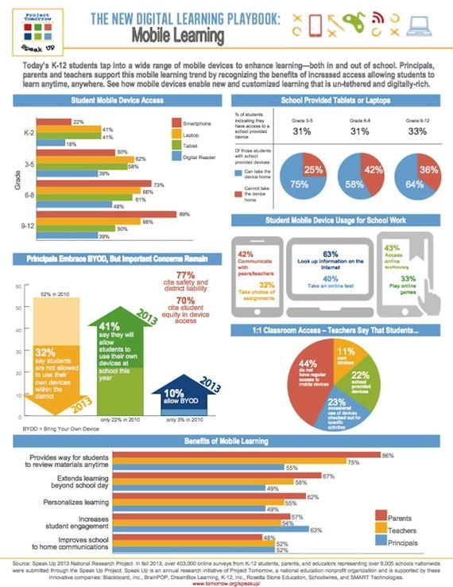
http://thejournal.com/Articles/2014/04/08/A-Third-of-Secondary-Students-Use-School-Issued-Mobile-Devices.aspx?p=1

