Slide 1

Quality at the Peak:
Colorado Community College System's Approach to QM Implementation
Tina Parscal, Ph.D. – Executive Director
Stephen McElroy, Ph.D. – Director of Academic Excellence
Darci Duran, M.S.Ed. – Instructional Design Manager
Colorado Community Colleges Online

Slide 2

Outline
Presentation Learning Objectives
Scope of QM at CCCS
History and Current Activities
Academic Excellence and Professional Development
Strategy and Sustainability
Notes:
Garden of the Gods with Pikes Peak in the background.

Slide 3
Learning Objectives
Examine strategies used in planning and implementing Quality Matters within a state community college system
Discuss the evolution of course design and quality assurance processes
Examine the impact of Quality Matters and quality assurance policies on instructional practices and academic policies

Slide 4
Colorado Community College System
13 Community Colleges in Colorado
Serve nearly 144,000 students
53,013 FTE in FY 2014-15
Serve 48% of all under-represented undergraduate students in Colorado
55% of CCCS students are female
56% of CCCS students are under 25 years old
60% completely debt-free
www.cccs.edu
Notes:
Largest higher education system in the state.

Slide 5
Colorado Community Colleges Online
(CCCOnline)
Consortium of 13 colleges, plus Dawson CC
25,000 students / 40,000 enrollments annually
65% of CCCOnline students are female
44% of CCCOnline students are under 25 years old
210 courses
452 instructors
Over 2300 sections annually
15-, 10-, and 6-week terms
www.ccconline.org
Notes:
Largest higher education system in the state.

Slide 6
Member Colleges & CCCOnline
Colleges
Student Advising
Registration
Award Grades
Accreditation
Curriculum
Common Course Numbering System
CCCOnline
Develop courses
Hire, develop, and evaluate instructors
Hire SMEs
Administer system’s LMS
24/7 Help Desk
Library
Tutoring
Quality Matters

Slide 7

CCCS QM Members

Slide 8
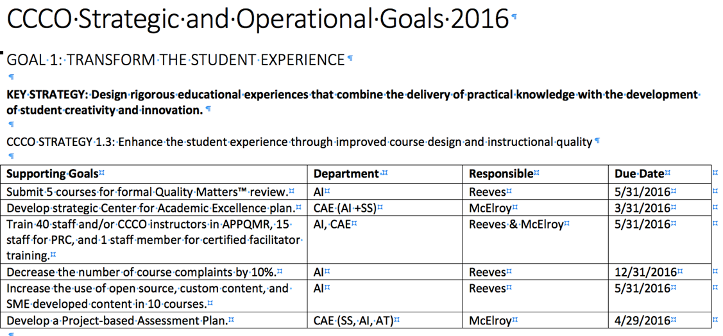
Aligning QM with Strategy
Transform the Student Experience
Transform our Workforce Experience
Create Transformational Partnerships
Redefine our Value Proposition
Notes:
Transform the Student Experience
Top 20 courses at CCCOnline
Redefining the Value Proposition
Grow Online and Hybrid Enrollments
Transform the Workforce
Professional Development

Slide 9
History
2011 – QM member institution
  Raise quality in course design and standardize courses
2013 – First Master Course Template
2013 – State Subscription with 4 other colleges
2015 – QM Implementation Plan
2015 – Internal QM review of courses begins
2015 – First QM recognized course (COM125)
2016 – Face-to-Face Facilitator

Slide 10
Where We Are Now?
Individuals Trained – 127
  Applying the Quality Matters Rubric: 87
  Peer Reviewer Course: 40
Peer Reviewers (active) – 14
Facilitators – 2
QM Recognized Courses – 6
  Interpersonal Communication (COM125)
  World Mythology (HUM115)
  Public Speaking (COM115)
  College Algebra (MAT 121)
  Medical Terminology (HPR178)
  Principles of Macroeconomics (ECO201)

Slide 11
Master Course Template
Standardized guidelines for course creation
  Ensures alignment of courses and module objectives with assessment, instructional materials, course activities/engagement, and use of technology/tools
  Provides Subject Matter Experts (SME) a clear design template for each module
  Facilitates input of course content by SME / ID so that the remaining QM Specific Review Standards can be met

Slide 12
Master Course Template (MCT)
MCT is reviewed and updated annually
Fulfills 26 of 43 QM Specific Review Standards:
  14/21 Essential Standards
  8/14 Very Important Standards
  4/8 Important Standards
How do we address the remaining 17 Specific Review Standards?

Slide 13

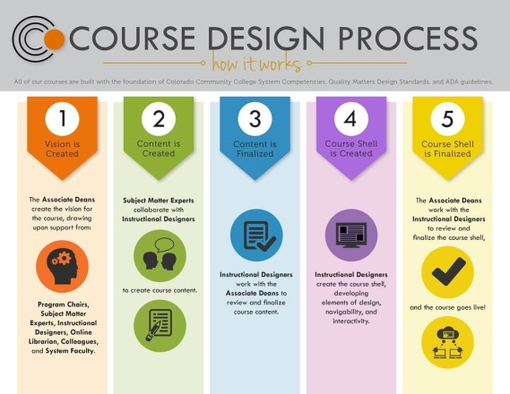

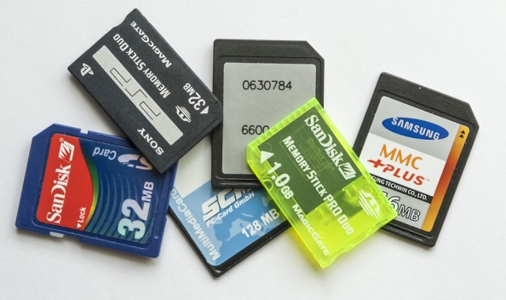
Academic Excellence
Curriculum
Mapping
Process
Impacts for
Assessment
Subject Matter
Expert Orientation
Capacity
Building
for QM
Notes:
Small cabins lined up in a neat row to illustrate alignment.
Treasure map to illustrate collaborative work necessary to reach the goal of meaningful assessment.
Five steps of the course design process.
Memory cards to illustrate capacity building.

Slide 14
Academic Excellence
Curriculum Mapping Process
  Examined alignment in 27 high enrollment courses
  Used Common Course Numbering System (CCNS) competencies that establish course consistency
  Mapped out alignment of module content with course learning outcomes
  Lessons learned: instructional design process
    Emphasize content breadth > depth
    Create meaningful grading rubrics
    Standardize course build process in five modules

Slide 15
Academic Excellence
Curriculum Mapping Impacts for Assessment
  Develop course content with assessment in mind
  Focus on consistent grading among instructors in the same course
  Continuous improvement process at CCCOnline
  Collaboration is critical:
    Instructional design team and subject matter experts
    Online instructors and teaching excellence team
  Assessment ensures quality and accountability

Slide 16
Academic Excellence
Subject Matter Expert Orientation
  Training course to familiarize instructors with our course design process
  91 instructors completed it since May 2016 launch
  Includes all required document templates
    Course Syllabus Template
    Course Map Template
    Content Gathering Method Guidelines
    Course Content Template
    Course Assessment Template
    Seat Time Calculator

Slide 17
Academic Excellence
Capacity Building for QM
  Identify top instructors for QM training
  Fund participation in APPQMR and PRC
  Allocate budget for sustained QM activities
  Utilize instructors for internal reviews
  Provide opportunities for remunerated QM reviews
  Assigned PD Specialist to coordinate QM registrations

Slide 18
QM Professional Development
Applying the Quality Matters Rubric
  Subject Matter Experts
Peer Reviewers
  Associate Deans, Program Chairs, Academic Excellence staff, and Instructional Designers
Online and Face-to-Face Facilitators
  Two online and one face-to-face session each year
Cape Program

Slide 19

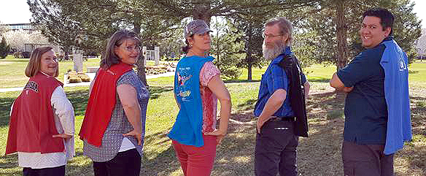
Cape Program
Program
Chairs
Instructional
Designers

Slide 20
Strategy and Sustainability
Serves as integral part of academic and operational infrastructure
Provides common language and benchmarks
Builds synergy and partnerships
Deepens and expands involvement within system
Grounds innovation efforts

Slide 21
Impact of QM
Course Design
Course Development
QA Processes
Instructional Process
Professional Development
Institutional Effectiveness

Slide 22
Thank You
Contact Information:
    Tina Parscal Tina.Parscal@cccs.edu
    Stephen McElroy Stephen.McElroy@cccs.edu
    Darci Duran Darci.Duran@cccs.edu
    Colorado Community Colleges Online

