Slide 1
Quality Conversations in Assessment
Shelley Ragland, PhD

Slide 2
Session objectives
Identify key stakeholders in the assessment quality conversation
Determine appropriate and meaningful quality metrics
Understand the cyclical nature of quality conversations

Slide 3
Competency-based education
CBE allows students to advance based on their ability to master a skill or competency at their own pace regardless of environment (Educause)
WGU: a competency-based, student-focused, online, nonprofit university
Educause
WGU

Slide 4
Leaders in CBE
When WGU was founded in the late 1990s, it represented the first higher education institution to award degrees based solely on competencies.
CBE programs now firmly established:
  Alverno College
  Capella University*
  Excelsior College*
  Lipscomb University*
  Southern New Hampshire University
Measuring Mastery, 2015

Slide 5
Shared vision
To promote and improve the quality of online education and student learning through:
Development of research-supported, best practice-based quality standards and appropriate evaluation tools and procedures.
Recognition as experts in online education quality assurance and evaluation.
Fostering institutional acceptance and integration of QM standards and processes into organizational improvement efforts focused on improving the quality of online education.
Provision of faculty development training in the use of QM Rubric(s) and other quality practices to improve the quality of online/blended courses.
Provision of quality assurance through the recognition of quality in online education.
The QM Mission

Slide 6
Different tools
To promote and improve the quality of online education and student learning through:
evaluation tools and procedures
QM standards and processes
QM Rubric(s) and other quality practices
The QM Mission

Slide 7
WGU’s path to quality
Quality Assessment Review
Ongoing Process
Regular & Routine Occurrence
Several Stakeholders
Proactive Approach
Mini Program Review

Slide 8
Key stakeholders
WGU
Program Management
Performance Feedback
Psychometrics
Other Universities
Responsible for success of program
Responsible for success of students
Responsible for organization metrics

Slide 9
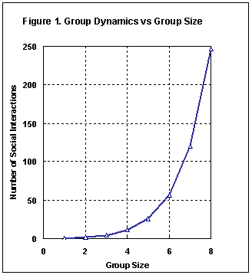
Number of Stakeholers

Slide 10
Key metrics
Responsible for success of program
Pass Rates
On-Time-Progress
Graduation Rates
Awards
Recognition
Enrollment
Employer Satisfaction
Alumuni Satisfaction

Slide 11
Key metrics
Responsible for success of students
Pass Rates
On-Time-Progress
Graduation Rates
Student Satisfaction
Course Evaluations
Instructor Feedback
Advisor Feedback

Slide 12
Key metrics
Responsible for organization metrics
Pass Rates
On-Time-Progress
Graduation Rates
Large-Scale Assessment Metrics: reliability & validity
External Comparisons

Slide 13
Characteristics of quality metrics
Shared
Respected
Consistent

Slide 14
Participation guide
Break into small groups
  Make Introductions:
    Who are you?
    What do you do at your institution?
    Why did you come to this session?
  Determine Roles:
    Responsible for success of program
    Responsible for success of students
    Responsible for organization metrics

Slide 15
Participation guide
  Open Your Report
    What looks good?
    What looks bad?
    Which course(s) would you prioritize?
  Share Your Report with Your Team
    Which course(s) would you all prioritize?
  Report to the Larger Group

Slide 16
references

