Slide 1
Quality Online Course Development:
Its Role in Promotion & Tenure
Quality Matters 8th Annual Conference
New Mexico State University
Notes:
Sandy

Slide 2
NMSU Research Team
Richard Oliver- Professor, College of Business
Susan Bussmann- Distance Education Director
Michelle Lebsock- Academic Technology
Sandra Johnson- Quality Matters Coordinator
Paula Johnson- Instruction & Liaison Librarian
Kerry Forsythe- Online Course Improvement Program
Miley Grandjean- Online Course Improvement Program
Tyler Luster - Graduate Student, College of Business
Junayet (Mohammed) Hossain - Distance Education
Notes:
Sandy

Slide 3
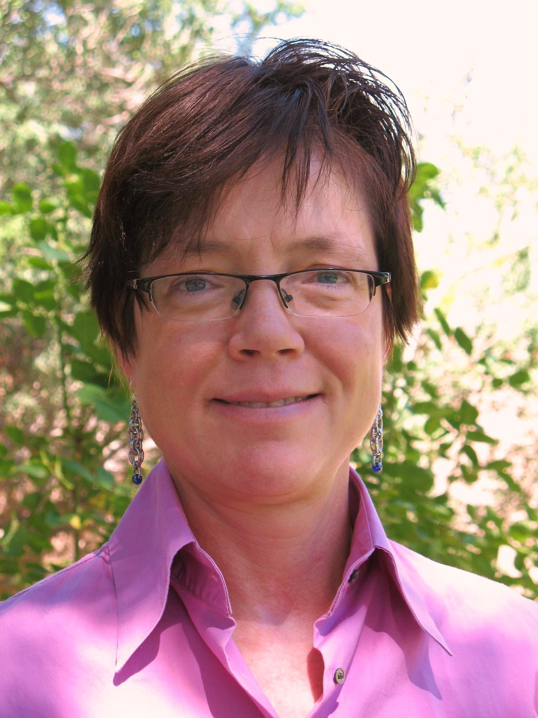
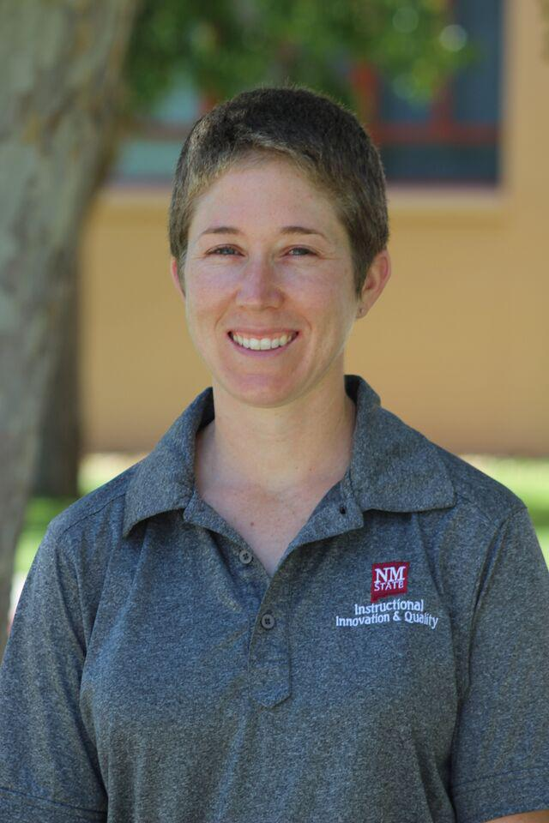



Tyler Luster
Paula Johnson
Miley Grandjean
Junayet Hossain
Kerry Forsythe
Notes:
Sandy

Slide 4
About NMSU
Public land grant institution
Hispanic-serving, doctoral granting
High research activity R2 Carnegie Classification
15,490 undergraduate and graduate students (NMSU, 2016).
Offers wide variety of programs through its Graduate School
Six academic colleges
  Agricultural, Consumer, and Environmental Sciences; Arts and Sciences; Business; Education; Engineering; and Health and Social Services.
Notes:
Michelle

Slide 5
Programs at NMSU
University Degrees
DE Degree Programs
21 Doctoral Programs
51 Masters’ Programs
87 Baccalaureate Programs
3 PhD Degree Programs
20 Masters’ Degree Programs
8 Bachelor Degree Programs
3 Graduate Certificate Programs
3 Endorsements
2 Licensures
Notes:
Michelle

Slide 6
Distance Education Snapshot FY16
Average 550 DE courses per semester
480-485 faculty teaching DE courses
Notes:
Michelle

Slide 7
Overview of Study
The focus of this study was to determine whether developing a “quality” (peer-reviewed) online course receives credit in the promotion and tenure process at 4-year public universities in the western United States.
Research Questions
Does your department have a well-developed and explicitly stated policy for rewarding “quality” online course development in the promotion and tenure process?
If so, how is a “quality” online course valued in Promotion & Tenure?
Notes:
Sandy

Slide 8
Literature Review
Calls to include faculty effort in teaching quality online courses in promotion and tenure considerations have been made almost since these courses have been offered. (Wolcott, 1997; Banas & Emory, 1998; Roby et al, 2012)
Concerns that producing and teaching a quality online course will actually work against a faculty member’s obtaining promotion and tenure, by taking time away from more highly valued scholarship and service. (Bower, 2001; Blair & Monske, 2003; Schifter, 2004; Brary, Harris and Major, 2007; Tabata and Johnsrud, 2008; Seaman, 2009; Gutman, 2012; Hopewell, 2012; Raffo, et al., 2015)
P & T committees often fail to grasp the significant amount of labor required to develop quality online classes, so it is given less credit toward promotion and tenure than it deserves. (Blair and Monske, 2003; Schell, 2004; Green, et al., 2009; Orr, Williams & Pennington, 2009; Simpson, 2010)
Notes:
Sandy

Slide 9
Literature Review
A national survey of doctorate-granting institutions revealed that one third of the faculty did not know if their online teaching would factor in promotion and tenure decisions, and forty percent believed it would not have a positive impact on their promotion and tenure. (Hoyt & Oviatt, 2013)
Current practice is to give considerable weight to course evaluations in assessing a faculty member’s teaching. Typically, evaluations for online courses aren’t different from traditional; “Student Evaluation of Teaching: The Inequity of Faculty Scores in Online versus Face-to-Face Courses.” (Sullivan et al., 2013; Speaks, et al., 2015;Tobin, 2015)
Notes:
Sandy

Slide 10
Methods
15 universities identified as New Mexico State University (NMSU) peer institutions and 3 additional 4-year public research universities
Survey invitation sent to 248 departments stating they had online programs
  18/19 Institutions responded; 1-12 responses from each; Provided an average of 3 per institution
  56 survey completions for a return rate of 23%.
More in-depth follow-up phone interviews were conducted with 10 respondents
Interviews were transcribed and coded for common themes.
Notes:
Sandy

Slide 11
Survey Results

Slide 12
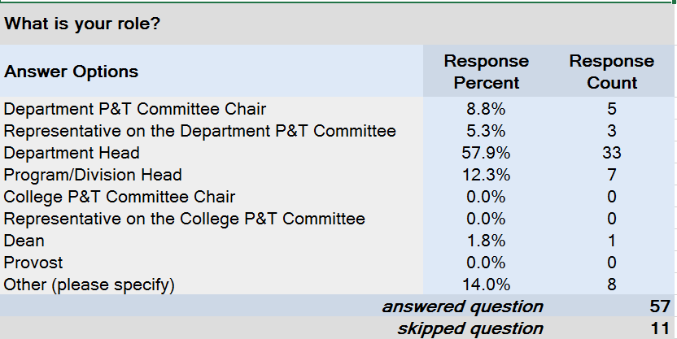
Notes:
Richard

Slide 13
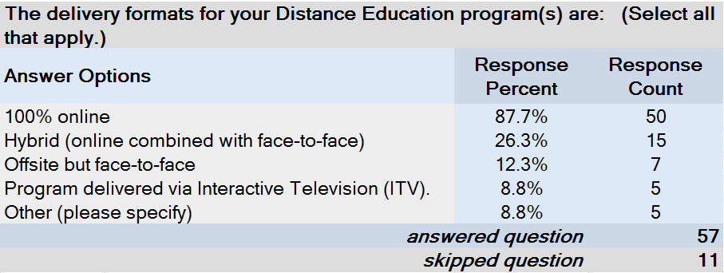
Notes:
Richard

Slide 14
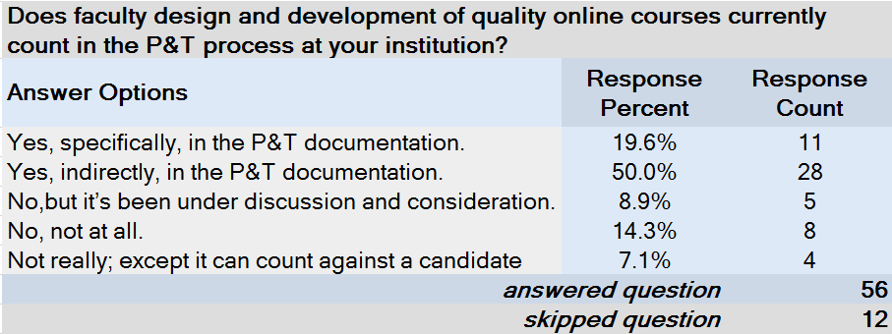
Notes:
Richard

Slide 15
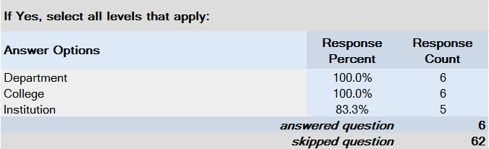
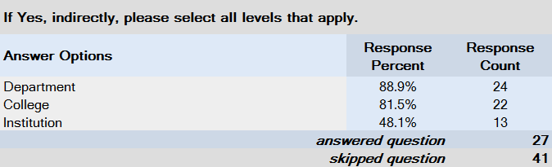
Notes:
Richard

Slide 16
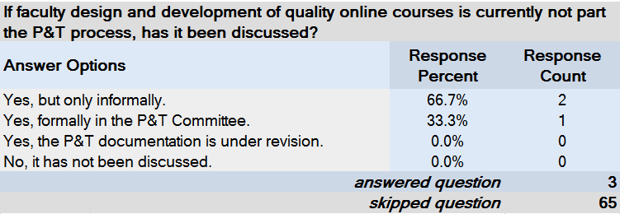
Notes:
Richard

Slide 17
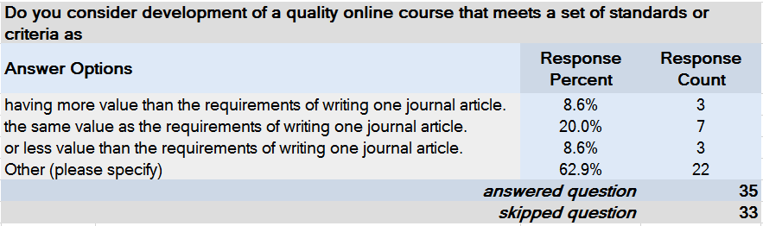
Notes:
Richard

Slide 18
Comments “compared to journal article”
Examples: (12 out of 22) 54%
  “Different aspects of a role statement. Research and teaching documentation requires different evidence to show excellence.”
  “I evaluate teaching independent of research.”
  Examples (7 out of 22) 33%
  “Same value as publishing one journal article (we give no credit for writing an article).”
  “Not equivalent to a publication.”
  “Depends on the journal article.”
Notes:
Richard

Slide 19
Comments “compared to journal article”
Examples: (2 out of 22) 9%
  “We don’t tally a sum total, we look for quality in all aspects of the appointment.”
  “This is difficult to say in quantitative terms like those presented. We do not evaluate contributions in such strict numerical terms, but consider the whole candidate.”
Examples: (1 out of 22) 5%
  “I would compare it in value to other activities within the teaching role.”
Notes:
Richard

Slide 20
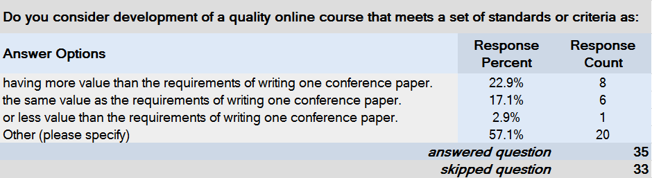

Slide 21
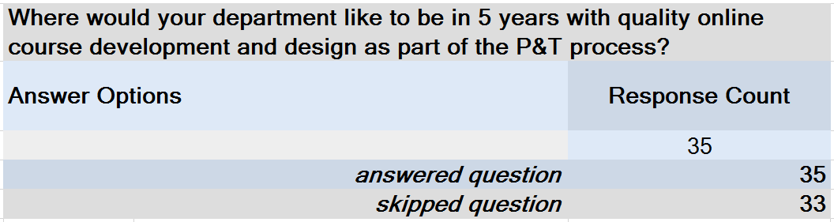

Slide 22
5 Year Outlook Summary
Examples: (12 out of 29) 43%
  “We are already there.”
  “I am happy with what we do at the moment.”
Examples: (8 out of 29) 27%
  “Moving more and more to online. Expect faculty to incorporate latest technology and pedagogy.”
  “Utilization of Quality Matters certification process as an indicator high quality contributions in P.” (Assuming “P” means Promotion)

Slide 23
5 Year Outlook Summary
Examples: (4 out of 29) 14%
  “Quality instruction has always been important regardless of delivery.”
  “Online counts no differently that face-to-face in terms of evaluating teaching for P&T.”
  “Indistinguishable from face-to-face offerings in terms of criteria for success; when have we asked for folks to take a class on teaching face-to-face?”

Slide 24
5 Year Outlook Summary
Examples: (3 out of 29) 10%
  “We need to move toward meeting standards in all courses.”
  “100% approved as best practices.”
Examples: (2 out of 29) 7%
  “I am not sure.”
  “We have not discussed this since the start of our online Master’s program.”

Slide 25
Interview Analysis

Slide 26
Interviewees’ Profile
10 Interviews
  8 Department head or chair
  1 Faculty member
  1 Coordinator of Graduate Studies
8 Institutions representing 7 states
Protocol of questions
Average interview 25 - 35 minutes

Slide 27
Colleges | Departments
2 Engineering 3 Arts & Sciences 3 Agriculture 1 Business 1 Education | Computer and Industrial Engineering Anthropology Physics Apparel, Events & Hospitality Management Ag Ed & Communications Natural Resources Fisheries and Wildlife Agribusiness Family Consumer Science & Human Development

Slide 28
Qualitative Results
Started DE/online courses/degrees 2000 - 2009
Faculty choose to develop/teach online
Faculty develop online course w/ assistance instructional designers (IDs, 7)
  Mandate online course developed by IDs (2)
  Choose develop yourself, with ID, or by IDs (1)
“Quality” focus part of course development (4)
Mandate for meeting “quality” metric for online course design
  Formally defined metric templates, ID support, review process
Incentives - stipends, course buyout, revenue sharing
  3 no and 5 yes

Slide 29
Hiring and Contract Expectations Re: Online Course Development & Teaching
None (1)
  Faculty-driven
Expectation (6)
  Not in the contract, but, "It's kind of an expectation that, at the very least, everyone, at one point or another, whether it's a graduate, undergraduate class, or both, they are going to be teaching online.”
New faculty develop and teach online explicitly stated (3)
  “... made sure that it was part of their hiring document that said you will be teaching every other year an online graduate course in this program, in this discipline."

Slide 30
Research Question 1
1. Does your department have a well-developed and explicitly stated policy for rewarding “quality” online course development in the promotion and tenure process?
No : 12 survey responses, 1 interview
Indirectly, inherent in evaluation of teaching effectiveness: 28 survey responses and 6 interviews
Yes: 11 survey responses, 3 interviews

Slide 31
Research Question 2
2. If so, how is a “quality” online course valued in Promotion & Tenure?
Online course development recognized as a separate activity in P&T:
11 survey responses, 3 interviews
“Quality” metric defined and mandated
No specific equation for determining value = # publications, research or ??

Slide 32
Conclusions
Online course development and teaching are expected, versus specified in hiring, contracts, P&T documentation, and the P&T review process.
“Quality” online course development is not formally listed in the P&T documents.
“Quality” in online course development is not recognized as a formal peer review process, much like a peer-reviewed journal article, in P&T.
Face-to-face and online are treated the same.
  Teaching
  Course Development
  Student evaluations
Student evaluations are primary evidence of “quality” in an online course.

Slide 33
Comparsion to Literature Review
How do our results compare to previous research?
Let’s go take a look!

Slide 34
Literature Review
Calls to include faculty effort in teaching quality online courses in promotion and tenure considerations have been made almost since these courses have been offered. (Wolcott, 1997; Banas & Emory, 1998; Roby et al, 2012)
Concerns that producing and teaching a quality online course will actually work against a faculty member’s obtaining promotion and tenure, by taking time away from more highly valued scholarship and service. (Bower, 2001; Blair & Monske, 2003; Schifter, 2004; Brary, Harris and Major, 2007; Tabata and Johnsrud, 2008; Seaman, 2009; Gutman, 2012; Hopewell, 2012; Raffo, et al., 2015)
P & T committees often fail to grasp the significant amount of labor required to develop quality online classes, so it is given less credit toward promotion and tenure than it deserves. (Blair and Monske, 2003; Schell, 2004; Green, et al., 2009; Orr, Williams & Pennington, 2009; Simpson, 2010)
Notes:
Sandy

Slide 35
Literature Review
A national survey of doctorate-granting institutions revealed that one third of the faculty did not know if their online teaching would factor in promotion and tenure decisions, and forty percent believed it would not have a positive impact on their promotion and tenure. (Hoyt & Oviatt, 2013)
Current practice is to give considerable weight to course evaluations in assessing a faculty member’s teaching. Typically, evaluations for online courses aren’t different from traditional; “Student Evaluation of Teaching: The Inequity of Faculty Scores in Online versus Face-to-Face Courses.” (Sullivan et al., 2013; Speaks, et al., 2015;Tobin, 2015)
Notes:
Sandy

Slide 36
Recommendations

Slide 37
Recommendations
Establish a clear policy on P&T on the value of faculty developing quality online courses from start to finish.
Mentor junior faculty to determine what an academic path one would take in the P&T process.
Call to administrators and P&T committee members to understand the time, effort, and cost of “quality” online education.
Align course evaluations to online format.
Provide professional development in quality online course development.

Slide 38
Questions?
Thank you for your attendance!

