Slide 1
The Meaning of quality in an online course to administrators, faculty, and students
Esther Smidt, Rui Li, Jennifer Bunk,
Timothy Kochem, and Ashley McAndrew
West Chester University

Slide 2
Purpose of Study
To understand administrator, faculty, and student perceptions of quality in distance education courses.

Slide 3
Literature review
Perceptions of Quality in Distance Education

Slide 4
Student Perceptions
Student surveys
Quality meets/exceeds own standards → studying for (Richardson, 2005) and satisfaction with course (Simpson & Benson, 2013).

Slide 5
Faculty Perceptions
Personally rewarding, institutionally supported, and professionally recognized (Roby, Ashe, Singh, & Clark, 2013, p. 30).

Slide 6
Administrator Perceptions
Has yet to be explored.

Slide 7
Methodology

Slide 8

Research Question
What is the meaning of “quality” in an online course to administrators, faculty, and students?

Slide 9
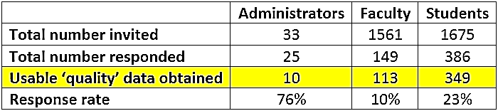
Participants
Experienced in online teaching or learning
2 mid-sized public universities
Mid-Atlantic United States

Slide 10

Data Collection
NVivo 10
Responses read and broad themes established
Responses coded in detail based on previously identified and newly arisen themes
Representative excerpts
Top 7 codes

Slide 11
Results

Slide 12
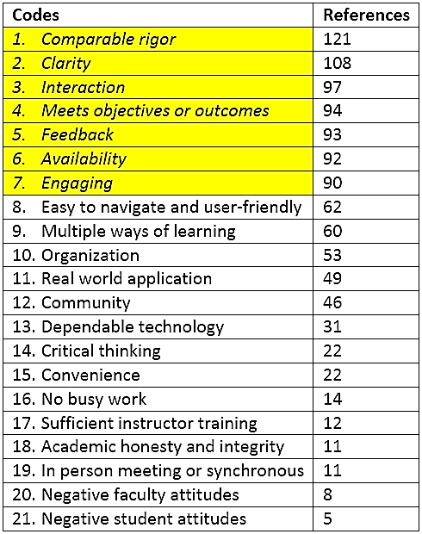
What is the meaning of ”quality” in an online course to administrators, faculty, and students?

Slide 13
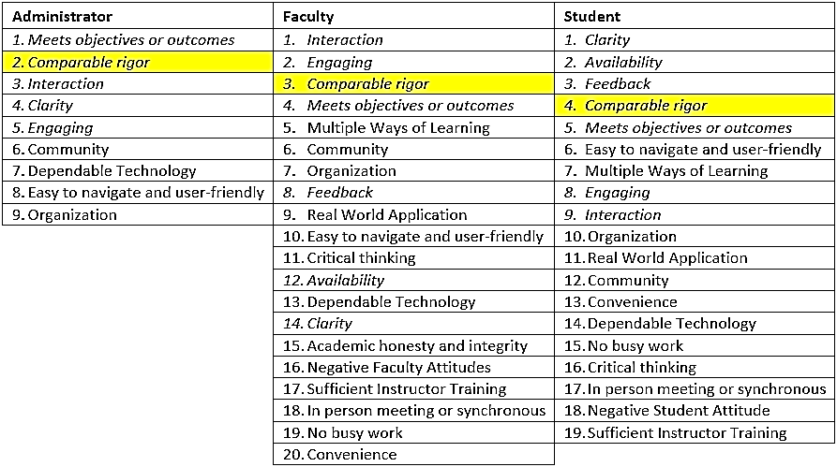
#1 Comparable rigor
“Provide materials and learning experiences digitally that result in student learning outcome achievements that are not statistically significant from those results found in comparable courses taught in-person.” (A001)
Co-Occurrence:
comparable rigor/meets objectives and outcomes

Slide 14
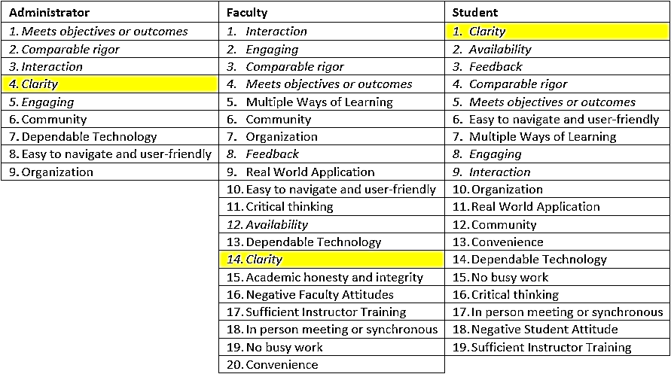
#2 Clarity
“Quality means clear communication with clearly-stated goals and objectives. … Assignments should be organized by due date with each task for a due date separated. Once a task is complete, the user should see that indicated. Professors need to be concise and clear in their language of what is expected.” (S313)

Slide 15
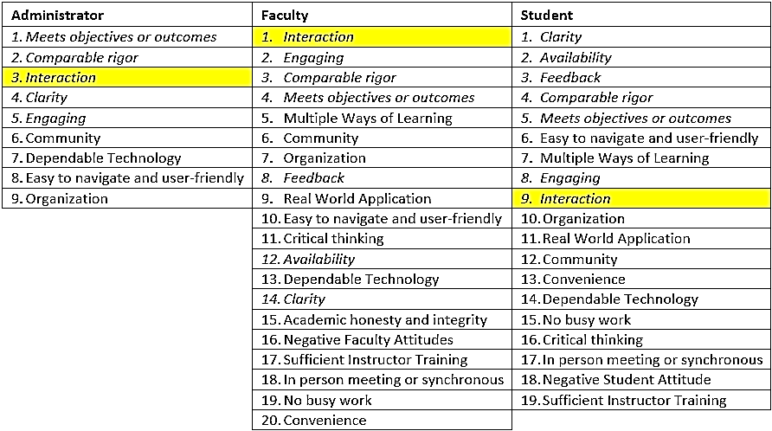
#3 Interaction
“Quality means … participating in meaningful discussions with other students” (F018)

Slide 16
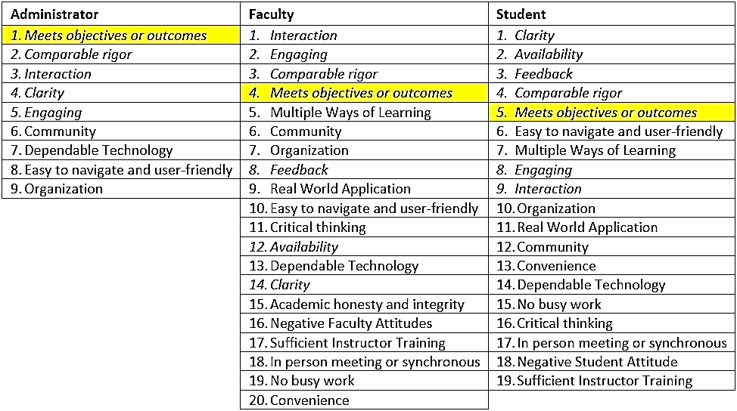
#4 Meets Objectives and Outcomes
“The university has well defined standards” (A009)

Slide 17
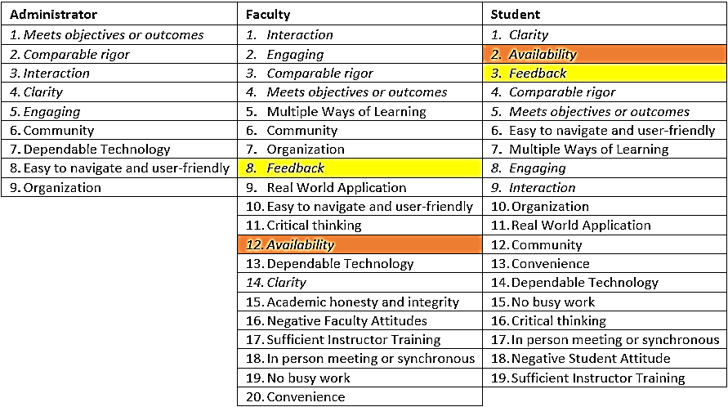
#5 Feedback
#6 Availability
Co-occur with students:
“The teacher needs to be available during office hours, and reasonably responsive to emails. The grading system should be immediate (computer graded) or [within] a week.” (S206)
?

Slide 18
#5 Feedback
#6 Availability
Co-occur with faculty:
“To me, quality means the professor has been allotted adequate time to participate in the course. … I feel small class sizes assists professors in having the one-on-one time needed to learn course material adequately.” (F048)

Slide 19
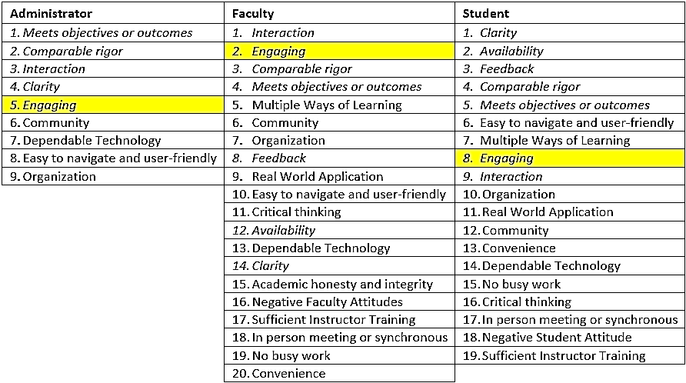
#7 Engaging
“Quality means that the professor prepares material that … promotes online discussion and learning in a different type of community. … There must be meaningful discussions … ” (F007)
Co-occurred with interaction

Slide 20
Discussion

Slide 21
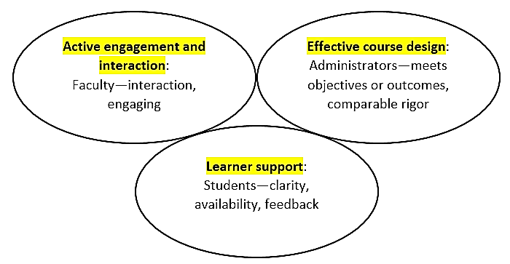
Features of a Quality Online Course
Top 7 codes/quality features
Prioritization of quality features for particular constituents.
(Blood-Siegfried et al., 2008; Damjanovic, 2014; Darabi & Jin, 2013; Dolog et al., 2004; Jung, 2011; Kanuka et al., 2007; McGorry, 2003; Wu et al., 2016)

Slide 22
implications

Slide 23
Student Quality Features
Clarity Availability Feedback | Clear syllabus, clear assignment expectations. Clear about availability

Slide 24
Faculty Quality Features
1. Interaction 2. Engagement 3. Comparable rigor | Educate faculty on the different prioritization. Engagement-rich course design by internal and external players.

Slide 25
Administrator Quality Features
Meets objectives and outcomes Comparable rigor Interaction | Aligns more with faculty than students. Outcomes assessment? Faculty training, student support, infrastructure updates

Slide 26
References
Alexander, S. & Golja, T. (2007). Using students’ experiences to derive quality in an e-learning system: an institution’s perspective. Educational Technology & Society, 10 (2), 17-33.
Anderson, T. (Ed.) (2008). The theory and practice of online learning. Edmonton, AB: Athabasca University Press.
Black, L. M. (2013). A history of scholarship. In M. G. Moore (Ed.), Handbook of distance education (pp. 3-20). New York: Routledge.
Blood-Siegfried, J. E., Short, N. M., Rapp, C. G., Hill, E., Talbert, S., Skinner, J., Campbell, A., & Goodwin, L. (2008). A rubric for improving the quality of online courses. International Journal of Nursing Education Scholarship, 5(1), 1-13.
Bower, B. L. (2001). Distance education: facing the faculty challenge. Journal of Distance Learning Administration, 4(2), 1-6.
Chaney, B. H., Eddy, J. M., Dorman, S. M., Glessner, L., Green, B. L., & Lara-Alecio, R. (2007). Development of an instrument to assess student opinions of the quality of distance education courses. American Journal of Distance Education, 21(3), 145-164.
Chao, I. T., Saj, T., & Hamilton, D. (2010). Using collaborative course development to achieve online course quality standards. International Review of Research in Open and Distance Learning, 11(3), 106-126.
Collins, D., Weber, J., & Zambrano, R. (2014). Teaching business ethics online: perspectives on course design, delivery, student engagement, and assessment. Journal of Business Ethics, 125, 513-529.
Damjanovic, D. (2014). Requirements quality online courses. Intelligent Information Management, 6, 89-96.
Darabi, A. & Jin, L. (2013). Improving the quality of online discussion: the effects of strategies designed based on cognitive load theory principles. Distance Education, 34(1) 21-36.
Dolog, P., Henze, N., Nejdl, W., & Sintek, M. (2004). Personalization in distributed learning environments. In Proceedings of the 13th international conference on World Wide Web––alternate track papers and posters (pp. 170–179).
Dubin, R., & Taveggia, T. C. (1968). The teaching-learning paradox: A comparative analysis of college teaching methods. Eugene, OR: Center for the Advanced Study of Educational Administration. ERIC Document ED 026 966.
Green, D. (Ed.) (1994). What is quality in higher education? Bristol, PA: Open University Press.
Harry, K., Keegan, D., & John, M. (2013). Distance education: New perspectives. New York: Routledge.
Heaton, L. A., Pauley, R., & Childress, R. (2002). Quality control for online graduate course delivery: a case study. Distance Education: Issues and Concerns, 103-114.
Jung, I. (2011). The dimensions of e-learning quality: from the learner’s perspective. Education Technology Research Development, 59, 445-464.
Kanuka, H., Rourke, L., & Laflamme, E. (2007). The influence of instructional methods on the quality of online instruction. British Journal of Educational Technology, 38(2), 260-271.
Keegan, D. (1996). Foundations of distance education. Psychology Press.
Kozma, R. B. (2001). Counterpoint theory of ‘learning with media’. In R. E. Clark (Ed.), Learning from media: Arguments, analysis, and evidence (pp. 137-178). Greenwich, CT: Information Age Publishing Inc.
Liu, O. L. (2012). Student evaluation of instruction: in the new paradigm of distance education. Research in Higher Education, 53, 471-486.
Lloyd, S. A., Byrne, M. M., & McCoy, T. S. (2012). Faculty-perceived barriers of online education. Journal of Online Learning and Teaching, 8(1), 1-12.
McGorry, S. Y. (2003). Measuring quality in online programs. Internet and Higher Education, 6, 159-177.
Moore, M. G. (Ed.) (2013). Handbook of distance education. New York: Routledge.
Nandi, D., Hamilton, M., & Harland, J. (2012). Evaluating the quality of interaction in asynchronous discussion forums in fully online courses. Distance Education, 33(1), 5-30.
Oliver, R. (2001). Assuring the quality of online learning in Australian higher education. Proceedings of Moving Online II Conference, 222-231.
Richardson, J. T. E. (2005). Students’ perceptions of academic quality and approaches to studying in distance education. British Educational Research Journal, 31(1), 7-27.
Roby, T., Ashe, S., Singh, N., & Clark, C. (2013). Shaping the online experience: how administrators can influence student and instructor perceptions through policy and practice. Internet and Higher Education, 17, 29-37.
Rovai, A. P. (2003). A practical framework for evaluating online distance education programs. Internet and Higher Education, 6, 109-124.
Shattuck, K., Frese, J., Lalla, S., Mikalson, J., Simunich, B., & Wang, L. (2013). Results of review of the 2011-2013 research literature. Retrieved from https://www.qualitymatters.org
Simonson, M. (2015). Accreditation and quality in distance education. Distance Learning, 12(1), 27.
Simpson, J. M. & Benson, A. D. (2013). Student perceptions of quality and satisfaction in online education. The Quarterly Review of Distance Education, 14(4), 221-231.
Vu, P., Meyer, R., & Cepero, J. (2016). Models of administration for online learning programs in the U.S. higher education institutions. Journal of Applied Educational and Policy Research, 2(1), 24-31.
Wu, X., Liu, Y., Zhang, Y., & Ji, L. (2016). Providing quality online education for continuing education. International Journal of Information and Education Technology, 6(2), 157-161.

Slide 27
Thank you for your time!
Questions?

