Slide 1

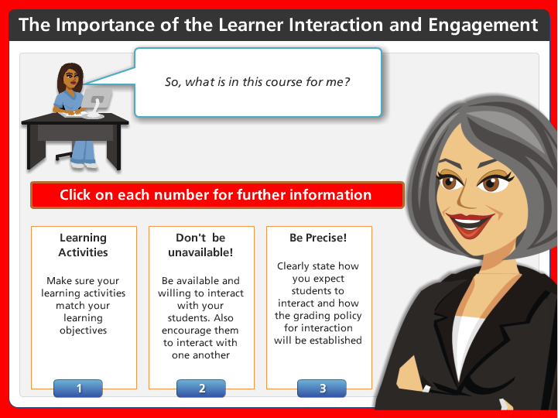
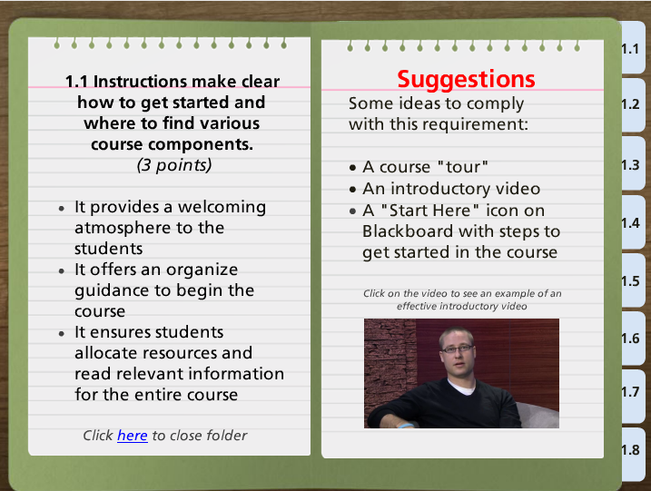
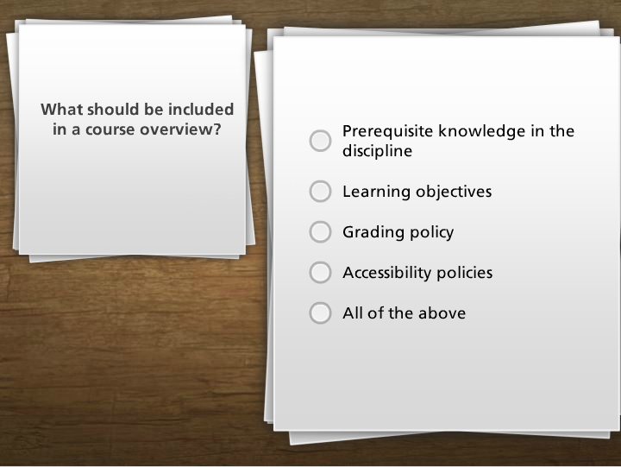


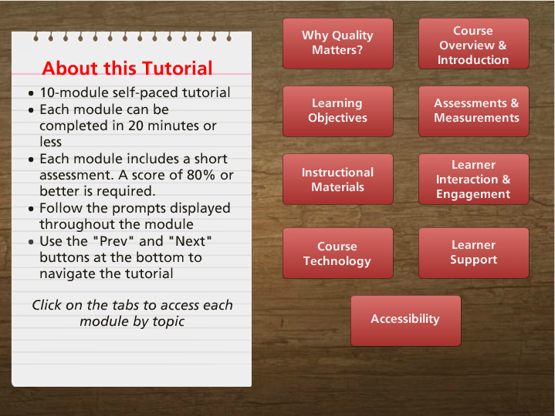
Quality on Demand: Innovative Resources for Training and Course Design
Miguel A. Nino & Robert Kearns, Johns Hopkins University School of Nursing
Introduction
Syllabus Templates
Assessments
The Johns Hopkins University School of Nursing (JHUSON)’s goal is to obtain the Quality Matters (QM) certification for several of its online and blended programs. This goal can only be achieved if the right resources are offered to faculty and staff involved in online course design and development.
Using an innovative approach, the JHUSON has developed the following initiatives to meet QM standards:
Templates pre-loaded in all online courses to satisfy the QM requirements
A self-directed online tutorial that will guide faculty and staff to effectively apply the QM rubric.
In addition, instructional design support is continuously offered to faculty and staff.
  The syllabus template for the School of Nursing has also been customized to assist in meeting QM criteria. All syllabi have mandatory placeholders for the course purpose and structure, expected prerequisite knowledge, course grading policy, assignment rubrics and instructor response expectations. This helps ensure the following QM Standards are met: 1.2, 1.5, 3.2, 3.3, 5.3
  The template uses Microsoft Word’s Headings feature to ensure that when the document is converted to a PDF for posting to the course, it is accessible to screen readers for students with disabilities. The helps meet QM Standard 8.4
Tutorial Assessments
To measure the effectiveness of the content of the tutorial, learners are required to complete short assessments at the end of each module with a score of 80% or better.
Post-Assessment & Surveys
As a future evaluation initiative, the courses that were internally assessed before the creation of the tutorial will be reassessed upon completion of the tutorial by faculty. In addition, surveys will be distributed upon completion of the tutorial to measure the overall experience of the learners.
Sections of Quality Matters Online Tutorial
Conclusions
Focus on Innovation
The design of templates with compliant information has helped the JHUSON to obtain the QM certification for many courses. It has also helped faculty and staff become more familiar with the rubric and standards. As a result, the overall online/blended experience has been positive for the students.
Training
The development of an online tutorial and the instructional support at the JHUSON are addressing more complex issues that faculty and staff face when complying with QM. These tools provide independence to faculty when designing courses. This massive initiative will increase the QM certifications for online/blended courses
Online Tutorial
Course Templates
An internal assessment of 40 undergraduate and graduate courses, using the QM rubric was conducted. This assessment allowed the identification of the topics and areas that had to be addressed in an online tutorial.
Characteristics
Getting Started Module
The getting started module is automatically copied into every course and is intended to orient students to the Course Management System, support services, technical requirements, and disability services. In this function, it ensures the following QM Standards are automatically met: 1.1, 1.6, 7.1, 7.2, 7.3, 7.4
Instructional Design Support
Syllabus & Course Info Section
All Blackboard sites come pre-populated with a place holder for the course syllabus. This section automatically contains the SON Netiquette Policy, Guidelines for Online Communication, Inclement Weather Policy, and a link to the Student Handbook which contains many other SON policies. This meets standards 1.3 and 1.4
All of these innovative initiatives are fully supported by the Instructional Design team at the JHUSON, which provides continuous assistance and resources to faculty, staff, and students, in collaboration with other departments. Faculty and staff consult on a regular basis with this team to ensure courses comply with QM.
Contact Information
Robert Kearns, Instructional Design Manager, Johns Hopkins School of Nursing.
Email: robert.kearns@jhu.edu

